Slide 1

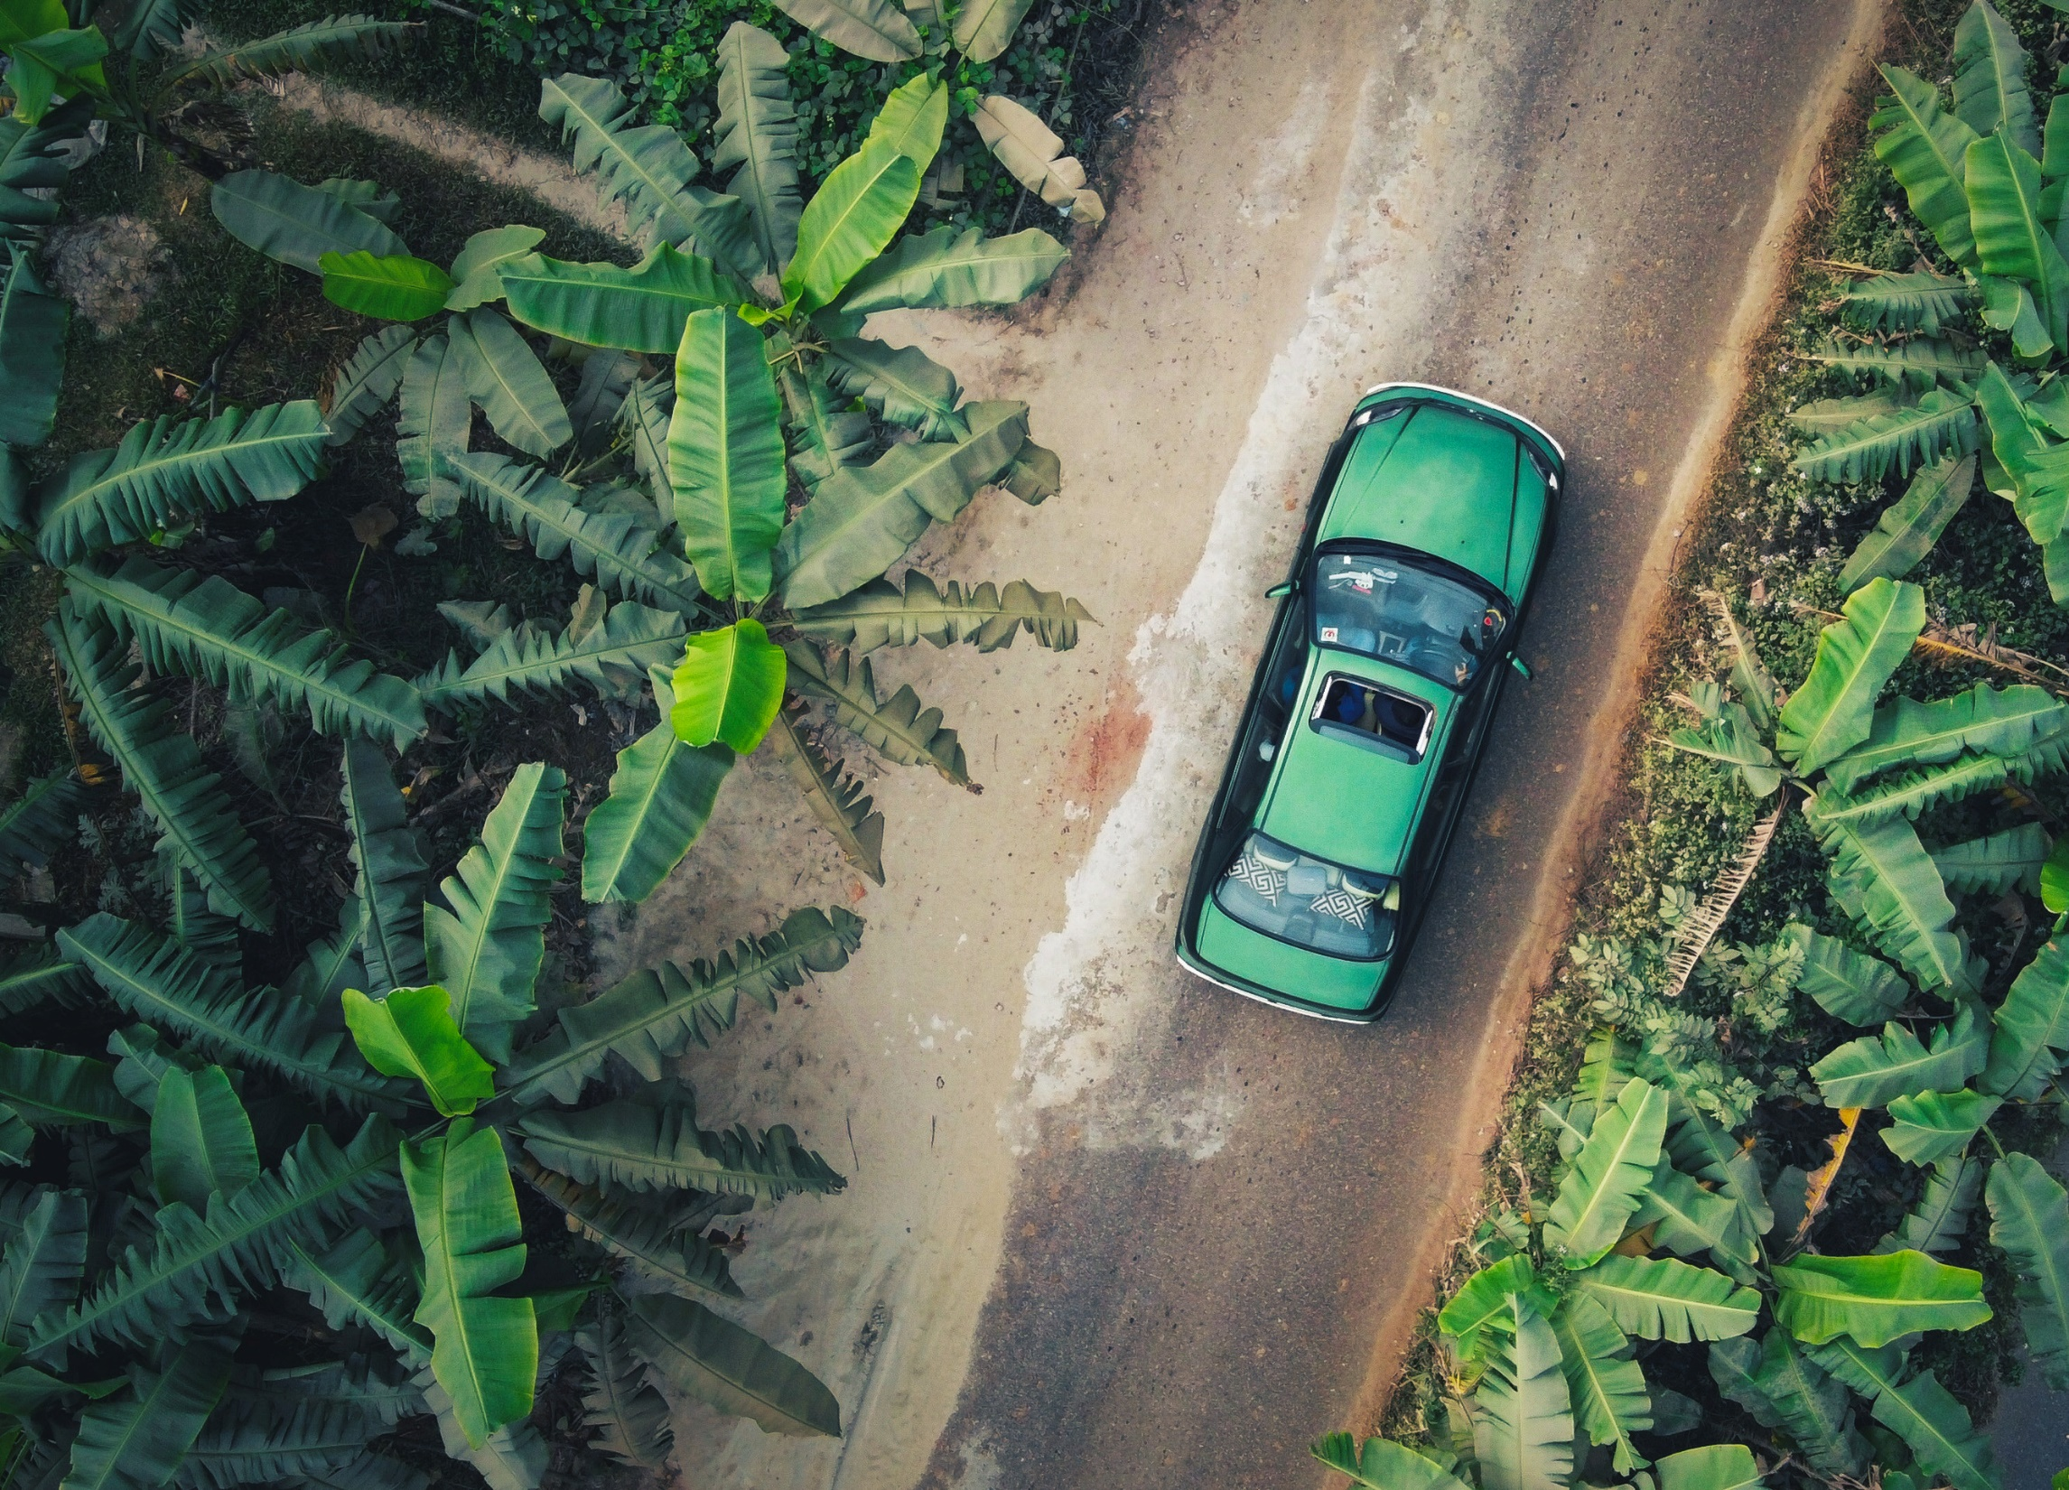




Unit 5
The Green Banana

Slide 2
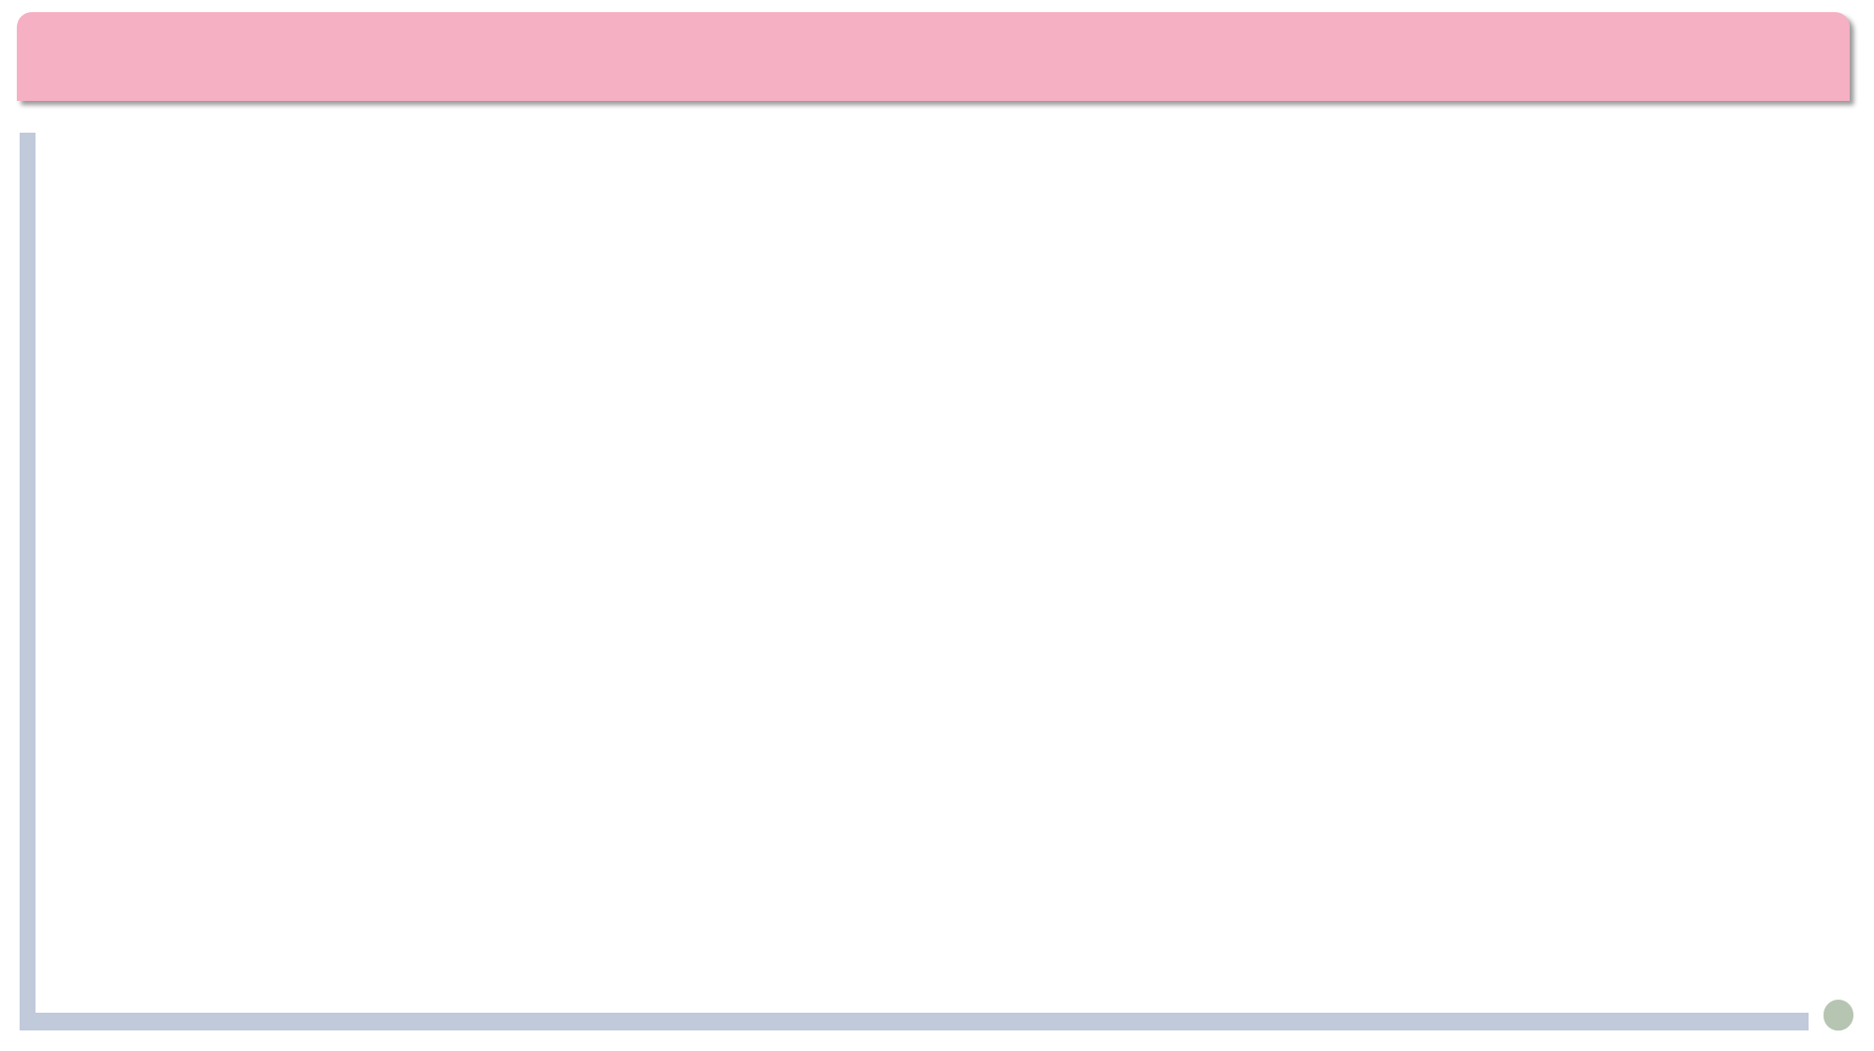


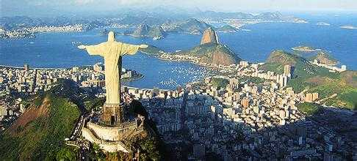
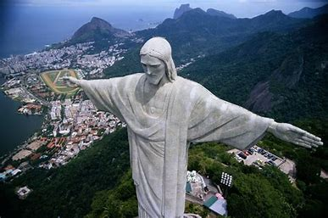
Background
Where is the place in the picture?
Rio de Janeiro里约热内卢, simply Rio, is the second-most populous city in Brazil.

Slide 3
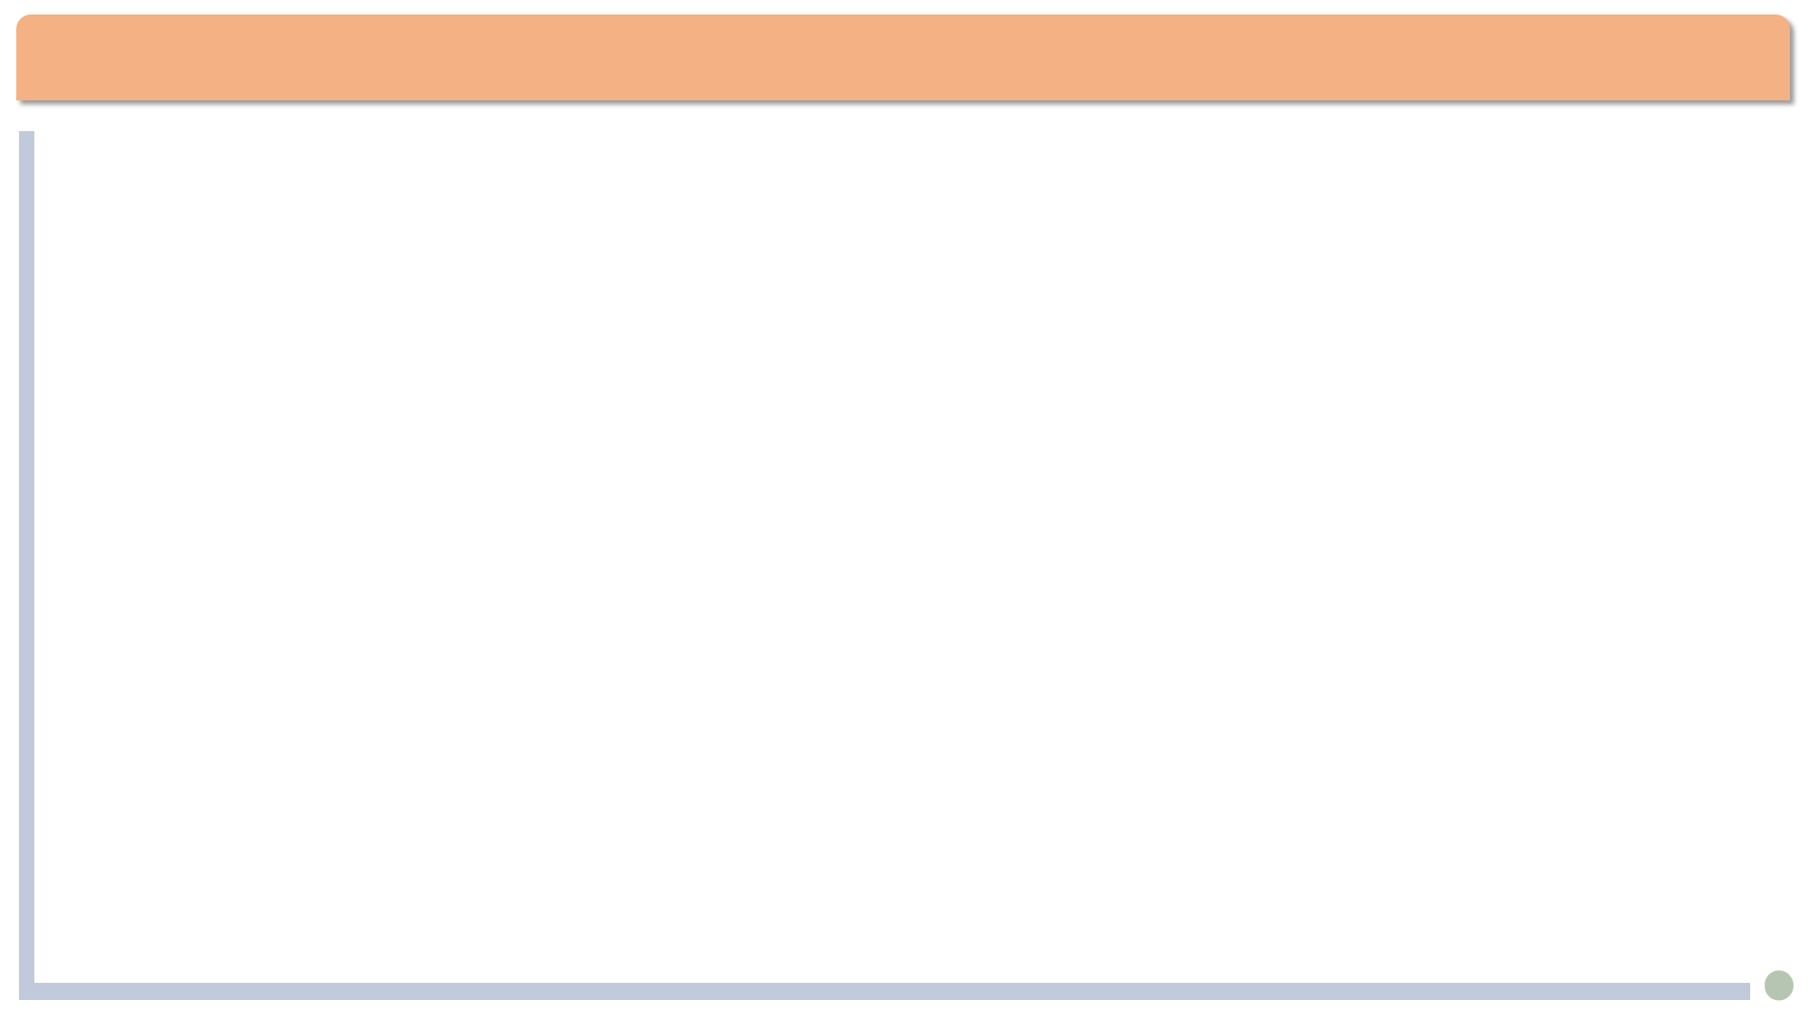
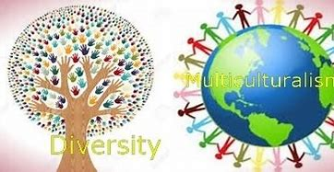
Lead-in
Background
Multiculturalism 多元文化主义: no culture is superior to others; coexistence of multiple cultures.
Ethnocentrism 本族中心主义: the culture of one’s own is superior.
Eurocentrism 欧洲中心主义: viewing the world from a European perspective, often considering European culture as superior.
Cultural protectionism 文化保护主义 protecting a nation's cultural identity from foreign influence
Travel is fatal to prejudice, bigotry (偏执), and narrow-mindedness.
--- Mark Twain

Slide 4
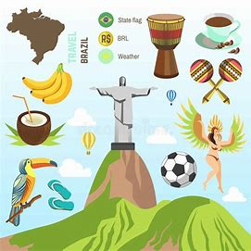
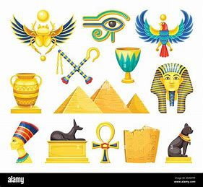
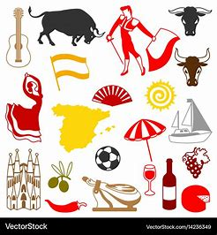
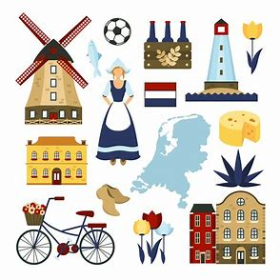
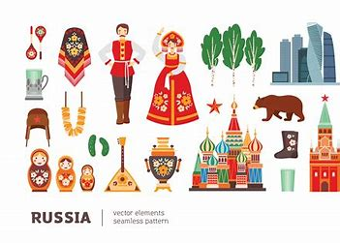
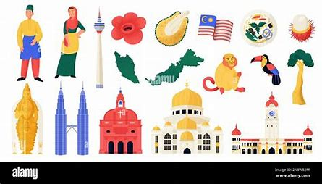
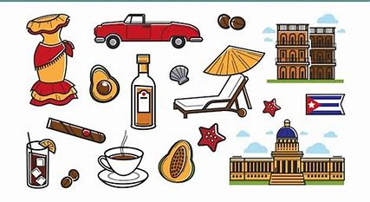
Lead-in
Which countries do these cultural symbols belong to?
Spain
The Netherlands
Brazil
Egypt
Russia
Malaysia
Cuba

Slide 5

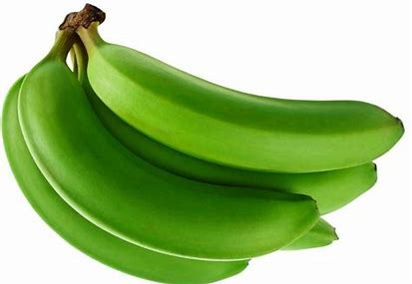
填空题
25分
Chinese to English translation:
1. 陡峭的山路：a [填空1] mountain road
2. 我与青香蕉的邂逅: my [填空2] with green bananas
3. 零星散布在周围的房屋：houses that were [填空3] here and there
4. 三股细细的热水流从孔里涌出来：Three [填空4] streams of hot water were [填空5] from holes.
作答

Slide 6
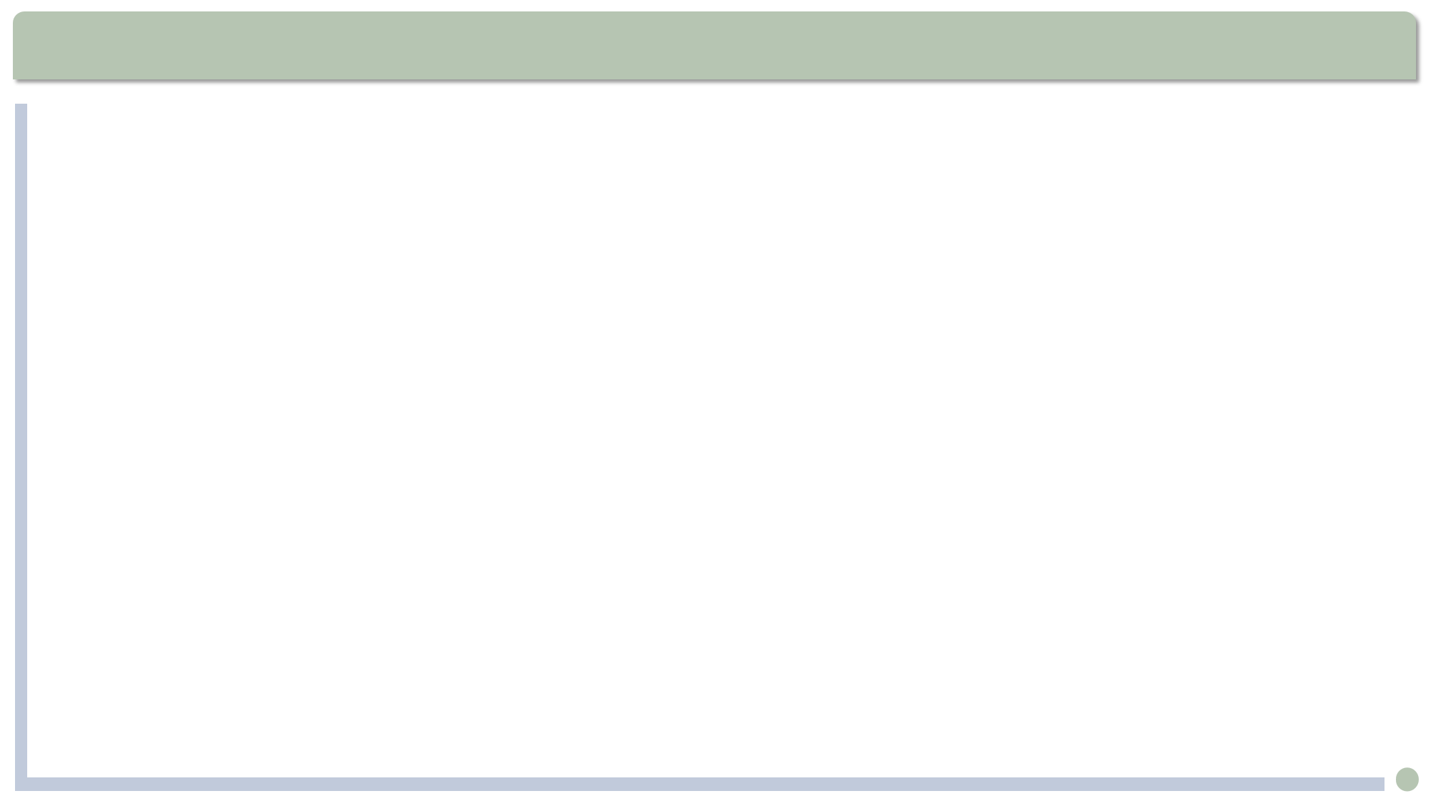
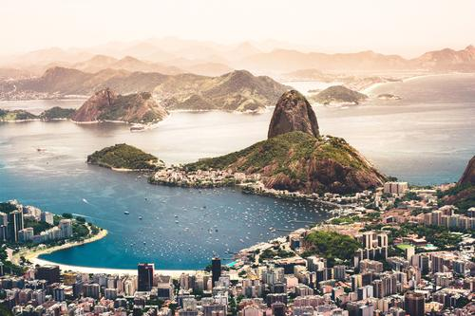
Text Analysis
The author’s interesting experience in central Brazil. (paras. 1–4)
I did not ask them, though, as that would show my ignorance.
though: (adv.) （尤用于句末补充说明，使语气减弱）不过，可是，然而
It’s hard work. I enjoy it though.
这个活比较累，不过我乐意干。
我们队输了，可是这也不失为一场好球。
Our team lost. It was a good game, though.
Sugarloaf Mountain

Slide 7
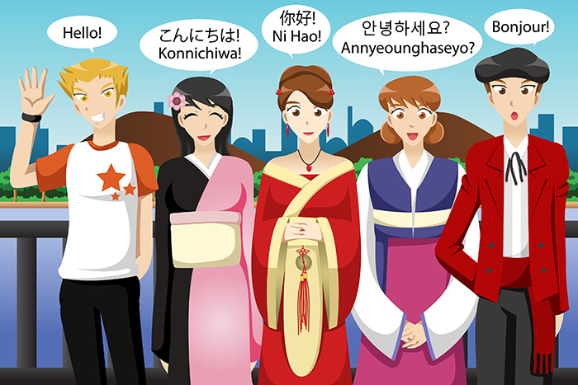
Text Analysis
He, in turn, inspected me carefully, as if to make sure I grasped the significance of his statement.
1. 她清了清嗓子好像要讲话。
She cleared her throat as if to speak.
2. 他站起来好像要离开。
He stood up as if to leave.
3. 他感到自己彷佛要爆炸了。
He felt as if he were to burst./ ...he would burst.

Slide 8

填空题
20分
Choose the best explanation of each underlined word or phrase.
1. A tall, slender pinnacle of rock : [填空1]
A. a high pointed piece of rock
B. the highest point of development
2. He inspected me carefully: [填空2]
A. suspected B. looked closely at
3. ... called for some show of recognition on my part: [填空3]
A. about me B. from me
作答

Slide 9
Text Analysis
... give me extra bananas to take along in case my radiator should give me trouble again.
Note: “In case”(以防；以防万一) is followed by the simple present, simple past tenses, or “should”.
should: used to say that you believe sth. is likely to happen in the future
1. 带上雨衣，以防下雨。
Take a raincoat in case it rains.
2. 他们决定搜查一下汽车，以防里面有炸弹。
They decided to search the car in case there should be a bomb.
[comparison] Take a raincoat lest it should rain.

Slide 10
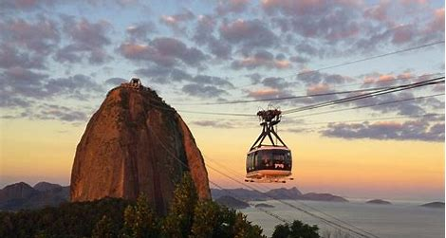
Text Analysis
The author’s reflections on his experience (paras. 5–7)
We all tend to regard as the center that special place where we are known, where we know others, where things mean much to us, and where we ourselves have both identity and meaning: Family, school, town, and local region could all be our center of the world.
Note the inversion(倒装): The normal order is: We all tend to regard that special place... as the center.
我们都会把某个特殊的地方视为中心，因为在那里我们为其他人所知，我们也认识其他人，那里的一切对我们都有非凡的意义，在那里我们知道自己是谁，活得也有意义，因此无论是家庭，还是学校，城镇还是当地地区，都有可能是我们心目中的世界中心。

Slide 11
多选题
15分
What were the author’s two learning moments?(Para. 5)
A
He learned the use of the green banana to fix the leaks of a radiator.
B
He learned the genius and kindness of ordinary people.
C
He learned that every culture has wonderful treasures to share with others.
D
He learned that every placce has a right to regard itself as the center of the world.
提交

Slide 12
Text Analysis
The author’s reflections on his experience (paras. 5–7)
The lesson which gradually dawned on me was actually very simple.
dawn on sb.: if sth dawns on you , you begin to realize it for the first time使开始明白；使渐渐领悟；使开始理解
1. The truth about the conspiracy slowly dawned on her as she pieced together the clues.
关于这个阴谋的真相随着她拼凑线索慢慢浮现在她的脑海中。
2. It dawned on them that they had been following the wrong map.
他们逐渐意识到一直在跟着错误的地图走。

Slide 13
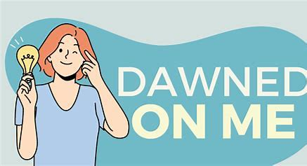
主观题
20分
Make a sentence with “dawn on sb.”
1. The truth about the conspiracy slowly dawned on her as she pieced together the clues.
2. It dawned on them that they had been following the wrong map.
作答

Slide 14
Text Analysis
But once a conscious breakthrough to a second center is made, a life-long perspective and collection can begin.
但是，一旦有意识地突破至第二个中心，一种终身的视野与积淀便由此开启。
但是，一旦你努力冲破自己的中心去体验另一个中心，你的视野就会不断地扩展，你将终身受益。
But once you make a serious effort to overcome your prejudice and go out to encounter different cultures, for the rest of your life your mind will keep broadening as you experience and benefit from more and more treasures of other cultures.

Slide 15
单选题
20分
The green banana in Paragraph 8 refers to ______.
A
a method by which leaks in a radiator can be fixed
B
the funny things you experience when you travel in a foreign country
C
wisdom that is to be discovered in other cultures by an open mind
D
the different varieties of bananas to be found in other countries
提交

Slide 16
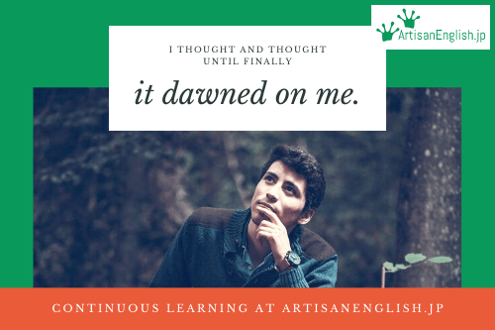
Assignment
1. Write an essay entitled “A Lesson that Dawned on Me”. (in 120-180 words)
1) a special experience;
2) a lesson from this experience.
2. Write an essay entitled “A Double-Edged Sword: The Impact of Foreign Cultures on Chinese Youth” (in 120-180 words).
1) The positive impact
2) The negative impact
3) How to treat foreign cultures

