Slide 1

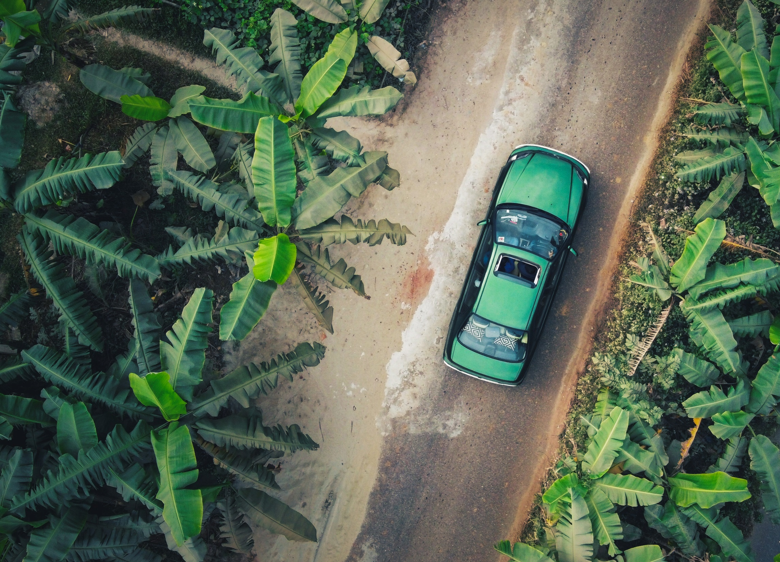




Unit 5

Slide 2



Glossary
Fill in each blank with the best word from the given words.
conscious instant leak perspective pinnacle scatter strain tease
1. He became acutely ________ of having failed his parents.
2. We have to look at the event from an international ___________.
3. When the tree falls, the monkeys ________.
4. I ________ my ears to catch what they were saying.
5. We live in a culture of ______ gratification, forgetting the pleasure of anticipation.
6. Other children often ______ him because of his long hair.
7. The contents of the report were ______ to the press.
8. Despite having touched the ________, Messi believes his best is still to come.
conscious
perspective
scatter
strained
instant
tease
leaked
pinnacle

Slide 3

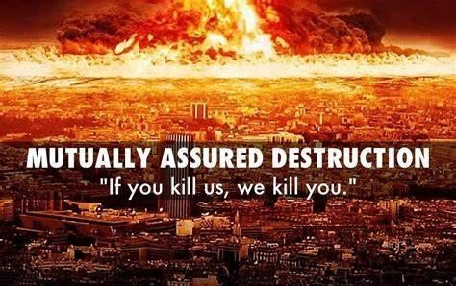
Glossary
assure insure ensure
1.I can _______ you that the three kids are perfectly safe.
2. We must ______ that all patients have access to high quality care.
assure
ensure
assure vt. ~sb. of sth. / ~sb that...使确信；向…保证 ~ sth. 确保
insure vt. 投保；给…保险
ensure vt. ~sth. / ~ that... 保证；确保

Slide 4

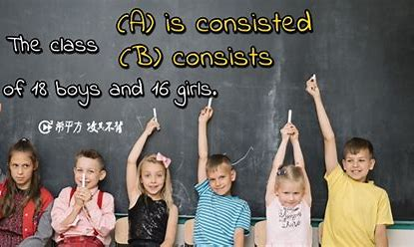
Glossary
consist v.
1. (~ of) be made up or composed of 由……组成
2. (~ in) be based on or depend on 在于，取决于
1) The buffet consisted _____ several different Indian dishes.
2) Happiness does not consist ____ how many possessions you own.
of
in

Slide 5
Glossary
Fill in the blanks with the correct form of “conscious”.
1. He was quite ___________ of the danger.
2. We all tend to ______________ copy the gestures of people we like.
3. Confucianism is the largest Chinese school of thoughts, and the mainstream ____________ of the ancient China.
4. In their presence I became ____________ and tongue-tied.
unconscious
subconsciously
consciousness
self-conscious
难为情的; 不自在的
unconscious, semi-conscious, self-conscious,
subconsciously, consciousness

Slide 6


Glossary
potential
1. n. [U] the possibility that sth. will have a positive effect 潜力
2. a. likely to develop into a particular type of person or thing in the future 潜在的，可能的
1) 开发潜力
2) 发挥潜力
3) 未开发的潜力
4) 无限的潜力
5）潜在风险
6) 潜在客户
1) exploit/ unlock the potential
2) fulfil/ realize the potential
3) untapped potential
4) limitless potential
5) potential risk
6) potential customers

Slide 7
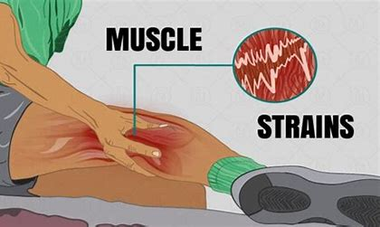
Glossary
strain
1) He strained his back during a practice session.
2) She was straining to keep her head above the water.
3) She was tired and under great strain.
4) His constant complaints were straining our patience.
1) 扭伤
2) 竭尽全力
3) n. 压力；重负
4) 使不堪承受

Slide 8

Exercises · Language Exercises
1. Give the corresponding nouns for the following verbs.
1) strain ____________ 10) grasp ___________
2) tease __________________ 11) appreciate ____________
3) dawn __________ 12) fly __________
4) die __________ 13) assure ____________
5) leak ___________ 14) astonish____________
6) inspect __________________ 15) expect ____________
7) realize __________ 16) insure _________________
8) bury ___________ 17) reflect _________________
9) scatter ___________ 18) believe ____________
strain/strainer
grasp
teasing/tease/teaser
appreciation
dawn
flight/flier
death
assurance
leak/leakage
astonishment
inspection/inspector
expectation
realization
insurance/insurer
burial
reflection/reflector
scattering
belif/believer

Slide 9
Exercises · Language Exercises
2. Give the corresponding verbs for the following nouns.
1) stream ____________ 6) acceptance ___________
2) statement __________ 7) encounter __________
3) relation __________ 8) collection__________
4) formation__________ 9) radiation ____________
5) recognition___________ 10) identity __________
stream
accept
state
encounter
relate
collect
form
radiate
recognize
identify

Slide 10
Exercises · Language Exercises
3. Give the corresponding nouns (referring to people) for the following verbs.
1) report ___________ 12) murder ___________
2) profess___________ 13) travel __________
3) edit_________ 14) compose __________
4) advise______________ 15) interpret ___________
5) rob__________ 16) beg__________
6) act __________ 17) sail __________
7) begin __________ 18) announce ___________
8) support___________ 19) manage __________
9) visit___________ 20) invade__________
10) lie ___________ 21) create __________
11) sell __________
reporter
murderer
professor
traveler
editor
composer
adviser/advisor
interpreter
robber
beggar
actor
sailor
beginner
announcer
supporter
manager
visitor
invader
liar
creator
seller

Slide 11
Exercises · Language Exercises
4. Translate the following expressions, paying attention to the use of the suffix “-ful”.
1) shameful result ___________________
2) a bowlful of rice __________________
3) colorful dresses __________________
4) a delightful person ________________
5) a basketful of apples _______________
6) a boxful of chocolate _______________
7) a small handful of people __________
8) a helpful suggestion _______________
令人羞耻的结果
满满一碗米饭
色彩鲜艳的衣服
一个令人快乐的人
满满一篮子的苹果
满满一盒巧克力
一小撮人
一条有帮助的建议

Slide 12
Exercises · Language Exercises
4. Translate the following expressions, paying attention to the use of the suffix “-ful”.
9) a harmful habit ________________
10) take a big mouthful _______________
11) wishful thinking _________________
12) a hopeful situation _________________
13) a houseful of guests ________________
14) a spoonful of oil __________________
15) an armful of books ________________
16) a painful memory _________________
一个有害的习惯
吃一大口
一厢情愿的想法
有希望的形势
一屋子的客人
一调羹油
一大捧书
痛苦的记忆

Slide 13
Exercises · Language Exercises
5. Study the formation of the following compound words and then translate them into Chinese.
1) an over-heated engine ____________
2) a life-long perspective __________
3) a hand-made purse____________
4) a simple-minded young man____________________
5) an old-fashioned keyboard______________
6) a new-born baby______________
7) a well-meaning proposal__________
8) peace-loving people_______________
过热的引擎
终身视角
手工钱包
纯朴的/头脑简单的年轻人
老式键盘
新生婴儿
善意的建议
热爱和平的人民

Slide 14
Exercises · Language Exercises
5. Study the formation of the following compound words and then translate them into Chinese
9) state-owned enterprises________________
10) dark-blue waters_______________
11) ever-green bushes_________________
12) a high-pressure reactor_________________
13) a first-rate teacher________________
14) a down-to-earth spirit__________________
15) learner-centered teaching________________
16) a left-handed person_________________
国有企业
深蓝色的海域
常绿灌木
高压反应堆
一流教师
脚踏实地的精神
以学生为中心的教学
左撇子

Slide 15
Exercises · Language Exercises
2. Fill in the blanks with the correct form of the phrases listed below.
1. For a long time, people thought that this area was too dry to grow trees, but they have been proven wrong ___________. Today, the whole area has become lush(茂盛的) and green.
2. Peking University is generally __________ one of the most important universities in China. It __________ some of the best faculties(系) in our country.
3. I am glad to go to that important meeting. Besides, the place where the meeting will be held is within walking distance of where my sister works. I haven’t seen her _________, so I can do two things ___________.
consist of melt into cut … in half reflect on in relation to regard as
dawn on call for at once after all in turn in case
work out for ages on one’s part for a fact
after all
regarded as
consists of
for ages
at once

Slide 16
Exercises · Language Exercises
2. Fill in the blanks with the correct form of the phrases listed below.
4. The generation gap is a big problem and ___________ serious attention. I think we young people ____________ should try to understand older people’s worries and cares, and respect their experiences, while older people, __________, should understand young people’s wishes and desires, and respect their new ideas.
5. It suddenly __________ us that __________ the whole polar ice cap should ___________ water, many of our coastal cities could disappear under the sea.
consist of melt into cut … in half reflect on in relation to regard as
dawn on call for at once after all in turn in case
work out for ages on one’s part for a fact
calls for
on our part
in turn
dawned on
in case
melt into

Slide 17
Exercises · Language Exercises
2. Fill in the blanks with the correct form of the phrases listed below.
6. Whenever two nations quarrel, people tend to put all the blame on the other side. However, if they can ___________ the issue and everything ___________ it objectively and rationally, they will find that compromises(妥协) are often possible.
7. The enemy troops tried to __________ our defense line __________, but to their disappointment, the plan did not ___________ because our troops, although outnumbered(数量上超过), held their ground.
8. No one can deny the progress we have made, but we also know _________, that we are still the largest developing country in the world.
consist of melt into cut … in half reflect on in relation to regard as
dawn on call for at once after all in turn in case
work out for ages on one’s part for a fact
reflect on
in relation to
cut
in half
work out
for a fact

Slide 18
Exercises · Language Exercises
3. Fill in the blanks with the correct prepositions or adverbs that collocate with the verbs “see” and “agree”.
Wait a second. I’ll see you _____(送到门口). It’s dark and our neighbor’s got a big dog.
2. Li Bai wrote this beautiful poem to express his thanks to a friend who had walked a long way to see him ________.
3. The film was really junk. But I had to see it _____________ because my six-year-old son found it amusing.
4. He tried to give people the impression that he was a great scholar, but they quickly saw ________ (看穿)him.
5. She worked hard to see ____ it (保证)that she could help her parents pay the rent for their apartment. However, her monthly pay simply was not enough to see her __________(使渡过难关、得以维持).
out
off
out/through
through
to
through

Slide 19
Exercises · Language Exercises
3. Fill in the blanks with the correct prepositions or adverbs that collocate with the verbs “see” and “agree”.
6. I had an awful stomachache the other day. It must have been something I ate that didn’t agree ____ me(适合，相宜).
7. I’m sure you will all agree ____ me when I say that the relationship between our two countries has never been better.
8. Historians generally agree _________________ the facts. Their difference lies in their interpretation(阐释) of the facts.
9. We have already handed in our proposal. We will see if the school authorities agree ________________ it.
10. The mountain air must have agreed _____ (适合，相宜)my father. In two months he has recovered his health remarkably.
with
with
on/about/with /to
to/with/on/about
with

Slide 20
Exercises · Language Exercises
4. Fill in the blanks with the appropriate phrases listed below. Some of them may be used more than once.
1. He came up with this great idea at the age of 14. Naturally, few people, if any, took him seriously ___________. In fact, people did not even understand what this idea meant _____________.
2. People may not see the truth _________________, but don’t worry, they will find out ___________.
3. The superhighway was planned to open to traffic on National Day, and it was completed __________ in spite of tremendous(巨大的) difficulties.
in time during the time at the time on time
at times at the same time by that time at a time
high time for the time being for a long time in no time
at the time
for a long time
for the time being暂时
in time
on time

Slide 21
Exercises · Language Exercises
4. Fill in the blanks with the appropriate phrases listed below. Some of them may be used more than once.
4. She remembered her hard life in her childhood. It was ______________ of the terrible economic depression in her country, and _____________ both her parents were out of work.
5. Don’t try to do two things _________________. Do them one ___________.
6. From that day on, people could not even find enough water to drink. ___________ it had not rained for months.
7. Accidents still occur __________, but the situation has much improved.
in time during the time at the time on time
at times at the same time by that time at a time
high time for the time being for a long time in no time
during the time
for a long time
at the same time
at a time
By that time
at times

Slide 22
Exercises · Language Exercises
4. Fill in the blanks with the appropriate phrases listed below. Some of them may be used more than once.
8. People’s awareness of the environment problem is a pretty recent thing, historically speaking. _________________________ people did not understand its importance. They were generally concerned about their GDP.
9. —Hi, Ben! I’ve finally decided to quit smoking.
—You have? Great. It’s _____________ you did.
10. You’re smart. If you work a little harder, I’m sure you’ll catch up with the others __________ it had not rained for months.
11. He was to be the most important person in her life, but she did not know __________. She liked him, but that was all.
in time during the time at the time on time
at times at the same time by that time at a time
high time for the time being for a long time in no time
For a long time/At the time
high time
in no time
at the time

Slide 23
Exercises · Language Exercises
5. Translate the following sentences and tell the grammatical functions of the infinitive phrases.
1. To be or not to be, that is the question.
To be or not to be (infinitive phrase used as the subject)
生存还是毁灭，这是一个问题。
2. We eat to live, not live to eat.
(eat) to live; (live) to eat (infinitive phrase used as an adverbial of purpose)
我们吃东西是为了活着，但活着不是为了吃。

Slide 24
Exercises · Language Exercises
5. Translate the following sentences and tell the grammatical functions of the infinitive phrases.
3. My mother wanted to go to the nursing home to see Grandma, and she wanted me to go with her. I told her that I had a lot of homework to do, but she said that it wouldn’t take us long to visit Grandma, and I would have plenty of time to finish my homework.
to go to the nursing home (object of “want”); to see Grandma (adverbial of purpose); to go with her (direct object); to do (attributive); to visit Grandma (subject); to finish my homework (attributive).
我妈要去养老院看我姥姥，想让我跟她一起去。我告诉她我有很多家庭作业要做，可是她说看姥姥花不了多少时间，我还有足够的时间完成作业。

Slide 25
Exercises · Language Exercises
5. Translate the following sentences and tell the grammatical functions of the infinitive phrases.
4. I think the best policy in international relations is still to live and let live.
to live and let live (predicative)
我认为国际关系中最好的政策仍然是和平共存。
5. It would be very much like the story of Master Dongguo and the Wolf. You free the wolf out of the goodness of your heart only to be threatened to be the hungry wolf’s dinner.
to be threatened to be (adverbial of result)
这就会像东郭先生和狼的故事一样。你出于好心放了狼，结果却受到威胁，要被当做这头恶狼的晚餐。

Slide 26
Exercises · Language Exercises
5. Translate the following sentences and tell the grammatical functions of the infinitive phrases.
6. One often picks up a rock to hurt somebody only to drop it on their own toe.
to hurt somebody (adverbial of purpose); to drop it (adverbial of result)
经常有人捡起石头想伤人，却砸了自己的脚。
7. One human weakness is the irresistible desire to prove himself to be right and never wrong, and the surest way to flatter someone is to tell him he is the only person you know who hates flattery.
to prove himself to be right (attributive); to flatter someone (attributive); to tell him (predicative)
人性的弱点之一是无法抗拒地想证明自己是对的，从不犯错，因此奉承他人最可靠的方法就是告诉他，他是你见过的唯一讨厌奉承的人。

Slide 27
Exercises · Language Exercises
5. Translate the following sentences and tell the grammatical functions of the infinitive phrases.
8. To tell the truth, I think it is easier to conquer poverty than to conquer wealth. I have seen many people suffer, not because they are too poor, but because they are too rich.
To tell the truth (adverbial compliment, usually placed at the beginning of a sentence); to conquer poverty/to conquer wealth (subject; “it” is used as the logical subject); see many people suffer (part of the complex object)
说实话,我认为战胜贫困比战胜财富要容易。我见过很多人受苦,不是因为他们太穷了，而是因为他们太富了。
9. I drove all the way from coast to coast, only stopped to eat and sleep.
to eat and sleep (adverbial of purpose)
我一路从东海岸开到西海岸，只停下来吃饭睡觉。

Slide 28
Exercises · Language Exercises
6. Study the following examples and complete the sentences.
Examples:
Pattern 1: ... (just) in case + reason clause ... (should) do/did
They ... gave me extra bananas to take along in case my radiator should give me trouble again. (para. 4)
1. Take your raincoat with you in case _______________________________ .
2. Look up the word in the dictionary in case ___________________________ .
3. Don’t show your fear in case ________________________________.
it (should) rain/rained/rains
you (should) misunderstand
the dog (should) come at/came at you

Slide 29
Exercises · Language Exercises
6. Study the following examples and complete the sentences.
Examples:
Pattern 2: ... so + adj./adv. + that + result clause
I was so astonished at this that I must have looked rather foolish and everyone laughed. (para. 4)
4. I was so tired that _________________________________ .
5. She was so excited that __________________________________________.
6. People’s opinions were so divided that _________________________________________________.
I could barely stand straight
she ran out of the room, screaming and shouting
there was not the slightest chance of reaching a consensus

Slide 30
Exercises · Language Exercises
6. Study the following examples and complete the sentences.
Examples:
Pattern 3: ... so that + purpose clause
... I hope one of my children ... gives me grandchildren so that I can pass on the land’s secret messages to them. (para. 11, Text A, Unit 2)
7. All the people in that area were quickly removed to safe places so that ______________________________________________________.
8. We must not jump to conclusions on this matter so that
___________________.
9. History is full of useful lessons which we should remember so that _____________________________________.
relief workers could concentrate on containing the chemical spill
we can think through it
we can make wiser decisions in the future

Slide 31
Exercises · Language Exercises
6. Study the following examples and complete the sentences.
Examples:
Pattern 4: ... main verb (past continuous/past perfect tense) + when + time clause
My ancient jeep was straining up through beautiful countryside when the radiator began to leak ... (para. 1)
The soldier on leave had already arrived home when he received the order to return to the front.
10. That day, most people _____________________ when the fire started.
11. The sailors and their officers ____________________________________
in Pearl Harbor when bombs from the Japanese aircrafts broke the silence.
12. The sea water had ebbed away, and people were busy collecting fish stranded on the beach when _____________________________________.
had already fallen asleep
were still sleeping after Saturday’s activities
they found a man lying face-down on the beach

Slide 32
Exercises · Language Exercises
7. Translate the following sentences, using the words and expressions in the brackets.
1.地上只有些散落的石头，人们不容易认出这是一段千年以前的城墙。(scatter)
With only some rocks scattered here and there, it would not be easy for us to recognize the place as part of the city wall from a thousand years ago.
2.今天，年轻人看问题都有了新的角度，不再把大城市作为就业的首选。(perspective; regard as)
Today, young people have gotten a new perspective, no longer regarding big cities as their first choice for employment.

Slide 33
Exercises · Language Exercises
7. Translate the following sentences, using the words and expressions in the brackets.
3. 让我们同意对方可以有不同意见吧。但是我们起码在这点上意见是一致的，那就是我们同意不采取暴力，我们同意我们的分歧必须和平解决。(agree)
Let’s agree to disagree, but we can at least agree on this one thing: We agree not to use force; we agree that we must settle our disputes peacefully.
4. 真正关心教育的是那些率先要求振兴和改革教育的人。(call for)
Those who care sincerely about education will be among the first to call for its renewal and reform.
5. 我可以向你保证，她是一个非常随和的人。我从来没有见过她发脾气。(assure)
I can assure you that she is a very easy-going person. I have never seen her lose her temper.

Slide 34
Exercises · Language Exercises
7. Translate the following sentences, using the words and expressions in the brackets.
6. 我也会时不时地感到沮丧，但总会想办法让自己尽快振作起来。(time)
I do feel frustrated at times, but I always find ways to pull myself together in no time.
7. 大学教育应该确保大学生具备批判性思维能力。(see to it)
College education should see to it that students are able to do critical thinking.
8.你们在预习功课的时候，一定要尽量试试，看是否能提出重要的问题来，是否能作出有意义的评论。(see if)
While you are preparing your lessons, you must try to see if you can raise some significant questions and give meaningful comments.

Slide 35
Exercises · Language Exercises
7. Translate the following sentences, using the words and expressions in the brackets.
9. 在对这个问题进行仔细思考以后，我认识到，我们必须确保我们的学生不但能谋生，还懂 得怎样生活。(reflect on)
After reflecting on this issue carefully, I’ve come to realize that we must make sure that our students not only can make a living, but also know how to live.
10. 我们逐渐意识到，我们必须不断保持知识创新才能不断发展向前。(dawn)
It has gradually dawned on us that only ceaseless pursuit of knowledge and innovation can ensure continuous development.

Slide 36
Exercises · Language Exercises
8. Fill in each blank of the passage with ONE suitable word.
One summer evening I was sitting (1)_____________ good science fiction story. I was (2)____ interested in the story that I was not (3) ______ that it was getting dark. when I (4)___________ it was too dark to read, I put the (5)_________ down and got up. I was about to turn on the light (6)_____ I heard someone cry out, “Help! Help!” The cry (7)________________ to have come from the trees at the other end of the yard. I looked out (8)____ it was now too dark to see anything (9)_______________. A few seconds later I heard the cry again. It (10)________ like that of a child. Wondering what a child (11)_________________ be doing in our backyard at this hour, I decided that I (12)____________ to go out to the yard and have a look just in (13)______ a child was in trouble. I rushed into the yard, only to see a bird flying out of the trees.
by/near/beside
so
aware
realized/saw
book/story
when
seemed/appeared
but
clearly/distinctly
sounded
could/might/would
ought/needed
case

Slide 37
Exercises · Language Exercises
9. Find and correct the TWO mistakes in each exercise.
1. Make sure you all have your smartphones with you with everybody’s phone number, in case if anyone gets lost in the mountain.
Make sure you all have your smartphones with you with everybody’s phone number, in case if anyone should get lost in the mountain.
2. It dawned to me that I may have left my purse at home when I was changing my clothes.
It dawned on me that I might have left my purse at home when I was changing my clothes.

Slide 38
Exercises · Language Exercises
9. Find and correct the TWO mistakes in each exercise.
3. My father kept reminding me of seeing my aunt during I stayed in London.
My father kept reminding me to see my aunt during my stay/while I stayed in London.
4. More and more educated young people are reported returning home, building their new hometowns.
More and more educated young people are reported to be returning home to build their new hometowns.

Slide 39
Exercises · Language Exercises
9. Find and correct the TWO mistakes in each exercise.
5. We believed when he claimed to have a university degree. However, it turned out to be false though.
We believed him when he claimed to have a university degree. However, it turned out to be false though. (However, It turned out to be false though.)
6. The world is changing so fast so that we can hardly keep with the pace.
The world is changing so fast so that we can hardly keep up with the pace.

Slide 40
Exercises · Language Exercises
9. Find and correct the TWO mistakes in each exercise.
7. The farmer said that he had four children. However, by the time he needed someone to take care, they all left home to work in faraway places.
The farmer said that he had four children. However, by the time he needed someone to take care of him, they had all left home to work in faraway places.
8. This is an area where she regards it as her harbor.
This is an area (which/that) she regards it as her harbor.

