Slide 1

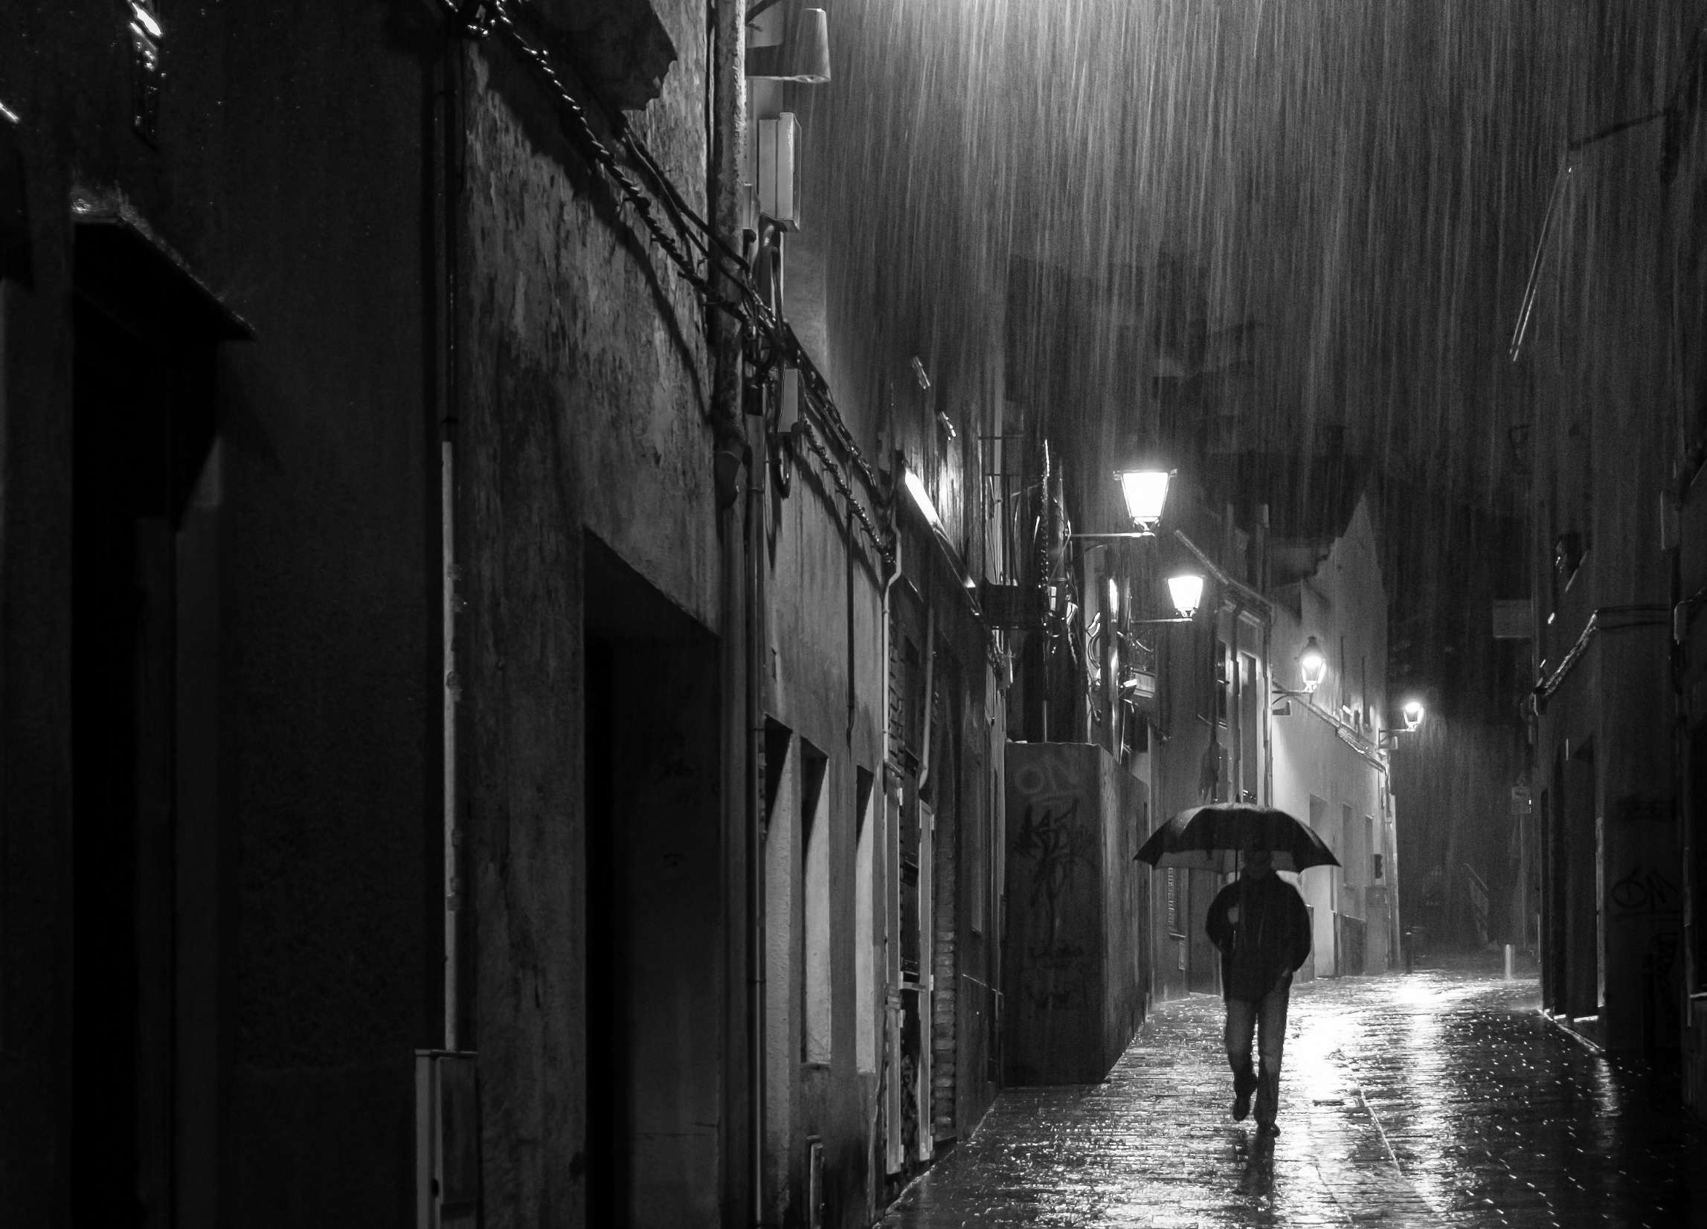




Unit 6
After Twenty Years

Slide 2
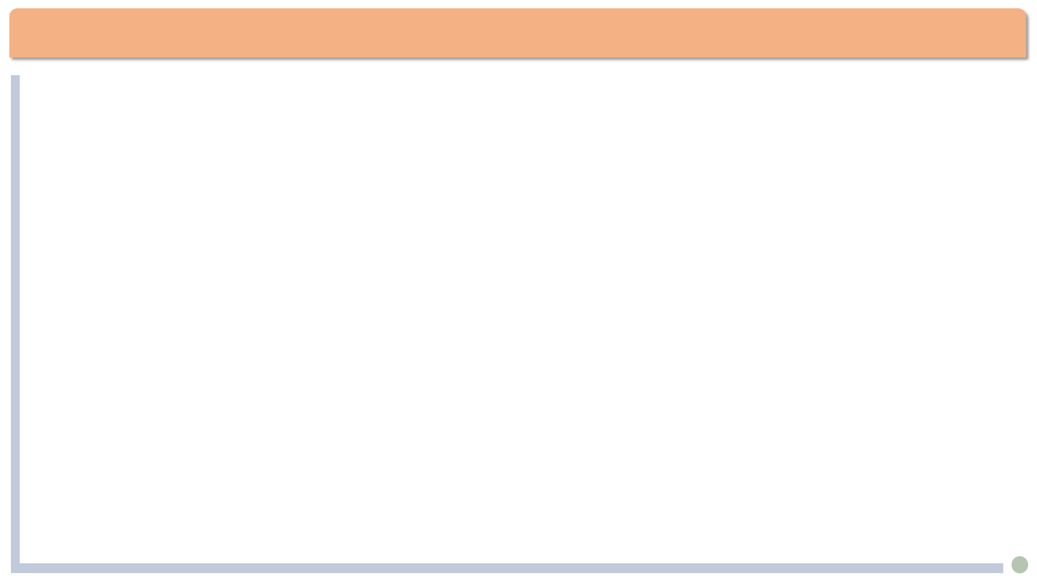


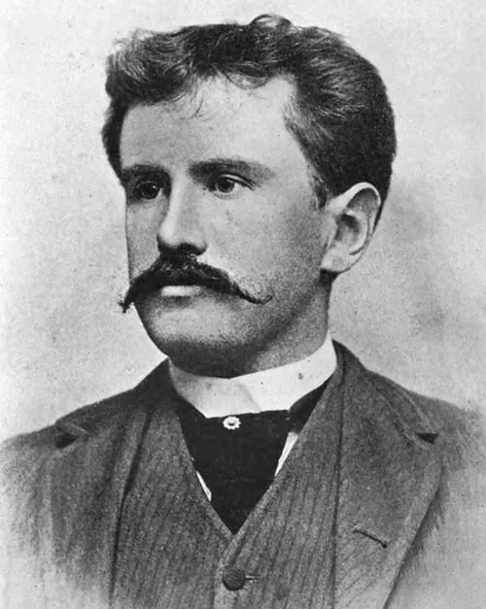
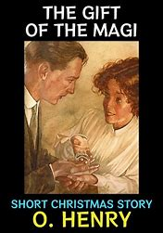
Lead-in
Author of the text
O. Henry (1862—1910): American short story writer
Original name: William Sydney Porter
Noted for surprise endings to his tales.
Representative works:
The Gift of the Magi, The Last Leaf, The Cop and the Anthem, The Ransom of Red Chief, etc.

Slide 3
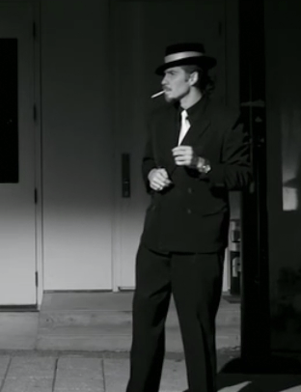
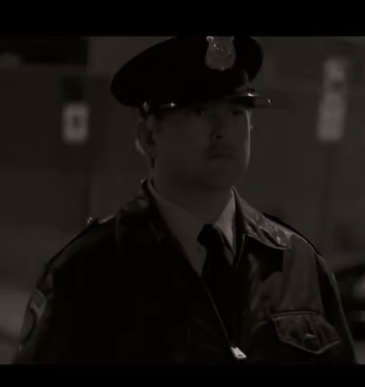
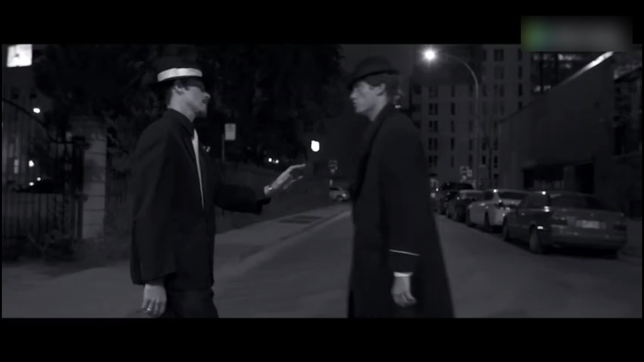
Characters of the story:
Lead-in
Bob
Who is Jimmy Wells?
Find the foreshadowing(伏笔) for the surprise ending.

Slide 4
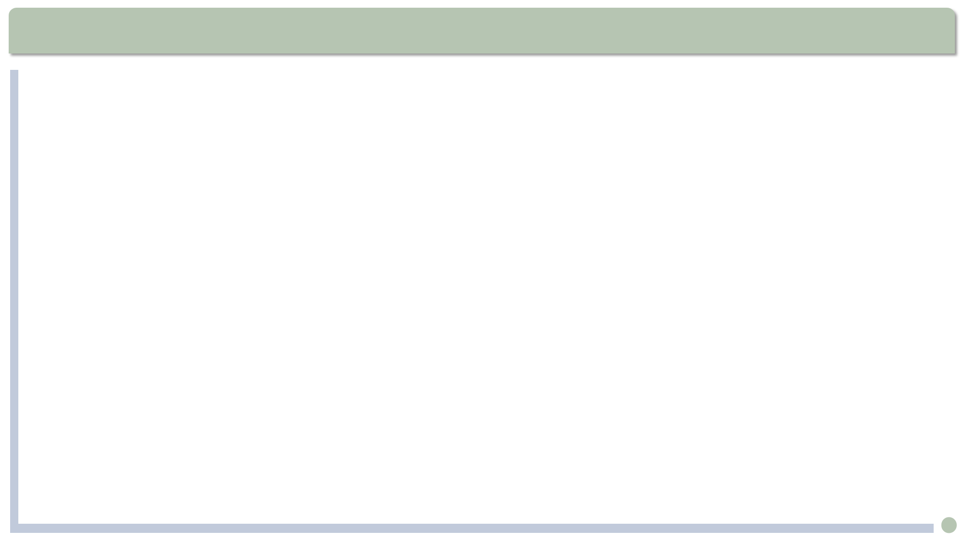
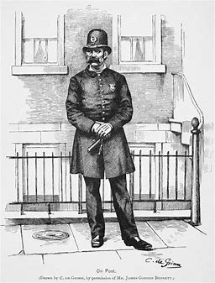
Text Analysis
①Trying doors as he went, ②swinging his club with many clever movements, ③turning now and then to cast his watchful eye down the peaceful street, the officer, ④with his strongly built form and slight air of superiority, made a fine picture of a guardian of the peace.(Para.2)
cast one’s eye / an eye on/over/down ... 投去（一瞥、一眼）
Mellor cast an eye over the draft for inaccuracies.
梅勒扫了一眼草稿，看有没有错误。
向……投去钦佩的目光
向……投去欣赏的目光
向……投去羡慕的目光
cast an admiring eye on sb.
cast an appreciative eye on sb.
cast an envious eye on sb.

Slide 5

填空题
20分
What do the details about the policeman suggest?
1. [填空1] (挥舞 -ing) his club with many clever movements: his confidence; not being a green hand.
2. Casting his [填空2](警惕的) eye down the street: his sense of responsibility; expecting someone
3. His strongly built form: his strength
4. His slight air of [填空3](优越感): his pride as a police officer
All these made a fine picture of a [填空4](守护者) of the peace.
作答

Slide 6
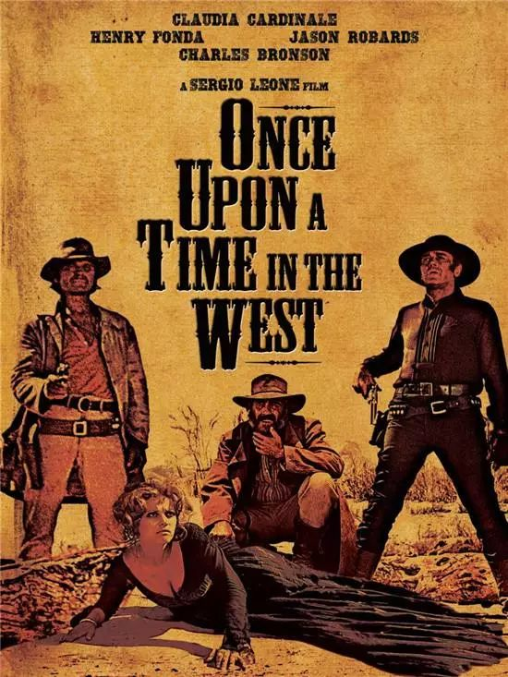
填空题
20分
What do the details about Bob suggest?
1. pale face: [填空1]
2. keen eyes: [填空2]
3. scar near his eyebrow: [填空3]
4. tiepin being a large diamond, oddly set: [填空4]
a. exhausted
b. honest
c. alert; perhaps shrewd
d. had a tough life, perhaps with violence.
e. fashionable
f. rich, showing off, with bad taste
作答

Slide 7
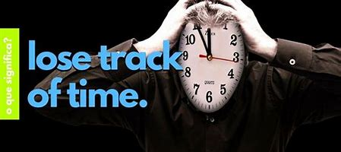
Text Analysis
... we lost track of each other. (Para.9)
... we lost contact with each other
keep/lose track of sb./sth.: to have/not have information about what is happening or where sb/sth is与…保持/失去联系;了解/不了解…的动态；
— Have you kept track of the stock market?
— I have lost track of its latest development.
了解时事动态非常重要。
It is important to keep track of current affairs.

Slide 8
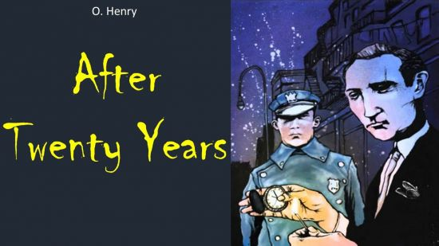
Text Analysis
He was a kind of slow man, though, good fellow as he was.
good fellow as he was: though he was a good fellow
as引导的让步状语从句：1. 表语 + as + 主语及系动词
虽然汤姆很有名，但是他非常谦虚。
Famous as he was, Tom was very modest.
尽管他是个孩子，但他对世界了解很多。
Child as he is, he knows a lot about the world.
2. 副词状语+ as + 主语及其他成分
Hard as I tried, I failed to finish the job on time.

Slide 9
主观题
10分
Make a sentence containing a adverbial clause of concession(让步状语从句) by “as”, as below:
Famous as he was, he was very modest.
Child as he is, he knows a lot about the world.
Hard as I tried, I failed to finish the job on time.
作答

Slide 10
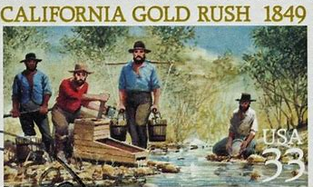
Text Analysis
A man gets stuck in New York. It takes the West to make a man really keen.
A man is unable to go very far or to be very successful in New York where life is boring. He has to go to the West to become an eager and exciting person.
在纽约，人们很难有多大的作为，人只有到西部去才有进取心/才能干大事。
take: to need or require sth in order to happen or be done需要；要求
“It takes a village to raise a child.” (African Proverb)
养育一个孩子需要整个村庄的力量。
“It takes strength to be gentle.” ——Gandhi
温柔需要力量。

Slide 11
多选题
20分
Which translations are correct according to the text?
A
slow man: 走路慢的人
B
sharp brain: 精明的人
C
with pocketed hands: 双手插兜
D
a fine rain: 美好的雨
提交

Slide 12
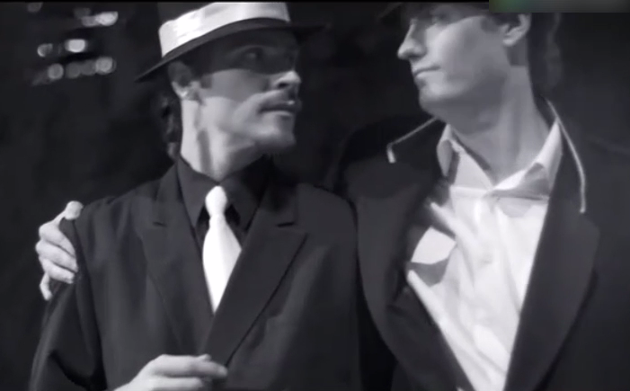
填空题
20分
Chinese-English translation:
1. 千真万确：as sure as [填空1]
2. 他惊呼道,“天哪!”：He [填空2] (过去式), “Bless my heart!”
3. 他们同时转身打量彼此的脸：Each of them turned [填空3] to gaze upon the other’s face.
4. 你被捕了：You are under [填空4] .
作答

Slide 13
Discussion
Do different personalities lead to different life paths? (As Bob is more adventurous, while Jimmy more peaceful and steady.)
When loyalty to friendship is in conflict with legal and moral principles, how would you deal with the situation?
Kin concealment(亲亲相隐) or placing righteousness above family loyalty(大义灭亲)？

Slide 14
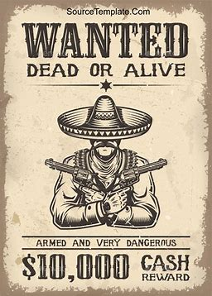
主观题
10分
If you were the policeman Jimmy, what would you do to your old friend Bob who was a criminal wanted by the police?
作答

