Slide 1

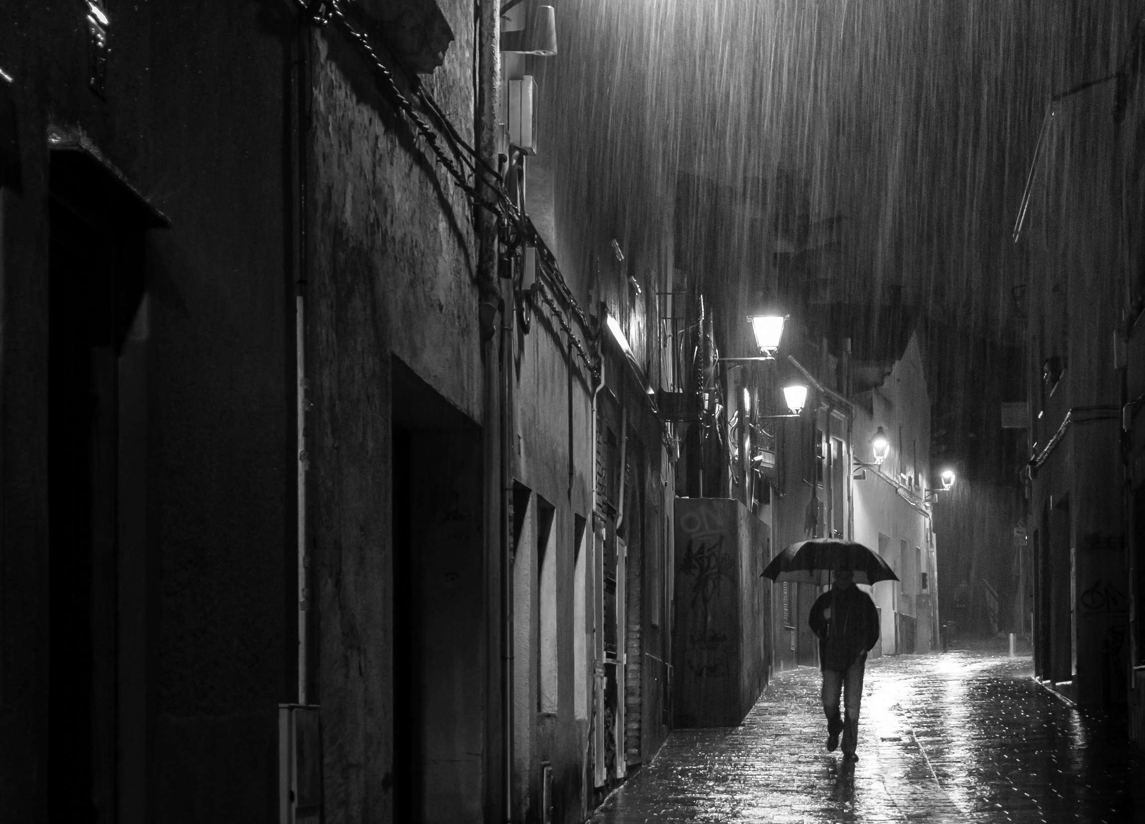




Unit 6 (2)

Slide 2



Glossary
doorway dismal gaze guardian gust spectator release watchful
gust
watchful
dismal
gaze
doorway
release
guardian
spectator

Slide 3
Glossary
Fill in each blank with the best word from the given words.
cast exclaim keen moderate sensible simultaneously unfold
unfolds
1. As the story _________, the characters show who they really are.
2. The detective's ________ mind for details helped him find the clue.
3. I can not help but _______, “I found it”!
4. The two guns fired almost ________.
5. It is ________ to go to work by subway instead of by car in the morning.
6. She ________ a welcoming smile on the new guest.
7. Despite having a ________ income, he often feels frustrated by his mediocre career progress.
keen
exclaim
simultaneously
sensible
cast
moderate

Slide 4
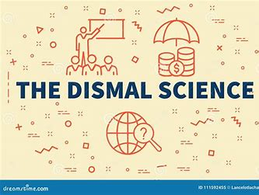
Glossary
dismal a. causing or showing sadness 忧郁的；凄凉的；惨淡的；阴沉的
a dismal weather
阴郁的天气
dismal economic conditions
萧条的经济
dismal prospect
悲观的前景
dismal failure
惨败
Synonym: gloomy; miserable

Slide 5


Glossary
sensible a. reasonable, practical, and showing good judgment 明智的；理智的；合理的
[Comparison] sensible, sensitive(敏感的)
1. It was a ______ decision to save some money each month, given the uncertain economic situation.
2. She's very ______ about her family background and often avoids discussing it with others.
3. She was a ________ girl and did not panic.
sensible
sensitive
sensible

Slide 6

Exercises · Language Exercises
2. Translate the following sentences, paying attention to the words and expressions in bold type which may have different meanings in different contexts.
1. Plainly, he considers himself a promising political figure in that country.
显然，他认为自己是那个国家很有前途的政治人物。
2. I can’t figure out why she keeps changing her quarters.
我想不明白她为什么要不断地改变住处。
3. The only thing I know about the country is “The rain in Spain stays mainly in the plain,” which is an expression I picked up at school more than a quarter of a century ago.
关于这个国家我只知道“西班牙的雨集中在平原地区”，这还是我25多年（四分之一个多世纪）前在上学的时候学到的一句话。

Slide 7
Exercises · Language Exercises
2. Translate the following sentences, paying attention to the words and expressions in bold type which may have different meanings in different contexts.
4. The basketball player seemed to have cast a spell upon the spectators in the first quarter.
在开局第一节，那个篮球运动员似乎就已经把观众都迷住了。
5. It is plain to me that you can’t beat that movie for its strong cast.
在我看来，显而易见，那个电影演员阵容十分强大，这点别的电影无法相比。
6. I have a Ph.D. degree all right, but a plain-looking girl stands no chance in beauty contests. The focus is usually on height, figure, and a pretty face.
不错，我是有一个博士学位，但是像我这样姿色平平的女孩在选美比赛中根本没有机会。人家强调的一般都是个子高挑啦，身材啦，还有漂亮的脸蛋啦。

Slide 8
Exercises · Language Exercises
2. Translate the following sentences, paying attention to the words and expressions in bold type which may have different meanings in different contexts.
7. All right! Now stop beating about the bush. Just give me the plain truth.
行啦！你就不要再东拉西扯，转弯抹角了。跟我说实话吧。
8. When I was told that I had to pay $50,000 for the damage, my heart missed a beat. It was an impossible figure for me to afford.
在我被告知我得付五万美元赔偿费的那一刹那，我的心跳好像一下都停了。这是我不可能付得起的数目。
9. All right, I slapped his face, but he hit me back squarely on the jaw, so we are square.
好吧，我扇了他一耳光，但他也不偏不倚打在我下巴上，所以我们扯平了。

Slide 9
Exercises · Language Exercises
3. Fill in the blanks with the correct form of the phrases listed below.
1. The novel is about a poor black American put ___________ on a rape charge(指控) which is actually false.
2. People sometimes __________ in the middle of a sentence and can’t go on. It can happen to anybody.
3. I’m not sure if Mary is still in Macao. We __________ each other after we both married.
4. It’s been more than three months since she __________ her daughter last, and she is getting very worried.
for show tear down bring up hear from catch up
change … into get stuck in existence know of compete with
ask for under arrest on earth lose track of
under arrest
get stuck
lost track of
heard from

Slide 10
Exercises · Language Exercises
3. Fill in the blanks with the correct form of the phrases listed below.
5. It was a brilliant idea to __________ the old warship __________ a floating hotel.
6. Many people believe that some prehistoric animals are still __________, although efforts to find them have, so far, proven to be in vain.
7. I don’t know her personally, but I do __________ her. She is known to have published some best-selling stories for children.
for show tear down bring up hear from catch up
change … into get stuck in existence know of compete with
ask for under arrest on earth lose track of
change
into
in existence
know of

Slide 11
Exercises · Language Exercises
3. Fill in the blanks with the correct form of the phrases listed below.
8. Nowadays our farmers begin to __________ with the latest developments in agricultural science and technology and _____________ foreign farmers successfully.
9. I know a man who seems to have been __________ to believe that he will be the greatest scholar __________. He keeps collecting books, but I’ve hardly seen him read any of them. They are just __________.
10. I think they are __________ trouble building houses on the dry bed of the lake. Those houses will have to be __________ sooner or later.
for show tear down bring up hear from catch up
change … into get stuck in existence know of compete with
ask for under arrest on earth lose track of
catch up
compete with
brought up
on earth
for show
asking for
torn down

Slide 12
Exercises · Language Exercises
4. Fill in the blanks with the correct prepositions or adverbs that collocate with the verb “turn.”
1. Thanks to the reform and opening-up policy, this small seaside fishing village turned ______ a new commercial center in less than two decades.
2. The proposal to build another dam on the river was turned _______拒绝 by the Provincial People’s Congress because it was harmful to the environment.
3. Turn ______ the TV. Let us all turn _____ 上床睡觉now if we want to start off at early dawn tomorrow.
4. He was very kind and generous. People in the neighborhood would often turn ______ 求助于him whenever they badly needed help.
into
down
off
in
to

Slide 13
Exercises · Language Exercises
4. Fill in the blanks with the correct prepositions or adverbs that collocate with the verb “turn.”
5. She looked very shy, but she turned ______ 结果是，证明是to be the most courageous person among us in the face of danger.
6. According to this agreement we would build the power station, operate it for twenty years, and then turn it ______ 移交to that country.
7. Jimmy finally persuaded the wanted man to turn himself ________ 自首to the police and from then on turn ______ a new leaf洗心革面 in his life.
8. People’s tastes differ. The same art, music, or food may turn some people ______, 使感兴趣but turn others ______使厌烦. It’s quite natural.
out
over
in/over
over
on
off

Slide 14
Exercises · Language Exercises
4. Fill in the blanks with the correct prepositions or adverbs that collocate with the verb “turn.”
9. It’s getting late; I must be on my way. But I will turn it ______ in my mind反复考虑 and tell you what I think of the plan tomorrow.
10. I don’t understand why anybody should be praised for turning ______ 生产more cigarettes if we agree that cigarettes are harmful to our health.
11. The speaker was extremely popular; you wouldn’t believe how many people turned ______ that day to listen to his talk.
over
out
up

Slide 15
Exercises · Language Exercises
6. Study the following examples and translate the sentences, using the “wish + that-clause” pattern.
1. 我当然愿意把我的车借你用，可是我现在正要到医院探望我母亲。
I wish I could let you use my car, but I am just on my way to visit my mother in the hospital.
2. 我要是有你的脑袋那么聪明就好了。我其实并不聪明，但是我一直自以为是。
I wish I had a brain like yours. I am not really a smart man, and yet I have always been so sure of myself.
3. 我现在开始感觉到自己上了年纪了，我真希望能再年轻二十岁。
I am beginning to feel age telling on me. How I wish I were twenty years younger.

Slide 16
Exercises · Language Exercises
6. Study the following examples and translate the sentences, using the “wish + that-clause” pattern.
4. 我这辈子生活一团糟，我真希望当初能听你的劝告。
I have made a mess of my life. I wish I had taken your advice.
5. 我知道投资有风险，我当初真不该把所有鸡蛋都放在一个篮子里。
I know that investment is always risky. I wish I had not put all my eggs in one basket.
6. 说起后悔的事情，我真希望进大学的第一学期我没有浪费那么多时间享受自己所谓的自由。
Speaking of regrets, I wish I had not wasted so much time enjoying my so-called freedom in my first semester at the university.

Slide 17

Exercises · Language Exercises
6. Study the following examples and translate the sentences, using the “wish + that-clause” pattern.
7. 回想起来，我们真希望当初没有把那些森林都改成农田。
Looking back, how we wish that we had not turned the forests into farmland.
8. 作为一个历史学家，我真应该对我所学的历史教训都认真对待。
As a historian, I wish I had taken historical lessons I learned more seriously.

Slide 18
Exercises · Language Exercises
7. Translate the following sentences, using the words and expressions in the brackets.
1. 事业成功冲昏了他的头脑。不管合伙人如何劝他谦虚一点，他都充耳不闻。(turn one’s head; turn a deaf ear to)
Career success turned his head. No matter how (hard) his partners tried to advise him to be modest, he turned a deaf ear to their advice.
2. 随着故事情节的展开，你逐渐意识到自己最初的猜想是多么错误。(unfold)
As the story/plot unfolds, you gradually realize how wrong your initial assumptions (original guesses) were.

Slide 19
Exercises · Language Exercises
7. Translate the following sentences, using the words and expressions in the brackets.
3. 多年来我们学校培养了很多优秀的学生，大家都在各自的岗位上做着贡献。(position)
For years, our school has produced (turned out/graduated) many good students, all of whom have been making their contributions in their various positions.
4. 我原来以为这个话题会非常乏味，可是这位教授的演讲让我着了迷。(turn sb. on)
I thought the subject would be boring, but the professor’s lecture really turned me on.

Slide 20
Exercises · Language Exercises
7. Translate the following sentences, using the words and expressions in the brackets.
5. 他相信这件事值得一试，但是他知道不管我们做什么都必须有人民的支持。(worth)
He believed that it was worth trying, but he knew that whatever we do, we must have people’s support.
6. 很多人决定拆除被地震毁掉的老房子，建造新的。但有些人不然，他们宁可按原样翻新修补，以便留个回忆。(tear)
Many people decided to tear down their old houses destroyed by the earthquake and build new ones, but some people didn’t. Instead, they preferred to renew them for memory’s sake.

Slide 21
Exercises · Language Exercises
7. Translate the following sentences, using the words and expressions in the brackets.
7. 我给你看怎样用手机追踪你的货物。(keep track of)
Let me show you how you can keep track of your shipment with your smartphone.
8. 水灾过去以后，我们首先要清理垃圾，修通道路。当然，我们也要让生还者有地方可住，有东西可吃。(have sth. done)
When the flood is gone, the first thing we must do is to have the garbage removed and the road repaired. Of course, we must also have the survivors properly sheltered and fed.

Slide 22
Exercises · Language Exercises
8. Fill in each blank of the passage with ONE suitable word.
The tradition of dedicating a day in (1) ________ of friends began in the United States in 1935. The U.S. Congress, that year, declared the first Sunday of August to be known as National Friendship Day. Although it began as a small event, (2) ________ then,
celebration of the occasion has become an annual affair. Gradually, however, Friendship Day has become a(n) (3) __________________ festival, which is commemorated in other countries as well, and more and more people come to appreciate the (4) ________________ of honoring friendship—one of the most important human (5) ________________.
hornor
since
popular/international
idea/practice
relationships

Slide 23
Exercises · Language Exercises
8. Fill in each blank of the passage with ONE suitable word.
The occasion is celebrated in various (6) ________. Exchanging gifts, flowers, friendship bands, and greeting cards has become a(n) (7) ________ of Friendship Day. Partying all through the night is one of the recent developments, largely popular (8) ___________ young people.
Now, with the development of information technology, exchanging wishes and greetings is no (9) ________ just limited to sending cards, letters, or emails. Some brand-new methods of conveying wishes on the occasion are much (10) ________ by netizens, users of the Internet, including e-cards, instant messages, and video chat.
ways
tradition
among/with
longer
favored

Slide 24

Exercises · Language Exercises
9. Find and correct the TWO mistakes in each exercise.
1. It was getting late, and I was just about to close the bar when a fat man stumbled through the door. The snow outside by now was thickening, and the newly arrival was shivering in cold.
It was getting late, and I was just about to close the bar when a fat man stumbled through the door. The snow outside by now was thickening, and the new arrival/newly arrived man was shivering with cold.

Slide 25
Exercises · Language Exercises
9. Find and correct the TWO mistakes in each exercise.
2. The man was now worth of more than a million, but he decided not to leave all the money to his son, which was sensitive because if he did, it would probably make his son idle and useless, if not wanted by the police.
The man was now worth of more than a million, but he decided not to leave all the money to his son, which was sensible because if he did, it would probably make his son idle and useless, if not wanted by the police.
3. There are many differences among the leaders naturally, but they knew they must hang together if they did not want to be hung separately by King George.
There were many differences among the leaders naturally, but they knew they must hang together if they did not want to be hanged separately by King George.

Slide 26
Exercises · Language Exercises
9. Find and correct the TWO mistakes in each exercise.
4. His family were all terribly worried about him, for they haven’t heard of him after the plane crash was reported by the press.
His family were all terribly worried about him, for they hadn’t heard of him since the plane crash was reported by the press.
5. There was a guard in plain clothes on board the ship, casting his watchful eyes around time and then, for any sign of trouble.
There was a guard in plain clothes on board the ship, casting his watchful eye around time and again/from time to time/now and then/now and again/every now and then/every now and again, for any sign of trouble.

Slide 27
Exercises · Language Exercises
9. Find and correct the TWO mistakes in each exercise.
6. That day my father suddenly had a sharp pain in the chest. He was a strong-built man and had never been known to have any health problem. The doctor asked us to make him lay down in bed first before he came.
That day my father suddenly had a sharp pain in the chest. He was a strongly-built man and had never been known to have any health problem. The doctor asked us to make him lie down in bed first before he came.
7. How I hope that the beautiful city wall of Beijing has been preserved. It is a pity we only see its value in hindsight.
How I wish that the beautiful city wall of Beijing had been preserved. It is a pity we only see its value in hindsight.

