Slide 1






Unit 7

Slide 2


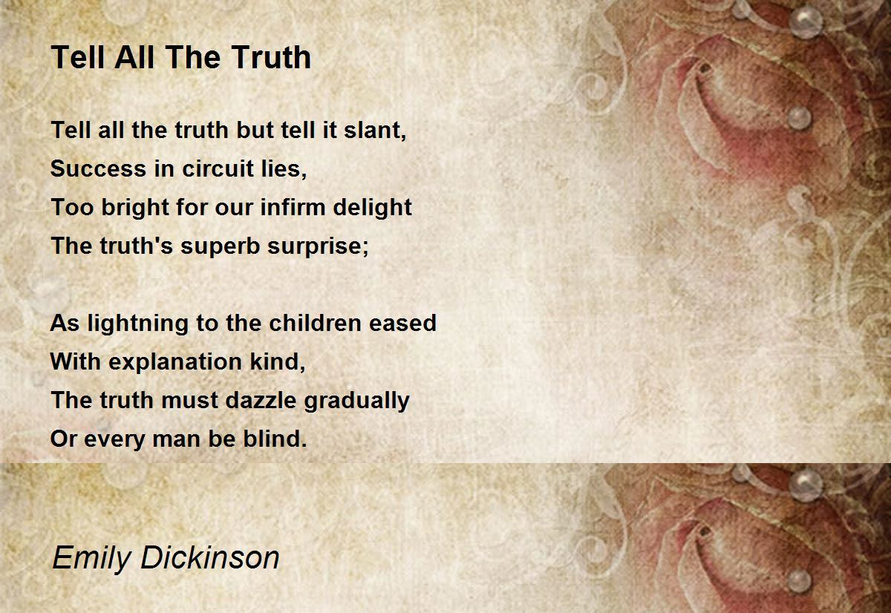
Poem
要说出全部真相，但切莫直言——
迂回之路方能取胜
真相的惊喜太炫目
对于我们脆弱的欢喜而言，过于明亮
如缓解孩子对闪电的惊恐
需要我们慈爱的解释，
真相必须逐渐散发它的光芒，
否则每一个人都会失明。

Slide 3


Glossary
delicacies luxury scrawl spectacles stupefied sullen throne wince
scrawl
throne
delicacies
spectacles
luxury
sullen
wince
stupefied

Slide 4
Glossary
Fill in each blank with the best word from the given words.
casualty consolation fuss grant nuisance plead resolve tentative
1. Almost kneeling down, the lady ________ with her son to come back home.
2. He tends to ________ over his appearance before going out.
3. Luckily, I was ________ permission to visit the palace.
4. The children were a great __________ to him when his wife died.
5. He could be a bit of a _________ when he was drunk.
6. It was a fierce battle: both sides had suffered heavy________.
7. The difficulties strengthened her ________ to uncover the truth.
8. We made a _________ arrangement to meet on Friday.
pleaded
fuss
granted
consolation
nuisance
casualties
resolve
tentative
Why all the fuss on it?

Slide 5

填空题
30分
Fill in the blanks with the words given. Change the form if necessary.
accompany, assail, sheer, soothe, throb
1. The enemy plane tried to [填空1] our defense position.
2. Young people are moving into big cities, which are [填空2] with life and energy
3. They won the championship by [填空3] luck.
4. Children under 14 must be [填空4] by an adult.
5. When I'm anxious, I [填空5] myself with a nice cup of tea.
作答
Soothing Music

Slide 6
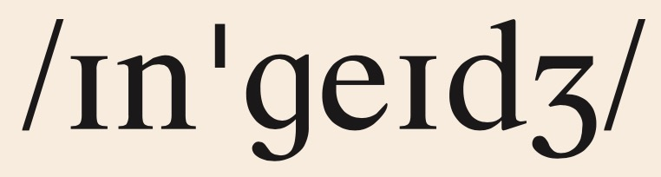
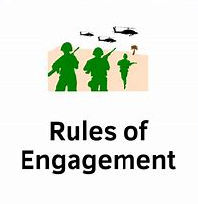
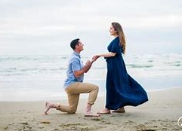
Glossary
engage v.
1.Only 10% of American adults engage in regular exercise.
2. It is difficult to engage workers of quality now.
3. It is a movie that engages both the mind and the eye.
4. He is now engaged on his second novel.
5. The two armies engaged on the open field.
6. They plans to get married next spring after being engaged for over a year.
参加；从事
雇佣
吸引（赏心悦目）
忙于
交战；交火
订婚

Slide 7
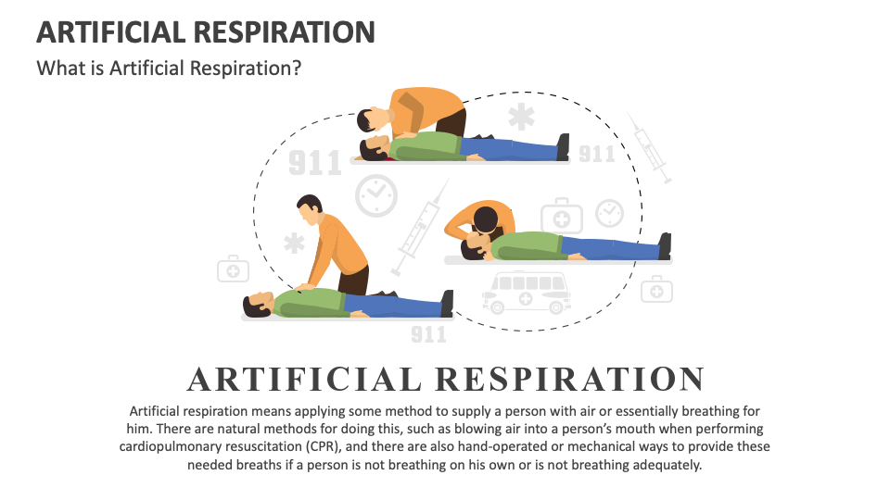
Glossary
Comparison
aspiration 渴望；抱负；志向
inspiration灵感；鼓舞
respiration 呼吸
perspiration 汗水，出汗
conspiracy 阴谋
expiration 期满，到期

Slide 8
填空题
20分
Fill in the blanks with the words given:
aspiration 渴望；抱负；志向 inspiration灵感；鼓舞
respiration 呼吸 perspiration 汗水，出汗
conspiracy 阴谋 expiration 期满，到期
1. As Thomas Edison said, Genius is 1% [填空1] and 99% [填空2] .
2. Her [填空3] to become a UN diplomat stems from a deep desire to promote global peace.
3. The [填空4] date on this yogurt was November 20.
作答

Slide 9
Unit 7 Phrases
给我留下刻薄的印象
单独留出这天
直视某人
悬在他头上的一把剑
纯粹出于无聊
对音乐的迷恋
私底下, 关起门来
过分关注, 对……大惊小怪
摆脱这件麻烦事
剥夺我从音乐获取的慰藉
雇了一个小提琴手给我伴奏
... struck me as mean
set apart this day
look sb. (straight) in the face/eye
a sword hanging over his head
out of sheer boredom
weakness for music
behind closed doors
fuss over sth./sb.
get rid of the nuisance
deny me the consolation of music
engage a violinist to accompany me

Slide 10
Unit 7 Phrases
满面汗珠
宣布审判结果
站在那儿目瞪口呆
还清，结帐
……将一帆风顺
（大胆）说出你的观点
说得再委婉一些
熬夜
打断反方的发言
遭受惨重的伤亡
压垮骆驼的最后一根稻草
沉溺于
(one’s face) beaded with perspiration
deliver a sentence
stood there stunned /stupefied/ dumbfounded
paid off ...
to be smooth sailing
come out with your opinion
speak more soothingly
sitting up all night
cut the opposite side short
suffer heavy casualties
the straw that broke the camel's back
indulge in

Slide 11
主观题
30分
Choose at least 3 phrases from below and make sentences with them.
1. a sword hanging over one’s head
2. behind closed doors
3. fuss over sth./sb.
4. stood there stupefied
5. to be smooth sailing
6. the straw that broke one’s back/ might break one’s back
作答

Slide 12

填空题
20分
Dictation 1:
All the way home he felt worried. He knew that his of [填空1] life was not going to be smooth sailing [填空2] as so much of his future depended upon the headmaster’s [填空3] . Did not Harishchandra lose his [填空4] , wife, child, because he would speak nothing but the [填空5] Truth?
作答

Slide 13
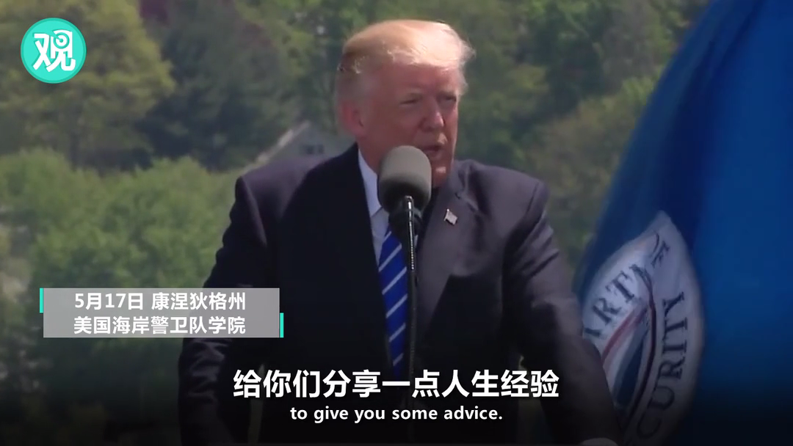
Speech
Word tips
warranted 必要的，正当的
naysayer 否定者，唱反调者
adversity 困境
righteous /ˈraɪtʃəs/ 正当的；正义的
Now, I want to take this opportunity to give you some advice. Over the course of your life, you will find that things are not always fair. You will find that things happen to you that you do not deserve, and that are not always warranted. But you have to put your head down and fight, fight, fight. Never, ever, ever give up. Things will work out just fine.
...You can’t let them get you down. You can’t let the critics and naysayers get in the way of your dreams. ...Adversity makes you stronger. Don’t give in, don’t back down, and never stop doing what you know is right. Nothing worth doing ever, ever, ever came easy. And the more righteous you fight, the more opposition that you will face.

Slide 14
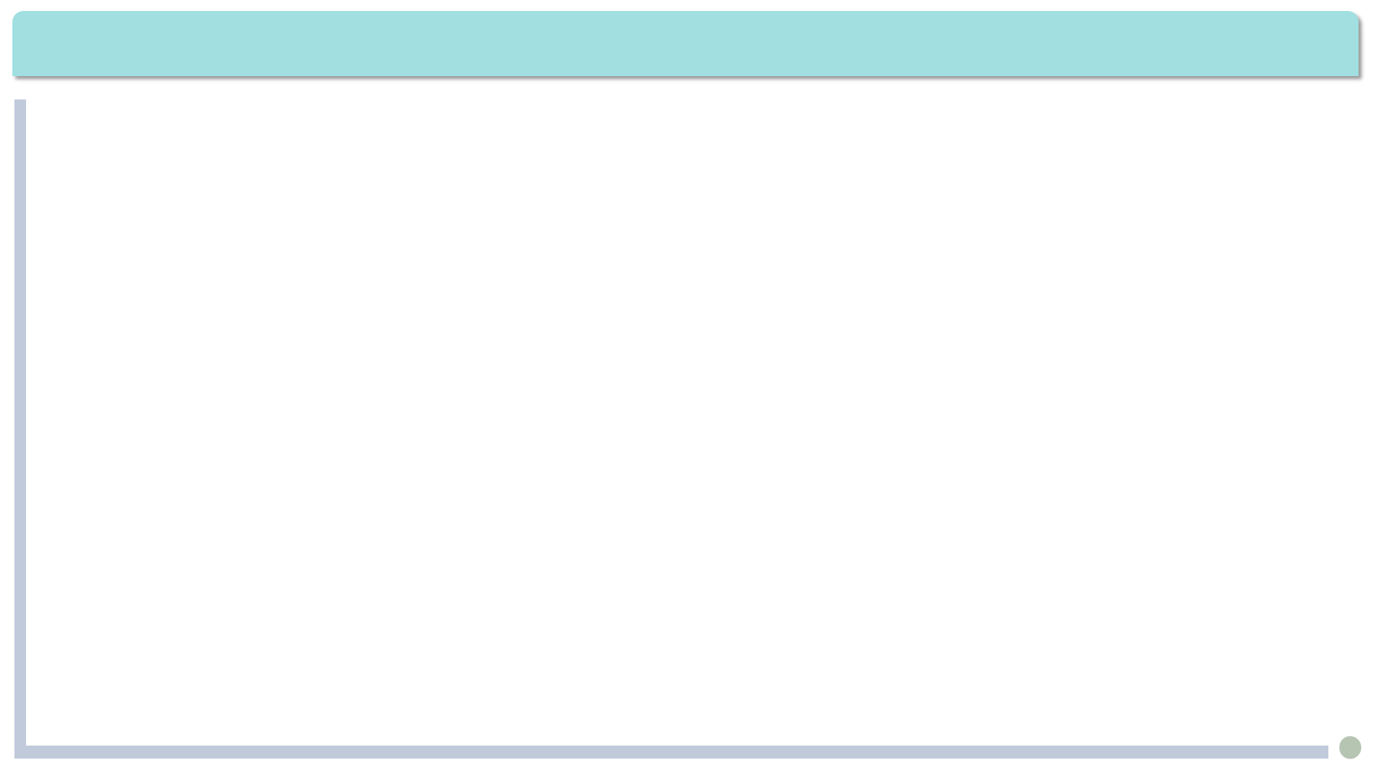
Exercises · Language Exercises
2. Translate the following sentences, paying attention to the words in bold type which may have different meanings in different contexts.
1. Why don’t you engage a secretary to deal with all the paperwork?
你为什么不聘用一个秘书来处理这些文书工作呢？
2. —Are you engaged, sir?
—What business is it of yours? But as a matter of fact, I am engaged, to Miss ...
—Oh, I mean, are you free, sir?
—You mean, am I disengaged?
——您有事忙着吗，先生？
——这跟你有什么关系？不过，我确实订婚了，跟一位小姐……
——噢，我的意思是，您现在有空吗?
——你是问，我是不是没在忙？

Slide 15
Exercises · Language Exercises
2. Translate the following sentences, paying attention to the words in bold type which may have different meanings in different contexts.
3. Our enemy spent a whole month trying to engage our main forces for a decisive battle, but they failed.
敌军花了整整一个月的时间试图与我军主力部队进行决战，但没有成功。（engage:交战）
4. —Nobody is likely to miss him if he should disappear.
—Don’t be so mean. He strikes me as quite a generous and kind person.
——要是他失踪了，不会有人想他的。
——别这么刻薄。我觉得他挺慷慨的，人也和善。（ strike:让人觉得）
5. She is one of those who usually say what they mean and mean what they say.
她是那种心里怎么想就怎么说的人，说的话都算数。

Slide 16
Exercises · Language Exercises
2. Translate the following sentences, paying attention to the words in bold type which may have different meanings in different contexts.
6. He is now recovering slowly from the bad fall. He walks around three times a day, although he uses a stick.
他摔了一跤后，正在慢慢恢复。他每天散步三次，但是得用拐杖。
7. I find that many restaurants have already decided to stick up notices on the wall asking customers to use serving chopsticks, but some people still tend to stick to their old habits.
我发现很多餐厅已经在墙上张贴了通知，要求顾客使用公筷，但还有人坚持老习惯（不用公筷）。
8. Granted that government grants can help scientific development, those grants alone are not enough.
就算政府专款能为科学发展提供帮助，仅有这些专款也是不够的。

Slide 17
Exercises · Language Exercises
3. Fill in the blanks with the correct prepositions or adverbs that collocate with the verb “set.”
1. What set this policy _____ from(使与众不同) the others was that it put a lot more emphasis on home consumption.
2. The court’s decision set ____ (激起) public protests and threatened law and order in some places.
3. Let’s set _____(搁置；暂时不考虑) the question of cost for a moment. Do you think it wise to build more nuclear power stations?
4. Human history has always had twists and turns. Globalization may be set _____ (推迟；阻碍)for some time, but I don’t think it will stop. No one can set the clock _____(把指针往回拨) forever.
apart
off
aside
back
back

Slide 18
Exercises · Language Exercises
3. Fill in the blanks with the correct prepositions or adverbs that collocate with the verb “set.”
5. She proposed that we should set _____ a committee to be in charge of the research on how foreign languages should be taught today.
6. He set ______ (出发；启程)at early dawn, hoping that he could arrive there before sunset.
7. The village decided to set _____ a special fund for the job-training programs.
8. I still don’t know how to set ______(着手做)writing my paper. Can you give me some advice?
up
out/off
up
about

Slide 19
Exercises · Language Exercises
4. Fill in the blanks with the correct form of the phrases and expressions listed below.
1. The open debate became pretty fierce at times. Both sides kept ________ the opposite side _____.
2. We kept ___________ the multi-hundred-billion-dollar project for years because it roused a hot debate. Both those who were for and against it had very strong reasons. A project like that cannot be decided _________________ by a few people.
3. We’ll need to _______ the summit as soon as the sun rises if we hope to make it back down before dark.
fuss over strike ... as put off come out with throb with cut ... short start for behind closed doors
pay ... off out of make it
cutting
short
putting off
behind closed doors
start for

Slide 20
Exercises · Language Exercises
4. Fill in the blanks with the correct form of the phrases and expressions listed below.
4. You can always count on Alfred _____________ to you like it or not.
5. More and more young people are moving _______ curiosity into big cities, which are _____________ life and energy.
6. Don’t _________ every detail which might _______ you _____ important — just get the main idea across.
7. —You must ____ us ____by the end of this week, or we will see you in court.
—Please _______ 10 days, because my pay day is exactly 10 days away.
fuss over strike ... as put off come out with throb with cut ... short start for behind closed doors
pay ... off out of make it
come out with
out of
throbbing with
fuss over
strike
as
pay
off
make it

Slide 21
Exercises · Language Exercises
5. Study the following examples and complete the sentences by translating the Chinese in the brackets.
Examples：
At other times he would have said, considering her feelings in the matter, “I feel full up, that’s all.” (para. 2)
He had kept putting the work off for weeks, feeling all the time as if a sword were hanging over his head. (para. 6)
“Yes,” replied the headmaster, smiling to himself. (para. 14)
1. The bank robber finally decided to turn himself in ________________________, _________________ （省的警察们费劲抓捕他）.
saving the police the trouble
of tracking him down

Slide 22
Exercises · Language Exercises
5. Study the following examples and complete the sentences by translating the Chinese in the brackets.
2. ______________（冒着生命危险）, the firefighters forced their way into the burning house to rescue the missing kids.
3. She has been training for this competition for two years, thus _________________________________________ （很有可能赢得冠军）.
4. ___________ （前几天） I ran into an old classmate I hadn’t seen for a few years, but I couldn’t recall his name. I am getting terribly forgetful _________（最近这些日子）.
Risking their lives
standing a good chance of winning the championship
The other day
these days

Slide 23
Exercises · Language Exercises
5. Study the following examples and complete the sentences by translating the Chinese in the brackets.
5. _________________________________（瞧他那个样子）, you could easily take him for your next- door happy-go-lucky old neighbor. You would never guess that he is actually a most dangerous foreign spy.
6. ______________（回家路上） I was thinking of how I could respond to my parents. ____________________（他们一看到我）, they will want to know when I can bring a boyfriend home.
7. __________________________（上午，下午，晚上）, I have been thinking about this lesson the whole day. But I can assure you, ________（下一次）, if this should happen to me again, I won’t be so foolish.
8. ______________（我一拿到） what you want, I will bring it to you.
By the way/Judging from the way he looks
All the way home
The instant they see me
Morning, afternoon, and evening
next time
The moment I get

Slide 24
Exercises · Language Exercises
6. Translate the following sentences, using the words in the brackets.
1.等我干完活的时候，我的头在抽痛，心也狂跳不已，浑身都疼。(throb)
By the time I finished the job, my head was throbbing, my heart racing, and my whole body aching.
2.坐在这里担心有什么用？我们得做点什么。(use)
What use is there in sitting here worrying? We must do something about it.
3.他在家乡的所见所闻更加坚定了他报告这里形势的决心。(resolve)
What he saw in his hometown strengthened his resolve to report the true situation.

Slide 25
Exercises · Language Exercises
6. Translate the following sentences, using the words in the brackets.
4.那三个骑士见到那匹瘦马，不禁放声大笑。那骑在马上的年轻人冷冷地问道：“三位先生在笑什么？说出来大家一起笑笑如何？”(burst)
The three knights burst into laughter at the sight of the skinny horse. The young man sitting on the horse coldly asked, “What are you gentlemen laughing at? Perhaps we can laugh together.”
5.尽管这只是一次短期的工作出差，大家还是希望能腾出一天时间来观光一下。(set)
Although it was a short business trip, everyone hoped that one day could be set aside/apart for sightseeing.
6.据报道，巴西的热带雨林正以每分钟两万平方米的速度遭到破坏。(rate)
It is reported that Brazil’s tropical rainforest is being destroyed at the rate of 20,000 square meters a minute.

Slide 26
Exercises · Language Exercises
6. Translate the following sentences, using the words in the brackets.
7.我一回到家，爸妈就立刻为我忙碌起来，好像忘记了我已经是两个孩子的父亲。(fuss)
When I got home, my parents immediately started to fuss over me, forgetting that I was a father of two kids myself.
8.记者欣喜地发现，那个村庄没有一个人无所事事，每个人都在紧张忙碌着。(engage)
The reporter was glad to find that nobody was idle in that village. Everybody was intensely engaged.
9.有人主张对开会迟到的人处以罚款。我觉得这样的提案颇为荒唐，似乎罚款是解决问题的万能药。(strike)
Someone proposed that we should fine those who are late for the meeting. This proposal strikes me as rather ridiculous, as if fining is a magic bullet /panacea.

Slide 27
Exercises · Language Exercises
7. Fill in each blank of the passage with ONE suitable word.
Most of us fear making mistakes or being (1)____ responsible for a big failure. We fear that mistakes could (2) ____ us grades, relationships, money, or even careers. However, it’s possible to (3) ____ an entirely different attitude toward mistakes. (4) ______ of fearing them, we could actually celebrate them.
A creative environment is one in (5) _____ failure is not fatal. Businesses strive to be competitive, (6) _____means they all desperately seek innovative changes. Yet innovation (7) _______ risk-taking—and along with it, the chance of failing.
held
cost
take
Instead
which
which
requires

Slide 28
Exercises · Language Exercises
7. Fill in each blank of the passage with ONE suitable word.
This is not idle talk. There are real places (8) ______ people celebrate mistakes. The chief executive of officer of one company sometimes opens meetings by (9) _____ managers to describe their biggest mistakes. The person with the “best” mistake gets a $100 (10) ______ .
One manager of a major company (11) _____ made a mistake that cost his company $1,000,000. He predicted that he would be (12) _____ for sure when his boss found out. (13) _______ , his boss responded, “Fire you? I can’t (14) _____ to do that. I just spent $1,000,000 training you.” Mistakes are part of the learning process.
where
asking
reward
once
fired
However
afford

Slide 29
Exercises · Language Exercises
8. Find and correct the TWO mistakes in each exercise.
1. Difficulties are paper tigers. No matter whenever you come across them, just look at them straight in the face, and they will not dare to stand in your way.
Difficulties are paper tigers. No matter when/Whenever you come across them, just look at them straight in the face, and they will not dare to stand in your way.
2. We were still discussing whether we should plead the local government to build the bridge then the news came that the project was already well under way.
We were still discussing whether we should plead with the local government to build the bridge when the news came that the project was already well under way.

Slide 30
Exercises · Language Exercises
8. Find and correct the TWO mistakes in each exercise.
3. The stranger treated Aladdin very friendly and told him that he was actually his long-lost uncle who had returned home to see his beloved brother. Aladdin told him that his father had died. When the stranger heard this, he burst out into tears.
The stranger treated Aladdin very kindly (was very friendly to Aladdin) and told him that he was actually his long-lost uncle who had returned home to see his beloved brother. Aladdin told him that his father had died. When the stranger heard this, he burst out into tears (burst out crying).
4. You know my weakness in Shaoxing opera. I feel the movie is worth to be seen over and over again. I never get bored.
You know my weakness for Shaoxing opera. I feel the movie is worth seeing over and over again. I never get bored.

Slide 31
Exercises · Language Exercises
8. Find and correct the TWO mistakes in each exercise.
5. Shortly after the emperor died, two poor peasants led people to the fight against the powerful Qin Dynasty, and not long afterward, the uprising led in the end of the dynasty.
Shortly after the king died, two poor peasants led people in the fight against the powerful Qin Dynasty, and not long afterward, the uprising led to the end of the dynasty.
6. The boss promised to us full payment at the moment he returned from his business trip to London.
The boss promised to us full payment at the moment he returned from his business trip to London.

Slide 32
Exercises · Language Exercises
8. Find and correct the TWO mistakes in each exercise.
7. The poor young woman had to work as a slave all her life in order to pay for the necklace she had lost. When finally the poor old woman (she was no longer young) paid off the debt, she was told that the one she had borrowed was actually artificial and quite invaluable.
The poor young woman had to work like a slave all her life in order to pay for the necklace she had lost. When finally the poor old woman (she was no longer young) paid off the debt, she was told that the one she had borrowed was actually artificial and quite valueless.

