Slide 1

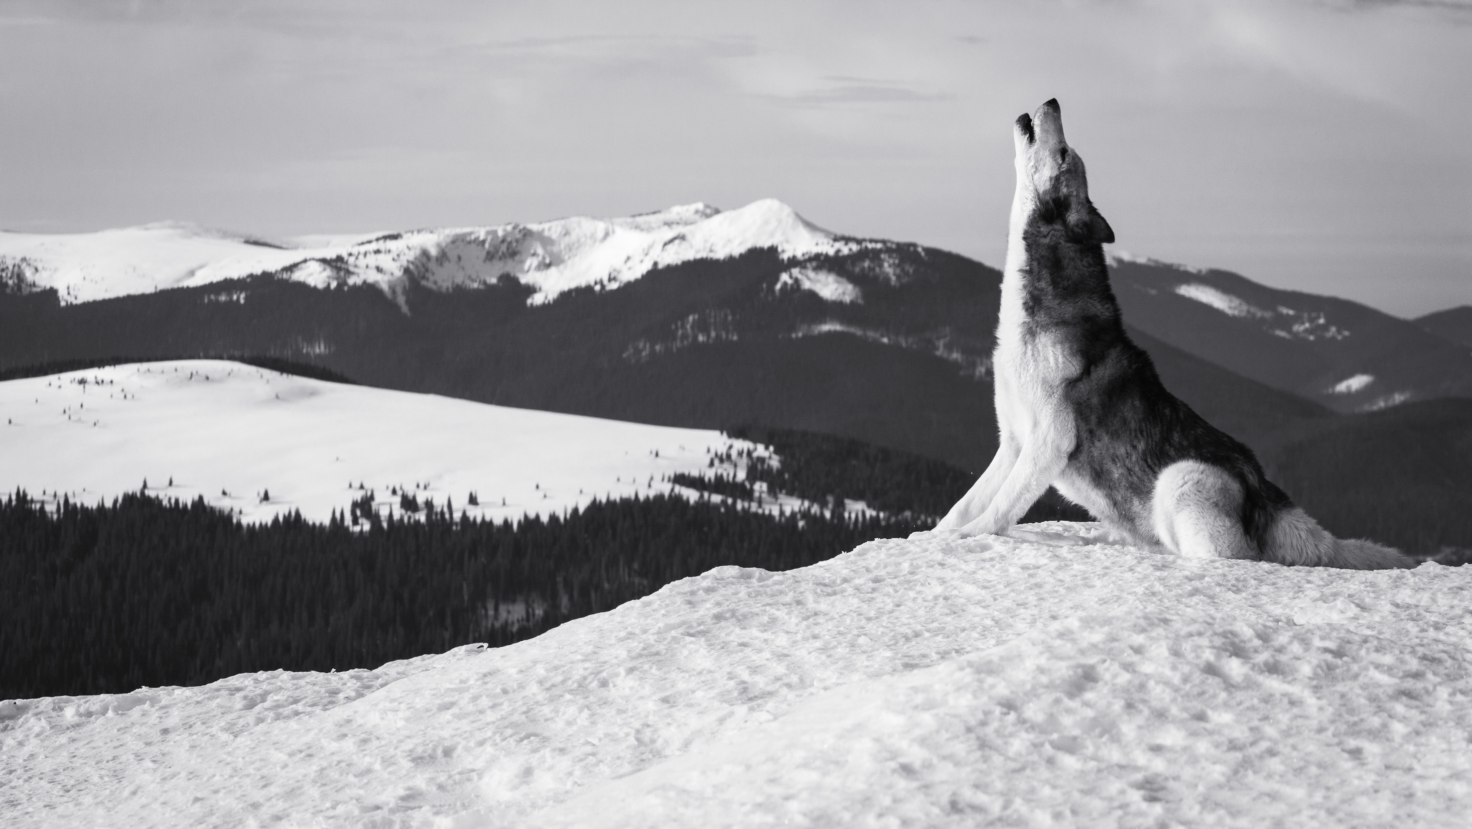




Unit 8

Slide 2



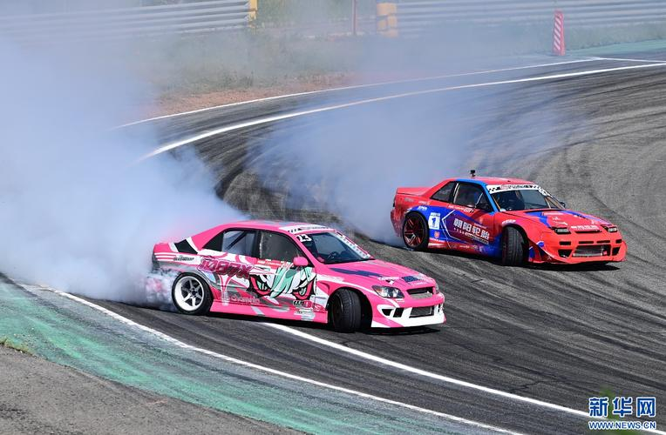
Glossary
drift mischievous restless shack shiver soaked sob squat
mischievous
shack
restless
drift
shiver
squat
sob
soaked

Slide 3

填空题
30分
Fill in the blanks with the words given. Change the form if necessary.
alert, detain, dim, drift, smother, stumble, slash
1. We must be [填空1] to the possibility of danger. 2. His budding talents were [填空2] by the ban(禁令).
3. Researchers have [填空3] upon(偶然发现) a drug that may cure cancer.
4. Two suspects(嫌疑犯) have been [填空4] by the police for questioning.
5. Come to our Summer Sale, where prices have been [填空5] by 75%.
6. Life is too short for us to [填空6] aimlessly(得过且过); we need goals to guide us.
作答

Slide 4

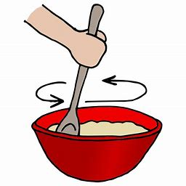
Glossary
stir
1) A gentle breeze stirred the lake.
2) He stirs his coffee with a spoon.
3) The heartbreaking story stirred his sympathy.
4) A feeling of guilt began to stir in her.
5) The book will cause a big stir in the world.
1. (使)微动，拂动
2. 搅拌，搅动
3. 激发，激起，挑起；
4. vi. 苏醒；被唤起
5. n. 惊动，轰动
* stir-fry v. (中式烹饪中的)炒

Slide 5

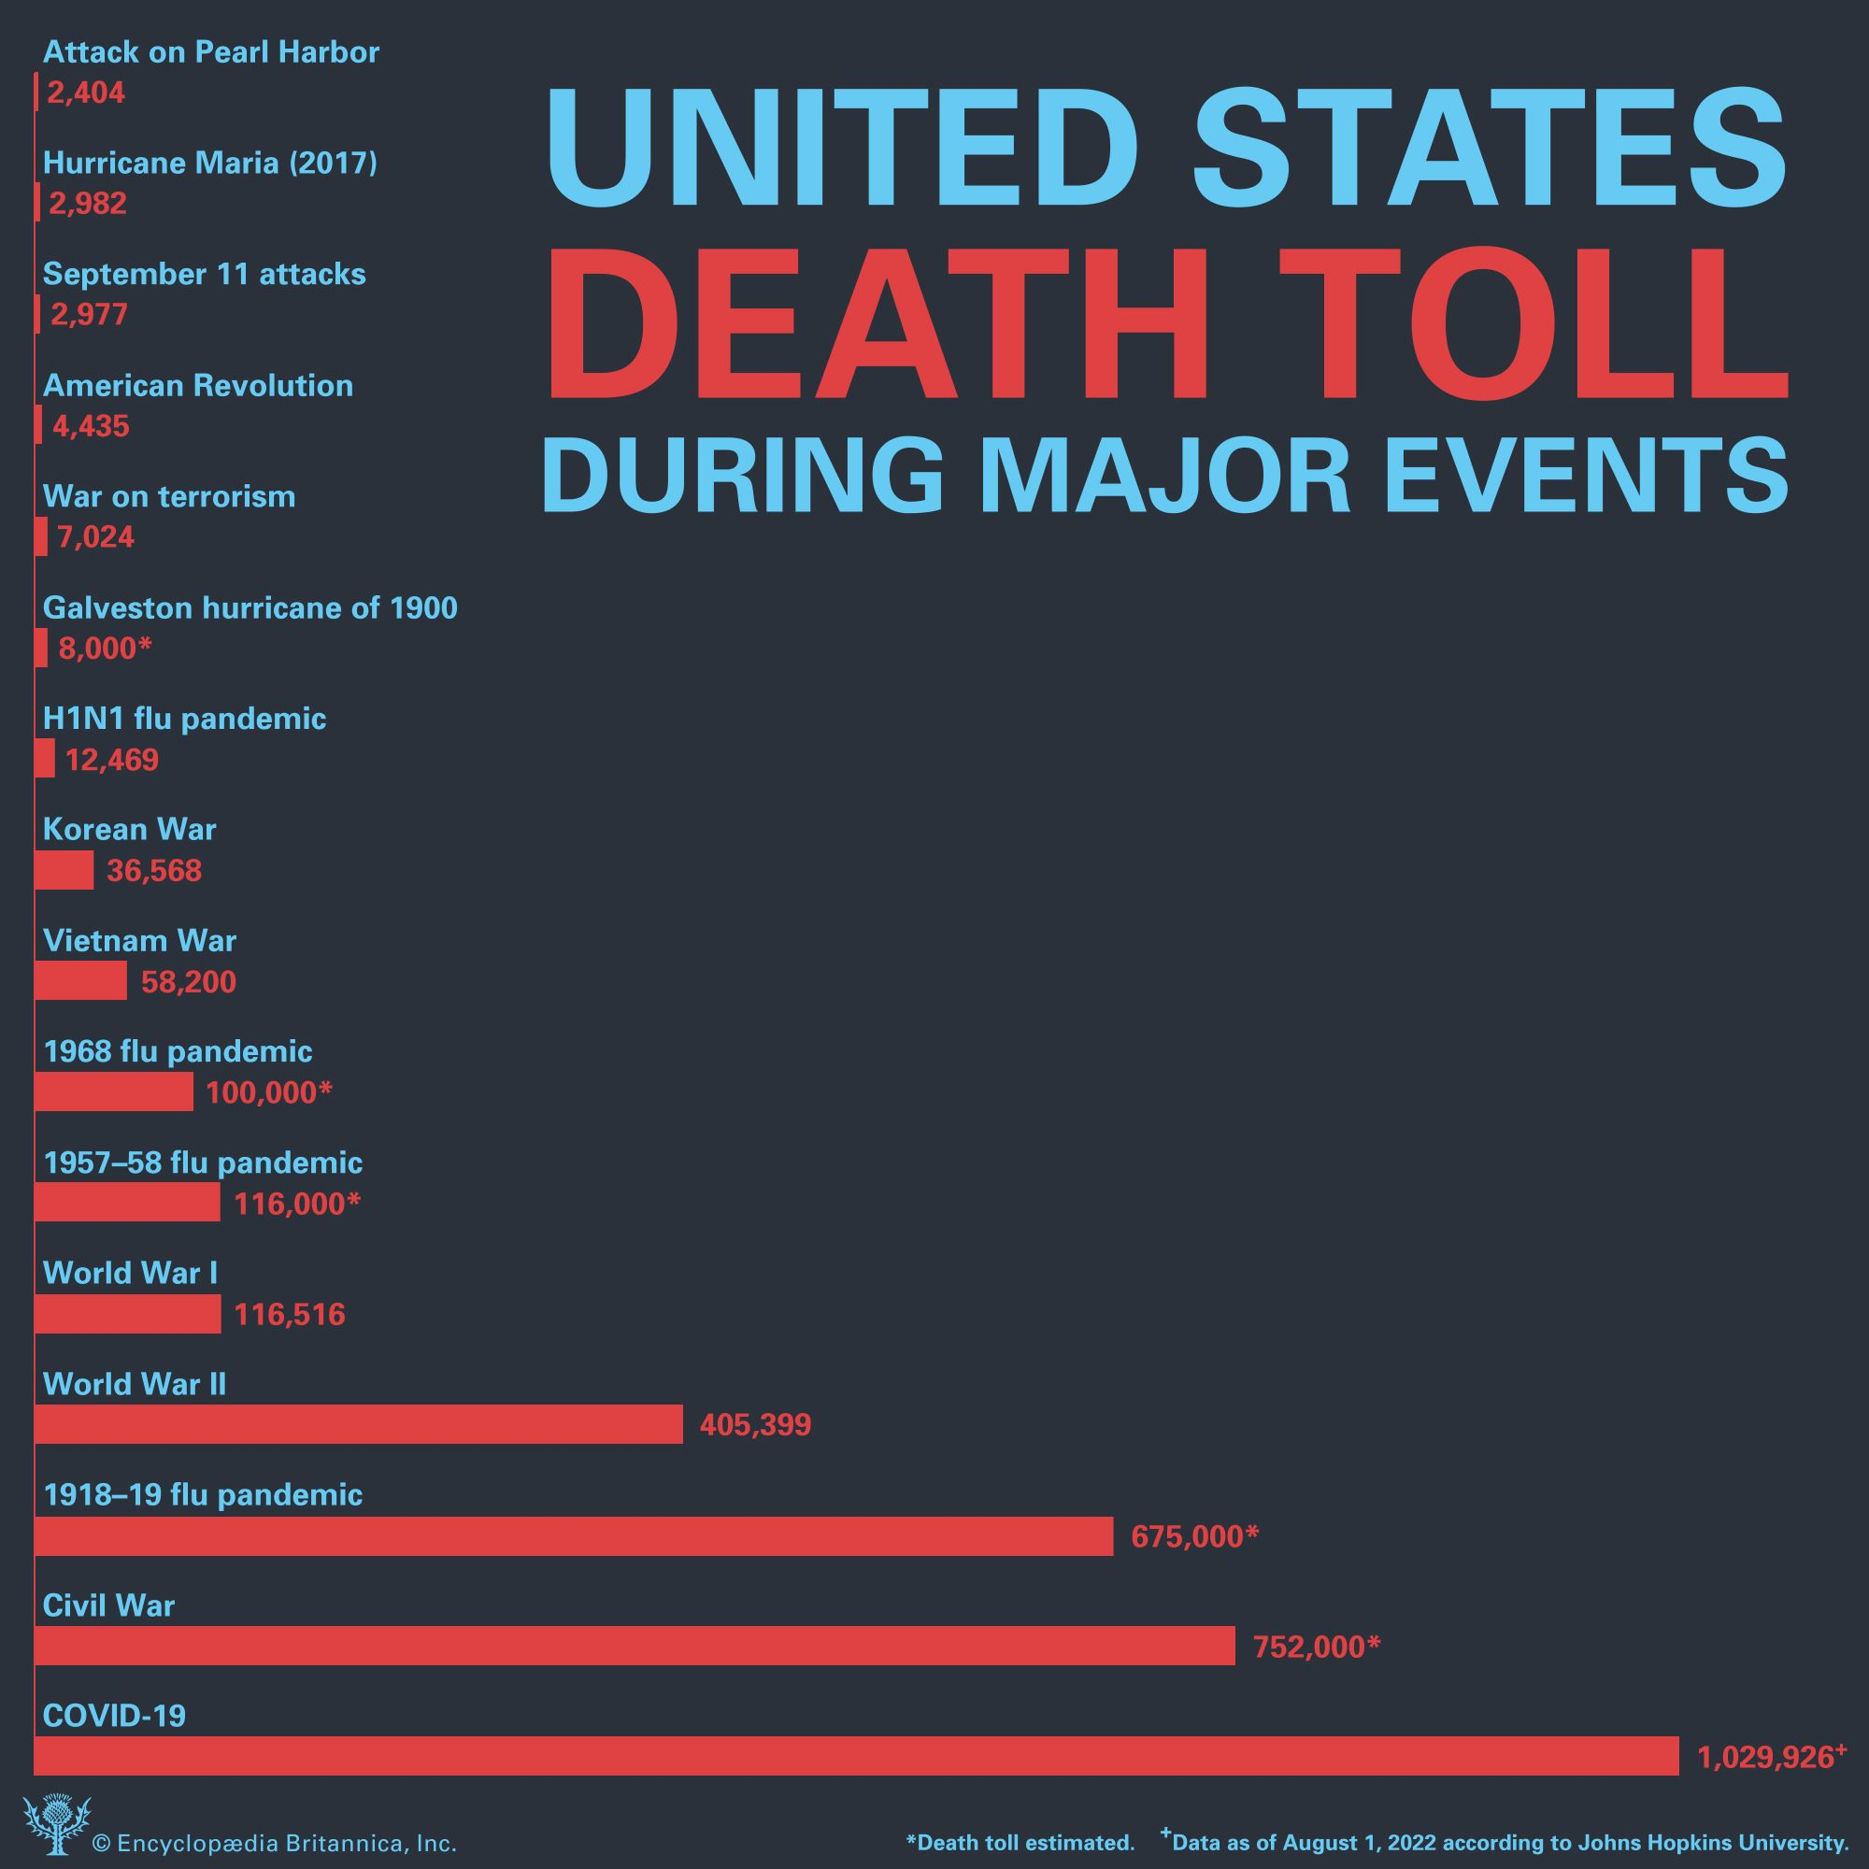
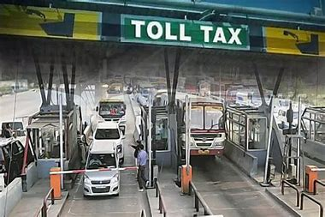
Glossary
toll n.
The death toll has risen to 83.
You have to pay tolls on expressways.
The bell tolled for those killed in the war.
Smoking takes its toll on his health.
死亡人数
（道路、桥梁的）通行费
（尤指）鸣（丧钟）
损害； 造成坏影响

Slide 6
单选题
5分
Choose the best translations for the underlined words.
The Covid-19 pandemic was ①taking its toll on public health, and the whole nation reflected on the heavy ②toll the pandemic had taken.
A
①威胁；②代价
B
①威胁；②死亡人数
C
①损害；②代价
D
①损害；②死亡人数
提交

Slide 7

填空题
25分
Dictation:
Not that we didn't have our troubles. Maheegun was the most [填空1] wolf cub ever. He was curious too. Like looking into Grandma's [填空2] basket—which he upset, [填空3] thread and buttons all over the floor. At such times, she would [填空4] him out with a broom and Maheegun would poke his head around the corner, waiting for things to [填空5] down.
作答

Slide 8
Unit 8 Phrases
倒不是说
等事情平息下来
（也许）最好的安排
像储存坚果过冬的松鼠一样忙
被急事耽搁
搬起石头砸了自己的脚
被血浸透的绷带
费力地走出
赶走
产生恶果；造成重大损失
偶然发现
得过且过；随波逐流
变得清晰；成为关注的焦点
Not that...
wait for things to quiet down
all for the best
as busy as a squirrel storing nuts for the winter
detained by some urgent business
picks up a stone only to drop it on his own toes
blood-soaked bandage
work my way out of/through
drive off
take one’s toll (on...)
stumble upon
drift aimlessly /drift along
come into focus

Slide 9
Unit Task: Giving a speech
Make a 2-minute English speech (150-200 words suggested) with one of the following titles:
1. One World, One Home: Humans and Animals in Coexistence
2. My Vision of the Future World
3. Beautiful China
1. Content 50% (original, coherent, impressive, persuasive, interesting, figures of speech, free of error, audience-oriented)
2. Performance 50% (fluency, pronunciation, rhythm, tone, emotion, eye contact, gestures...) (preferably without script)

Slide 10
填空题
20分
What are the words for the female? (Don’t use “female”)
1. 母狼： [填空1]
2. 母狮子： [填空2]
3. 母牛： [填空3]
4. 公主： [填空4]
5. 女英雄： [填空5]
作答

Slide 11

Exercises · Language Exercises
1. Give the words for the opposite sex.
Male | Female
hero
prince
waiter
rooster
horse
emperor
policeman
Male | Female
he-monkey
congressman
bull
male member
lion
widower
fiancé
heroine
she-monkey
princess
congresswoman
waitress
cow
hen
female member
mare
lioness
empress
widow
policewoman
fiancée

Slide 12
Exercises · Language Exercises
3. Translate the following expressions into English.
1) 养狗 / 猫（作为宠物）；养马 / 警犬（作为经营业务）；养孩子；举手；举枪；抬起头；提高嗓门；提高收入；提出强烈反对
keep a dog/a cat; keep horses/police dogs; raise children; raise one’s hand(s);raise the rifle/gun; raise one’s head; raise one’s voice; raise one’s income; raise a strong objection
2) 铺桌子（准备吃饭）；打基础；设陷阱；生蛋
lay the table; lay the foundation; lay a trap; lay eggs

Slide 13
Exercises · Language Exercises
3. Translate the following expressions into English.
3) 装满烟斗；装满箱包；填补差距；遵守约定
fill the pipe; fill the box/bag; fill the gap; fill one’s appointment
4) 生火；放火；点火；着火；灭火；发生火灾了； 被火烧掉了；正在燃烧；火蔓延烧到其他地方；火势渐渐小了；火自己熄灭了；重新把火扇着
make a fire; set fire (to); light a fire; catch fire; put out the fire; (a fire) broke out; burn sth. down; be on fire; (fire) spread to; (the fire) died down; (the fire) died out; fan the fire back to life

Slide 14
Exercises · Language Exercises
3. Translate the following expressions into English.
5) 有了力气；增加体重；加快速度；获得利润；取得经验；获得知识
gain strength; gain weight; gain speed; gain profits; gain experience; gain knowledge (Note: It is rather formal and always means to obtain something to your advantage.)
6) （高兴得）冲昏头脑；使读者糊涂；使问题复杂化
fog one’s mind; confuse the readers; complicate the matter
7) 打翻篮子；使人烦恼；打乱计划；打破平衡
upset the basket; upset sb.; upset a plan; upset the balance

Slide 15
Exercises · Language Exercises
2. Fill in the blanks with the correct prepositions or adverbs, paying attention to the verb phrases with “come.”
1. It is natural that we will come _______ (<偶然>遇见)many difficulties in our relationship. There is no cause _____ alarm. I’m sure the present storm will blow itself _____.
2. This kind of fruit is no longer hard to come _____(得到) . You can find it all ______ the place.
3. I came __________ a book the other day. It came _____(出版) quite recently. It was so interesting that I could hardly tear myself away _____ it.
across
for
out
by
over
across/upon
out
from

Slide 16
Exercises · Language Exercises
2. Fill in the blanks with the correct prepositions or adverbs, paying attention to the verb phrases with “come.”
4. Zhou Yu suddenly came __________ a big problem. To destroy the enemy ships ______ fire, he would need to have an east wind, but at that time of year, the wind usually blew the other way.
5. People were overjoyed when the boy was still alive when they dug him out. The boy remained unconscious for several hours. When he finally came _____ (苏醒), the first thing he asked for was a chocolate bar.
6. Many different opinions came ________(出现) at the meeting. So the plan had to be dropped. But it was all ______ the best, because otherwise we would have fallen right ______ the enemy’s trap.
upon/across
with
to
up/out
for
into

Slide 17

Exercises · Language Exercises
2. Fill in the blanks with the correct prepositions or adverbs, paying attention to the verb phrases with “come.”
7. I’m afraid the main idea still does not come ________(体现) in this article. Can you try again and make it come _____ focus?
8. His cabin is located ________________ the edge of a forest. It is safe and he usually leaves the door unlocked. But in winter when the place is smothered ______ thick snow, he is ____ trouble because it is extremely difficult to work his way ____ the nearest town.
through
into
at/near/by/along
with/by
in
to

Slide 18
Exercises · Language Exercises
3. Rewrite the following sentences, replacing the parts in bold type with the correct form of the words and expressions listed below.
1. It took him quite some time to get the fire going again.
to fan the fire back to life.
2. ... as busy as a bee making honey.
as busy as a squirrel storing nuts.
3. My brother failed in the entrance exam. But I told him that perhaps it was a good thing for him, because now he could be a farmer all his life as he had once wished.
But I told him that perhaps it was all for the best for him, because now he could be a farmer for life as he had once wished
4. The pipe is small and only a little boy can manage to get through it to the basement.
can work his way through it.

Slide 19
Exercises · Language Exercises
5. It was not because she didn’t like Canada. She liked it very much. But she wanted to work for her own country.
... It was not that she didn’t like Canada. to serve her own country
6. For some time we went everywhere looking for people ... Then our leaders decided to keep our three-hundred-year town as it was.
... in search of people...decided to leave our three-hundred-year town unchanged.
7. These endless power struggles did a lot of damage and made the Roman Empire collapse at last.
... took a heavy toll and caused the Roman Empire to fall at last.
8. After a moment, in sailed the angry fat lady saying firmly that the waiter must be fired.
demanding that the waiter be fired.
9. ...until the moving objects became clearer on the screen.
...the moving objects came into focus.

Slide 20
Exercises · Language Exercises
4. Study the following examples and complete the sentences by translating the Chinese in the brackets.
Example 1: It was some time before the bleeding stopped. (para. 28)
1. It was quite some time___________________________________________
(我才意识到自己真正的兴趣所在).
2. Many years may have to pass______________________________________ __________________________ (人类才开始明白自然界不应该是被人类征服的对象).
before I came to realize what I was really interested in
before human beings can realize that nature
is not meant to be conquered

Slide 21
Exercises · Language Exercises
4. Study the following examples and complete the sentences by translating the Chinese in the brackets.
Example 2: I had not gone far before big flakes of snow began drifting down. (para. 22)
3. Yuan Shikai had only been an emperor for less than three months _________________________________________ (他就被迫放弃这个主意了).
4. They had not been married long _________________________________ _________________________ (她丈夫就被拉去修长城了).
before/when he was forced to give up the idea
before/when her husband was dragged away to build the Great Wall

Slide 22
Exercises · Language Exercises
4. Study the following examples and complete the sentences by translating the Chinese in the brackets.
Example 3: That year … was the happiest of my life. Not that we didn’t have our troubles. (para. 4–5)
5. I feel that I am the luckiest wife in the world.__________________________ __________________________ (倒不是因为我丈夫有钱有势，或者才貌双全).
6. I am proud of my hometown. _________________________________ ______________ (倒不是因为它没有各种问题).
Not that my husband is rich and powerful, or smart and handsome
Not that it doesn’t have its share of problems

Slide 23
Exercises · Language Exercises
4. Study the following examples and complete the sentences by translating the Chinese in the brackets.
Example 4: Maheegun was the most mischievous wolf cub ever. (para. 5)
7. In Lu Xun’s The True Story of Ah Q, the poor guy is ____________________ __________________________________ (被描写成一个世上少有的健忘的人).
8. In my memory, he is _____________________________________ (世上最正直的人).
described as one of the most forgetful persons in the world ever
the most upright person in the world ever

Slide 24
Exercises · Language Exercises
4. Study the following examples and complete the sentences by translating the Chinese in the brackets.
Example 5: I tried to travel west but only to hit the creek again. (para. 24)
9. What they were doing was very much like a person picking up a big stone _____________________________ (结果砸了自己的脚).
10. He tried to stop the man who was running after a girl with a gun in his hand, _______________________________________ (结果发现他们只是在拍电影).
only to drop it on his own toes
only to find that they were shooting a movie

Slide 25
主观题
20分
Rewrite the two sentences into inversion.
1. The Tomb of the Unknown Soldier lies in a corner of the park.
2. The days when big powers can order other countries about are gone.
(order ... about 使唤；发号施令)
作答

Slide 26
Exercises · Language Exercises
6. Rewrite the following sentences by inverting the subject and main verb.
1. Three floor-length bookcases stood along a wall of the study(书房).
Along a wall of the study stood three floor-length bookcases.
2. It was midnight, but from the distance, the bangs of firecrackers came now and then.
It was midnight, but now and then, from the distance, came the bangs of firecrackers.
3. The Tomb of the Unknown Soldier lies in a corner of the park.
In a corner of the park lies the Tomb of the Unknown Soldier.

Slide 27
Exercises · Language Exercises
6. Rewrite the following sentences by inverting the subject and main verb.
4. People from all walks of life were present at his 90th birthday party along with over a hundred former students.
Present at his 90th birthday party were people from all walks of life, along with over a hundred former students.
5. The days when big powers can order other countries about are gone.
Gone are the days when big powers can order other countries about.

Slide 28
Exercises · Language Exercises
7. Translate the following sentences, using the words and expressions in the brackets.
1. 经济衰退使住房市场遭受重大损失。 (take its toll)
The economic recession is taking its toll on the housing market.
2. 动物权益的议题最近成了朋友们关注的焦点。 (come into focus)
The issue of animal rights has come into focus among friends recently.
3. 他说，他何尝不想去，只是没时间罢了。我知道事实是，他何尝没时间，只是不想去罢了。 (not that)
He said that it’s not that he doesn’t want to go; he just hasn’t got the time. I know the truth is: It’s not that he doesn’t have the time; he just doesn’t want to go.
He said that he would love to go if only he had the time. But I know the truth is that he does have the time but simply doesn't want to go.

Slide 29
Exercises · Language Exercises
7. Translate the following sentences, using the words and expressions in the brackets.
4. 你确定想要他做你的终身伴侣吗 ? (for life)
Are you sure you want him as your partner for life?
5. 我很好奇你当初是怎么决定学中文的，中国离你们那么远。 (come to decide)
I am quite curious how you came to decide to study Chinese, with China being so far away from your country.

Slide 30
Exercises · Language Exercises
7. Translate the following sentences, using the words and expressions in the brackets.
6. 那些将军、官员和学者都不知道如何称那头大象的重量，但是一个小孩突然想出了一个主意。 (come up with)
None of those generals, officials, and scholars knew how to weigh the elephant, but a young child suddenly came up with a brilliant idea.
7. 那时候我很单薄瘦弱，所以从未有过减肥的想法，我只希望能增加一些体重。(gain)
I was very thin and weak at that time. Therefore it never came to my mind/occurred to me that I needed to lose weight. I wished I could gain some weight instead.

Slide 31
Exercises · Language Exercises
7. Translate the following sentences, using the words and expressions in the brackets.
8. 那片草地不见了，一个大饭店取而代之。 (go; place)
Gone was the meadow, and in its place stood a big hotel.
9. 大门突然开了，跳出来一条狗。它开始冲我吼叫，直到它的主人出来才安静下来。 (quiet down)
The door opened suddenly and out jumped a dog. It started barking at me and didn’t quiet down until its master came out.

Slide 32
Exercises · Language Exercises
8. Fill in each blank of the passage with ONE suitable word.
A member of the dog family, the wolf is known for its intelligence, courage, and endurance.
Wolves are (1) ________ animals, living in close-knit packs, organized groups for hunting and rearing the young. A typical wolf (2) ________ is a group made up of a pair of adult wolves and their offspring. The male and female leaders in the pack (3) ________ the sole right to mate and reproduce. The size of a pack may go up to 30, (4) __________ on the abundance of food.
social
pack
have
depending

Slide 33
Exercises · Language Exercises
8. Fill in each blank of the passage with ONE suitable word.
A wolf, it is believed, pairs with its mate for (5) ________ . Wolves breed between the months of January and April. The (6) ________ are reared collectively by the pack. The young cubs are (7) _____________ to hunt and fend for themselves. As they become adults, they leave the pack, looking for new territory and mates.
Wolves normally hunt at night in organized groups. They feed (8) ______ large animals (9) ________ as deer and moose. They also eat smaller animals like squirrels and mice. Wolves are rarely known to eat humans.
life
cubs
trained/taught
on
such

Slide 34

Exercises · Language Exercises
9. Find and correct the TWO mistakes in each exercise.
1. The miners demanded that the cause of the accident will be looked in and the dead and injured compensated.
The miners demanded that the cause of the accident (should) be looked into and the dead and injured compensated.
2. As the movie was just about coming to the climax when the screen went black suddenly.
As The movie was just about to come to the climax when the screen went black suddenly./As the movie was just about to come to the climax, when the screen went black suddenly.

Slide 35
Exercises · Language Exercises
9. Find and correct the TWO mistakes in each exercise.
3. I hurried to the airport only was told the flight cancelled for bad weather.
I hurried to the airport only to be told the flight was/had been cancelled for bad weather.
4. It might be years when anybody can work your way up to the head of the department.
It might be years before anybody can work his/her way up to the head of the department.
5. The passenger had just fastened their seat belts then the plane began dipping wildly.
The passengers had just fastened their seat belts when the plane began dipping wildly.

Slide 36
Exercises · Language Exercises
9. Find and correct the TWO mistakes in each exercise.
6. It was quite sometime before the boy can see everything around him clearly.
It was quite some time before the boy could see everything around him clearly.
7. Only by training hardly an athlete can hope to break a world record.
Only by training hard can an athlete hope to break a world record.
8. In front of the bookshelves a desk stood on which pens and pieces of paper were laying around.
In front of the bookshelves stood a desk on which pens and pieces of paper were lying around.

Slide 37
Exercises · Language Exercises
9. Find and correct the TWO mistakes in each exercise.
9. Where have you been? I’ve looked for you the whole morning. Your wife has been calling three times saying that it is urgent business.
Where have you been? I’ve been looking for you the whole morning. Your wife has called three times saying that it is urgent business.
10. In 21st century, a computer will be playing a more and more important role in our everyday life.
In the 21st century, the computer will be playing a more and more important role in our everyday life.

