Slide 1
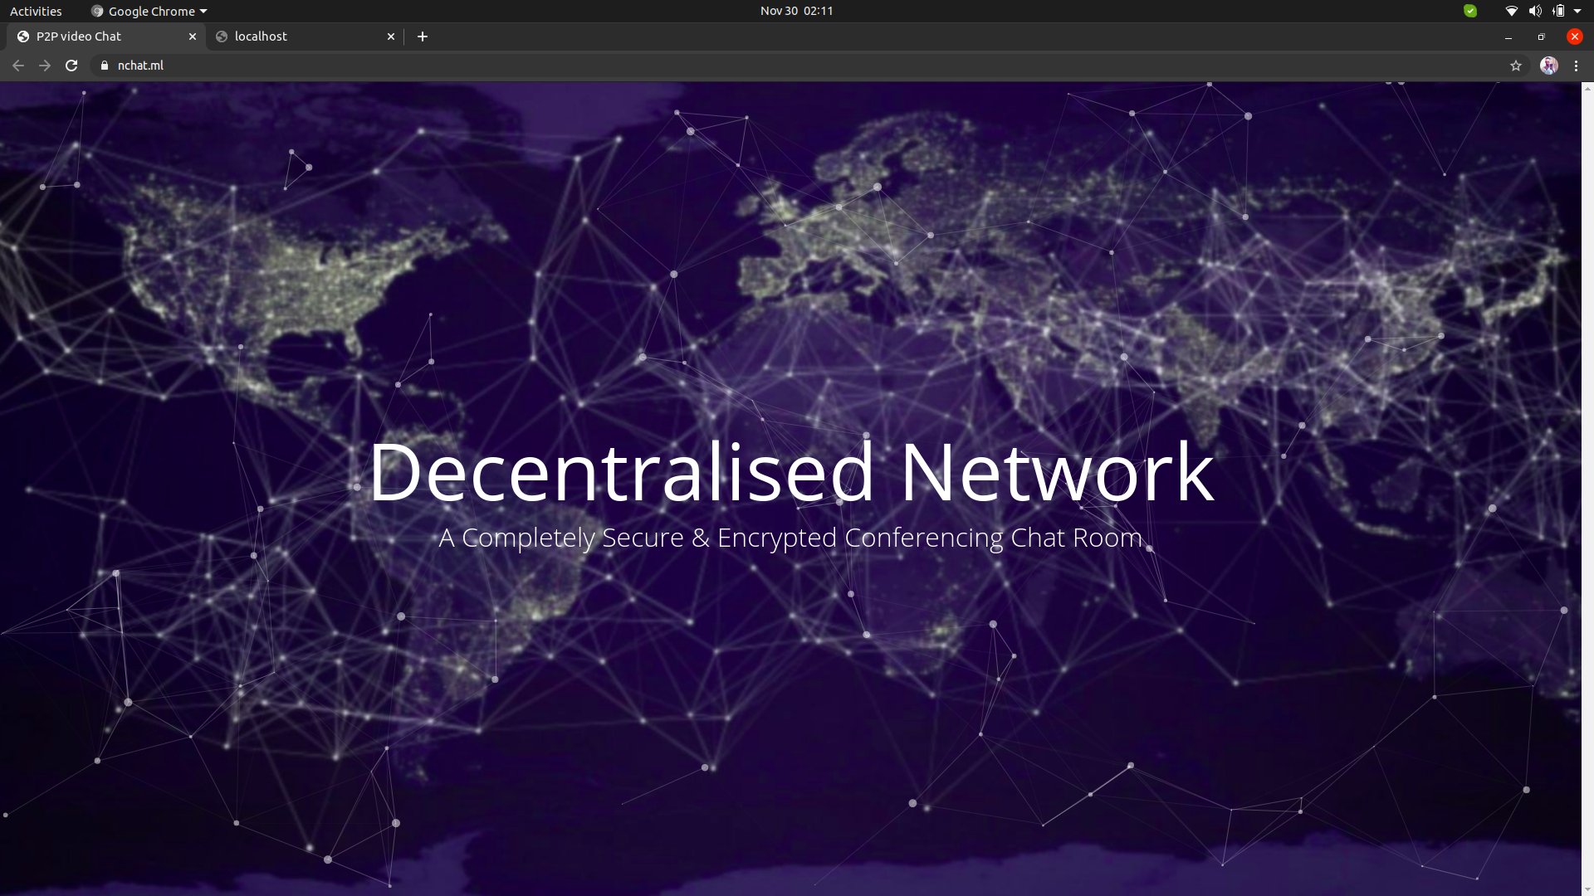
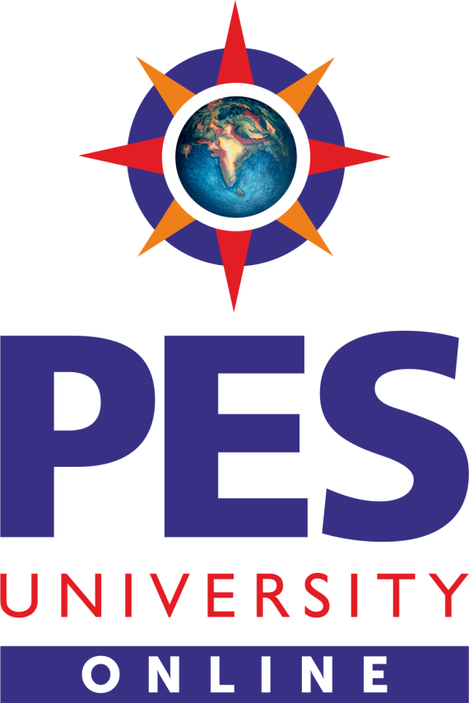
Developed by
Qazi Amaan (PES2201800285)
Nithin S (PES2201800654)

Slide 2

Project Abstract
Privacy is the driving force behind this project. It uses secure technologies like WebRTC , PeerJs , SocketIO to directly connect between participants. The website that provides the web app and mediates the communication stores as few data as possible (nearly negligible) and does not know anything about the contents of established conversations. No accounts are required. No cookies are used. No data is being saved!.
Our Conferencing Chat Room is completely decentralised and transfers your video directly to the peer you are talking to without the need of servers in the middle. This is done using PeerJs & Socket.io

Slide 3
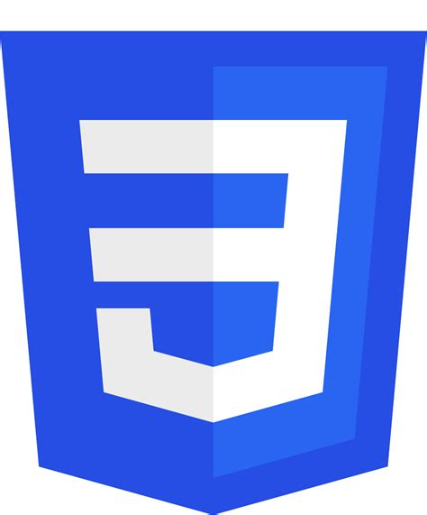


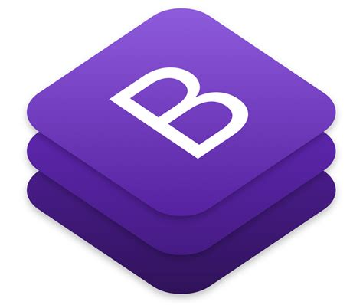
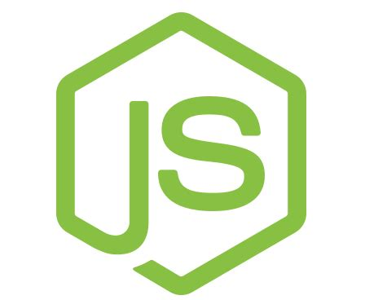

Technologies Used
Node Js
Express
Angular
Mongo DB
Socket IO
Peer Js
Bootstrap
Jquery
Css

Slide 4
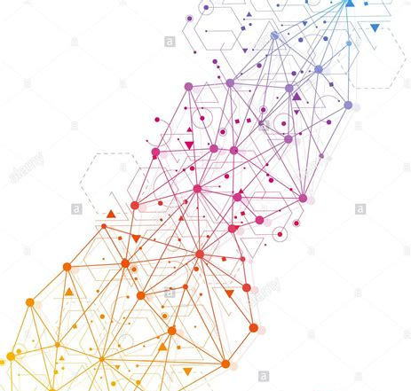
Member Contribution
Qazi Amaan
Node Js
Socket IO
Angular
Peer JS
Bootstrap
Nithin S
Node Js
Socket IO
Mogo Db
Peer JS
Bootstrap
* Above noted is the major contribution by the team members. Both of us have worked individually on all the technology stack we used

Slide 5
Project Links
N-Chat
A Fully Functional p2p Video Conferencing Chat App designed majorly on
Node Js
Mogo DB
No Angular Used
Website Link :
https://nchat.ml
Github :https://github.com/NithinSGowda/P2P-video-chat
Pandas
Video Conferencing Chat App with minor issues designed majorly on
Node Js
Angular
Socket.IO
Website Link :
https://aselpanda.ml
Github :
https://github.com/qazi9amaan/DecentralisedVIdeoConference
*Two variations exist as Angular doesn’t natively support peer programming, the second version isn’t suitable for production

