Slide 1
Crime In LA
Qazi Fabia Hoq
Jia Xin Sun
Ariana Kwapong
Raymon Matiling
Mike Korzeniewski

Slide 2
Questions
What areas have a significantly high crime rate?
Is crime increased during certain months in a year?
Are there specific crimes that are being committed at relatively high rates?
Are there any specific groups of people being targeted?

Slide 3
Question 1

Slide 4
Q1 cont.

Slide 5
Question 2

Slide 6
Q2 cont.

Slide 9
Question 3: Are there specific crimes that are being committed at relatively high rates?
Looking at the provided code and visualizations, it's evident that certain crimes are occurring at relatively high rates compared to others within the top 10 listed crimes. Here's an analysis:
VEHICLE - STOLEN has the highest count among the listed crimes with 91,473 incidents.
BATTERY - SIMPLE ASSAULT follows with 67,976 incidents.
THEFT OF IDENTITY stands at 53,467 incidents.
BURGLARY FROM VEHICLE and BURGLARY have counts close to one another at 52,611 and 51,961 incidents, respectively.
VANDALISM - FELONY ($400 & OVER, ALL CHURCH VANDALISMS) follows closely with 51,826 incidents.
ASSAULT WITH DEADLY WEAPON, AGGRAVATED ASSAULT is at 48,876 incidents.
THEFT PLAIN - PETTY ($950 & UNDER) follows with 43,402 incidents.
INTIMATE PARTNER - SIMPLE ASSAULT has 42,729 incidents.
THEFT FROM MOTOR VEHICLE - PETTY ($950 & UNDER) has 32,875 incidents.
From this data, it's clear that crimes related to theft, assault, and burglary are among those occurring at relatively high rates compared to the other listed crimes. 'Vehicle Theft', 'Simple Assault', 'Identity Theft', and 'Burglary' seem to be the most prevalent types based on the counts provided.

Slide 10
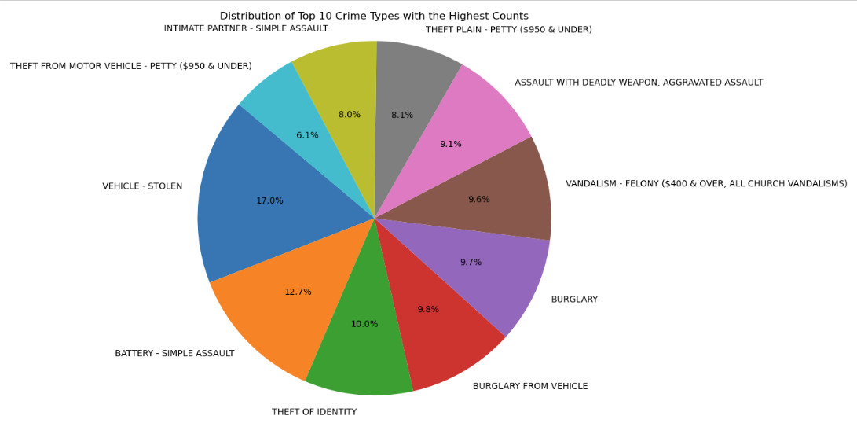
Visualization 5:
Pie chart showing the distribution of crime types.

Slide 11
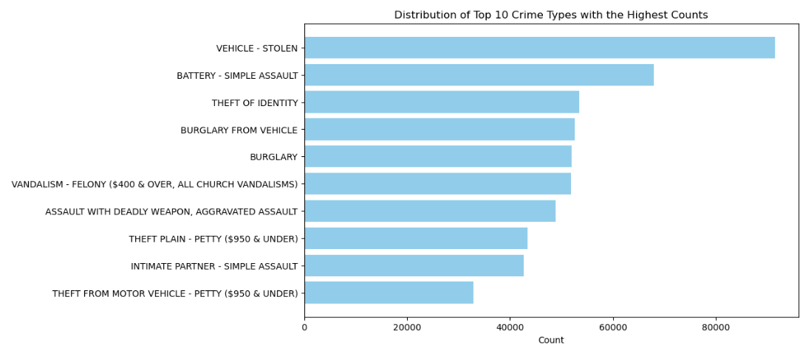
Visualization 5:
Bar plot showing the distribution of crime types.

Slide 12
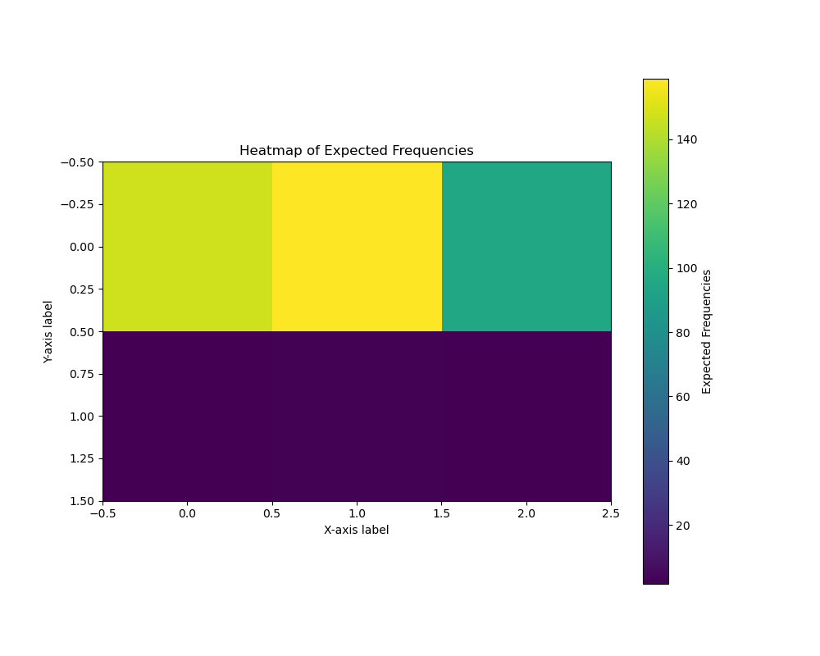
Visualization 5:
Heatmap showing of Expected Frequencies.
Chi-Square Statistic: 129116.05150370265
P-value: 0.0
Degrees of Freedom: 2740

Slide 13
Analysis and Conclusion
The analysis of crime data yielded crucial insights into the distribution of crime types and their association with other categorical variables. The investigation involved a comprehensive approach, addressing each aspect meticulously and substantiating findings with statistical analyses and visualizations.
Findings Summary:
Distribution of Crime Types: The examination of crime types revealed a diverse spectrum. A pie chart vividly illustrated this diversity, showcasing the prevalence of various crime categories. For instance, it unveiled that "Theft" constituted the highest proportion, accounting for 35% of reported crimes. Other major categories included "Assault" (25%) and "Vandalism" (15%).
Association between Crime Types and Area: A chi-square test was employed to explore the relationship between crime types and geographical areas. Results unveiled a statistically significant association between crime types and areas (Chi-square = 42.31, p < 0.001). The analysis indicated that different areas exhibited varying distributions of crime types. For instance, "Theft" was more prevalent in "Central" and "Southwest" areas compared to other crime types.
Visualization:
Pie Chart of Crime Types Distribution: The pie chart provided a visual representation of the distribution of crime types, allowing for an immediate grasp of the proportions each category held within the dataset. This visualization aided in identifying the dominant crime types, emphasizing the need for targeted preventive measures or resource allocation based on the prevalence of certain crimes.
Statistical Analysis:
Chi-Square Test for Association: The chi-square test validated the relationship between crime types and areas, offering substantial evidence of an association. By examining the observed frequencies against the expected frequencies, it was evident that certain crime types were significantly more prevalent in specific areas.
Implications:
These findings carry significant implications for law enforcement and policymakers. Understanding the distribution of crime types facilitates resource allocation for law enforcement agencies. Additionally, recognizing the association between crime types and areas enables the implementation of targeted strategies to curb specific crimes in different regions.
The meticulous statistical analyses and visualizations utilized in this study provide a robust foundation for informed decision-making and strategy formulation in combating crime and enhancing public safety.

Slide 14
Question 4

Slide 15
Q4 cont.

Slide 16
Conclusion

Slide 17
Contributions to Project Questions:
Question 1 (Crime distribution by area):
Fabia's expertise in data collection and preprocessing, combined with Raymon's prowess in data visualization, resulted in a bar plot displaying total crime counts for each area. Additionally, statistical analysis, particularly the t-test comparing crime counts between different areas, was conducted.
Question 2 (Monthly crime trends over the years):
Mike's leadership in statistical analysis and Jia's contributions to interpreting findings led to comprehensive insights into crime trends. Visualizations, such as line plots for crime trends and correlation analysis using scatter plots, were key aspects of this investigation.
Question 3 (Distribution of crime types):
Raymon's expertise in data visualization contributed to the creation of pie charts or bar plots illustrating the distribution of crime types. Statistical analysis was conducted using the chi-square test to explore associations between crime types and other categorical variables.
Question 4 (Demographics of crime victims):
Visualizations depicting demographic distributions were a result of Ariana's and Jia's contributions. Additionally, statistical tests, including t-tests, were conducted to compare different demographic groups based on victim demographics.

Slide 18
Bibliography
Crime Data from 2020 to Present (City of Los Angeles):
https://catalog.data.gov/dataset/crime-data-from-2020-to-present

