Slide 1
From Pixels to Patterns The Magic of
Convolutional Neural Networks
Dr. Muhammad Sajjad
R.A: Kaleem Ullah

Slide 2
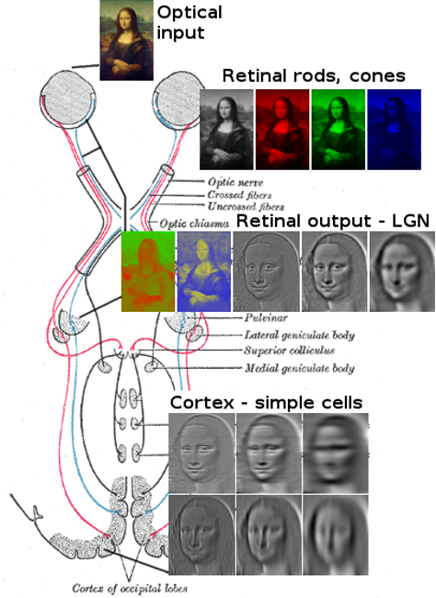
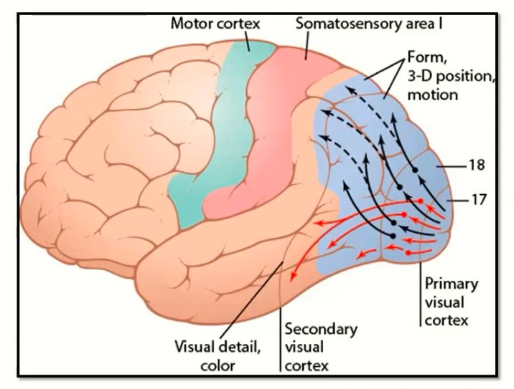
Our Brains are amazing at Vision
The visual cortex (located in the occipital lobe) is the primary cortical region of the brain that receives, integrates, and processes visual information relayed from the retinas

Slide 3
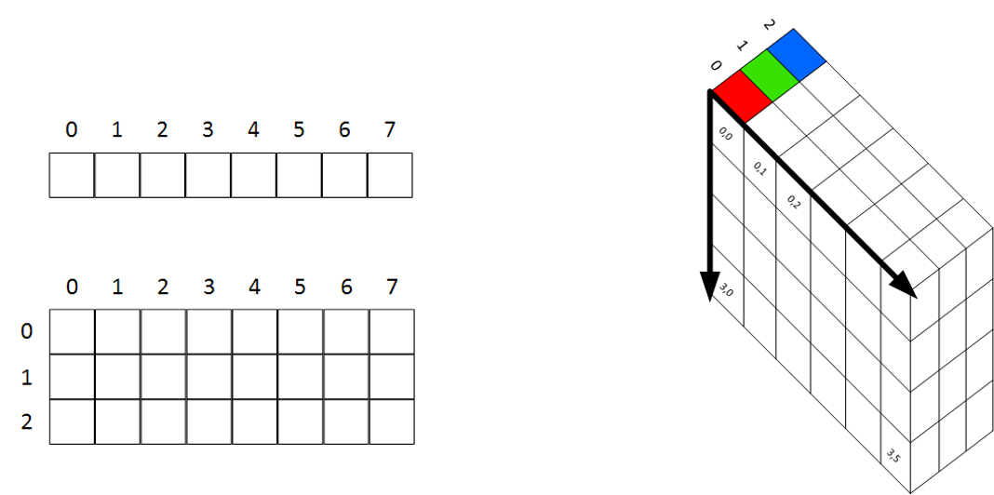
Digital Images Format
Images are stored in Multi-Dimensional Arrays
•
A 1-Dimensional array looks like this
•
A 2-Dimensional array looks like this
•
A 3-Dimensional array looks like this

Slide 4
Convolutional Neural Networks

Slide 5
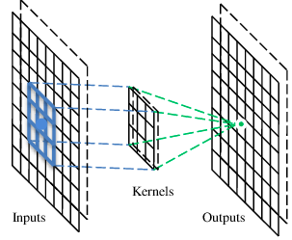
A convolutional layer
A CNN is a neural network with some convolutional layers
(and some other layers). A convolutional layer has a number
of filters that does convolutional operation.

Slide 6
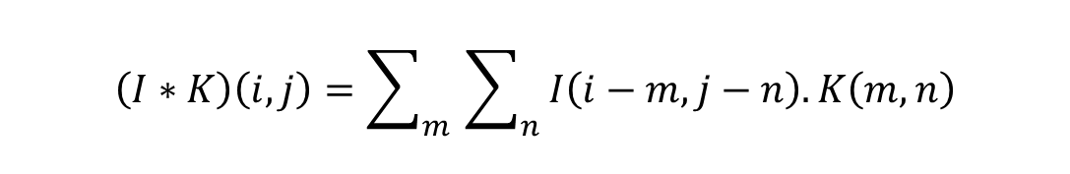
A convolutional layer
I is input Image
K kernel
m,n are filter indices
In CNNs, the convolution operation is the core building block
computing dot products between the filter and local regions of image
filter’s weights extracts features such as edges, textures or patterns.
$$\left(I∗K\right)\left(i,j\right)=\sum_{m}^{ }{ }\sum_{n}^{ }{ I\left(i−m,j−n\right). K\left(m, n\right)}$$

Slide 7
Example of a Convolution Operation
1 | 0 | 1 | 0 | 1
1 | 0 | 0 | 1 | 1
0 | 1 | 1 | 0 | 0
1 | 0 | 0 | 1 | 0
0 | 0 | 1 | 1 | 0
0 | 1 | 0
1 | 0 | -1
0 | 1 | 0
2 | 1 | -1
-1 | 1 | 3
2 | 1 | 1
*
=
Input Image
Filter or Kernel
Output or Feature Map

Slide 8
Example of a Convolution Operation
(1 × 0) + (0 × 1) + (1 × 0) + (1 × 1) + (0 × 0) + (0 × −1) + (0 × 0) + (1 × 1) + (1 × 0) = 2
 |  |  |  |  |  |  |  |  | 0 | 1
1x0 |  |  | 0x | 1 |  | 1x | 0
1x1 |  |  | 0x | 0 |  | 0x | -1 |  | 1 | 1
0x | 0 |  | 1x1 |  |  | 1x | 0 |  | 0 | 0
1 |  |  | 0 |  |  | 0 |  |  | 1 | 0
0 |  |  | 0 |  |  | 1 |  |  | 1 | 0
0 | 1 | 0
1 | 0 | -1
0 | 1 | 0
2
*
=
Input Image
Filter or Kernel
Output or Feature Map

Slide 9
Example of a Convolution Operation
(0 × 0) + (1 × 1) + (0 × 0) + (0 × 1) + (0 × 0) + (1 × −1) + (1 × 0) + (1 × 1) + (0 × 0) = 1
1 | 0x0 | 1x1 | 0x0 | 1
1 | 0x1 | 0x0 | 1x-1 | 1
0 | 1x0 | 1x1 | 0x0 | 0
1 | 0 | 0 | 1 | 0
0 | 0 | 1 | 1 | 0
0 | 1 | 0
1 | 0 | -1
0 | 1 | 0
2 | 1
*
=
Input Image
Filter or Kernel
Output or Feature Map

Slide 10
Example of a Convolution Operation
1 | 0 | 1 | 0 | 1
1 | 0 | 0 | 1 | 1
0 | 1 | 1 | 0 | 0
1 | 0 | 0 | 1 | 0
0 | 0 | 1 | 1 | 0
0 | 1 | 0
1 | 0 | -1
0 | 1 | 0
2 | 1 | -1
*
=
Input Image
Filter or Kernel
Output or Feature Map

Slide 11
Example of a Convolution Operation
1 | 0 | 1 | 0 | 1
1 | 0 | 0 | 1 | 1
0 | 1 | 1 | 0 | 0
1 | 0 | 0 | 1 | 0
0 | 0 | 1 | 1 | 0
0 | 1 | 0
1 | 0 | -1
0 | 1 | 0
2 | 1 | -1
-1
*
=
Input Image
Filter or Kernel
Output or Feature Map

Slide 12
Example of a Convolution Operation
1 | 0 | 1 | 0 | 1
1 | 0 | 0 | 1 | 1
0 | 1 | 1 | 0 | 0
1 | 0 | 0 | 1 | 0
0 | 0 | 1 | 1 | 0
0 | 1 | 0
1 | 0 | -1
0 | 1 | 0
2 | 1 | -1
-1 | 1
*
=
Input Image
Filter or Kernel
Output or Feature Map

Slide 13
Example of a Convolution Operation
1 | 0 | 1 | 0 | 1
1 | 0 | 0 | 1 | 1
0 | 1 | 1 | 0 | 0
1 | 0 | 0 | 1 | 0
0 | 0 | 1 | 1 | 0
0 | 1 | 0
1 | 0 | -1
0 | 1 | 0
2 | 1 | -1
-1 | 1 | 3
*
=
Input Image
Filter or Kernel
Output or Feature Map

Slide 14
Example of a Convolution Operation
1 | 0 | 1 | 0 | 1
1 | 0 | 0 | 1 | 1
0 | 1 | 1 | 0 | 0
1 | 0 | 0 | 1 | 0
0 | 0 | 1 | 1 | 0
0 | 1 | 0
1 | 0 | -1
0 | 1 | 0
2 | 1 | -1
-1 | 1 | 3
2
*
=
Input Image
Filter or Kernel
Output or Feature Map

Slide 15
Example of a Convolution Operation
1 | 0 | 1 | 0 | 1
1 | 0 | 0 | 1 | 1
0 | 1 | 1 | 0 | 0
1 | 0 | 0 | 1 | 0
0 | 0 | 1 | 1 | 0
0 | 1 | 0
1 | 0 | -1
0 | 1 | 0
2 | 1 | -1
-1 | 1 | 3
2 | 1
*
=
Input Image
Filter or Kernel
Output or Feature Map

Slide 16
Example of a Convolution Operation
1 | 0 | 1 | 0 | 1
1 | 0 | 0 | 1 | 1
0 | 1 | 1 | 0 | 0
1 | 0 | 0 | 1 | 0
0 | 0 | 1 | 1 | 0
0 | 1 | 0
1 | 0 | -1
0 | 1 | 0
2 | 1 | -1
-1 | 1 | 3
2 | 1 | 1
*
=
Input Image
Filter or Kernel
Output or Feature Map

Slide 17
Convolution Operations on Color Images
Color image: RGB 3 channels
1 | -1 | -1
-1 | 1 | -1
-1 | -1 | 1
-1 | 1 | -1
-1 | 1 | -1
-1 | 1 | -1
1 | -1 | -1
-1 | 1 | -1
-1 | -1 | 1
-1 | 1 | -1
-1 | 1 | -1
-1 | 1 | -1
1 | -1 | -1
-1 | 1 | -1
-1 | -1 | 1
-1 | 1 | -1
-1 | 1 | -1
-1 | 1 | -1
Sum all the numbers to get the Feature Map Output
Filter 1
Filter 2
1
1
0
0
0
1
1
0
0
0
1
1
1
0
0
0
1
0
0
0
1
0 -
1
3 | 3 | 0
3 | 3 | 0
3 | 3 | 0
0
-1
1
1
0
0
0
1 | 0 | 0 | 0 | 0 | 1
0 | 1 | 0 | 0 | 1 | 0
0 | 0 | 1 | 1 | 0 | 0
1 | 0 | 0 | 0 | 1 | 0
0 | 1 | 0 | 0 | 1 | 0
0 | 0 | 1 | 0 | 1 | 0
1
1
0
0
0
1
1 | 0 | 0 | 0 | 0 | 1
0 | 1 | 0 | 0 | 1 | 0
0 | 0 | 1 | 1 | 0 | 0
1 | 0 | 0 | 0 | 1 | 0
0 | 1 | 0 | 0 | 1 | 0
0 | 0 | 1 | 0 | 1 | 0
1
1
0
0
0
1
1
0
-1
*
0 -
1
=
1 | 0 | 0 | 0 | 0 | 1
0 | 1 | 0 | 0 | 1 | 0
0 | 0 | 1 | 1 | 0 | 0
1 | 0 | 0 | 0 | 1 | 0
0 | 1 | 0 | 0 | 1 | 0
0 | 0 | 1 | 0 | 1 | 0
1
1
0
0
0
1
0
-
1
1
1
0
0
0
1
1 0
-1
1
1
0
0
0
0 -
1
1
1
0
0
0
1
0
-
1
1
1
1
0
0
0
1
0
0
0
1
0
-1
1
1
0
0
0
1
1
0
0
0
Input Image
Filter or Kernel
Output or Feature Map

Slide 18
Advantages of Having a Filter For Each Colour
1
1
0
0
0
1
1
0
0
0
1
1
1
0
0
0
1
0
0
0
1
0 -
1
3 | 3 | 0
3 | 3 | 0
3 | 3 | 0
1
1
0
0
0
1
0
-1
1
1
0
0
0
1
1
0
-1
1
1
0
0
0
*
0 -
1
=
1
1
0
0
0
1
0
-
1
1
1
0
0
0
1
1 0
-1
1
1
0
0
0
0 -
1
1
1
0
0
0
1
0
-
1
1
1
1
0
0
0
1
0
0
0
1
0
-1
1
1
0
0
0
1
1
0
0
0
Input Image
Filter or Kernel
Output or Feature Map
We can detect features that are specific to a colour

Slide 19
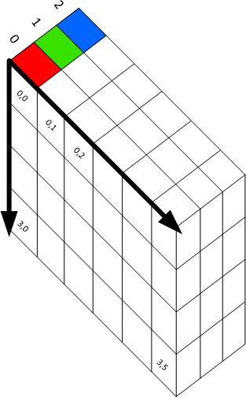
Considered 3D Volumes
3 | 3 | 0
3 | 3 | 0
3 | 3 | 0
*
=
Input Image 5 x 5 x 3
Filter or Kernel 3 x 3 x 3
Output or Feature Map 3 x 3

Slide 20
How Multiple Filters Affect Our Output
 | 3 |  | 3 |  | 0
 | 3 |  | 3 |  | 0
 | 3 |  | 3 |  | 0
3
3
0
*
=
3
3
0
3
3
0
Input Image 5 x 5 x 3
2 Filters or Kernels
3 x 3 x 3 x 2
Output or Feature Map 3 x 3 x 2

Slide 21
Calculating Output Size for 3D Conv Volumes
(n × n × n_{c}) * ( f × f × n_{c}) = (n − f + 1) × (n − f + 1) × n_{f}
(5 × 5 × 3) * (3 × 3 × 3) = 3 × 3 × 2
 | 3 |  | 3 |  | 0
 | 3 |  | 3 |  | 0
 | 3 |  | 3 |  | 0
3
3
0
*
=
3
3
0
3
3
0
Input Image 5 x 5 x 3
2 Filters or Kernels
3 x 3 x 3 x 2
Output or Feature Map 3 x 3 x 2

Slide 22
Consecutive Conv layers would keep shrinking the output
Can we preserve our image size?
We’ve added a 1 pixel pad of zeros (zero padding) around our input
0 | 0 | 0 | 0 | 0 | 0 | 0
0 | 1 | 0 | 1 | 0 | 1 | 0
0 | 1 | 0 | 0 | 1 | 1 | 0
0 | 0 | 1 | 1 | 0 | 0 | 0
0 | 1 | 0 | 0 | 1 | 0 | 0
0 | 0 | 0 | 1 | 1 | 0 | 0
0 | 0 | 0 | 0 | 0 | 0 | 0
0 | 1 | 0
1 | 0 | -1
0 | 1 | 0
*
=
7 x 7
n × n
3 x 3
f × f

Slide 23
Padding
Let’s Perform our Convolution with the Padding
0 | 0 | 0 | 0 | 0 | 0 | 0
0 | 1 | 0 | 1 | 0 | 1 | 0
0 | 1 | 0 | 0 | 1 | 1 | 0
0 | 0 | 1 | 1 | 0 | 0 | 0
0 | 1 | 0 | 0 | 1 | 0 | 0
0 | 0 | 0 | 1 | 1 | 0 | 0
0 | 0 | 0 | 0 | 0 | 0 | 0
0 | 1 | 0
1 | 0 | -1
0 | 1 | 0
*
=
7 x 7
n × n
3 x 3
f × f

Slide 24
Padding
Let’s Perform our Convolution with the Padding
0 | 0 | 0 | 0 | 0 | 0 | 0
0 | 1 | 0 | 1 | 0 | 1 | 0
0 | 1 | 0 | 0 | 1 | 1 | 0
0 | 0 | 1 | 1 | 0 | 0 | 0
0 | 1 | 0 | 0 | 1 | 0 | 0
0 | 0 | 0 | 1 | 1 | 0 | 0
0 | 0 | 0 | 0 | 0 | 0 | 0
0 | 1 | 0
1 | 0 | -1
0 | 1 | 0
*
=
7 x 7
n × n
3 x 3
f × f

Slide 25
Padding
Let’s Perform our Convolution with the Padding
0 | 0 | 0 | 0 | 0 | 0 | 0
0 | 1 | 0 | 1 | 0 | 1 | 0
0 | 1 | 0 | 0 | 1 | 1 | 0
0 | 0 | 1 | 1 | 0 | 0 | 0
0 | 1 | 0 | 0 | 1 | 0 | 0
0 | 0 | 0 | 1 | 1 | 0 | 0
0 | 0 | 0 | 0 | 0 | 0 | 0
0 | 1 | 0
1 | 0 | -1
0 | 1 | 0
*
=
7 x 7
n × n
3 x 3
f × f

Slide 26
Padding
Let’s Perform our Convolution with the Padding
0 | 0 | 0 | 0 | 0 | 0 | 0
0 | 1 | 0 | 1 | 0 | 1 | 0
0 | 1 | 0 | 0 | 1 | 1 | 0
0 | 0 | 1 | 1 | 0 | 0 | 0
0 | 1 | 0 | 0 | 1 | 0 | 0
0 | 0 | 0 | 1 | 1 | 0 | 0
0 | 0 | 0 | 0 | 0 | 0 | 0
0 | 1 | 0
1 | 0 | -1
0 | 1 | 0
*
=
7 x 7
n × n
3 x 3
f × f

Slide 27
Padding
Let’s Perform our Convolution with the Padding
0 | 0 | 0 | 0 | 0 | 0 | 0
0 | 1 | 0 | 1 | 0 | 1 | 0
0 | 1 | 0 | 0 | 1 | 1 | 0
0 | 0 | 1 | 1 | 0 | 0 | 0
0 | 1 | 0 | 0 | 1 | 0 | 0
0 | 0 | 0 | 1 | 1 | 0 | 0
0 | 0 | 0 | 0 | 0 | 0 | 0
0 | 1 | 0
1 | 0 | -1
0 | 1 | 0
*
=
7 x 7
n × n
3 x 3
f × f

Slide 28
Padding
Let’s Perform our Convolution with the Padding
0 | 0 | 0 | 0 | 0 | 0 | 0
0 | 1 | 0 | 1 | 0 | 1 | 0
0 | 1 | 0 | 0 | 1 | 1 | 0
0 | 0 | 1 | 1 | 0 | 0 | 0
0 | 1 | 0 | 0 | 1 | 0 | 0
0 | 0 | 0 | 1 | 1 | 0 | 0
0 | 0 | 0 | 0 | 0 | 0 | 0
0 | 1 | 0
1 | 0 | -1
0 | 1 | 0
*
=
7 x 7
n × n
3 x 3
f × f

Slide 29
Padding
Let’s Perform our Convolution with the Padding
Feature Map Size = Feature Map Size =
n − f + 1 = m
7 − 3 + 1 = 5
0 | 0 | 0 | 0 | 0 | 0 | 0
0 | 1 | 0 | 1 | 0 | 1 | 0
0 | 1 | 0 | 0 | 1 | 1 | 0
0 | 0 | 1 | 1 | 0 | 0 | 0
0 | 1 | 0 | 0 | 1 | 0 | 0
0 | 0 | 0 | 1 | 1 | 0 | 0
0 | 0 | 0 | 0 | 0 | 0 | 0
0 | 1 | 0
1 | 0 | -1
0 | 1 | 0
2 | 1 | -1 | 2 | 2
-1 | 1 | 3 | 2 | 1
2 | 1 | 1 | 1 | 2
1 | 1 | 1 | 0 | 2
2 | 0 | 2 | 3 | 1
*
=
7 x 7
n × n
3 x 3
f × f
5 x 5
m × m

Slide 30
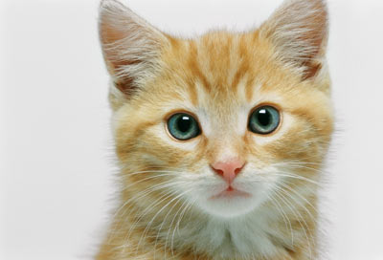
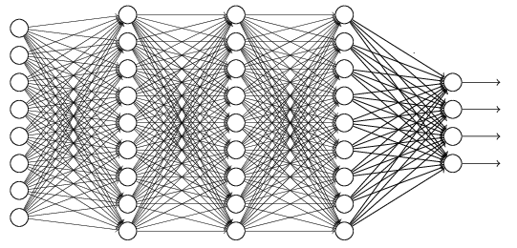
The whole CNN
cat dog ……
Convolution
Max Pooling
Can repeat many times
Fully Connected Feedforward network
Convolution
Max Pooling
Flattened

Slide 31
Example of Max Pooling
Stride = 2 Kernel = 2x2
MaxPool Operation
4 | 123 | 1 | 34
56 | 99 | 222 | 253
45 | 122 | 165 | 12
21 | 187 | 133 | 124
123 | 167
187 | 165

Slide 32
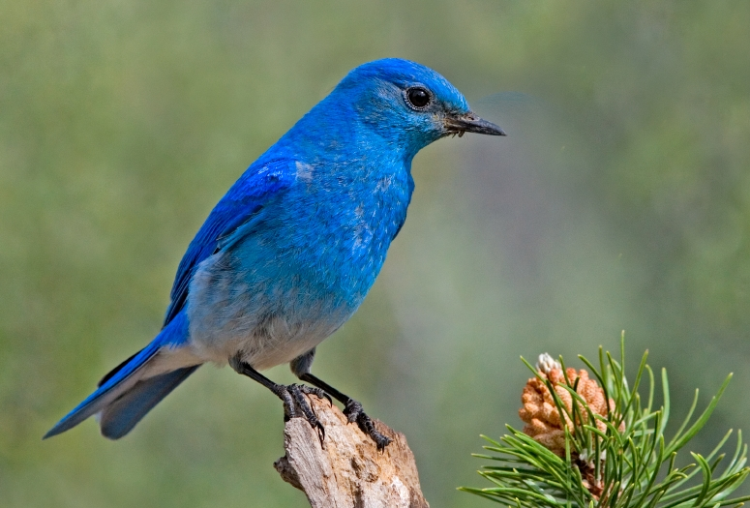

Why Pooling
Subsampling pixels will not change the object
bird
bird
Subsampling
We can subsample the pixels to make image smaller
fewer parameters to characterize the image

Slide 33
What a Stride of 1 Looks Like
1 | 0 | 1 | 0 | 1
1 | 0 | 0 | 1 | 1
0 | 1 | 1 | 0 | 0
1 | 0 | 0 | 1 | 0
0 | 0 | 1 | 1 | 0
0 | 1 | 0
1 | 0 | -1
0 | 1 | 0
2
*
=
Input Image
Filter or Kernel
Output or Feature Map

Slide 34
What a Stride of 1 Looks Like
1 | 0 | 1 | 0 | 1
1 | 0 | 0 | 1 | 1
0 | 1 | 1 | 0 | 0
1 | 0 | 0 | 1 | 0
0 | 0 | 1 | 1 | 0
0 | 1 | 0
1 | 0 | -1
0 | 1 | 0
2 | 1
*
=
Input Image
Filter or Kernel
Output or Feature Map

Slide 35
What a Stride of 1 Looks Like
1 | 0 | 1 | 0 | 1
1 | 0 | 0 | 1 | 1
0 | 1 | 1 | 0 | 0
1 | 0 | 0 | 1 | 0
0 | 0 | 1 | 1 | 0
0 | 1 | 0
1 | 0 | -1
0 | 1 | 0
2 | 1 | -1
*
=
Input Image
Filter or Kernel
Output or Feature Map

Slide 36
What a Stride of 1 Looks Like
1 | 0 | 1 | 0 | 1
1 | 0 | 0 | 1 | 1
0 | 1 | 1 | 0 | 0
1 | 0 | 0 | 1 | 0
0 | 0 | 1 | 1 | 0
0 | 1 | 0
1 | 0 | -1
0 | 1 | 0
2 | 1 | -1
-1
*
=
Input Image
Filter or Kernel
Output or Feature Map

Slide 37
What a Stride of 1 Looks Like
1 | 0 | 1 | 0 | 1
1 | 0 | 0 | 1 | 1
0 | 1 | 1 | 0 | 0
1 | 0 | 0 | 1 | 0
0 | 0 | 1 | 1 | 0
0 | 1 | 0
1 | 0 | -1
0 | 1 | 0
2 | 1 | -1
-1 | 1
*
=
Input Image
Filter or Kernel
Output or Feature Map

Slide 38
What a Stride of 1 Looks Like
1 | 0 | 1 | 0 | 1
1 | 0 | 0 | 1 | 1
0 | 1 | 1 | 0 | 0
1 | 0 | 0 | 1 | 0
0 | 0 | 1 | 1 | 0
0 | 1 | 0
1 | 0 | -1
0 | 1 | 0
2 | 1 | -1
-1 | 1 | 3
*
=
Input Image
Filter or Kernel
Output or Feature Map

Slide 39
What a Stride of 1 Looks Like
1 | 0 | 1 | 0 | 1
1 | 0 | 0 | 1 | 1
0 | 1 | 1 | 0 | 0
1 | 0 | 0 | 1 | 0
0 | 0 | 1 | 1 | 0
0 | 1 | 0
1 | 0 | -1
0 | 1 | 0
2 | 1 | -1
-1 | 1 | 3
2
*
=
Input Image
Filter or Kernel
Output or Feature Map

Slide 40
What a Stride of 1 Looks Like
1 | 0 | 1 | 0 | 1
1 | 0 | 0 | 1 | 1
0 | 1 | 1 | 0 | 0
1 | 0 | 0 | 1 | 0
0 | 0 | 1 | 1 | 0
0 | 1 | 0
1 | 0 | -1
0 | 1 | 0
2 | 1 | -1
-1 | 1 | 3
2 | 1
*
=
Input Image
Filter or Kernel
Output or Feature Map

Slide 41
What a Stride of 1 Looks Like
1 | 0 | 1 | 0 | 1
1 | 0 | 0 | 1 | 1
0 | 1 | 1 | 0 | 0
1 | 0 | 0 | 1 | 0
0 | 0 | 1 | 1 | 0
0 | 1 | 0
1 | 0 | -1
0 | 1 | 0
2 | 1 | -1
-1 | 1 | 3
2 | 1 | 1
*
=
Input Image
Filter or Kernel
Output or Feature Map

Slide 42
What about a Stride of 2?

Slide 43
What a Stride of 2 Looks Like
We start off in the same position
1 | 0 | 1 | 0 | 1
1 | 0 | 0 | 1 | 1
0 | 1 | 1 | 0 | 0
1 | 0 | 0 | 1 | 0
0 | 0 | 1 | 1 | 0
0 | 1 | 0
1 | 0 | -1
0 | 1 | 0
2
*
=
Input Image
Filter or Kernel
Output or Feature Map

Slide 44
What a Stride of 2 Looks Like
Now we jump two spots to the left
1 | 0 | 1 | 0 | 1
1 | 0 | 0 | 1 | 1
0 | 1 | 1 | 0 | 0
1 | 0 | 0 | 1 | 0
0 | 0 | 1 | 1 | 0
0 | 1 | 0
1 | 0 | -1
0 | 1 | 0
2 | -1
*
=
Input Image
Filter or Kernel
Output or Feature Map

Slide 45
What a Stride of 2 Looks Like
Now we go down, but by also 2 spots
1 | 0 | 1 | 0 | 1
1 | 0 | 0 | 1 | 1
0 | 1 | 1 | 0 | 0
1 | 0 | 0 | 1 | 0
0 | 0 | 1 | 1 | 0
0 | 1 | 0
1 | 0 | -1
0 | 1 | 0
2 | -1
2
*
=
Input Image
Filter or Kernel
Output or Feature Map

Slide 46
What a Stride of 2 Looks Like
Now we jump two spots to the left
1 | 0 | 1 | 0 | 1
1 | 0 | 0 | 1 | 1
0 | 1 | 1 | 0 | 0
1 | 0 | 0 | 1 | 0
0 | 0 | 1 | 1 | 0
0 | 1 | 0
1 | 0 | -1
0 | 1 | 0
2 | -1
2 | 1
*
=
Input Image
Filter or Kernel
Output or Feature Map

Slide 47
Stride Observations
A larger Stride produced a smaller Feature Map output
Larger Stride has less overlap
We can use stride to control the size of the Feature Map output

Slide 48
Calculating Output Size
Using Stride and Padding
Stride = 2
Padding = 0
1 | 0 | 1 | 0 | 1
1 | 0 | 0 | 1 | 1
0 | 1 | 1 | 0 | 0
1 | 0 | 0 | 1 | 0
0 | 0 | 1 | 1 | 0
0 | 1 | 0
1 | 0 | -1
0 | 1 | 0
2 | -1
2 | 1
*
=
Input Image 5 x 5
Filter or Kernel 3 x 3
n + 2p − f
n + 2p − f
5 + (2 × 0) − 3
5 + (2 × 0) − 3
(n × n) * ( f × f ) = (
+ 1) × (
+ 1) = (
+ 1) × (
+ 1) = 2 × 2
s
s
2
2

Slide 49
Calculating Output Size
Using Stride and Padding
Stride = 1
Padding = 0
1 | 0 | 1 | 0 | 1
1 | 0 | 0 | 1 | 1
0 | 1 | 1 | 0 | 0
1 | 0 | 0 | 1 | 0
0 | 0 | 1 | 1 | 0
0 | 1 | 0
1 | 0 | -1
0 | 1 | 0
2 | -1 | 1
2 | 1 | 0
1 | -1 | 1
*
=
Input Image 5 x 5
Filter or Kernel 3 x 3
n + 2p − f
n + 2p − f
5 + (2 × 0) − 3
5 + (2 × 0) − 3
(n × n) * ( f × f ) = (
+ 1) × (
+ 1) = (
+ 1) × (
+ 1) = 3 × 3
s
s
1
1

Slide 50
Calculating Output Size
When using Stride & Padding
Stride = 1
Padding = 1
0 | 0 | 0 | 0 | 0 | 0 | 0
0 | 1 | 0 | 1 | 0 | 1 | 0
0 | 1 | 0 | 0 | 1 | 1 | 0
0 | 0 | 1 | 1 | 0 | 0 | 0
0 | 1 | 0 | 0 | 1 | 0 | 0
0 | 0 | 0 | 1 | 1 | 0 | 0
0 | 0 | 0 | 0 | 0 | 0 | 0
0 | 1 | 0
1 | 0 | -1
0 | 1 | 0
2 | -1 | 1 | 1 | 0
2 | 1 | 0 | 1 | 2
1 | -1 | 1 | 0 | 1
0 | 1 | 2 | 1 | 1
2 | 0 | 1 | 0 | 2
*
=
Input Image 7 x 7
Filter or Kernel 3 x 3
n + 2p − f
n + 2p − f
5 + (2 × 1) − 3
5 + (2 × 1) − 3
(n × n) * ( f × f ) = (
+ 1) × (
+ 1) = (
+ 1) × (
+ 1) = 5 × 5
s
s
1
1
Note if we get non integer value for our output size, we found it down to the nearest integer

Slide 51
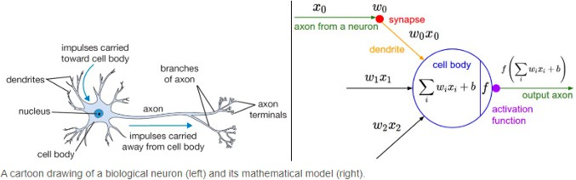
Purpose of Activation Functions
To enable the learning of complex patterns in our data
Biological neurons fire (activate) on certain inputs, these are then fed into other neurons
Introduces non-linearity to our network
This allows a non-linear decision boundary via non-linear combinations of the weight and inputs
Stanford’s CS231 Course

Slide 52
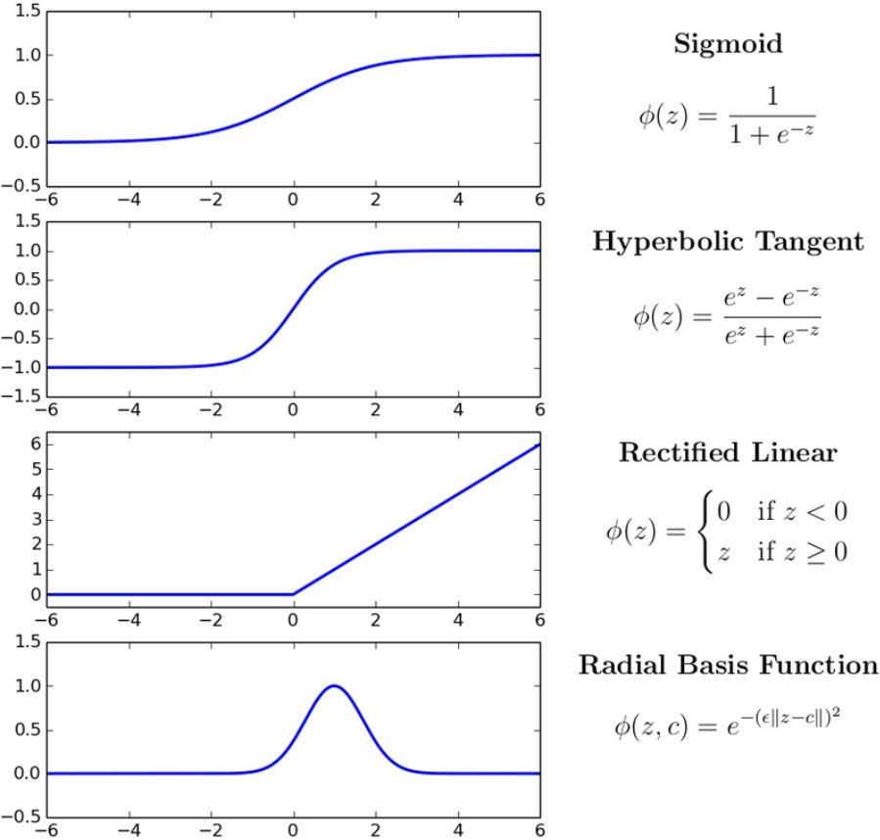
Types of Activation Functions
There are several activation functions we can use in our CNN. However, Rectified Linear Units (ReLU) have become the activation function of choice for CNNs.
ReLU is advantageous in CNN Training:
Simple Computation (fast to train)
Does not saturate

Slide 53
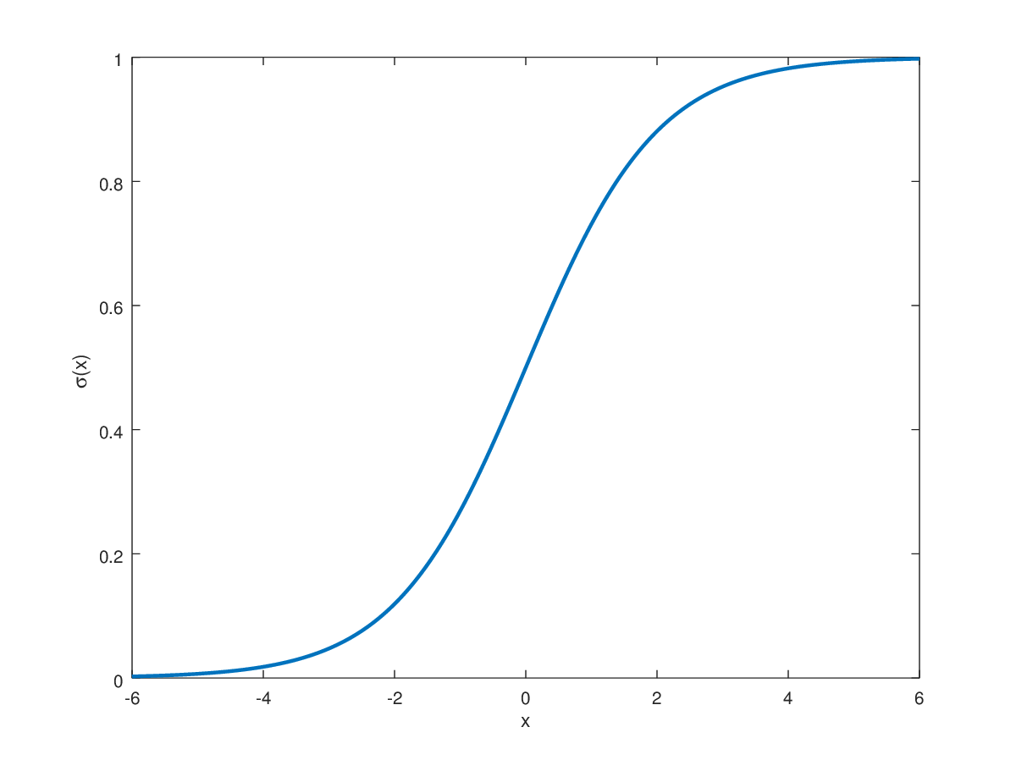
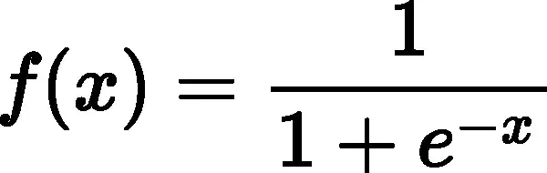
Sigmoid Function (Logistic)
Explanation: The sigmoid function squashes the input values between 0 and 1, making it useful in binary classification problems where we need to produce probabilities.
Formula:
Usage: Commonly used in the output layer for binary classification tasks, where it transforms the network's raw output into probabilities.

Slide 54
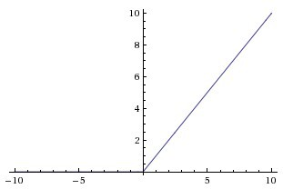
The ReLU Operation
Change all negative values to 0
Leave all positive Values alone
f(x) = max(0,x)

Slide 55
Applying the ReLU Activation
1 | 0 | 1 | 0 | 1
1 | 0 | 0 | 1 | 1
0 | 1 | 1 | 0 | 0
1 | 0 | 0 | 1 | 0
0 | 0 | 1 | 1 | 0
ReLU
0 | 1 | 0
1 | 0 | -1
0 | 1 | 0
2 | 1 | -1
-1 | 1 | 3
2 | 1 | -5
2 | 1 | 0
0 | 1 | 3
2 | 1 | 0
*
=
Input Image
Filter or Kernel
Output or Feature Map

Slide 56

Applying the ReLU Activation
One Layer
1 | 0 | 1 | 0 | 1
1 | 0 | 0 | 1 | 1
0 | 1 | 1 | 0 | 0
1 | 0 | 0 | 1 | 0
0 | 0 | 1 | 1 | 0
ReLU
0 | 1 | 0
1 | 0 | -1
0 | 1 | 0
2 | 1 | -1
-1 | 1 | 3
2 | 1 | -5
2 | 1 | 0
0 | 1 | 3
2 | 1 | 0
*
=
Input Image
Filter or Kernel
Output or Feature Map
Rectified Feature Map

Slide 57
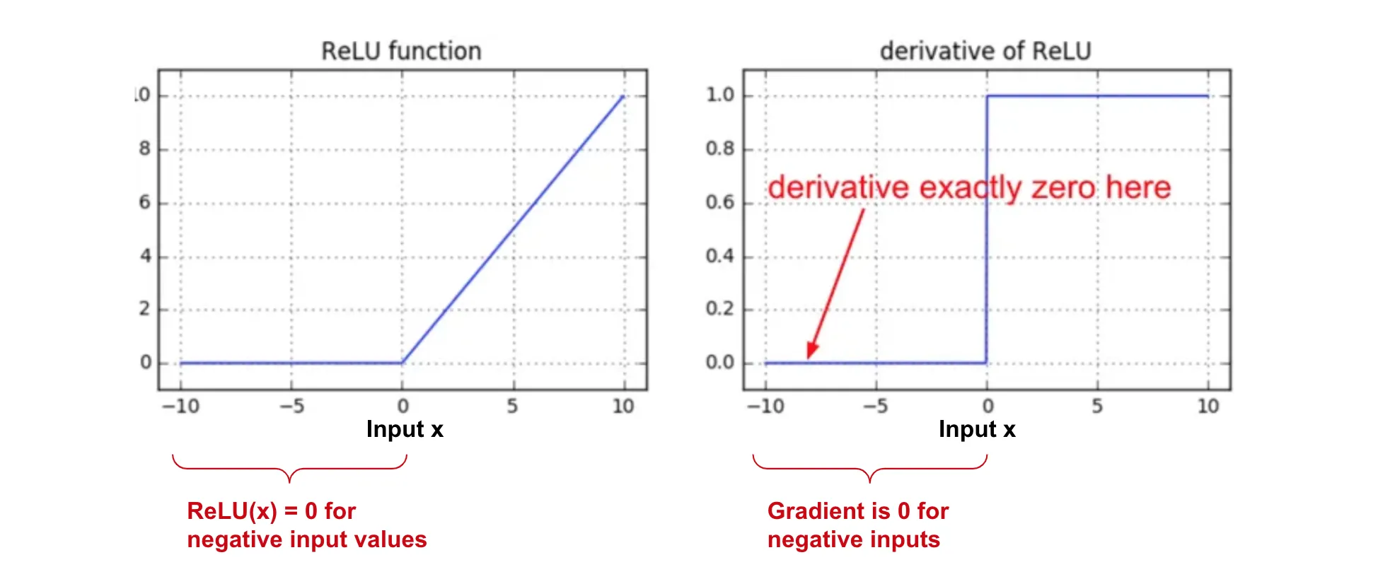
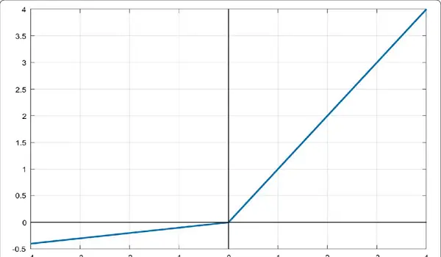
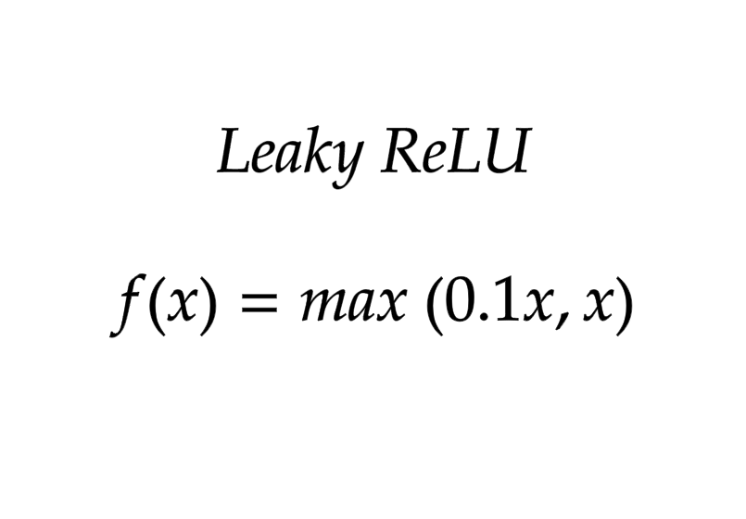
Leaky ReLU
Solution
Dying ReLU → neurons using the ReLU activation function become inactive during training and never recover.
Leaky ReLU is similar to ReLU but has a small slope for negative inputs, which helps mitigate the "dying ReLU" problem.
Formula:
Usage: Leaky ReLU addresses the "dying ReLU" problem by allowing a small gradient for negative inputs, which can be beneficial in training deep networks.
Dying ReLU

Slide 58
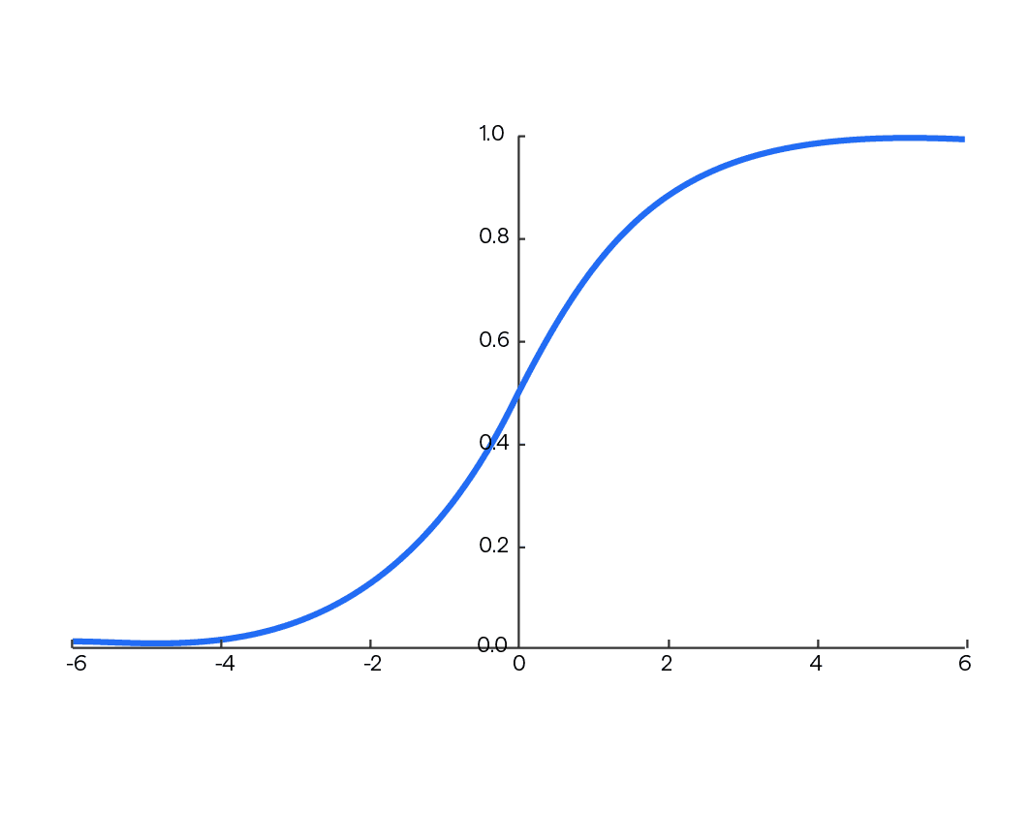
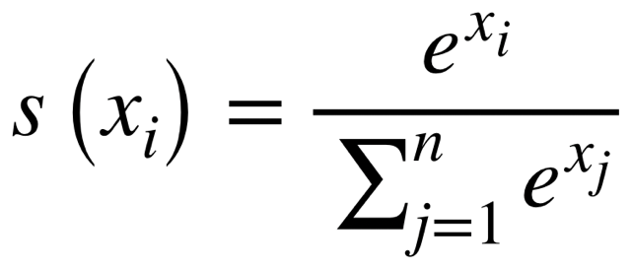
Softmax Function
Explanation: The softmax function is commonly used in the output layer of neural networks for multi-class classification problems. It converts raw scores (logits) into probabilities, ensuring that the sum of the probabilities for all classes is equal to 1.
Formula:
Usage: Softmax transforms the final layer activations into a probability distribution, allowing the model to make predictions about the likelihood of each class.

Slide 59
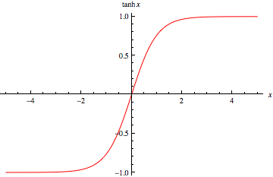
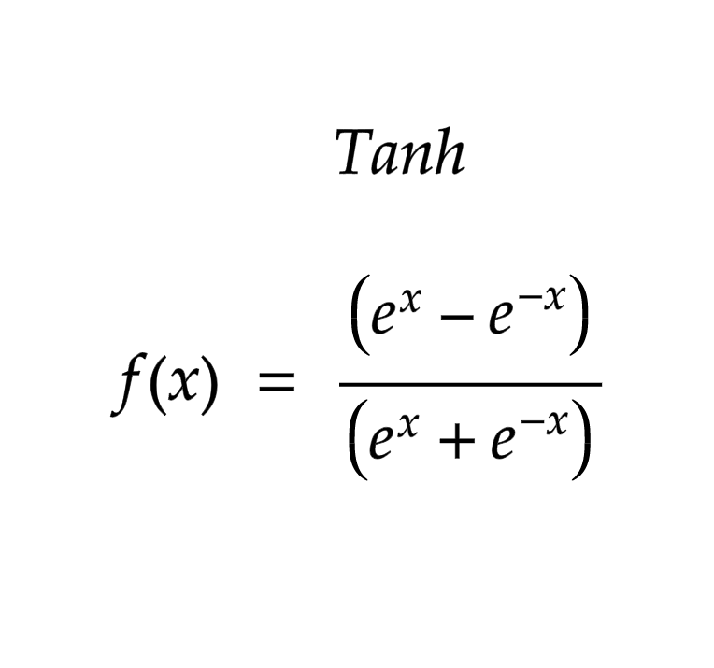
Hyperbolic Tangent Function (Tanh)
Explanation: Tanh function squashes the input values between -1 and 1, which can be useful for normalization and also in classification tasks.
Formula:
Usage: Similar to other activations function, tanh is used in the hidden layers of neural networks. Specifically useful in GANs and GenAI.

Slide 60
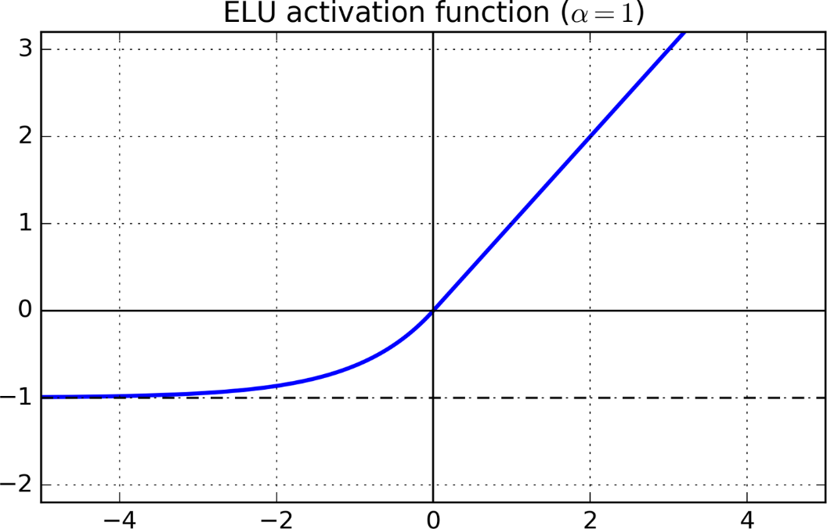
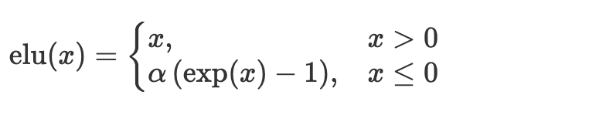
Exponential Linear Unit (ELU)
Explanation: ELU is similar to ReLU for positive inputs but allows negative values with a smooth curve, aiming to address some limitations of ReLU.
Formula
Usage: ELU mitigates the limitations of ReLU by handling negative inputs with a smooth curve, which can improve the robustness of deep networks.
Curve

Slide 61
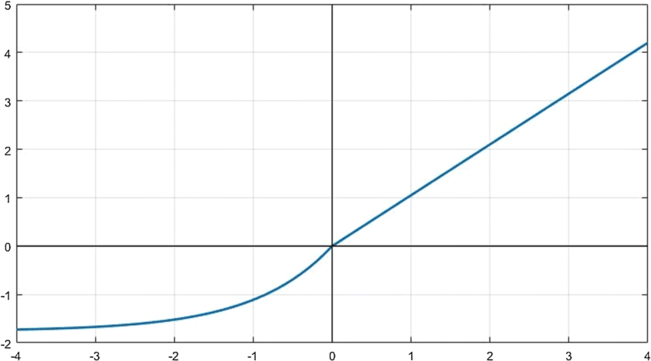
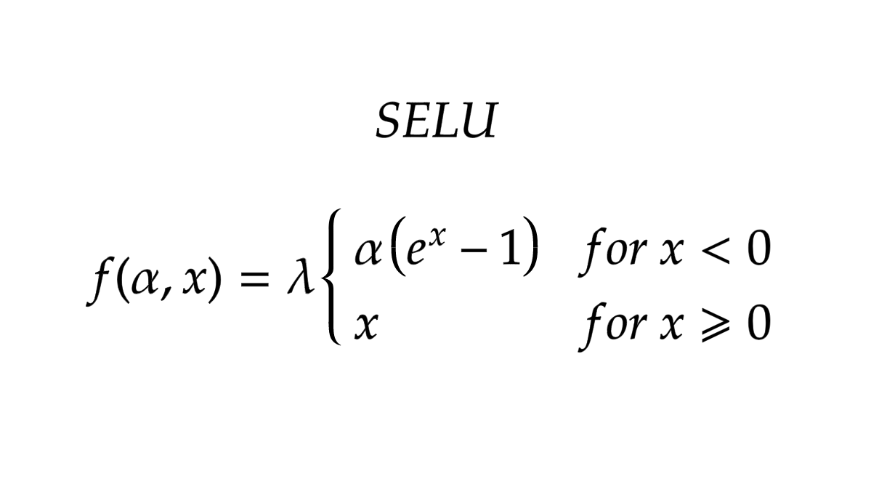
Scaled Exponential Linear Unit (SELU)
Explanation: SELU is designed to maintain the mean and variance of the activations close to 0 and 1 respectively, aiding convergence.
Formula
Usage: SELU is designed to maintain the stability of activations throughout the network, often leading to better convergence and performance in deep architectures.

Slide 62
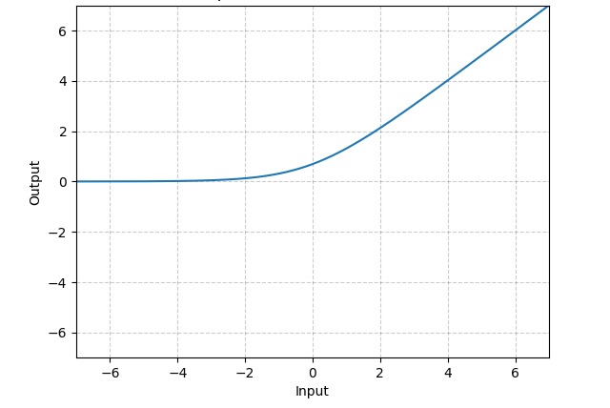
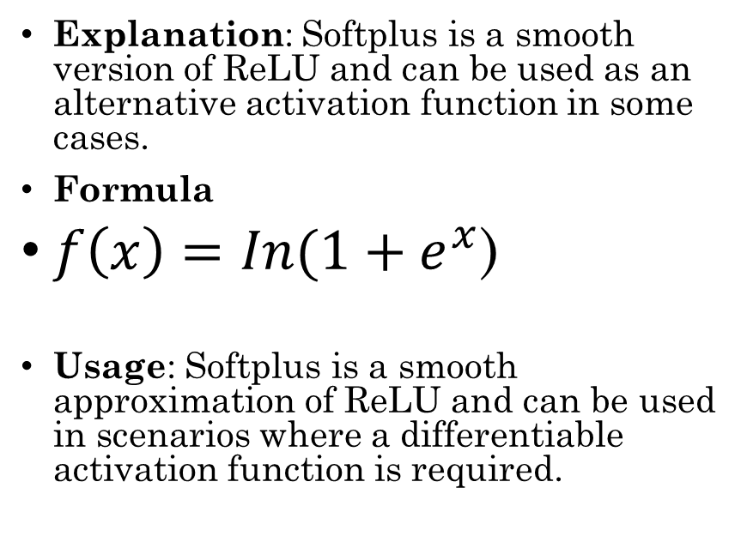
Softplus Function
Explanation: Softplus is a smooth version of ReLU and can be used as an alternative activation function in some cases.
Formula
$f\left(x\right)=In(1+e^{x}$)
Usage: Softplus is a smooth approximation of ReLU and can be used in scenarios where a differentiable activation function is required.

Slide 63
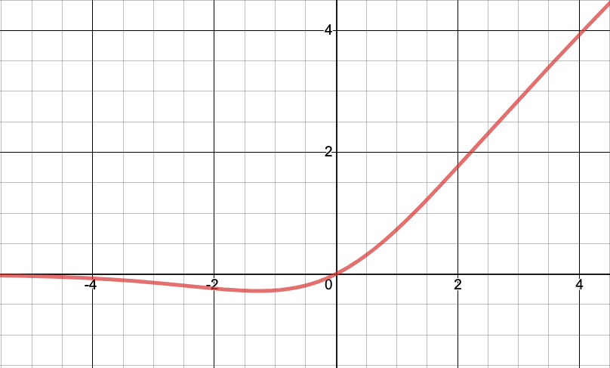
Swish Function
Explanation: Swish function is a recently proposed activation function that tends to perform better than ReLU in certain scenarios.
Formula
f(x)=x⋅sigmoid(x)
Usage: Swish is an alternative to ReLU, offering potentially better performance, especially in large-scale datasets and deeper networks.

Slide 64
FC Layer - The Max Pool Layer is Flattened
Every node is connected to a node
123 | 167
187 | 165
123
167
187
165
53
45
46
222
254
111
77
16
53 | 45
46 | 222
Flattened
254 | 111
77 | 16
FC Layer

Slide 65
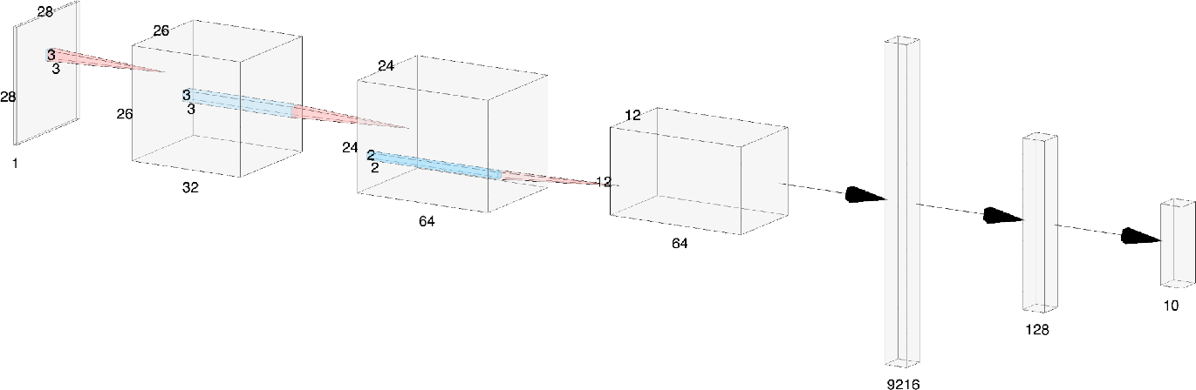

Another Representation
ReLU
Flatten
ReLU
Softmax
Input Image
Conv_1
Conv_2
Max Pool
FC
Layer | Depth | Width | Height | Filter (w) | Filter (h)
Input | 1 | 28 | 28
Conv_1 | 32 | 26 | 26 | 3 | 3
Conv_2 | 64 | 24 | 24 | 3 | 3
Max Pool | 64 | 12 | 12 | 2 | 2
Flatten | 9216 | 1 | 1
Fully Connected | 128 | 1 | 1
Output | 10 | 1 | 1
Notes:
We choose 32 & 64 Filters or Kernels for Conv_1 & Conv_2
We choose to
The Feature Maps are shown as Conv_1 and Conv_2
Stride is 1
Padding is 0 (not used)
Max Pool Stride is 2

Slide 66
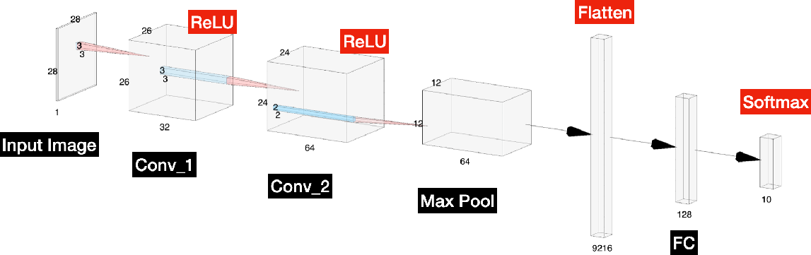
Calculating the Output Size of Conv_1
Notes:
We choose 32 Filters or Kernels for Conv_1
The Feature Maps are shown as Conv_1 & Conv_2
Stride is 1
Padding is 0 (not used)
Max Pool Stride is 2
Conv_1
n + 2p − f
n + 2p − f
28 + (2 × 0) − 3
28 + (2 × 0) − 3
(n × n) * ( f × f ) = (
+ 1) × (
+ 1) = (
+ 1) × (
+ 1) =
26 x 26
s
s
1
1
26 × 26
Where
n = 28
f = 3
s = 1
p = 0

Slide 67
Calculating the Output Size of Conv_2
Notes:
We choose 64 Filters or Kernels for Conv_2
The Feature Maps are shown as Conv_1 & Conv_2
Stride is 1
Padding is 0 (not used)
Max Pool Stride is 2
Conv_2
n + 2p − f
n + 2p − f
26 + (2 × 0) − 3
26 + (2 × 0) − 3
(n × n) * ( f × f ) = (
+ 1) × (
+ 1) = (
+ 1) × (
+ 1) =
24 x 24
s
s
1
1
24 × 24
Where
n = 26
f = 3
s = 1
p = 0

Slide 68
Calculating the Output Size of the Max Pool Layer
Notes:
We choose 64 Filters or Kernels for Conv_2
The Feature Maps are shown as Conv_1 & Conv_2
Stride is 1
Padding is 0 (not used)
Max Pool Stride is 2
Max Pool
n + 2p − f
n + 2p − f
24 + (2 × 0) − 2
24 + (2 × 0) − 2
12 x 12
(n × n) * ( f × f ) = (
+ 1) × (
+ 1) = (
+ 1) × (
+ 1) = 12 × 12
s
s
2
2
Where
n = 24
f = 2
s = 2
p = 0

Slide 69
Calculating the Output Size of Flattened Layer
Flatten
Notes:
We choose 64 Filters or Kernels for Conv_2
The Feature Maps are shown as Conv_1 & Conv_2
Stride is 1
Padding is 0 (not used)
Max Pool Stride is 2
12 × 12 × 64 =
9216
9216
Where
n = 12

