Slide 1
Digital System Design
EEE344
Lecture 1
INTRODUCTION TO THE COURSE
http://engr-zia-qazi.doomby.com/pages/dsd.html#

Slide 2
Contents of today’s Lecture
Course outline
Goals
The course
Introduction to digital design methodology

Slide 3
Course outline
COURSE TITLE: Digital System Design
Credit Hours: 3 (Theory) + 1 (Lab)
Pre-requisites: Digital Logic Design
COURSE OBJECTIVE:
The introduce the skills to write VHDL/Verilog code that can be synthesized for efficient logic circuits.

Slide 4
Course outline …
COURSE DESCRIPTION:
Introduction to Hardware Description Languages (HDLs), VHDL, Synthesizable Subset of VHDL, Digital System Modeling & Design using VHDL, Implementation Architectures, Finite State Machines, Digital Logic Testing and Simulation, Fault Simulation Techniques Design and Implementation Using FPGAs, Introduction to Application Specific Integrated Circuits (ASIC), ASIC Technologies, Design Methodologies, Design Verification, Analysis of Faulted Circuits, Design Methods for Data Intensive Applications (Digital Signal Processing and Telecommunication)

Slide 5
Course outline ..
Text(s):
Verilog HDL: A guide to Digital Design and Synthesis. Samir Palnitkar, SunSoft Press(A prentice Hall Title)
Advanced Digital Logic Design with the VERILOG HDL, Michael D. Cilette, prentice Hall Publishers, ISBN: 0130891614
Reference:
Fundamentals of Digital Logic with VERILOG Design, Stephen Brown and Zvonko Vranesic, 2nd edition, McGraw-Hill, 2005
Modern Processor Design: Fundamentals of Superscalar Processors, John P. Shen, Mikko H. Lipasti, Beta Edition, McGraw Hill Publishers

Slide 6
Goals
After completing this course student will be able to work on FPGA Spartan 6 board.
The student after completing this course will be able to design systems using Verilog HDL.

Slide 7
The course
Introduction to digital design methodology
Review of combinational and sequential logic designs
Verilog HDL
Systems design using Verilog
Parallelism techniques in hardware
DSP processors design
Examples of Digital Systems
SPM Machine
UART

Slide 8
Aerospace and Defense
ASIC Prototyping
Audio
Automotive
Broadcast
Consumer Electronics
Data Center
High Performance Computing
Industrial
Isolation Design Flow
Medical
Security
Smarter Networks
Smarter Vision
Wired Communications
Wireless Communications

Slide 9
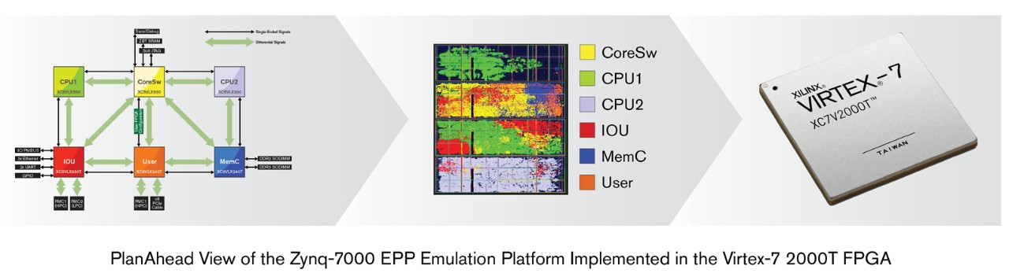
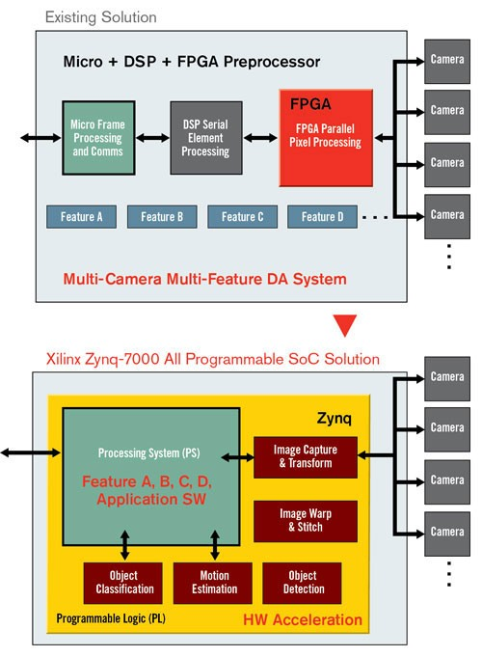
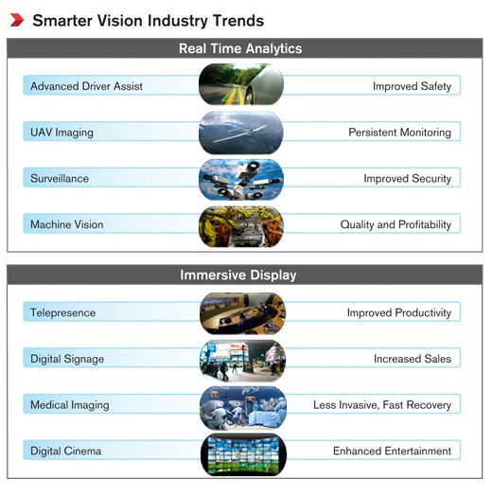
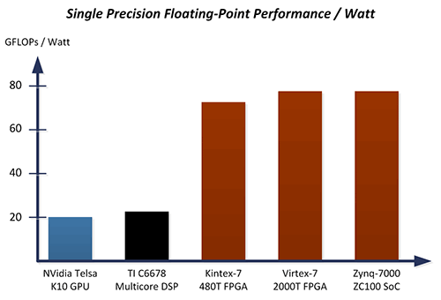
Course Website

Slide 10
Introduction to digital design methodology
What you do when are in some problem?
What will be the first step to solve a design problem?

Slide 11
Design Methodology
Design Methodology
Design Specification
" Verification
" Synthesis
Technology Options
" Full Custom VLSI
" Standard Cell ASIC
" FPGA

Slide 12
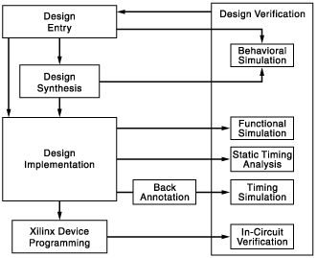
Design Methodology: Big Picture
Ref: http://www.xilinx.com/itp/xilinx10/isehelp/ise_c_fpga_design_flow_overview.htm

Slide 13
Design Entry
Create an ISE project as follows:
Create a project.
Create files and add them to your project, including a user constraints (UCF) file.
Add any existing files to your project.
Assign constraints such as timing constraints, pin assignments, and area constraints.

Slide 14
Functional Verification
You can verify the functionality of your design at different points in the design flow as follows:
Before synthesis, run behavioral simulation (also known as RTL simulation).
After Translate, run functional simulation (also known as gate-level simulation).
After device programming, run in-circuit verification.

Slide 15
Design Synthesis
Synthesize your design.
You can synthesize your design once design files have been created. The synthesis process will check code syntax and analyze the hierarchy of your design which ensures that your design is optimized for the design architecture you have selected. The resulting netlist is saved to an NGC file (for Xilinx® Synthesis Technology (XST)) or an EDIF file (for Precision, or Synplify/Synplify Pro).

Slide 16
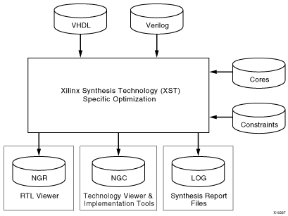
Synthesis

Slide 17
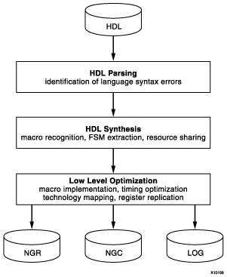
Synthesis detailed flow

Slide 18
Design Implementation
Translate, which merges the incoming netlists and constraints into a Xilinx® design file
Map, which fits the design into the available resources on the target device
Place and Route, which places and routes the design to the timing constraints
Programming file generation, which creates a bitstream file that can be downloaded to the device
Implement your design as follows:
Implement your design, which includes the following steps:
  Translate
  Map
  Place and Route
Review reports generated by the Implement Design process, such as the Map Report or Place & Route Report, and change any of the following to improve your design:
  Process properties
  Constraints
  Source files
Synthesize and implement your design again until design requirements are met.

Slide 19
Timing Verification
You can verify the timing of your design at different points in the design flow as follows:
Run static timing analysis at the following points in the design flow:
  After Map
  After Place & Route
Run timing simulation at the following points in the design flow:
  After Map (for a partial timing analysis of CLB and IOB delays)
  After Place and Route (for full timing analysis of block and net delays)

Slide 20
Xilinx Device Programming
Program your Xilinx device as follows:
Create a programming file (BIT) to program your FPGA.
Generate a PROM or ACE file for debugging or to download to your device. Optionally, create a JTAG file.
Use iMPACT to program the device with a programming cable.

Slide 21
Steps of solving digital design problem
Problem Statement
Define the problem in simple words
Think and write about what is required
Behavioral Description
Divide the tasks
Write Verilog code for each task
Synthesis
Subject your code to synthesis tool
Follow all the necessary steps
Hardware implementation

Slide 22
Verilog HDL
Created by Gateway Design Automation in 1985; now an IEEE standard Initially an interpreted language for gate-level simulation
Less explicit typing (e.g., compiler will pad arguments of different widths)
No special extensions for large designs

Slide 23
VHDL
Commissioned in 1981 by Department of Defense; now an IEEE standard
Initially created for ASIC synthesis
Strong support for package management and large designs

