Slide 1







Stack Overflow Developer Survey on 2019
M Nizar Hamzah Al Faris
19th June 2024

Slide 2



OUTLINE
Executive Summary
Introduction
Methodology
Results
Visualization – Charts
Dashboard
Discussion
Findings & Implications
Conclusion
Appendix

Slide 3

EXECUTIVE SUMMARY
The 2019 Stack Overflow Developer Survey data were used
Methodology employed in this research, including:
Data collection
Data wrangling
Exploratory data analysis
Data visualization and Dashboard creating
The results show some changes according to data
JavaScript and HTML/CSS still the most language used
PostgreSQL popularity increase followed by MongoDB and Redis
Linux, Windows, Docker and AWS popularity remain unchanged
Graph of the trends and complete dashboard provided
Summary has clear answer for the research question

Slide 4

INTRODUCTION
The 2019 Stack Overflow Developer Survey is the largest annual survey conducted among developers to see the trends of technology.
Around 90,000 developers were contributed in the survey
Language, Database, and Platform which are used and willing to be used are compiled to see the trends between developers
Question
How is the trend changing in languages used among developers?
How is the trend changing in databases used among developers?
How is the trend changing in platform used among developers?
This report is designed for other developer, consultant, or informatics related practitioner

Slide 5

METHODOLOGY
Data collection through APIs, Web Scraping, and Request library
Data wrangling includes: finding and removing duplicates, finding and filling missing values, and normalizing data
Exploratory analysis includes: data distribution, finding and removing outlier
Dashboard creating in IBM Cognos Analytics
Data visualization to measure distribution, relationship, composition, and comparison of Data

Slide 6



RESULTS
Results will be provided based on the changing content of data
Finding and implication are stated for better understanding

Slide 7
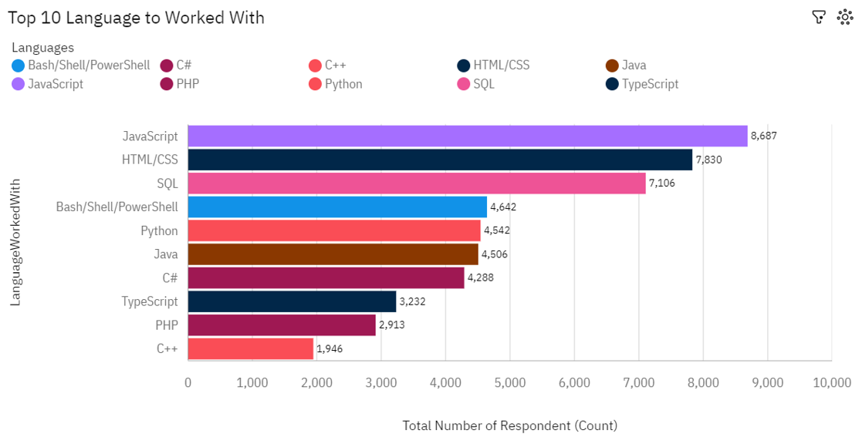
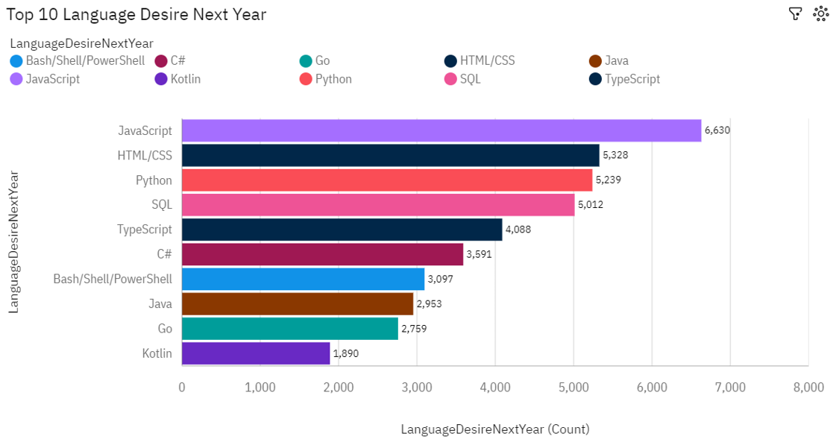
PROGRAMMING LANGUAGE TRENDS
Current Year
Next Year

Slide 8
PROGRAMMING LANGUAGE TRENDS - FINDINGS & IMPLICATIONS
Findings
The increase amount of language desire to work with occurred only in Python and TypeScript
SQL has the biggest decrease number of respondent in the term most language desire to work with.
JavaScript and HTML/CSS are remain the most favorited language to work with
Implications
There is a chance of SQL user move to Python and TypeScript language
Although the user of JavaScript and HTML/CSS remain the highest, the number is dropping
There is a chance of increasing demand of Python and TypeScript either class or training for the next year.

Slide 9
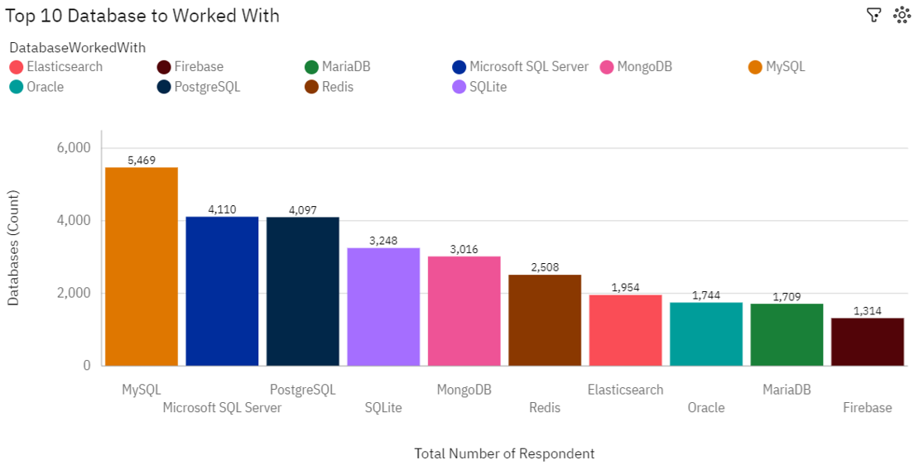
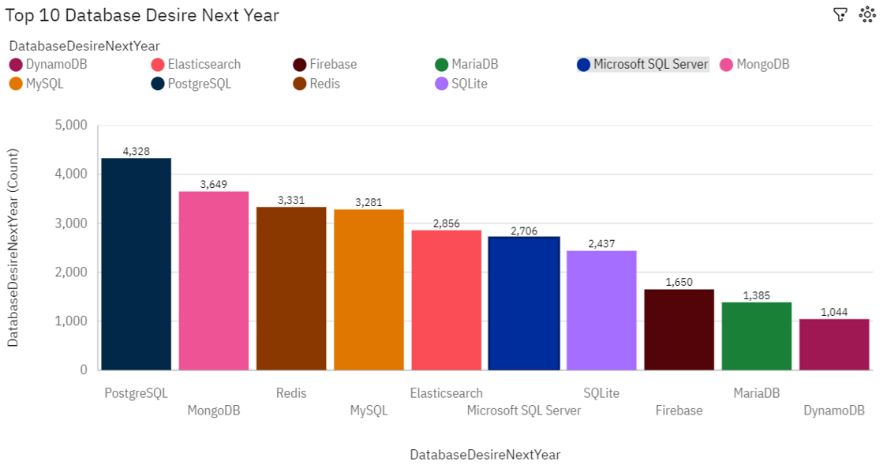
DATABASE TRENDS
Current Year
Next Year

Slide 10
DATABASE TRENDS - FINDINGS & IMPLICATIONS
Findings
MySQL, Ms. SQL server, PostgreSQL and SQLite is the most used in current year
PostgreSQL become the most desired databases to be used, while the other SQL databases count decreases in the next year.
MongoDB and Redis popularity and desire to be used increase.
Implications
There will be an great demand of PostgreSQL database in the next year.
MongoDB and Redis databases are more likely become alternative of PostgreSQL compared to other databases.

Slide 11
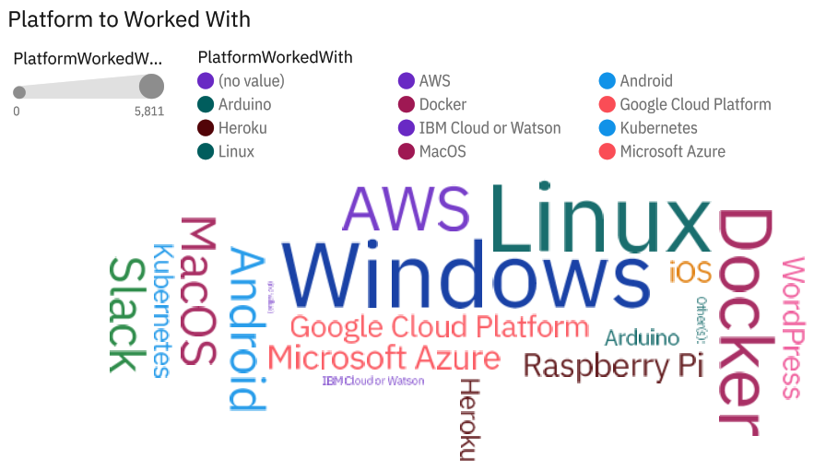
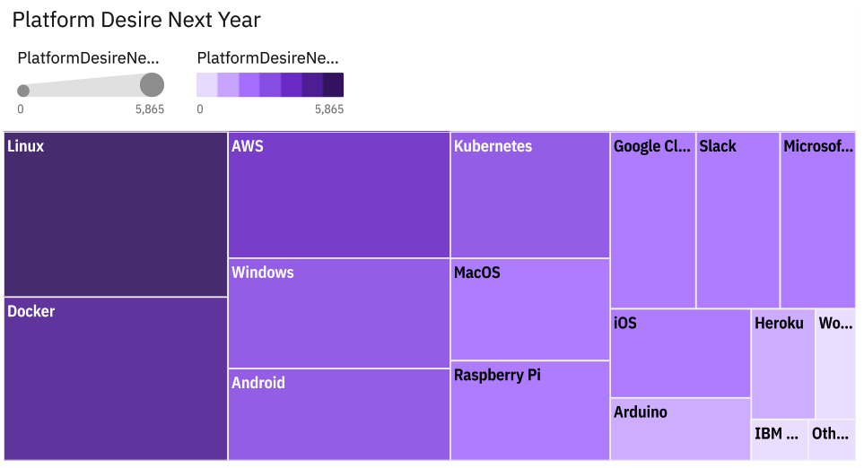
PLATFORM TRENDS
Current Year
Next Year

Slide 12
PLATFORM TRENDS - FINDINGS & IMPLICATIONS
Findings
Linux, Windows, AWS, Docker platform is remain the same for both year
Implications
Platform to work with demand will remain unchanged for the next year.

Slide 13

DASHBOARD
<https://github.com/qazqazpc/starting/blob/main/IBM%20Data%20Analytics%20Capstone.pdf

Slide 14
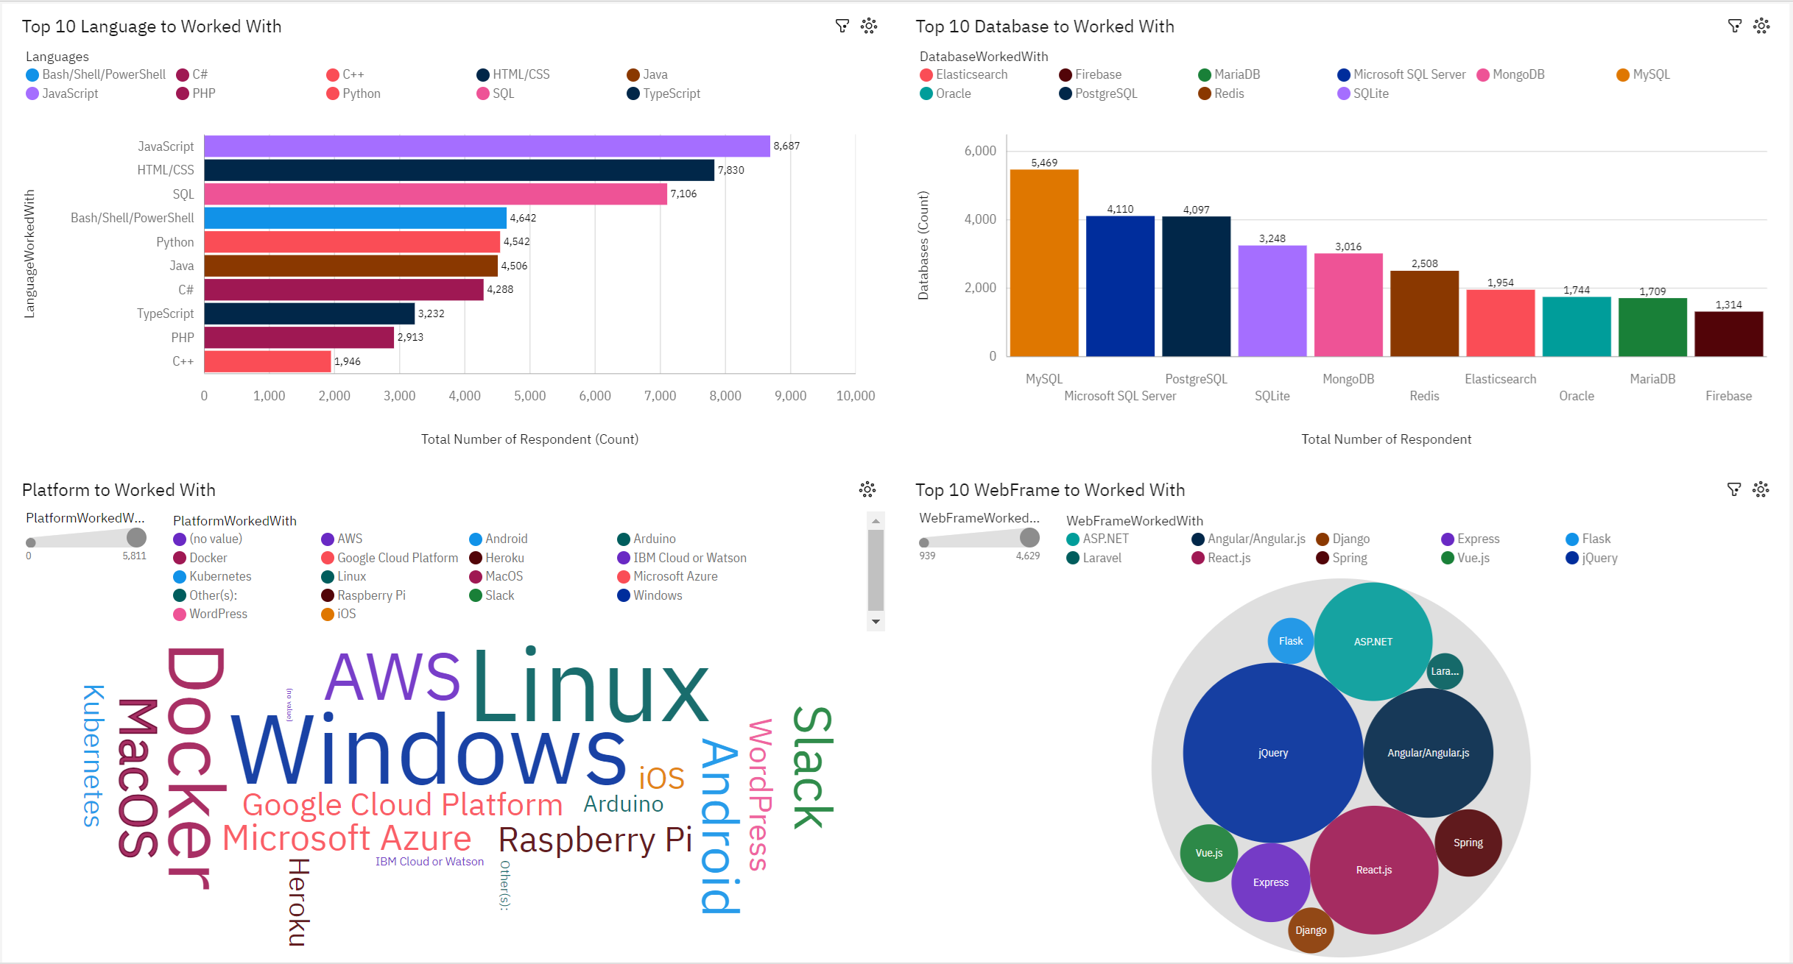
DASHBOARD TAB 1

Slide 15
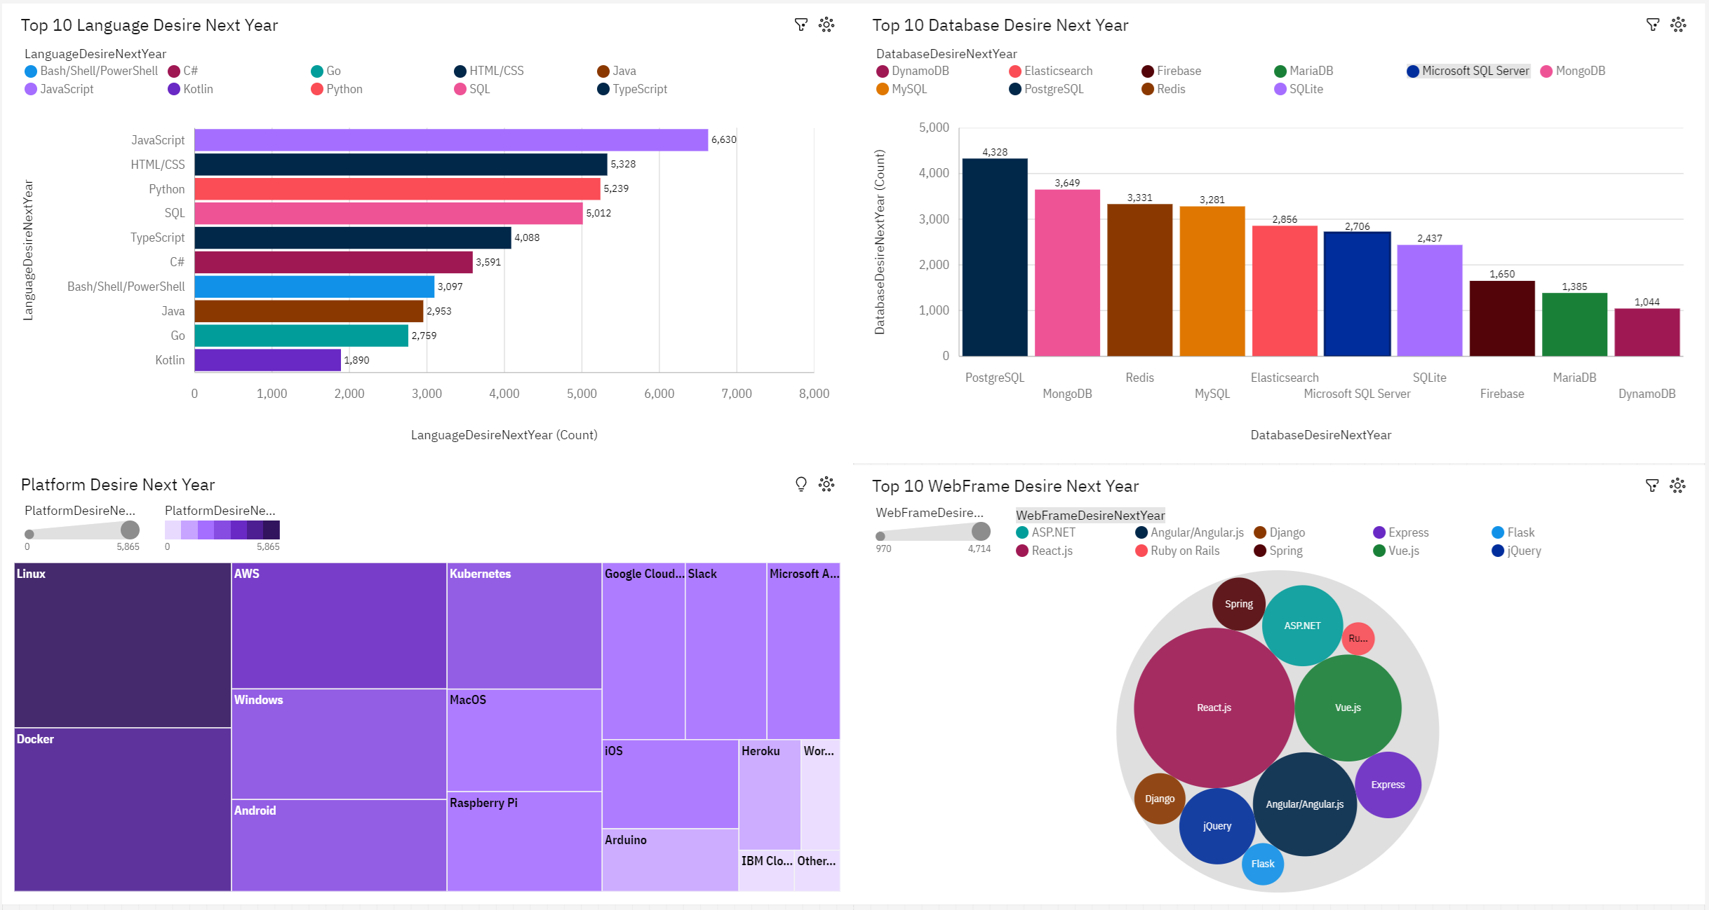
DASHBOARD TAB 2

Slide 16
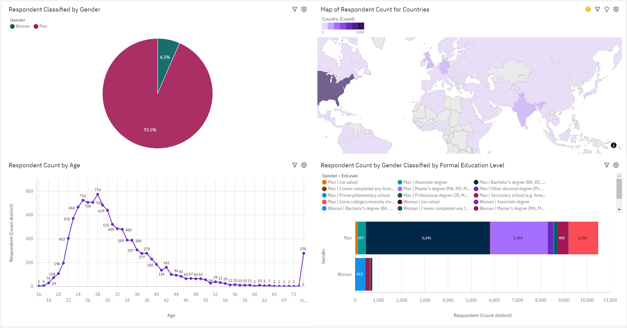
DASHBOARD TAB 3

Slide 17
DISCUSSION
Discussion will cover overall findings and implications
Each major finding and implication are summarized for better understanding

Slide 18
OVERALL FINDINGS & IMPLICATIONS
Findings
JavaScript and HTML/CSS remain the most used language, followed by the increase of Python user in the next year
PostgreSQL become the most voted database to work with in the next year, followed by MongoDB and Redis
Linux, Windows, Docker and AWS still the most popular platform to work with from both years
Implications
JavaScript and HTML/CSS demand still at the top while other language trends are changing.
PostgreSQL demand will increase. MongoDB and Redis may be alternative databases.
Platform to work with demand will remain unchanged for the next year.

Slide 19

CONCLUSION
How is the trend changing in languages used among developers? JavaScript and HTML/CSS remain the most used language, followed by the increase of Python user in the next year
How is the trend changing in databases used among developers? PostgreSQL become the most voted database to work with in the next year, followed by MongoDB and Redis
How is the trend changing in platform used among developers? Linux, Windows, Docker and AWS still the most popular platform to work with from both years

Slide 20

APPENDIX
The complete data used was taken from: https://stackoverflow.blog/2019/04/09/the-2019-stack-overflow-developer-survey-results-are-in/
Supplementary Job data was taken from: https://www.kaggle.com/datasets/promptcloud/jobs-on-naukricom
Supplementary Language data was taken from: https://cf-courses-data.s3.us.cloud-object-storage.appdomain.cloud/IBM-DA0321EN-SkillsNetwork/labs/datasets/Programming_Languages.html

Slide 21
JOB POSTINGS

Slide 22
POPULAR LANGUAGES

