Slide 1
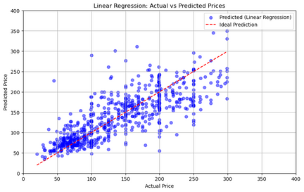
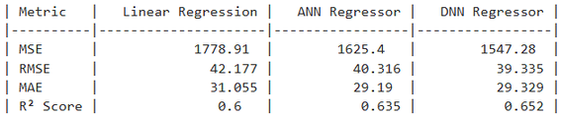
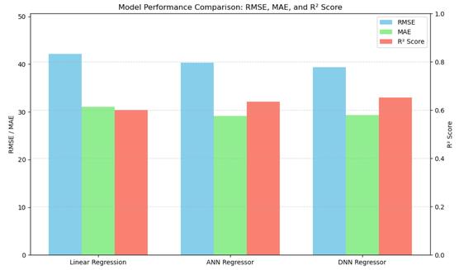
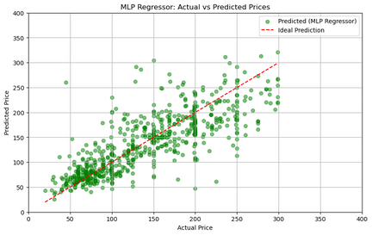
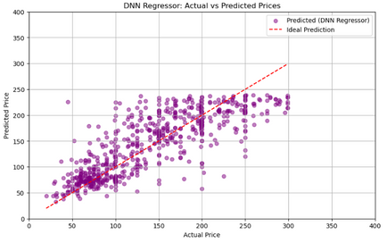
Modeling Airbnb Prices
Machine Learning Assignment | TT8L | Group 2
Introduction
Linear Regression
Evaluation Results
Accurately predicting Airbnb listing prices helps hosts stay competitive and guests find fair deals. This project analyzes key pricing factors using a cleaned dataset of Airbnb listings. Three models which are Linear Regression, Artificial Neural Network (ANN), and Deep Neural Network (DNN) were built and compared to identify the best-performing approach.
Implemented this model as a baseline to predict the Airbnb listing prices, assuming there is a linear relationship between inputs and target variable.
Used to benchmark the performance of other complex models
The performance of each model was assessed using standard regression metrics:
MSE, RMSE, MAE, and R² Score.
Objective and Problem Statement
The primary goal of this project is to develop a model that can reliably predict the price of an Airbnb listing by leveraging various listing attributes. This task falls under supervised learning, specifically a regression problem, where the objective is to estimate the listing’s price based on input features.
Selected Features
Numerical Features
These are number-based values used to train the model:
Accommodates: How many guests the listing can host.
Bedrooms: Total number of bedrooms.
Bathrooms: Number of bathrooms available.
Number of Reviews: Total reviews received by the listing.
Availability (30): Number of days available in the next 30 days.
Review Scores Rating: Average guest rating out of 100.
Reviews per Month: How often the listing gets reviewed monthly.
Cleaning Fee: Extra charge for cleaning
Security Deposit: Refundable amount held in case of damages
Price: The nightly price of the listing (target variable to predict).
Categorical Features
These are text-based features that describe the listing:
Room Type: Type of space
Property Type: Type of property
Neighbourhood Cleansed: Standardized location name
Host is Superhost: Whether the host is recognized as a Superhost
Instant Bookable: Whether the listing can be booked instantly.
The scatter plot shows predicted vs. actual prices. The model performs well in the mid-price range but struggles with higher-priced listings, showing that Linear Regression captures general trends but underfits more complex pricing behavior.
Artificial Neural Network (ANN)
Implemented using MLPRegressor with one hidden layer of 64 neurons.
Captured non-linear relationships better than Linear Regression, resulting in improved R² and lower RMSE/MAE.
Used early stopping and regularization to prevent overfitting and enhance generalization.
Key Observations
Linear Regression
Performed the weakest overall.
Struggled to capture complex patterns in the data.
Had the lowest R² score (0.600), meaning it explained the least variance in price.
Artificial Neural Network (ANN)
Performed better than Linear Regression.
Showed improved accuracy, with lower MSE and a higher R² (0.635).
Generalized better by capturing some non-linear relationships.
Deep Neural Network (DNN)
Achieved the best overall performance.
Had the lowest MSE and RMSE, and the highest R² (0.652), showing strong predictive power.
Although the MAE was slightly higher than ANN (due to occasional larger errors), DNN handled outliers better and still performed best on average.
The deeper architecture helped model more complex, non-linear patterns effectively.
The ANN model shows better alignment than Linear Regression, with more predictions clustering near the ideal line. However, there's still some visible deviation, especially in higher-price regions. While improved, the scatter plot suggests the ANN model may not be fully optimized or has limited depth.
Data Preprocessing
`Feature Selection
Selected key numerical and categorical features relevant to listing characteristics and pricing.
Handle Missing Values
Numerical columns filled using median or mean imputation.
Binary and categorical fields were filled with defaults (e.g., 0 or "missing").
Outlier Handling & Transformation
Removed listings above the 90th percentile of price.
Applied log transformation to the target variable (price) and selected skewed features.
Feature Engineering
Created new features to extract deeper relationships:
bed_bath_ratio – Bedrooms to bathrooms ratio
cleaning_per_guest – Cleaning fee divided by guest capacity
bedroom_per_guest – Bedrooms per guest
review_score_per_month – review rating x review frequency
Encoding & Scaling
Categorical features: One-Hot Encoding
Numerical features: StandardScaler
Train-Test Split
Data was split into 80% training and 20% testing for model evaluation.
Deep Neural Network (DNN)
Implemented using a Deep Neural Network (DNN) with three hidden layers of 220, 128, and 64 neurons.
Included dropout layers with rates of 0.15, 0.15, and 0.1 to prevent overfitting.
Challenges
1. High Variability in Price Data
Airbnb listings showed a wide range of prices, making it difficult to build a model that performs well across all price points, especially for high-end listings.
2. Handling Missing and Inconsistent Data
Several features contained missing or inconsistent values, requiring careful imputation and assumptions that may impact model accuracy.
3. Outliers and Skewed Price Distribution
Price-related features were highly skewed, and extreme values affected early models. Log transformation and outlier removal helped, but some distortions still persisted.
4. Balancing Model Complexity vs. Generalization
Deeper models like DNN performed better but required careful tuning (dropout, regularization, early stopping) to avoid overfitting, especially with a relatively small dataset.
5. Time consuming for training Deep Models
Training the DNN with many layers and large batch sizes was time-consuming, requiring longer experimentation cycles.
To improve R², we tested multiple DNN setups by varying layers, neurons, and dropout. The current model gave the best results. We also tried:
2 layers: 128 → 64 (dropout 0.2)
4 layers: 256 → 128 → 64 → 32 (dropout 0.3)
3 layers: 100 → 50 → 25 (dropout 0.1)
Conclusion
The DNN model achieved the best performance, with the lowest RMSE (39.335) and highest R² score (0.652). ANN performed moderately well, while Linear Regression underperformed due to its simplicity and inability to capture non-linear patterns.

