Slide 1

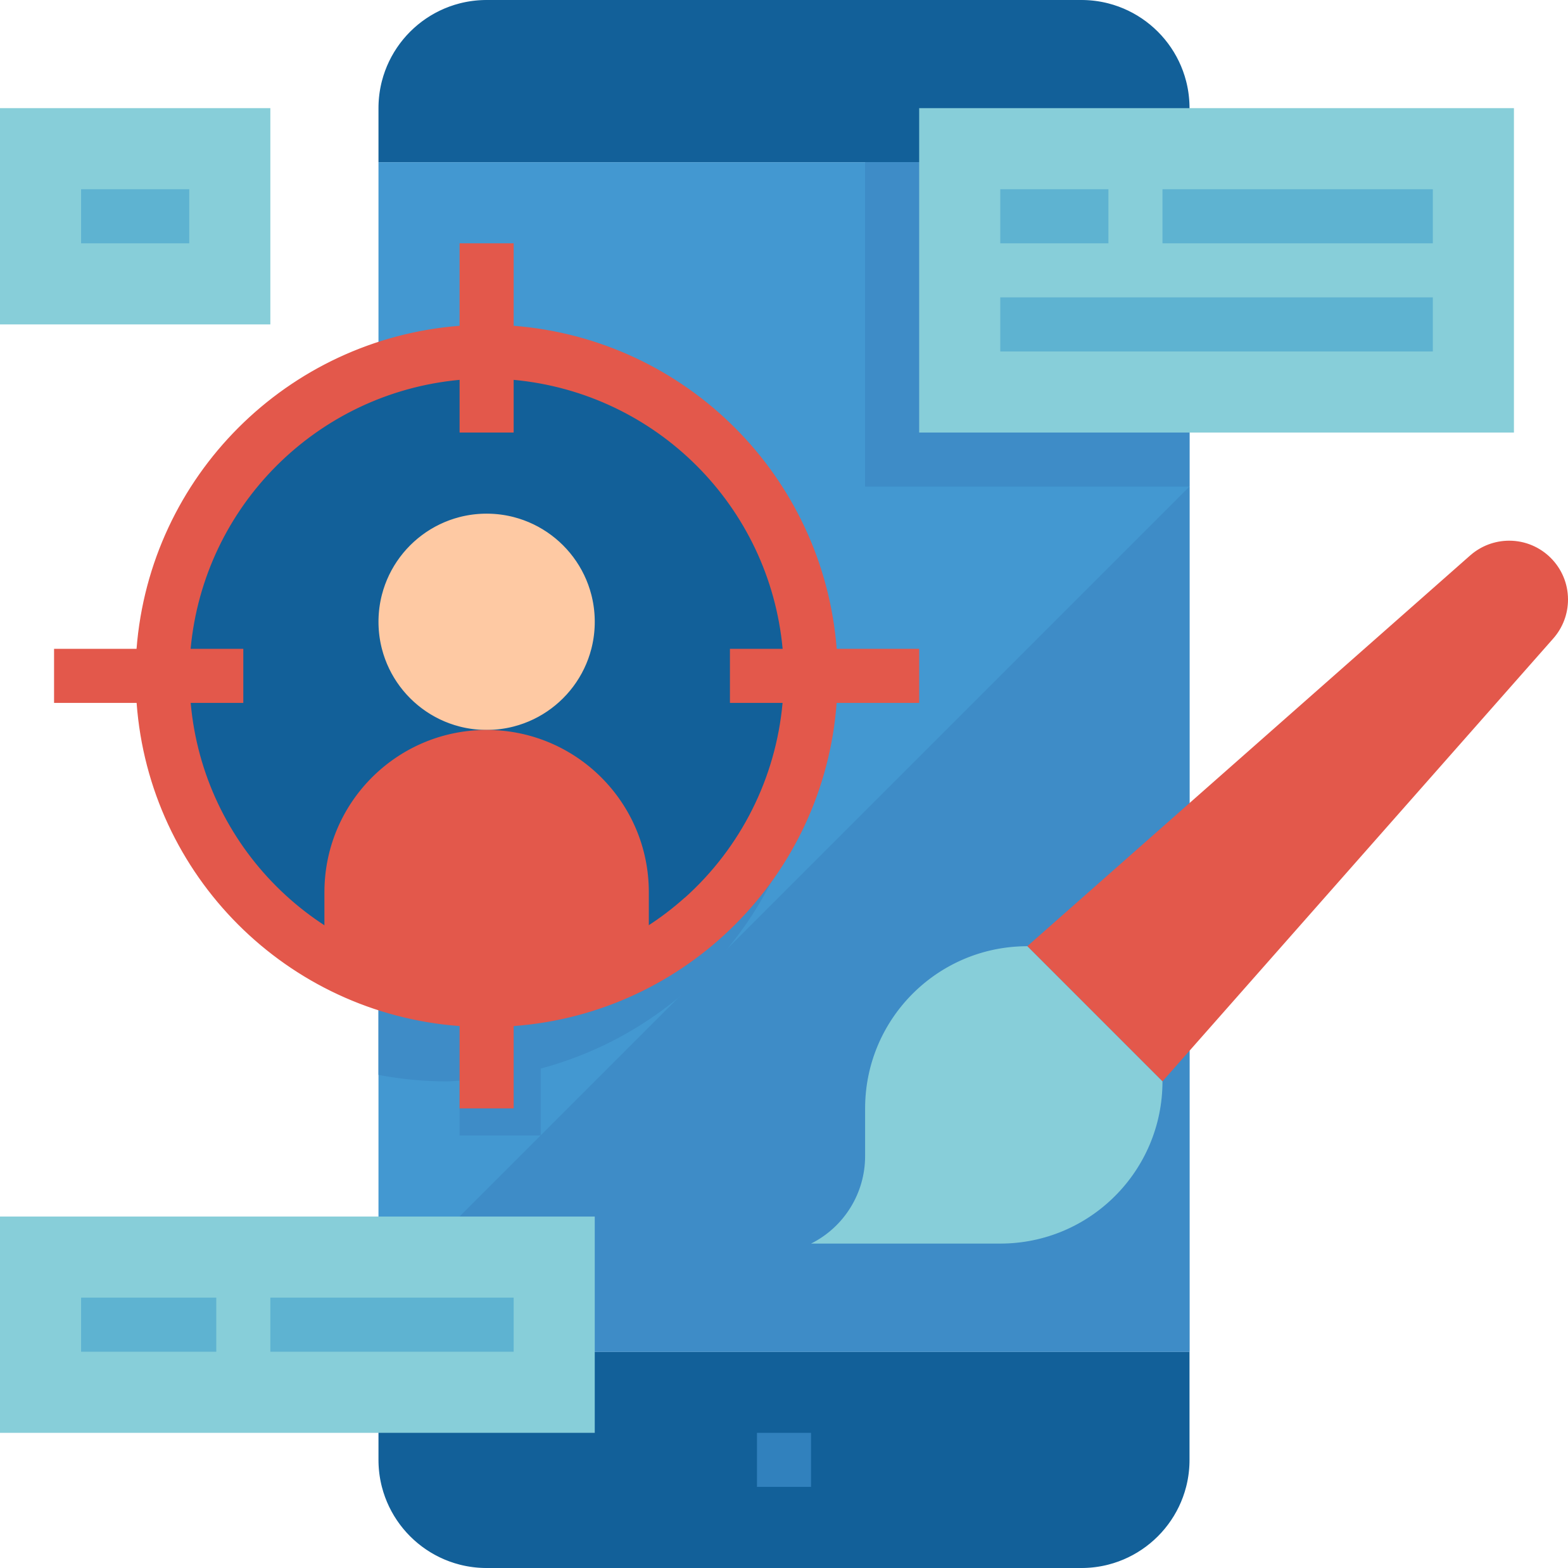
The value of privacy
Quintin Balsdon
Notes:
WhatsApp has recently caused quite a stir In the media when they announced an update to their terms and conditions. While the update itself is nothing to worry about, it did spark an interest in me to do some digging into exactly what privacy is, and why everyone should be concerned about it.

Slide 2

Notes:
Before we go down this rabbit hole, I would like to take a moment to tell you:
- The idea is not to cause panic, but to inform
We are responsible for our own privacy and the companies that I mention are not out to get us, they are out to make a profit
I believe that society and end users have caused a lot of the problem that exists today regarding privacy
In general, people want digital services for free, but they cost money to produce.
We complain about fake news, but so few pay for quality journalism

Slide 3
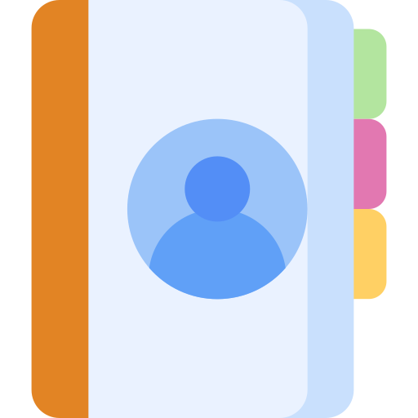
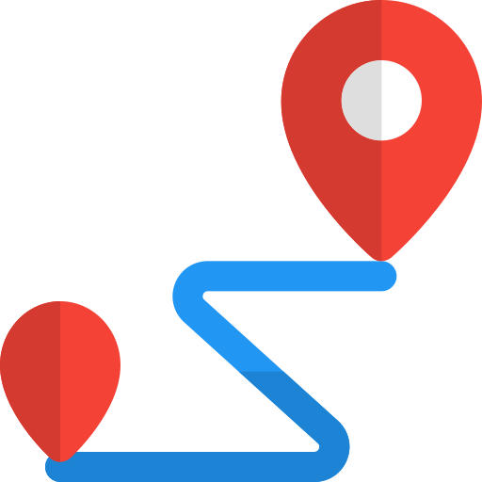
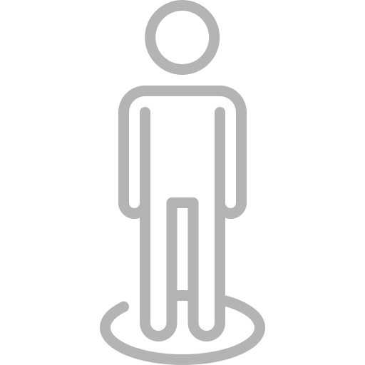
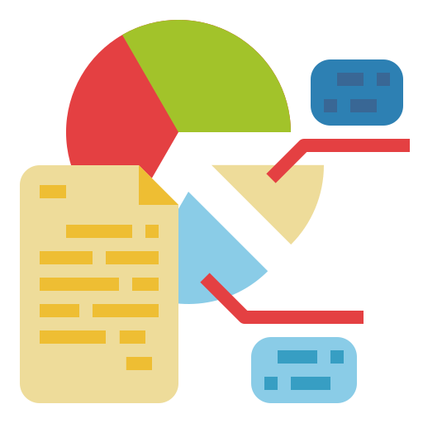

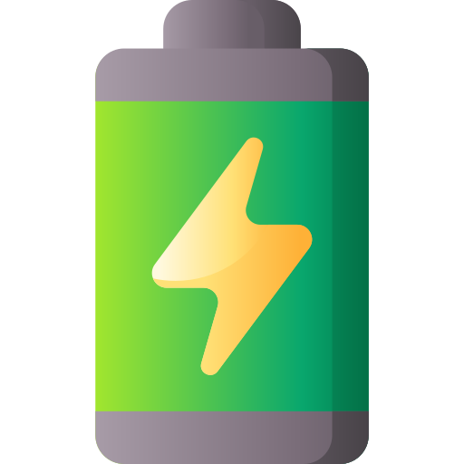
Notes:
What is Privacy?
Cambridge dictionary: “someone's right to keep their personal matters and relationships secret”
It’s a collection of anything that could be used to identify you, or something about you
Contacts
Location
Habits
Battery

Slide 4



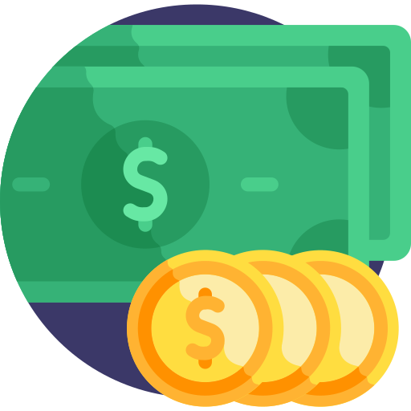
Notes:
Some common misconceptions about privacy
We don’t have privacy
I’m not interesting enough

Slide 5
Notes:
Comparing privacy and wearing a mask in a pandemic

Slide 6


Notes:
Android apps have a very neat feature known as a manifest file. This file is a record of every screen in an app, as well as any “broadcast receiver” – which we all know as a subscriber in a publish subscribe model. There are three types of broadcast in an Android app
System global
App global
App local
These can be used

Slide 7
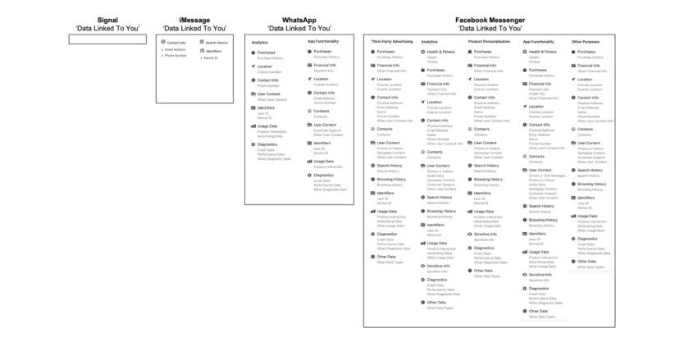

Slide 8
Notes:
Battery is one of the most interesting things I have found to be tracked, not just by apps but websites as well.

Slide 9
Research
https://www.fastcompany.com/90593066/whatsapp-facebook-privacy-ultimatum?partner=feedburner&utm_source=feedburner&utm_medium=feed&utm_campaign=feedburner+fastcompany&utm_content=feedburner&cid=eem524:524:s00:01/12/2021_fc
https://www.forbes.com/sites/zakdoffman/2021/02/28/whatsapp-warns-millions-of-apple-iphone-and-google-android-users-after-privacy-backlash/
https://bgr.com/2021/02/23/gmail-app-privacy-label-iphone-user-tracking/
https://twitter.com/endnowcyber/status/1357251207534768137?s=21
https://www-theverge-com.cdn.ampproject.org/c/s/www.theverge.com/platform/amp/2021/2/18/22289232/facebook-ad-revenue-proposed-reach-inflation-lawsuit-unredacted-filings

