Slide 1


Automating Android: Command Line Controls
Taking control of your Android device from the command line
Notes:
Introduce yourself
Developing Android Apps since 2011
Found it necessary or convenient to script certain actions on Android
Going to answer the WHAT and WHY questions first

Slide 2
What I’m talking about
ADB internals
controls
scripts
raspberry pi
Notes:
What the Android Debug Bridge is and the underlying architecture behind it
Some fundamental commands that employ the ADB
Some useful scripts that I have written to help simplify some of the actions that do on a day to day basis
Set up and demo on a raspberry pi (this is in the IoT section, after all)

Slide 3


Why?
Focus
Documentation
Communication
Accessibility
https://github.com/qbalsdon/talos
Notes:
Sometimes doing the same thing on the phone every day gets boring and repetitive, and writing shortcuts in code means I need to undo those changes later
Toggling certain settings becomes more painful given different implementations of the Android settings interface
I have found that registration and login journeys for an app might happen once every few months for a user, can happen multiple times in a day for me
Helps me have up to date documentation of how a flow works. I like calling it “living documentation”
Sometimes a particular journey goes beyond the scope of a test. For example, bug behaviour: We can’t write a test for every single bug
When scripting an action I find that I am creating a mechanism of understanding for a problem. People describe problems in their terms and can leave out certain details, for example whether you wait for something to finish loading before doing the next action
Multi language testing- select based on id
Other libs:
MonkeyRunner seems to have been abandoned or not used very much
AndroidViewClient (Culebra) I found difficult to install / get going
Other tools seem to be python interfaces for the same commands I use in bash
Mainly the reason I use Bash is to understand how everything works, without any interface between me and the real thing. This is helpful because these libraries are subject to changes and dependencies

Slide 4
ADB?
Client
Server
Daemon
Notes:
The Android Debug Bridge is command-line tool that lets you communicate with a device. It is a separate service used by IDE tools like Android Studio and Eclipse.
Because it has no user interface, it’s implementation is simple and can run on several different types of architectures, including ARM.
ELEMENTS OF THE ADB
- CLIENT: on your development machine– this has become what people refer to as the ADB “colloquially”
- SERVER: interface between client and daemon. The server maintains connections to all connected devices
- DAEMON: runs commands on the device – sometimes referred to as ADBD
In order to access ADB, you must enable developer settings. Settings ( > System) > About Phone > Build Number

Slide 5
Types of connection
Emulator
USB
Pre-Android 11 Wireless
Android 11+ Wireless
Notes:
Emulators are virtual devices that run using the local machine’s hardware. They are also called AVD’s or Android Virtual Devices
Before Android 11, there was a rudimentary method of TCP/IP Wireless debugging that was simple and insecure. Android 11 has introduced more security around the new features and made it a robust connection without driver issues.
does not need a cable to set up,
remembers connections over time,
utilize the full speed of the latest Wi-Fi standards

Slide 6
Create an AVD
> [SDK_LOCATION]/tools/bin/avdmanager
create avd --force --name testAVD
--abi google_apis/x86
--package
'system-images;android-29;google_apis;x86'
Notes:
You do need the SDK installed in order to create an Android Virtual Device,
--name : Name of the new AVD. [required] --force : Forces creation (overwrites an existing AVD)
--abi : The Application Binary Interface to use for the AVD (CPU instruction set). The default is to auto-select the ABI if the platform has only one ABI for its system images.
x86, arm64, armeabi,x86_64
--path : Directory where the new AVD will be created.

Slide 7
Some useful commands
adb [kill_server | start_server]
adb devices
adb [-s DEVICE] exec-out uiautomator dump
adb shell pm –l
adb shell wm size
adb pull [DEVICE_LOCATION]
adb push [HOST_LOCATION] [DEVICE_LOCATION]
scrcpy: https://github.com/Genymobile/scrcpy
Notes:
PM = Package manager – look at installed apps and services, as well as manage rights given to them. Can also be used to install and uninstall apps
WM = window manager – can be used to reset screen density / size, dismiss the on screen keyboard
The uiautomator takes a long time to perform a dump

Slide 8
adb shell input [SOURCE]
text string (Default: touchscreen)
keyevent [--longpress] code_number | name
tap x y
swipe x1 y1 x2 y2 [duration(ms)]
draganddrop x1 y1 x2 y2 [duration(ms)]
press (Default: trackball)
roll dx dy (Default: trackball)
Notes:
In order to access ADB, you must enable developer settings. Settings ( > System) > About Phone > Build Number
Sources are simulated and can be:
dpad
keyboard
mouse
touchpad
gamepad
touchnavigation
joystick
touchscreen
stylus
trackball

Slide 9
Notes on scripts
Not a replacement for good testing practices
Break easily
Computationally expensive
Notes:
Good tests test what we expect, great tests attempt to disprove assumptions. We’ll only ever get to an ok test with a script
Scripts are brittle and inflexible, and they fail fairly easily – as combinations are added complexity compounds and they don’t really handle that well
Put parameters that can contain spaces in inverted commas
While case shift catches me out all the time – single parameters don’t need a shift in the while.
Some notes:
I have written scripts that test a behaviour several hundred times – this is useful when dealing with reproducing race conditions
Be organized – if a script is for a specific application / ticket – put it in folders

Slide 10


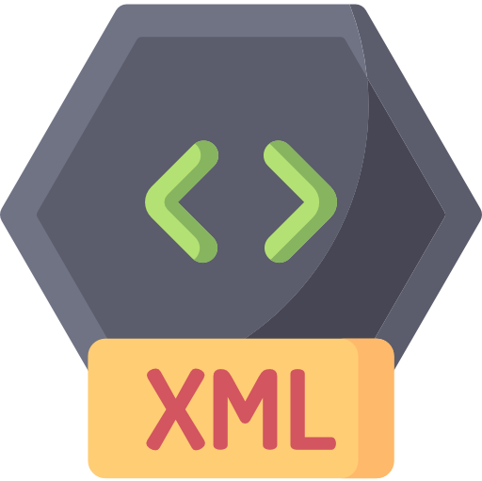



On Android Layouts

Slide 11
My scripts
Located in a repo, added to my ~/.bash_profile
export PATH="$PATH:~/Repo/talos/scripts/”
Enable / disable features
runOnAll
midOf
swipeTo / swipeThenTap
waitFor
tap
https://github.com/qbalsdon/talos
Notes:
All designed to do just a little bit more than what the original features of ADB provides. I find that I can modify the scripts in the particular manner I need per scenario
Turning on / off talkback is super useful with a script – no navigating through menus that change from OEM to OEM
A little bit annoying that the Android emulator doesn’t have Talkback – just be aware
Wifi cannot be toggled inside app code anymore, so a script has become super useful when testing connectivity

Slide 12
Demo time!

