Slide 1
Wear OS are we?
A brief look at Android’s Wear OS
Notes:
Horology: the study of the measurement of time.
The goal of this talk is to inspire Android developers to start writing Wear OS apps, and dive into the platform.

Slide 2
WearOS Partners
ARM
Asus
Hugo Boss
Broadcom
Casio
Diesel
Emporio Armani
Fossil
Gc
Guess
Intel
Kate Spade
LG
Louis Vitton
MediaTek
Michael Kors Access
MIPS
Misfit
Mobvoi
Mont Blanc
Motorola
Movado
New Balance
Nixon
Polar
Qualcomm
Samsung
Skagen
Sony
Tag Heuer
T Mobile
Tommy Hilfiger
Verizon
https://developer.android.com/wear

Slide 3
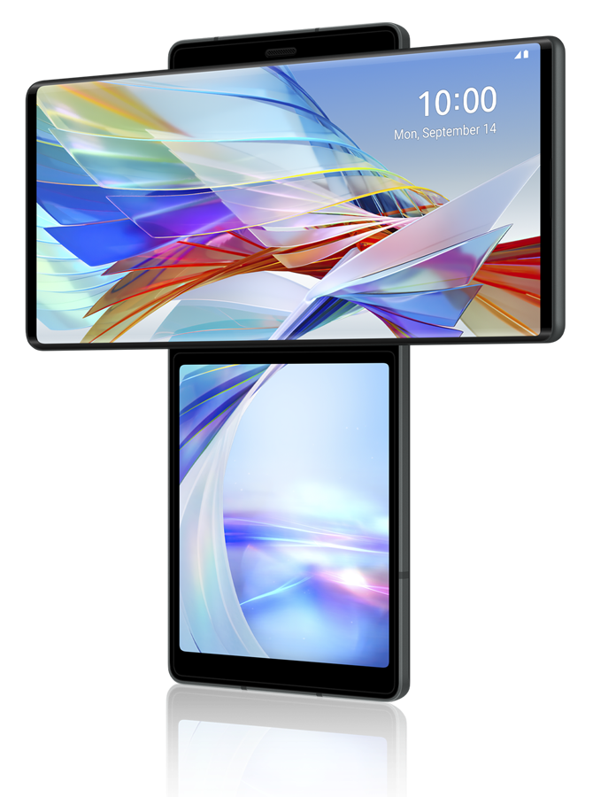
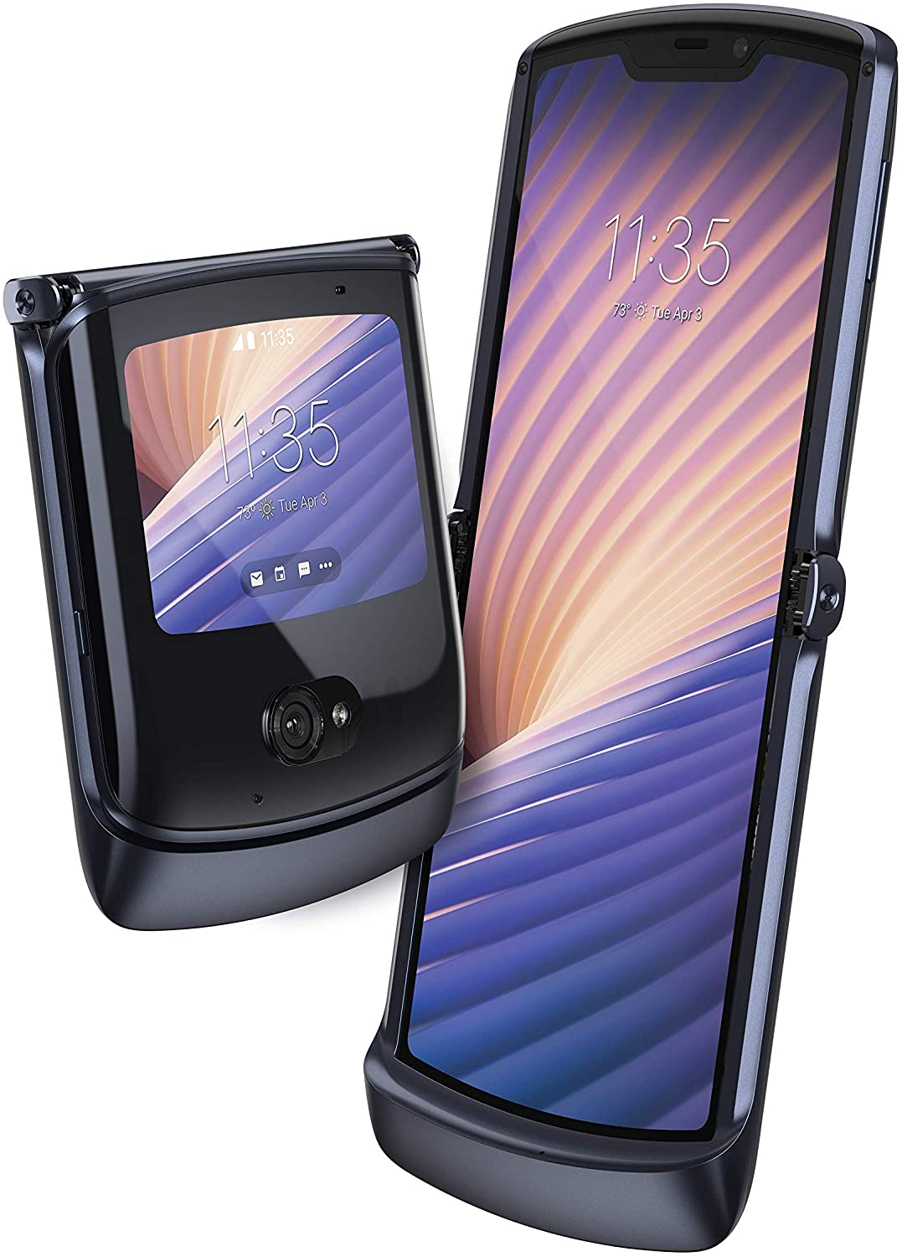
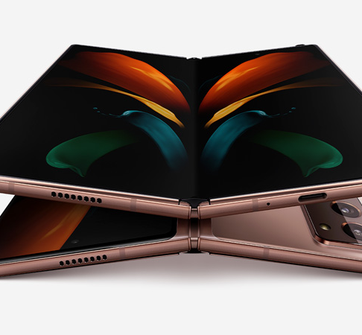
How Google works
Get it in users hands
Request user feedback
Fix
Battery
Privacy
Usability
Notes:
Google needs developer feedback, which we do by getting involved
The concerns are still the same:
Battery:
Doze in Android M – a) phone not plugged in, b) screen is off, c) phone not moving (disabled in N) – not always so easy in wearables
Standby
Privacy:
Ask for permission
Explain yourself
Worsened by fitness
Usability

Slide 4
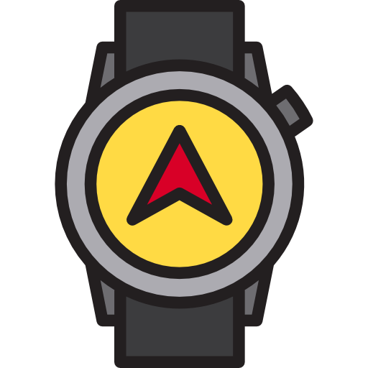
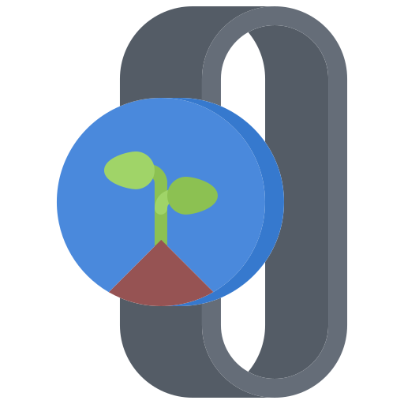
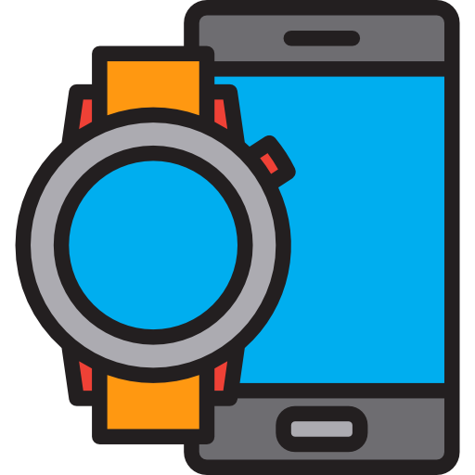
Types of app
Standalone
Companion
Complication
Complication provider
Watch face
Notes:
In horology, a complication refers to any feature in a mechanical timepiece beyond the display of hours, minutes and seconds

Slide 5
Timeline
Notes:
TIMELINE: https://docs.google.com/spreadsheets/d/1wRBi5qNtVD9mZizkqhaUsqry_glwNNP_7ZPi6Ykj-js/edit#gid=0
Talking points:
- Out the door first, still considered behind
- Still no Pixel watch
- The version number drop
4.4W1
- Initial release
4.4W2
- Offline music playback over Bluetooth - Watch GPS support (for watches with built-in GPS)
- New music control UI
1.0 (5.0.1W)
- Official watch face API - Sunlight mode (brightness boost) - Theater mode - Settings shade from top - Battery stats in Android Wear app - Recently used actions added to the top in drawer - Ability to undo dismissed notification
1.1 (5.1.1W1)
- Wi-Fi support (for watches with built-in Wi-Fi) - Drawable Emojis (as response to messages)
- Heads up notifications - Pattern lock screen
- Ability to change font size
- Add swipe left from watch face to access app drawer - Always on apps
- More wrist gestures
1.3 (5.1.1W2)
- Interactive watch faces
- Google Translate for Wear
1.4 (6.0.1W1)
- More wrist gestures
- Speaker support for watches with built-in speaker
- Send voice messages directly from the watch
1.5 (6.0.1W2)
- Brought back restart watch option - Added Android security patch level to About screen
2.0 (7.1.1W1)
- Revamped UI with Material Design, darker colors, and a more circular user interface for round watches.
- Standalone apps with Google Play Store on watch
- Complications for watch faces
- Built-in keyboard - Handwriting recognition
- Stackable notifications
- Smarter notifications
- Cellular Support
2.6 (7.1.1W2)
- Text size of notifications adapts to message length
- New download progress indicator
- New complication for launching previously-used app
2.6 (7.1.1W3, 8.0.0 W1)
- Brings Android 8.0 Oreo features to smartwatches
- Notification vibration strength setting
- Touch lock option for wet conditions
- Support for 7 new countries/languages
- Notification Channels
- Battery saving background limits
2.7 (7.1.1W4, 8.0.0 W2)
- Improved typefaces and font weights
- Complications now work with Talkback
- Text size of notifications adapts to message length
- Swipe down in Quick Settings to see connection type (Wi-Fi, Bluetooth, or mobile)
- Download progress notifications
- Recent App complication
- Better prevention of accidental side-swipe and long-press gestures
2.8 (7.1.1W5, 8.0.0W3)
- Improved notification glanceability with a new layout which shows more of the user's message at a glance
- Darker background for better readability and less battery usage
2.9 (7.1.1W6, 8.0.0W4)
- New notification preview complication which allows you to preview messages
- Improved glanceability in notification cards with longer titles
1
- Rebranding to Wear OS
- Expand Google Pay Support in more countries
1.4
- Faster Google Pay startup
- More glanceable design for events and appointments
- Time zone sync bug fix
2
- Swipe actions for faster access to Google Assistant
- Google Fit - Google Assistant feed with proactive personalized information
- New design for quick toggles and notifications stream
- New music controls with physical button support
- Bolder font in the app launcher
2.2
- New features for System version H MR1:
- Brings Android 9.0 Pie features to smartwatches
- Enables Battery Saver mode to only display the time once the battery falls below 10%
- Improves restoring the state of previously used apps
- Watches now enter a deep sleep mode after 30 minutes of inactivity
- Holding down the power button now provides options for shutting down or restarting the watch
2.6
- Tiles functionality when swiping left, providing access to next
- calendar events,
- weather forecast,
- heart rate,
- news headlines,
- timer functionality.
2.7
- Bugfixes
2.9
- Notifications
2.17
- New 'Wash hands' timer regarding coronavirus.
- New UI and Tiles for Google Fit
2.19
- Changes in System H MR2:CPU core improvements: app launch and boot time up to 20% faster
- SysUI improvements: more intuitive controls for managing different watch modes and workouts
- Increased performance with the Qualcomm Snapdragon Wear 4100 and 4100+ platforms
- Improved LTE support - Simplified pairing process
- Better battery life
- Support for an increased numbers of Tiles
- New Weather Tile design
- Upcoming changes to Music

Slide 6
Ideas
RSA tokens
Password managers
Ubiquitous data repository
Banking
Cooking
Shopping
Timers
Physical Access
Accessibility tools
Health tools
Tracker tools
Games (Pip-boy, Pokedex)
Augmented / Virtual reality support

