Slide 1
Sleeping with one eye open: Experiences in production support
Quintin Balsdon
Notes:
I have been supporting applications for over 7 years, from greenfield startups to long running corporate apps.
When a personal app of mine reached 30,000 downloads a few years back, I was really worried because I had no structure of maintaining that user base. And I realized that what I put out there into the wild, might get used by a lot of people.
20th of April to the 20th of May 2018: TSB had over 1.9 million customers with no access to their accounts
December 2018: O2 3rd party certificate non-renewal lead to 30 Million customers with no cellular access
July 2020: Virgin Media is focused in media reports when 10,000 customer complaints were registered on DownDetector – 2nd outage in 2 weeks
July 2020: Facebook SDK’s cause Spotify, Pinterest, Tinder and other apps to fail
Aug 2020: Spotify TLS (Transport Layer Security) certificate was not up to date

Slide 2
Should we support our software?
Team collaboration
Outcome of work
Fixing issues
Overall domain understanding
Requirement
Design
Implementation
Testing
Integration
Maintenance
Notes:
This is not advocating for blanket overnight production support, however I do believe that we should be a part of making our systems better

Slide 3




Put on the right hat
Avoid agendas
Steps
Diagnose (without blame)
Delegate
Decide
Most useful role for the problem
Have a primary and secondary
Notes:
Affects others perceptions of you
Behaviour is important to your reputation
When our software fails, it doesn’t matter who is to blame, what matters is that it’s broken and the team wants to fix it
O2 was very quick to point to when they found out that it was their fault the network went down.
Stories:
* Hardware Secure Module – Primary on load balancing and Secondary at communications management

Slide 4
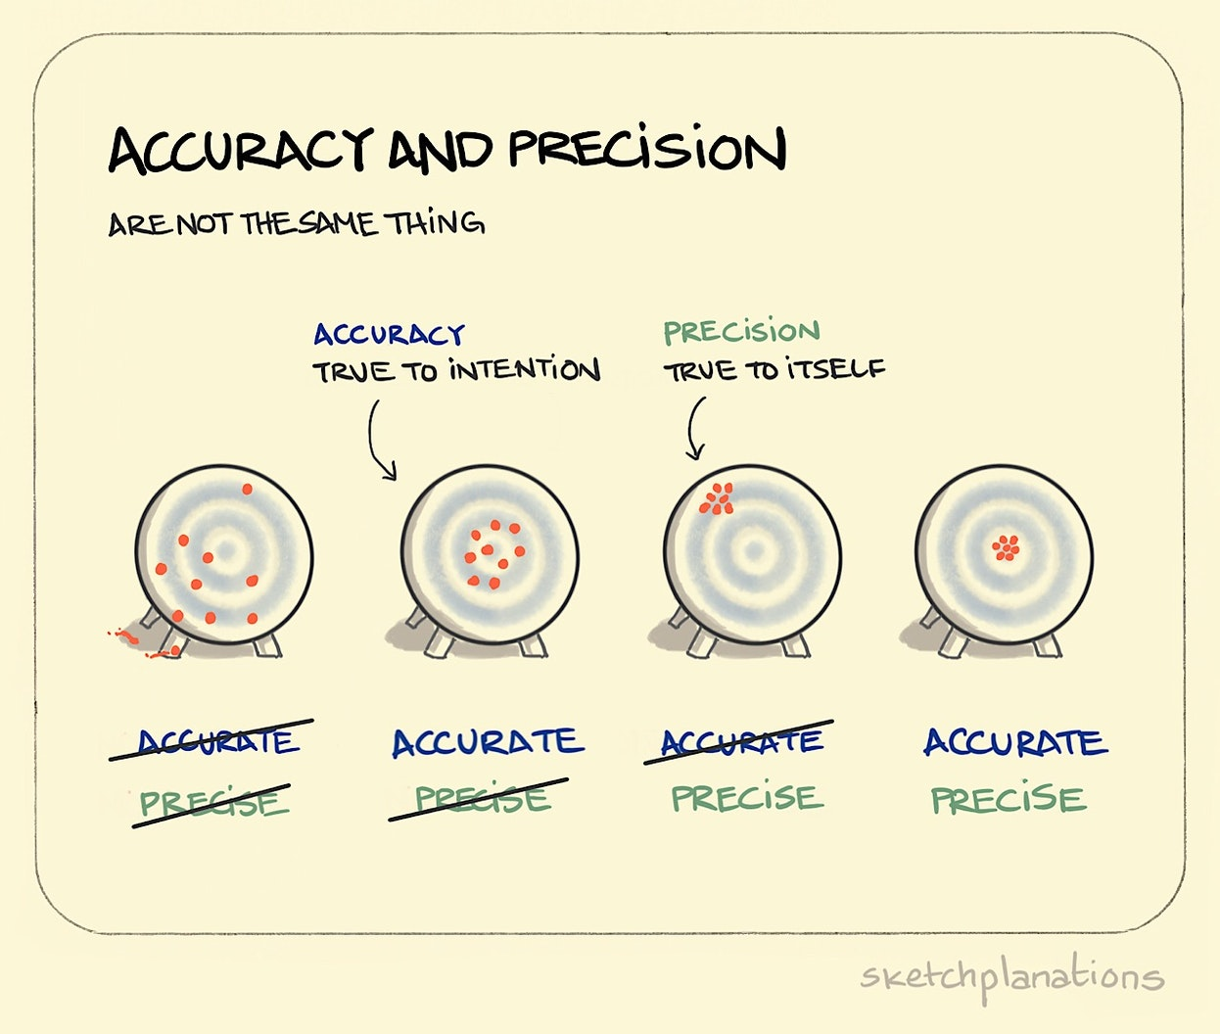
Ask Questions
Use questions as a diagnostic tool
Rephrase to promote understanding
Be clear
Avoid “quick responses”
Source of error report
Why now?
Separate concerns
Determine the impact
Notes:
Rather than just stating a problem, rephrase as “could it be this component”
Don’t cry wolf unless you are absolutely sure, it distracts the team
QA’s and testers often tell me “click here and then go back” – “do I wait for the content to load or not “ could have saved me 30 minutes.
Some people don’t know the difference between “crash” and “lag” or “error”
Know where your report came from:
- Social media / Call centre complaints - some experience is being affected and is more likely a subset of devices (e.g. Samsung Android devices) or a downstream service could be slow.
- Historic baseline delta spike - normally these are anomalies, like people doing more or less transactions during Christmas or New Years.
- Management personal account - sometimes a high level manager with a production account will report a problem to the support team. These are normally a personal connectivity issue.
- Crash rate increase - these are the most concerning as there is usually something really serious going on.
Imapct questions:
- Root cause: what actually caused the problem?
- Feature affected: what did users see?
- Reports:
- how did we know something was wrong?
- how do we know it is fixed?
- Users affected: can we determine the total number of unique affected users?
- Downtime: how long did it last?
- Resolution: what did we do to fix it?
- Reflection: how would we do it differently?
Stories:
AOL (Accounts On Line)

Slide 5




Have your tools ready
Access
Run books
Reports
Communication
Notes:
Ensure
You know what access you need and how to obtain it
your access to systems is maintained
Run books should be ordered by feature and contain
The core team responsible for delivery
Emergency contact information
Status report link
Architecture diagrams (dependency lists)
Repository link
Reports can sometimes only give you half the picture. It’s very important you know how to read reports.
Read in between the lines: 1000 crashes is not 1000 users impacted
I recommend only having one communication tool. Eliminate distractions and ensure you keep company and client data absolutely confidential
Stories:
- Once I was being pushed so hard for a fix I ended up creating 10 pull requests because people would not stop ”just pinging” me

Slide 6

Trust the team
Processes are there for a reason
Don’t be a hero
Sometimes things need to remain “unresolved”
Trust is precious, even more so when it’s lost
Ask for feedback
Notes:
Bypassing code review and testing in the name of an immediate fix is reckless.
It also undermines the entire point of having those things there
When you do something – remember it’s being done on behalf of everyone.
You’re acting on behalf of yourself, the team and the company.

Slide 7
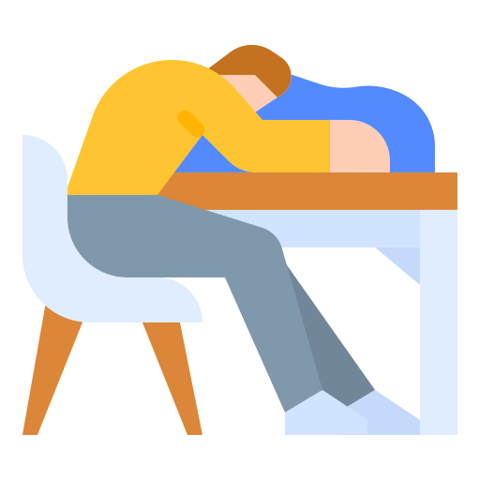
Take downtime
Rest period
Directly after a call out
Between being on call
Draw lines
Know what sacrifices you are making
Notes:
If you’ve been called out late at night, finish the call out by informing people you’ll be in later
It’s dangerous to be the guy everyone relies on, it’s just as bad NOT being that guy

Slide 8
Final thoughts
Do washups
Check your merging / release strategy
Schedule management

