Slide 1
Modernising Android Architecture Using MVVM and Android Architecture Components
https://github.com/zuhlke/dagger2_demo
Notes:
Introduce myself
The objective here is to try and come up with a SOLID, maintainable architecture. At Zuhlke, we do not want to necessarily subscribe to common practice and make the mistake of thinking it’s best practice

Slide 2
Agenda
Model-View-Controller (MVC) briefly
Model-View-Presenter (MVP)
dagger2
Lifecycle events
Model-View-ViewModel (MVVM)
Android ViewModel and LiveData
https://medium.com/@charbgr/bye-bye-dagger-1494118dcd41
Notes:
Some of you may be more familiar with some of these architecture models than others. Some of this will just be a general run through so that we are talking about the same structures
It’s really important that we consider our options for injection before we get really into the new ViewModel and LiveData structures, as we need to have a base for our understanding of each concept

Slide 3
Model-View-Controller
Controller
Actions
View
Update
Read / Write
Read / Write
Model
Notes:
SOLID non conformity
Increases distributes potential testing scope
Because we are developing Android apps, we would probably use this when we have an activity with lots of fragments so the controller can determine which fragment to display.

Slide 4
Model-View-Presenter
Presenter
Actions
View
Update
Read / Write
Model
Notes:
Presenters are easy to test in android because a unit test is normally enough.
They also contain all the business logic meaning that if there is a bug, we should be checking there
The main issue with presenters is that in order to be testable, it needs to be completely agnostic of Android libraries and lifecycle

Slide 5
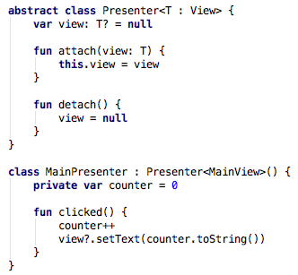
Model-View-Presenter
Notes:
This is what will be commonly used as our “go back”
Notice
the Presenter should be fully testable
Single Responsibility
Problems:
Presenter is tied to lifecycle of activity

Slide 6

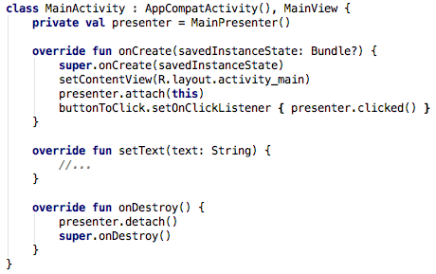
Model-View-Presenter
Notes:
This is what will be commonly used as our “go back”
Notice
the Presenter should be fully testable
Single Responsibility
Problems:
Presenter is tied to lifecycle of activity

Slide 7
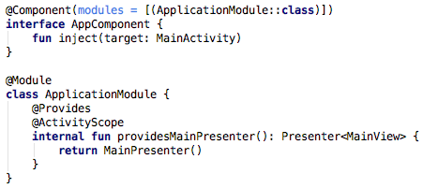
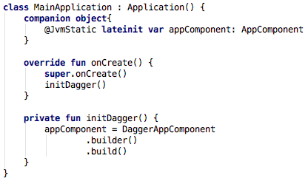
MVP with Dagger2
Notes:
Not lying: I don’t like Dagger. Not only because of it’s complexity, but also because documentation is fairly scattered
Can anyone spot the mistake in my design here?
providesMainPresenter should not have a new instance – but how then should it be managed? However this flaw occurs in both my options so it’s not really something that I can use to smash over the head
Application has a static reference to appComponent. Would love some suggestions to improving this – this is EXACTLY what we are trying to avoid

Slide 8
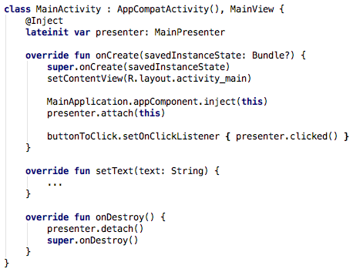
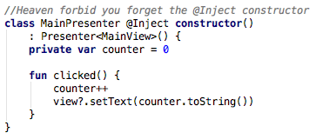
MVP with Dagger2

Slide 9

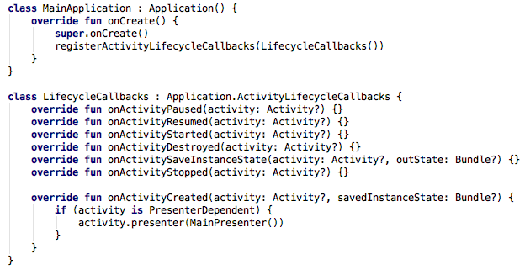
MVP with lifecycle events

Slide 10
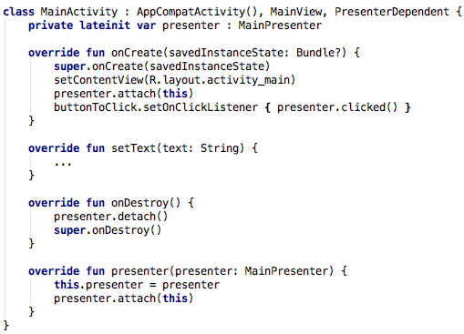
MVP with lifecycle events
Notes:
Files Changed Gradle changes
With dagger: 8 3
Without dagger: 3 0
This is taking into account that you have to modify the Manifest to add the custom application

Slide 11
Model-View-ViewModel
View
Model
Actions
View
Publish
Read / Write
Model
Notes:
ViewModel is slightly different from MVP. The ViewModel should have no reference to the View.
Instead the View is expected to subscribe to the elements of the ViewModel it is interested in, and it will receive updates
The benefits:
We are not constantly checking to see if the view is null on the ViewModel side
Surviving the orientation changes are now “free” – i.e. internally managed by the OS, not a 3rd party tool
There is a slight disadvantage: ViewModels are now Android objects <PAUSE FOR SHOCK>
This makes them hard to unit test

Slide 12


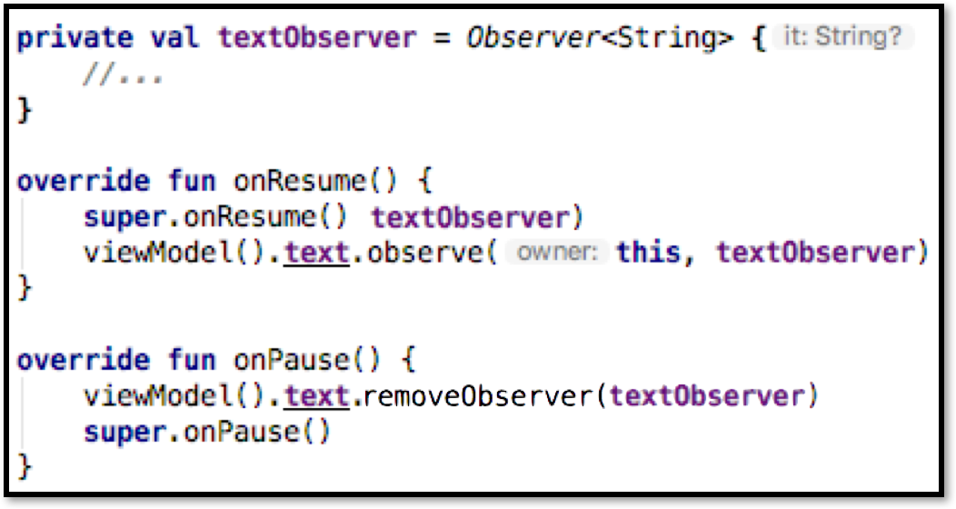
Model-View-ViewModel
Notes:
ViewModel is slightly different from MVP. The ViewModel should have no reference to the View.
Instead the View is expected to subscribe to the elements of the ViewModel it is interested in, and it will receive updates
The benefits:
We are not constantly checking to see if the view is null on the ViewModel side
Surviving the orientation changes are now “free” – i.e. internally managed by the OS, not a 3rd party tool
There is a slight disadvantage: ViewModels are now Android objects <PAUSE FOR SHOCK>
This makes them hard to unit test

Slide 13
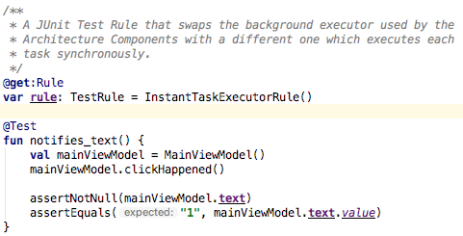
Model-View-ViewModel
Notes:
ViewModel is slightly different from MVP. The ViewModel should have no reference to the View.
Instead the View is expected to subscribe to the elements of the ViewModel it is interested in, and it will receive updates
The benefits:
We are not constantly checking to see if the view is null on the ViewModel side
Surviving the orientation changes are now “free” – i.e. internally managed by the OS, not a 3rd party tool
There is a slight disadvantage: ViewModels are now Android objects <PAUSE FOR SHOCK>
This makes them hard to unit test
We no longer need to inject Presenters or ViewModels because that gets handled for us. We can focus on injection of things like brokers that manage data, but in a similar manner

