Slide 1
Lean Agile
How I used Agile methodologies for weight loss
Notes:
I think the biggest problem with weight loss is that you can’t do it over night. You can’t make an emotional decision alone because it just won’t last.
Telling a loved one they’re over weight is particularly hard and the discussion is one that can be a serious relationship ender.
Even changing your patterns to more healthy ones can cause tension within relationships if you’ve become accustomed to a particular way of life. One thing is for sure though: Only one person is responsible for your health and what goes into your body and that is YOU

Slide 2
RETROSPECTIVE
What happened?
First iteration
Second iteration
What went badly
What went well
Backlog (Moving forward)
Notes:
First iteration lasted around 8+ years
Second iteration too

Slide 3
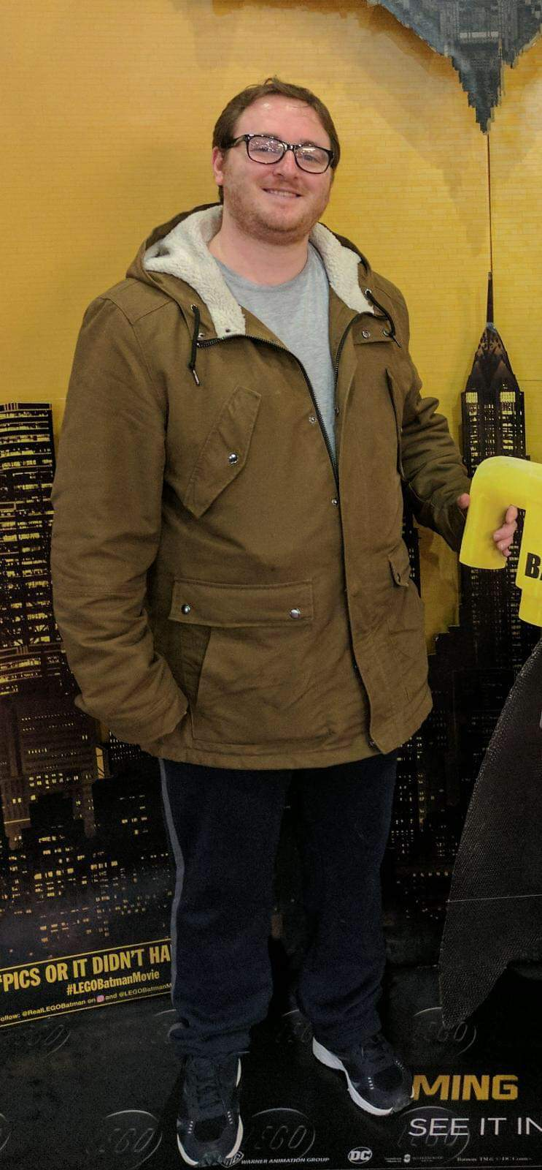
What happened? (1)
Me (2017)
Notes:
I’ve always been trying to control my weight. I moved to Northern Ireland in October 2016 and about a year later I realized I needed to do something
I had read several books, like “the 4 hour body” and while they had a lot of useful things, they also had a lot of impractical things
Logging is great, but does can become an addiction in and of itself
I plateaued way earlier than I had hoped. I hit a wall with calorie counting that felt next to impossible to break.

Slide 4
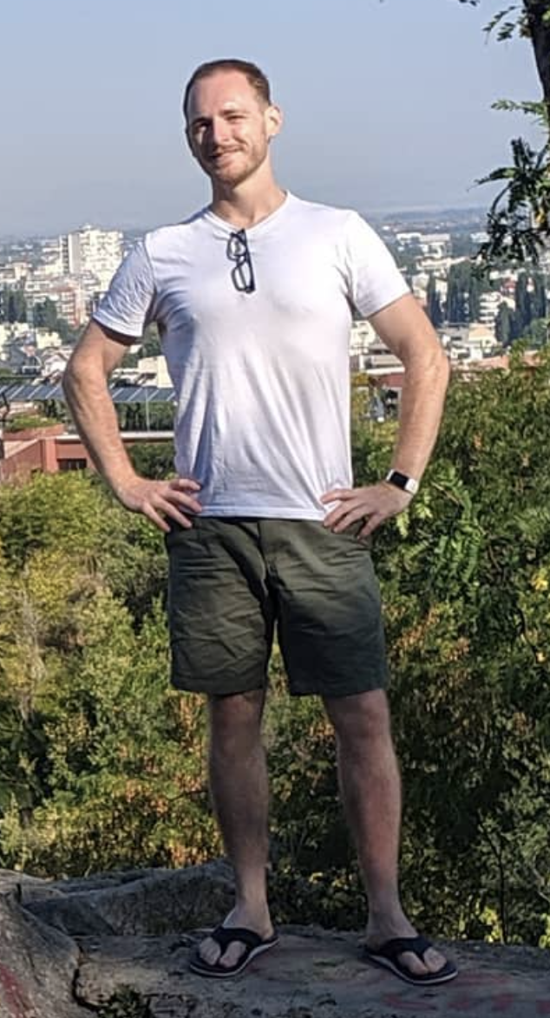
What happened? (2)
Changed the epic (Mindset) from “Lose weight” to “be healthy”
My dad lost a similar amount of weight
Started with 1 small change every 2 weeks
Drinking a minimum of 2l of water every day
Make the bed in the morning
Gradual changes to meals (add vegetables, then remove carbs)
Intermittent fasting, even for cheat days
Gym added later
Coffee added at the end
Me (2019)
Notes:
Some changes where mental. Some changes were practical. Some changes worked. Some didn’t.
I stopped worrying about numbers and started being concerned about my health. I was resolved to form healthy habits not necessarily losing weight. I stopped allowing myself to be coerced into eating badly.
While you will lose weight if you do weight training, I proved beyond a shadow of a doubt that it is possible to lose weight through diet alone without starvation.

Slide 5
What went badly
Having 30 grams of protein within the 1st 30 minutes of waking up
Using weight as the only metric
Having the same meals every day for 6 days a week over a period of 3 months
Counting calories (and not thinking of quality)
Measuring weight every day (with the wrong attitude)
Having a glass of tomato juice in the morning
Treating food as a reward
Stress eating
Notes:
Everyone has advice, even me. It can be overwhelming. Find someone you like and stick with them.
While thin people mean well, they don’t realize that they have some habits they just do without thinking.

Slide 6
What went well
Allowing for failure, celebrating success (without food)
Listen to others, but within reason*
Taking on the responsibility of food on myself
Not trying to change everything all at once and then giving up
Intermittent fasting after fixing the quality of meals
Focus on the attitude towards food and not exercise (for weight loss)
Started Walking, Hiking, dancing, Gym for fun
Knowing that “cheating” is a mental thing
Accountability (Friends, diary)
Seeking professional help
Never ”quitting” a particular kind of food
Notes:
Accountability is really useful and can come in several formats.
Your partner can help you,
your friends (I still have a WhatsApp group of close friends and we weigh in every week)
Keep a diary
You can take a photo of the food you eat next to your hand for scale
You can take regular pictures of yourself – MyFitnessPal is good for this or Google Calendar
I never “quit” any kind of food until January 2019, and that is more for a personal challenge than a diet thing.

Slide 7
The Application of Agile
Individuals and interactions over process and tools
What worked for me, sought professional help
Working software over comprehensive documentation
Metrics to the background, rather focus on habits
Customer collaboration over contract negotiation
Small changes over time rather than one large commitment
Responding to change over following a plan
When it didn’t work, it got cut out immediately
Notes:
Fitbits, smart scales, diet programs are only as useful as you make them.
Don’t do measurements if you can’t be honest with yourself

Slide 8
BACKLOG (moving forward)
No expectations
Keep the past in the rear view mirror
Dance in the moment
Don’t eat your feelings
Small Incremental changes
Notes:
It takes 21 instances of a behavior before it becomes habitual. I now drink around 4l of water a day, for example.
Eating feelings happens (for me) when I’m unusually happy and when I’m sad. I’m slowly learning to identify the behavior and correct this.

Slide 9
Useful Videos
A simple way to break a bad habit
https://youtu.be/-moW9jvvMr4
How bacteria rule over your body
https://www.youtube.com/watch?v=VzPD009qTN4
Gravity transformation
https://www.youtube.com/user/GravityTrainingSol
Notes:
There is science that suggests the bacterial microbiome in your stomach actually communicates with your brain, and the bacteria that are fed the most create the desire for particular food that they like.
This means that it’s more than just ”your” desires that encourage certain foods, but actually the foreign elements in your stomach. This make it more than just a change of mind, but biology, which takes time.
You will crave ”bad” foods
You need to create a “healthy” microbiome
One hack to this is when you crave unhealthy foods, have a healthy meal first and then have the unhealthy foods. After the healthy food you won’t be hungry anymore.
Filling up on vegetables is easy because they fill your stomach – carbs generally “liquify” easily and are harder to fill up on. Treat your stomach like you are playing the worlds worst game of tetris

Slide 10
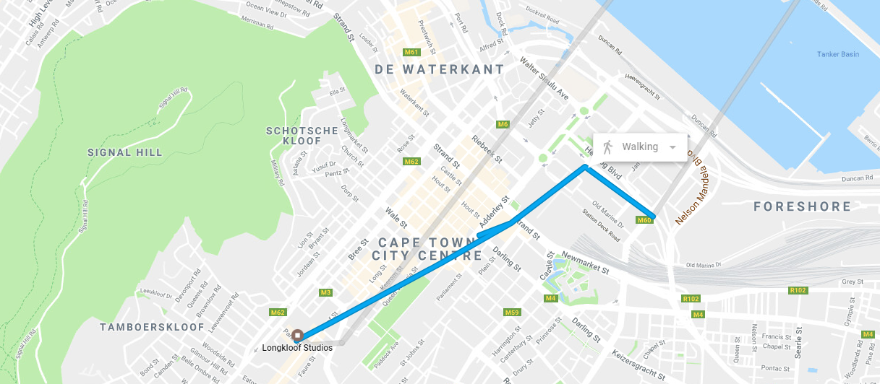
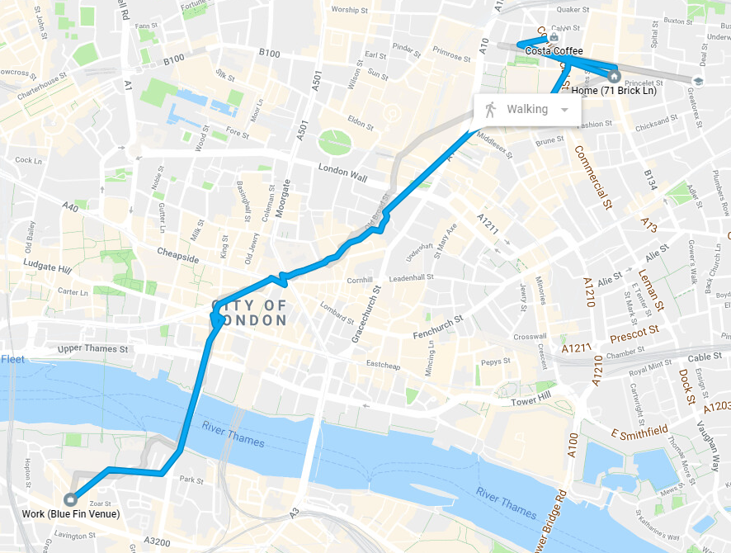
Interesting info
I used to walk 6km a day without changing diet No change in weight. I still walk around 6km a day
Conclusion: Exercise makes you healthy but diet makes you thin
Short term weight gain seems to be “easy-come easy-go”
Notes:
It’s really important to listen to the way people talk to you about weight loss
“Oh you can’t eat that now” – bullshit – I eat whatever I want. It’s what I want that has changed, and also on a regular basis
Biggest help for me was realizing that healthy people eat unhealthy in front of everyone, healthy when they are alone. I was the opposite.
“It’s because of all the dancing” – they don’t want to acknowledge that it’s something they could change themselves (not saying it’s necessarily this every time, but too often people are projecting, and this is subtle but important to note)
EXERSIZE MAKES YOU HEALTHY. IT IS POSSIBLE TO BE HEALTHY AND FAT. DIET MAKES YOU THIN. IT IS POSSIBLE TO BE THIN AND UNHEALTHY. I can’t stress this enough

