Slide 1
Kernel Probes for ARM
  Quentin Barnes
  q.barnes@motorola.com
  Motorola - Mobile Devices
  April 17, 2007

Slide 2
Overview
Introduction to kernel probes
How kernel probes work
The classic kprobe model and 'boosting'
Difficulties with the classic model and ARM
New approach used for ARM
  Details of implementation
  Cost and Performance
Wrap-up

Slide 3
Kernel Probes Introduction
New with 2.6.9-rc2 kernels
  Currently: avr32, i386, x86_64, ia64, powerpc, sparc64, s390
Allows dynamic breakpoints (registered at runtime) to be placed most anywhere in kernel
Breakpoint transfers control to user specified handlers, executes the instruction, and returns
User handlers often used to aid debugging or collect performance data
Can be relatively low overhead

Slide 4
Types of Kernel Probes
Kprobes - “Kernel Probes”
  Places breakpoint at symbol plus offset or address
Jprobes - “Jumper Probes”
  Insert function call ahead of probed function
Kretprobes - “Return Probes”
  Probe function's return
Djprobes - “Dynamic Jump Probes”
  Future direction: Kprobe-like, uses a jump instruction rather than a breakpoint

Slide 5
How Do Kprobes Work?
Places a breakpoint instruction most anywhere
  On ARM, uses an undefined instruction
May register optional user pre-, post-, break, and fault handlers
  User handlers can do most things except block
More than one Kprobe allowed at one address
  Not so for Jprobes and Kretprobes

Slide 6
'Classic' Kprobes Model

Slide 7
Kprobes Registration & Prep
Do symbol lookup, if necessary
Validate address
Record probe and address for hash lookup
Save instruction at address and replace it with a breakpoint instruction
Allocate and initialize instruction slot
Do additional architecture specific initialization

Slide 8
Executing a Kprobe

Slide 9
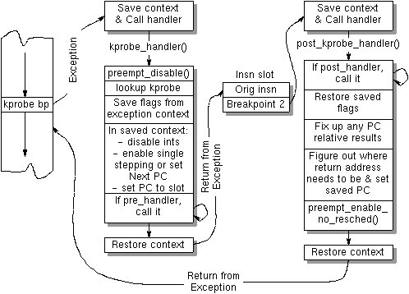

Slide 10
Issues with Classic Model
High execution overhead - two exceptions and four full context switches
Holds interrupts disabled through entire length
  Some re-enable though resulting in possible unbounded recursion, unpredictable behavior, and skipped user handlers

Slide 11
Performance Gain – 'Boosting'
Take one exception instead of two
Boosting short-circuits the second exception for pre-determined instructions by jumping directly back after execution

Slide 12
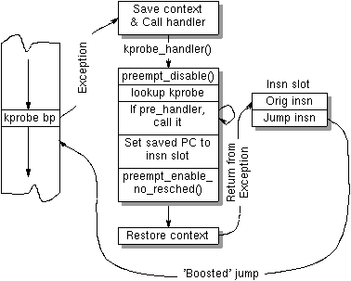

Slide 13
Boosting Limitations
Limited to only 'boostable' instructions
  No conditional jumps and no reserved or special instructions
Non-boostable instructions still run classic way (using two exceptions)
Use of post-handlers disable boosting still running classic way
Garbage collector

Slide 14
Boosting's Garbage Collector
Boosting holds lock on instruction slot even after execution completes
Garbage collector needed to clean up unused locks
When kernel preemption is enabled, garbage collector disables all interrupts and freezes all kernel threads across all CPUs simultaneously to run its O(n) time algorithm

Slide 15
Difficulties with Kprobes & ARM
No single-stepping supported in the processor
  Single-stepping causes the processor to trigger an exception after completing the current instruction
No Next-PC register
  The Next-PC register steps the processor to the “next” address after completing the current instruction

Slide 16
ARM Difficulties (cont.)
So no way to regain control of the ARM processor after executing instructions that alter the PC without decoding, detecting, and handling all instructions that can write the PC
No way to give correct results for instructions that read the PC without decoding, detecting, and handling
Once you've gone that far already, it's not that much further to a new approach

Slide 17
New Kprobes Approach

Slide 18
New Kprobes Goals
Do as much prep work as possible during registration of a kprobe to reduce its execution overhead
Complete the kprobe'd instruction and all its side-effects before returning from first (and only) exception
Provide consistent execution and behavior
Don't hold any locks longer than necessary

Slide 19
New Kprobes Advantages
Fully self-contained within arch, no changes to generic Kprobes code needed
Can work for all instructions, not just some
Always works, regardless of post-handlers
No second exception ever, so all that support code and additional logic goes away
No locks left dangling – so no headaches and no garbage collector

Slide 20
Advantages (cont.)
Interrupts disabled throughout single exception
  No unbounded recursion
  User handlers guaranteed to be called unless a handler itself triggers recursion by having a kprobe
Very light-weight
  Small code size
  Low execution overhead
MP and Preemptive (CONFIG_PREEMPT) clean

Slide 21
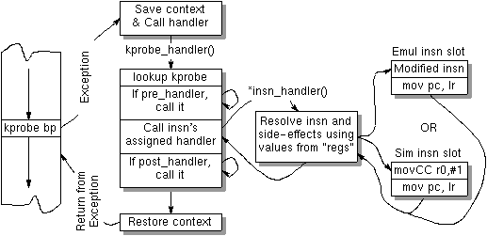

Slide 22
How Does *insn_handler() Work?
At registration time:
  Depending on the form of the kprobe'd instruction, an instruction execution handler is assigned
  Registers used by the instruction are recoded to use the registers the instruction handler expects
  Modified instruction or condition code test instruction saved to instruction slot
Two groups of instruction handlers - ones that execute a modified form and ones that resolve the instruction in straight C code
  C-only ones are for instructions that write the PC

Slide 23
Instruction Handler: Example 1
Kprobe'd instruction - “blne addr”
Modified instruction in slot - “movne r0, #1”
Handler assigned - simulate_bbl()
  25 total instructions

Slide 24
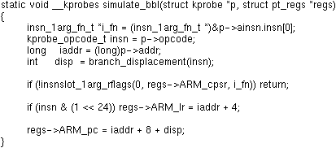
simulate_bbl()
All in C since “bl” writes to the PC
Handles both “b” (branch) & “bl” (branch & link)
Could have been two handlers

Slide 25
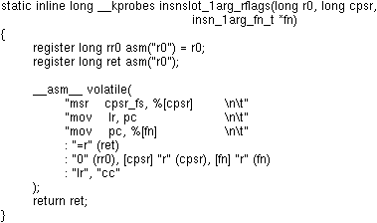
insnslot_1arg_rflags()

Slide 26
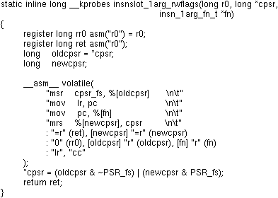
insnslot_1arg_rwflags()

Slide 27
Instruction Handler: Example 2
Kprobe'd instruction - “add r3,r6, #7”
Modified instruction - “add r0, r0, #7”
Handler assigned – emulate_alu_imm_rflags()
  19 total instructions

Slide 28
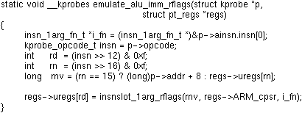
emulate_alu_imm_rflags()

Slide 29
Isn't It Expensive?
Twenty-seven instruction handlers (5 sim + 22 emul) cover virtually all ARM instructions
Most instruction handlers compile down to just 10-40 instructions
The ARM Kprobes is 6.6KB of code
With no second exception ever and no boosting, all that support code is tossed away

Slide 30
Overhead Performance
Overhead results on PXA270@364.00MHz
  Kprobe: 1.21us
  Jprobe: 3.11us
  Kretprobe: 3.40us
  Kprobe + Kretprobe: 3.81us
  Jprobe + Kretprobe: 5.86us
Measured with Jim Keniston's kprobe overhead testing software with defaults (iter=5000000, handler=1)

Slide 31
So What's the Catch?
Uses a lot of decode decision paths and some handlers infrequently used, so needs extensive testing and chance of latent bugs
Technique is easiest for RISC and orthogonal instruction sets, but could be harder for others

Slide 32
State of the Port
Kprobes, Kretprobes, and Jprobes complete and all working
Some bugs still running around
Some rare and unusual instructions not supported – ones that change CPSR state
Patches for 2.6.20.4 kernel released to Systemtap/Kprobes mailing list on 4/11/07

Slide 33
What's Left
Shakeout of approach and code
Test suite to test all decode paths and instruction execution handlers
Integrate into ARM Linux and kernel.org trees
Finish port of Systemtap's runtime and test suite to ARM and modify Systemtap to support cross-compiles
Djprobe version

Slide 34

What's Left? (cont.)
Remember for the new Kprobes I said one of the goals was to do as much prep work as possible? I'm not quite doing that yet...
Use larger instruction slots, do more at registration and less at runtime:

Slide 35
Systemtap
User space front end to Kprobes
Simple command line interface and scripting language
Does it all – compiles script to C code, builds, loads, and runs the kernel module

Slide 36
URLs
Systemtap:
  Home: http://sourceware.org/systemtap/
  Mailing list: http://sourceware.org/ml/systemtap/
Motorola Open Source
  http://opensource.motorola.com/

Slide 37
Questions?

