Slide 1
Basics of Wireguard
CUCUG
Quentin Barnes
1/20/22

Slide 2
Why use a VPN/Wireguard?
You don’t 100% trust the network
  Coffee shop, hotel, or any WiFi that’s not yours
You don’t 100% trust the network provider
  Comcast, AT&T sniffing traffic and DNS queries
You want to logically connect two physically separate networks
You want a service provider to think you’re somewhere else

Slide 3
What is Wireguard?
VPN software that’s secure and simple
Fast, flexible, and free
Supported on most devices
  MS Windows, MacOS, iOS, Android, Linux, BSD
Supported by many Commercial VPN providers
  NordVPN, Mullvad, ovpn.com, etc.

Slide 4
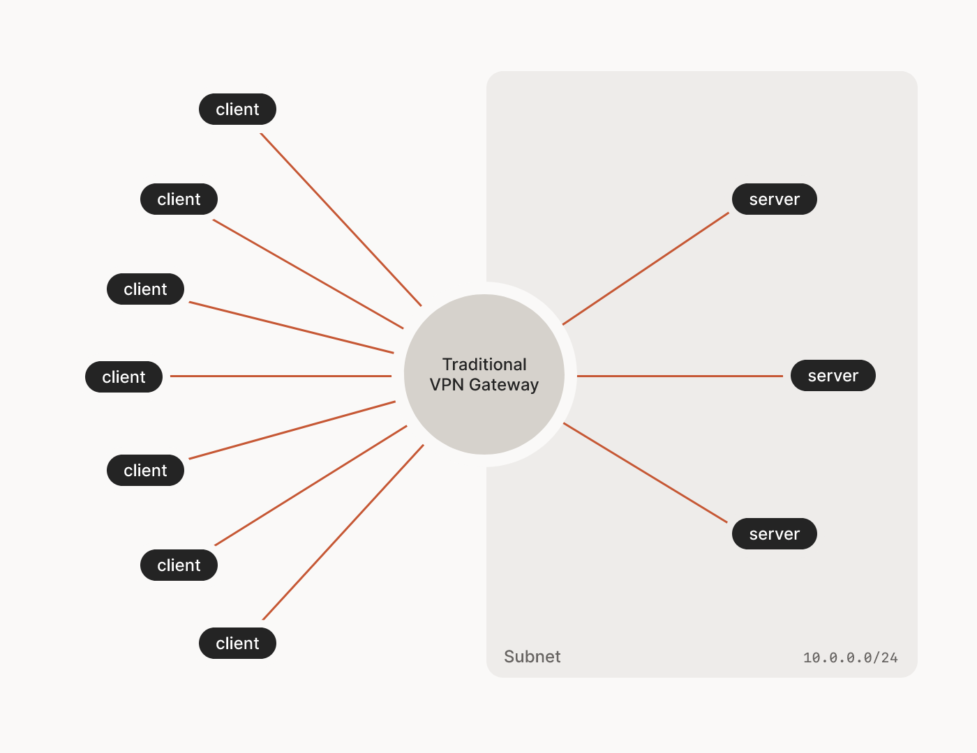
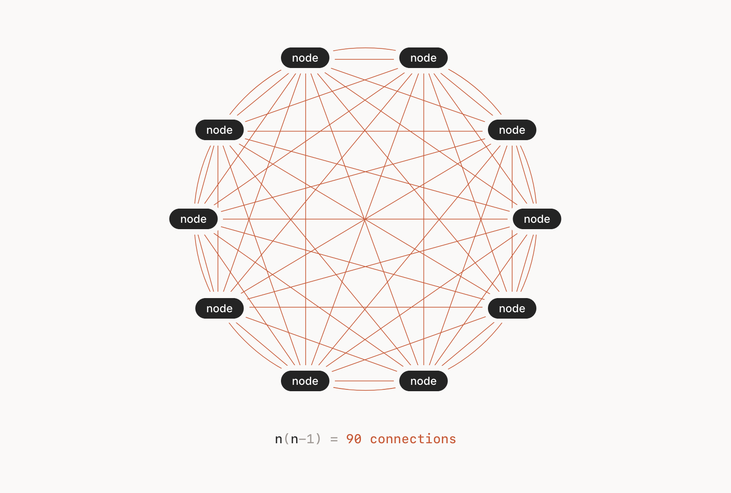
Using Wireguard
Hub and Spoke vs. Mesh
– Pictures from Tailscale

Slide 5
Home Wireguard Use Case

Slide 6

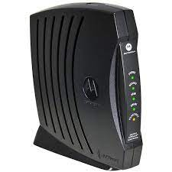
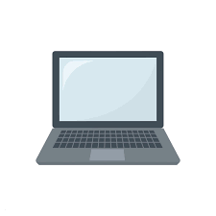
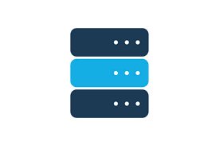
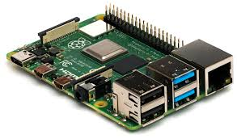
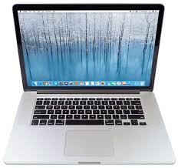
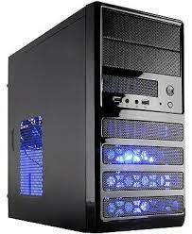
Physical Network Connections
My laptop at
Coffee shop
VPS
Droplet
Raspberry Pi
Wife’s MBP
Home Desktop

Slide 7
Logical Network Connections
Laptop at
Coffee shop
VPS
Droplet
Raspberry Pi
Wife’s MBP
Home Desktop

Slide 8
My Wireguard Uses
For security with laptop when away from home
  And still be on home network to access home machines
Wife, geolocation, and MLB.TV
Have VPS email server logically on my network
Cable modem has no Internet visible ports open
  No remote “attack vectors”

Slide 9
Other People’s Uses
With friends and family:
  Sharing home media servers
  Off-site backups
  Remote support
Uses mesh to keep all computers’ IP addresses unchanging at home or on the road (RV) without having to go through a hub

Slide 10
Demo!

Slide 11
Demo
Brand new VPS droplet
  Configure with 0-pkginst and 1-prep
  Use qrencode to display peer wireguard configuration
On device with camera
  Install Wireguard app and launch it
  Tap ‘+’, use QR code, add any name (e.g. “cucug”)
  Enable “cucug” with its button
  Test with whatismyipaddress.com to show droplet’s IP and that it thinks you’re now in New York

Slide 12
Additional Reading
https://www.wireguard.com/
https://tailscale.com/

