Slide 1

Building Your Own Desktop PC
CUCUG
Quentin Barnes
January 16, 2025

Slide 2
Why Build Your Own?
Get exactly what you want
  And don’t pay for things you don’t want!
Can be a lot cheaper
  My recent one was about half the cost of a comparable pre-built one
Makes it easier to plan what to upgrade later

Slide 3
Skills Needed
Basic knowledge of computer pieces and parts
Basic screwdriver skills
Mechanical and spatial awareness
Understanding that static electricity is bad
And most importantly - Patience!

Slide 4
What to Consider First
What is my budget?
What do I need the system to do or run?
  AAA gaming, A/V editing, browsing the web
Any parts I can scavenge or buy used?
  Monitors, keyboard/mouse, hard drives/SSDs
  Even motherboards, processors, graphics cards, memory, anything
What form factor(s)/physical size will work?

Slide 5
Budget Considerations
Where am I willing to cut?
What am I unwilling to compromise on?
  Certain features, manufacturers
Can I buy used or refurb?
What can I put off to a later upgrade?

Slide 6
What It Does
Look at all the software you’ll run
  See what other people use for that software:
    Processor speed, CPU count, cache size
    Graphics horsepower
    Memory and storage
    Any peripherals?

Slide 7
Scavenged and Used Parts
My previous desktop build from 2020 had:
  Case scavenged from an ancient 2005 build
  Used, refurb motherboard from Ebay
  Used DIMMs from Ebay
  Used graphics card from Amazon reseller
No regrets or problems from those parts

Slide 8
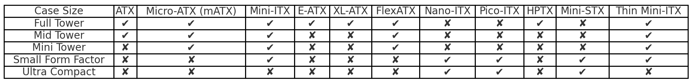
Form Factors
Decides case, motherboard, expansion slots, and power supply

Slide 9
Other Considerations
Number and type of USB ports
WiFi, Bluetooth, Ethernet ports and speed
How many monitors
  At what resolution and refresh, with what cabling
Power consumption
What future-proofing concerns might you have?

Slide 10
Helpful Resources
PC Part Picker
ChatGPT
Reddit

Slide 11
PC Part Picker
pcpartpicker.com helps you with:
  Sourcing
  Pricing
  Compatibility
  Tracks power consumption

Slide 12

ChatGPT
From your prompts will offer suggestions
  Keep in mind, ChatGPT info can lag
One of my sessions:

Slide 13
Reddit
Check out and ask questions in:
  r/buildapc
    And check out its Resources and Wiki
  r/mffpc, r/sffpc

Slide 14
Cautionary Notes
Shoot for a balanced system
  Don’t try to stick a V8 in a VW Beetle!
    Make sure processor, graphics, cooling system, and PSU are balanced
Be aware of “analysis paralysis”

Slide 15
My Goals
Beefy processor, fast memory and storage
  E.g.: Doing parallel builds of Linux kernels
Drives two 4K monitors at 60 Hz or higher
  Light gaming, so no hardy 3D graphics needed
Fast wired Ethernet
Smaller than a full-size desktop

Slide 16
Additional Goals
AMD Zen 5 processor
ASRock, Gigabyte, ASUS, or MSI motherboard
  Wanted a tweakable, hack-friendly BIOS
Buy nowish because of possible future tech tariffs

Slide 17

What I Went With
Got some screaming Cyber Monday deals
Lian Li A3 mATX case
ASRock B650M Pro RS WiFi motherboard
AMD Ryzen 9 9900X 12-core processor
Full build:

Slide 18
Goal Met!
Kernel build time dropped from 3:36:44 to 32:16
  Going from a Ryzen 5 3400G (July 2019)
  A 6.7X improvement!
  (Full kernel and tools package build with 38 rpms)

Slide 19
Questions?

