Slide 1
Software-defined Radios
(SDRs)
CUCUG
Quentin Barnes
May 21, 2026

Slide 2
What’s a Radio?
Converts an EM spectrum signal into data or voice
Antenna > Tuner > RF Amp > Demodulator >
Audio amp > Output/speaker

Slide 3
What’s a Software-defined Radio?
Antenna > ADC > > Output/spkr
Well, almost. Might have a bit of filtering and amplifiers between stages.
Magic Box
Running
Software

Slide 4
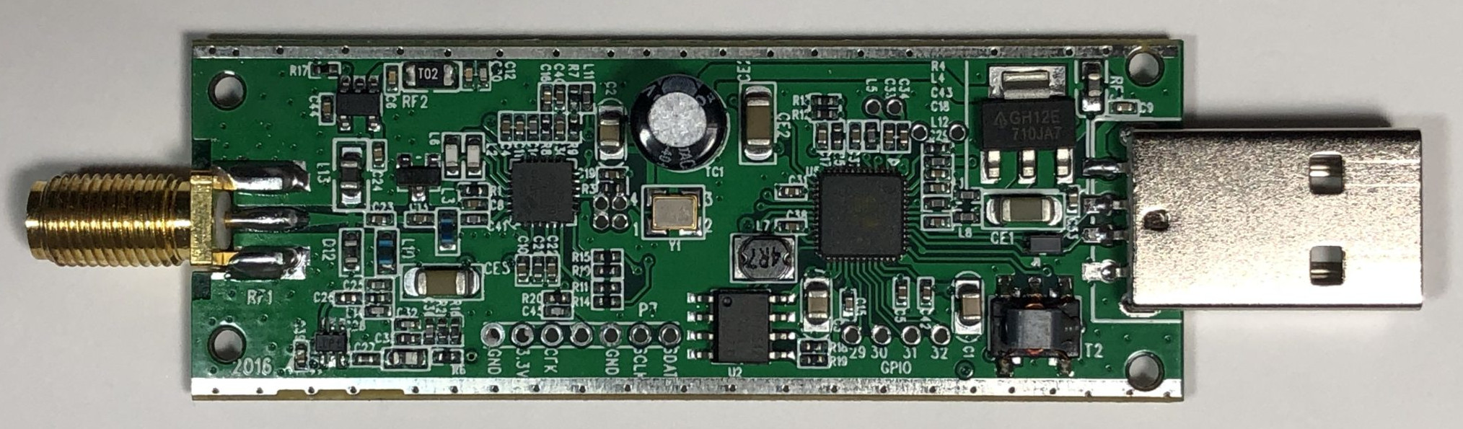
RTL-SDR v3 Guts

Slide 5
Units I Have Today
RTL-SDR Blog v4
Nooelec RTL-SDR v5
Specs
  100 kHz to 1.75 GHz
  ~2.4 MHz bandwidth
  ADC: 8-bit
  Interface: USB 2.0

Slide 6
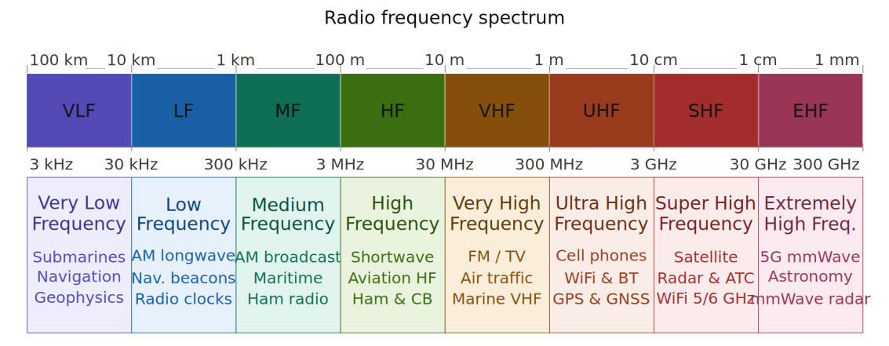

Slide 7
How Much?
Mid-Tier (~$100 - ~$400)
  AirSpy
  HackRF One
  SDRplay
Budget (~$35 - ~$50)
  Nooelec NESDR SMArt v5
  RTL-SDR Blog v3/v4/v4c/v4l

Slide 8
But What Can I Do with It?
Listen to just about any AM, FM, SW broadcast
Capture live pictures from satellites
Make a trunked software scanner
Track airplanes overhead via their ADS-B
  Log them on FlightAware or FlightRadar24
  Make Elon hate you!
Track NWS weather ballons
  Log them on Sondehub

Slide 9
Thoughts to Keep in Mind
Sensitivity vs. Selectivity
  Block filters may be needed
Bandwidth
  SDR’s “window” into the RF spectrum
Analog-to-Digital Converter (ADC)
  More bits, more signal resolution
Antenna and placement is essential
  Bigger is not always better!

Slide 10
Demo!

