Slide 1
Some Raspberry Pi Alternatives
With an Orange Pi 5 Demo
Quentin Barnes
1/19/22

Slide 2
Why Alternatives?
“Unobtainium”
  Supply problems, Industrial customers
  I’ve been trying to buy an RPi 4B since last April
No Raspberry Pi 5 until 2024
More selection, multiple vendors

Slide 3
Some Alternative Companies
Udoo (https://www.udoo.org/)
ODROID (https://www.hardkernel.com/)
Libre Computer (https://libre.computer/)
ASUS Tinker (https://tinker-board.asus.com/)
Banana Pi (https://www.banana-pi.org/)
Orange Pi (http://www.orangepi.org/)

Slide 4
Markets
Some companies tend to emphasize:
Low end, hobbyist boards:
  Libre Computer, Banana Pi, Orange Pi
Entry/low-power computing boards:
  Udoo, ODROID
Embedded commercial/industrial:
  ASUS
But most have offerings across multiple markets

Slide 5
Orange Pi, the Company
China-based
Direct competition to Raspberry Pi
Open hardware and software
May not be hardware accessory compatible
  Need to check each device
  HATs (Hardware Attached on Top) not compatible

Slide 6
Orange Pi 5
Light Desktop Computer
Powerful ARM Cortex CPU (8 cores, up to 2.4GHz)
Powerful Graphics (2D/3D engine)
  Multiple displays, 8K (7680x4320) resolution @ 60Hz
Up to 32GB on-board RAM
PCIe M.2 socket for SSD or peripherals
Gigabit Ethernet, but no on-board WiFi or Bluetooth

Slide 7
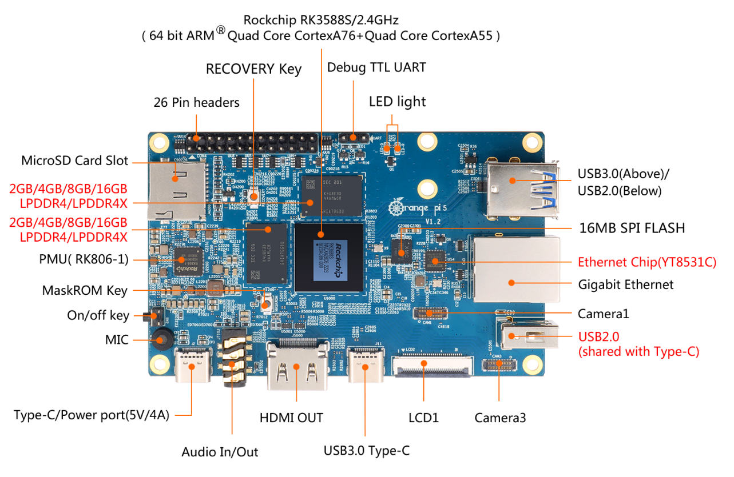

Slide 8
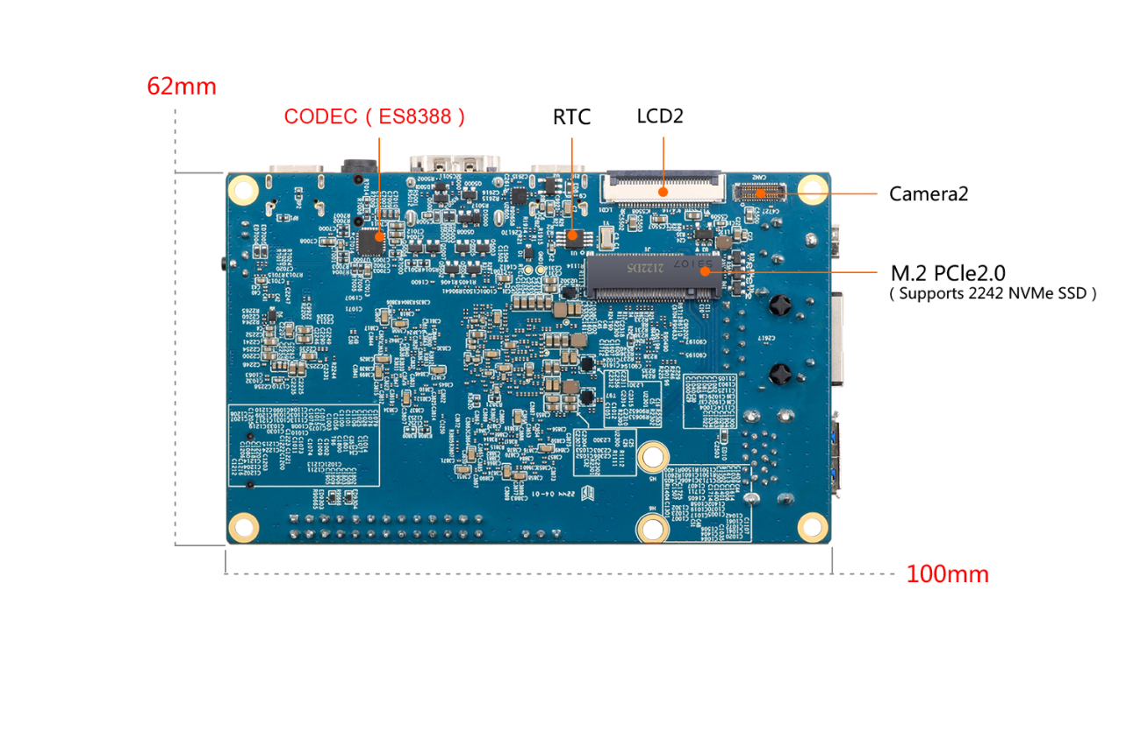

Slide 9
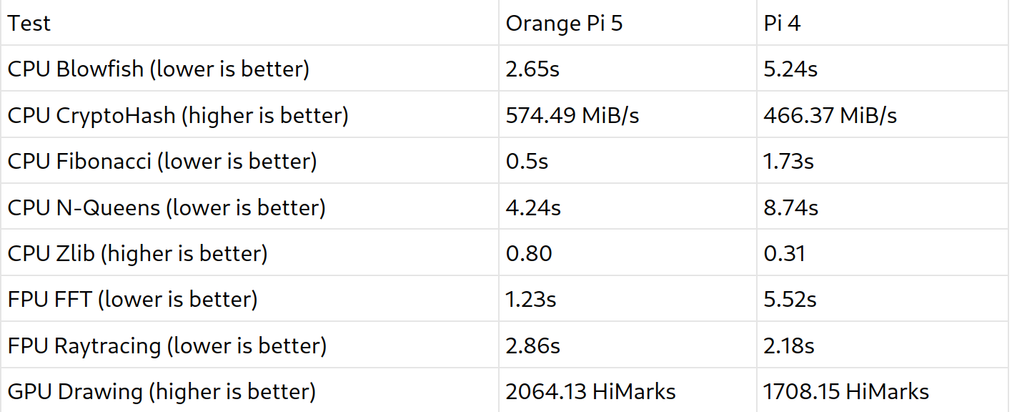
Rpi4 vs Opi5 Performance

Slide 10
Costs
Raspberry Pi 4B 8GB - $75 MSRP
  Street prices now around $175, but trending down
Orange Pi 5 8GB - $100
My setup with power supply, heat sinks, and acrylic case ran me in total (incl shipping+taxes) - $126
  Street price for my exact setup now - $141
Boards with less RAM much cheaper though

Slide 11
Demo!

