Slide 1

Scanning Lots of Huge
and Bound Items
CUCUG
Quentin Barnes
August 20, 2026

Slide 2
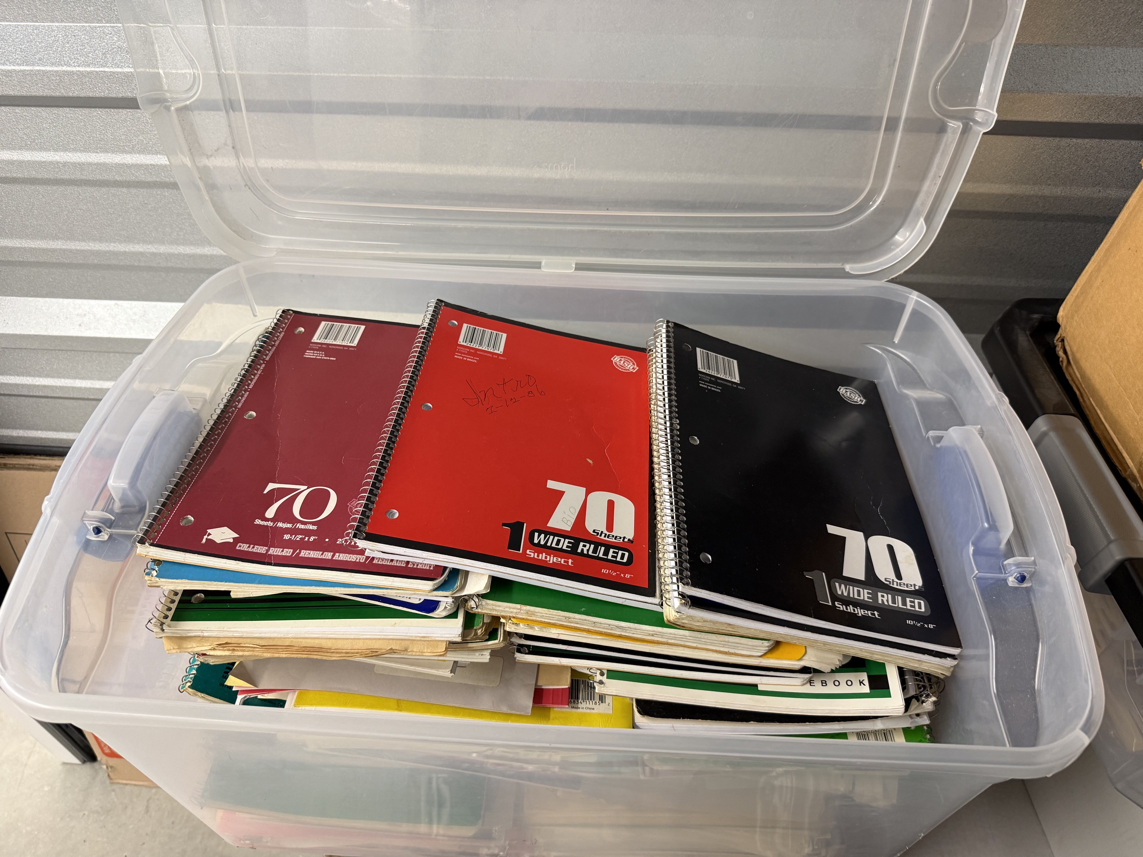
Mission: Archive
My ~40 year-old box of wide, fanfold printouts
My dad’s tub of folders,
notebooks, magazines,
newsletters, files, maps,
and correspondence

Slide 3
Considered: Current Scanner
Brother MFC-L2750DW with Duplex ADF
Cut bindings or do 1000s of pages one at a time
Only 8.5”x14”, so no maps, newspapers, or most printouts

Slide 4
Considered: New Scanner
Looked at overhead flatbed scanners
Expensive
  Ones that are good, could do handle large enough sizes, and would auto-flatten are around $800 on up
Once the project is over, sell it?

Slide 5
Local Public Scanners
Champaign Public Library
Urbana Free Library
UIUC Libraries

Slide 6
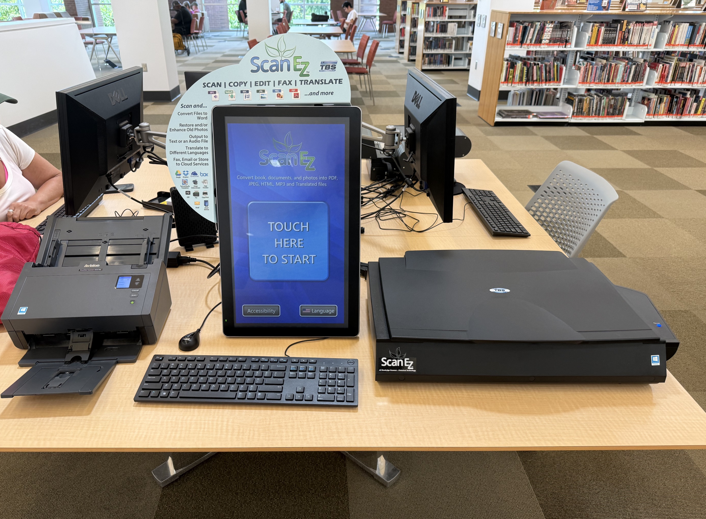
Champaign & Urbana Libraries
Basically same equipment (TBS ScanEZ)
  Urbana has more equipment in its archive room
ADF and an A3
flatbed (11.7”x16.5”)

Slide 7
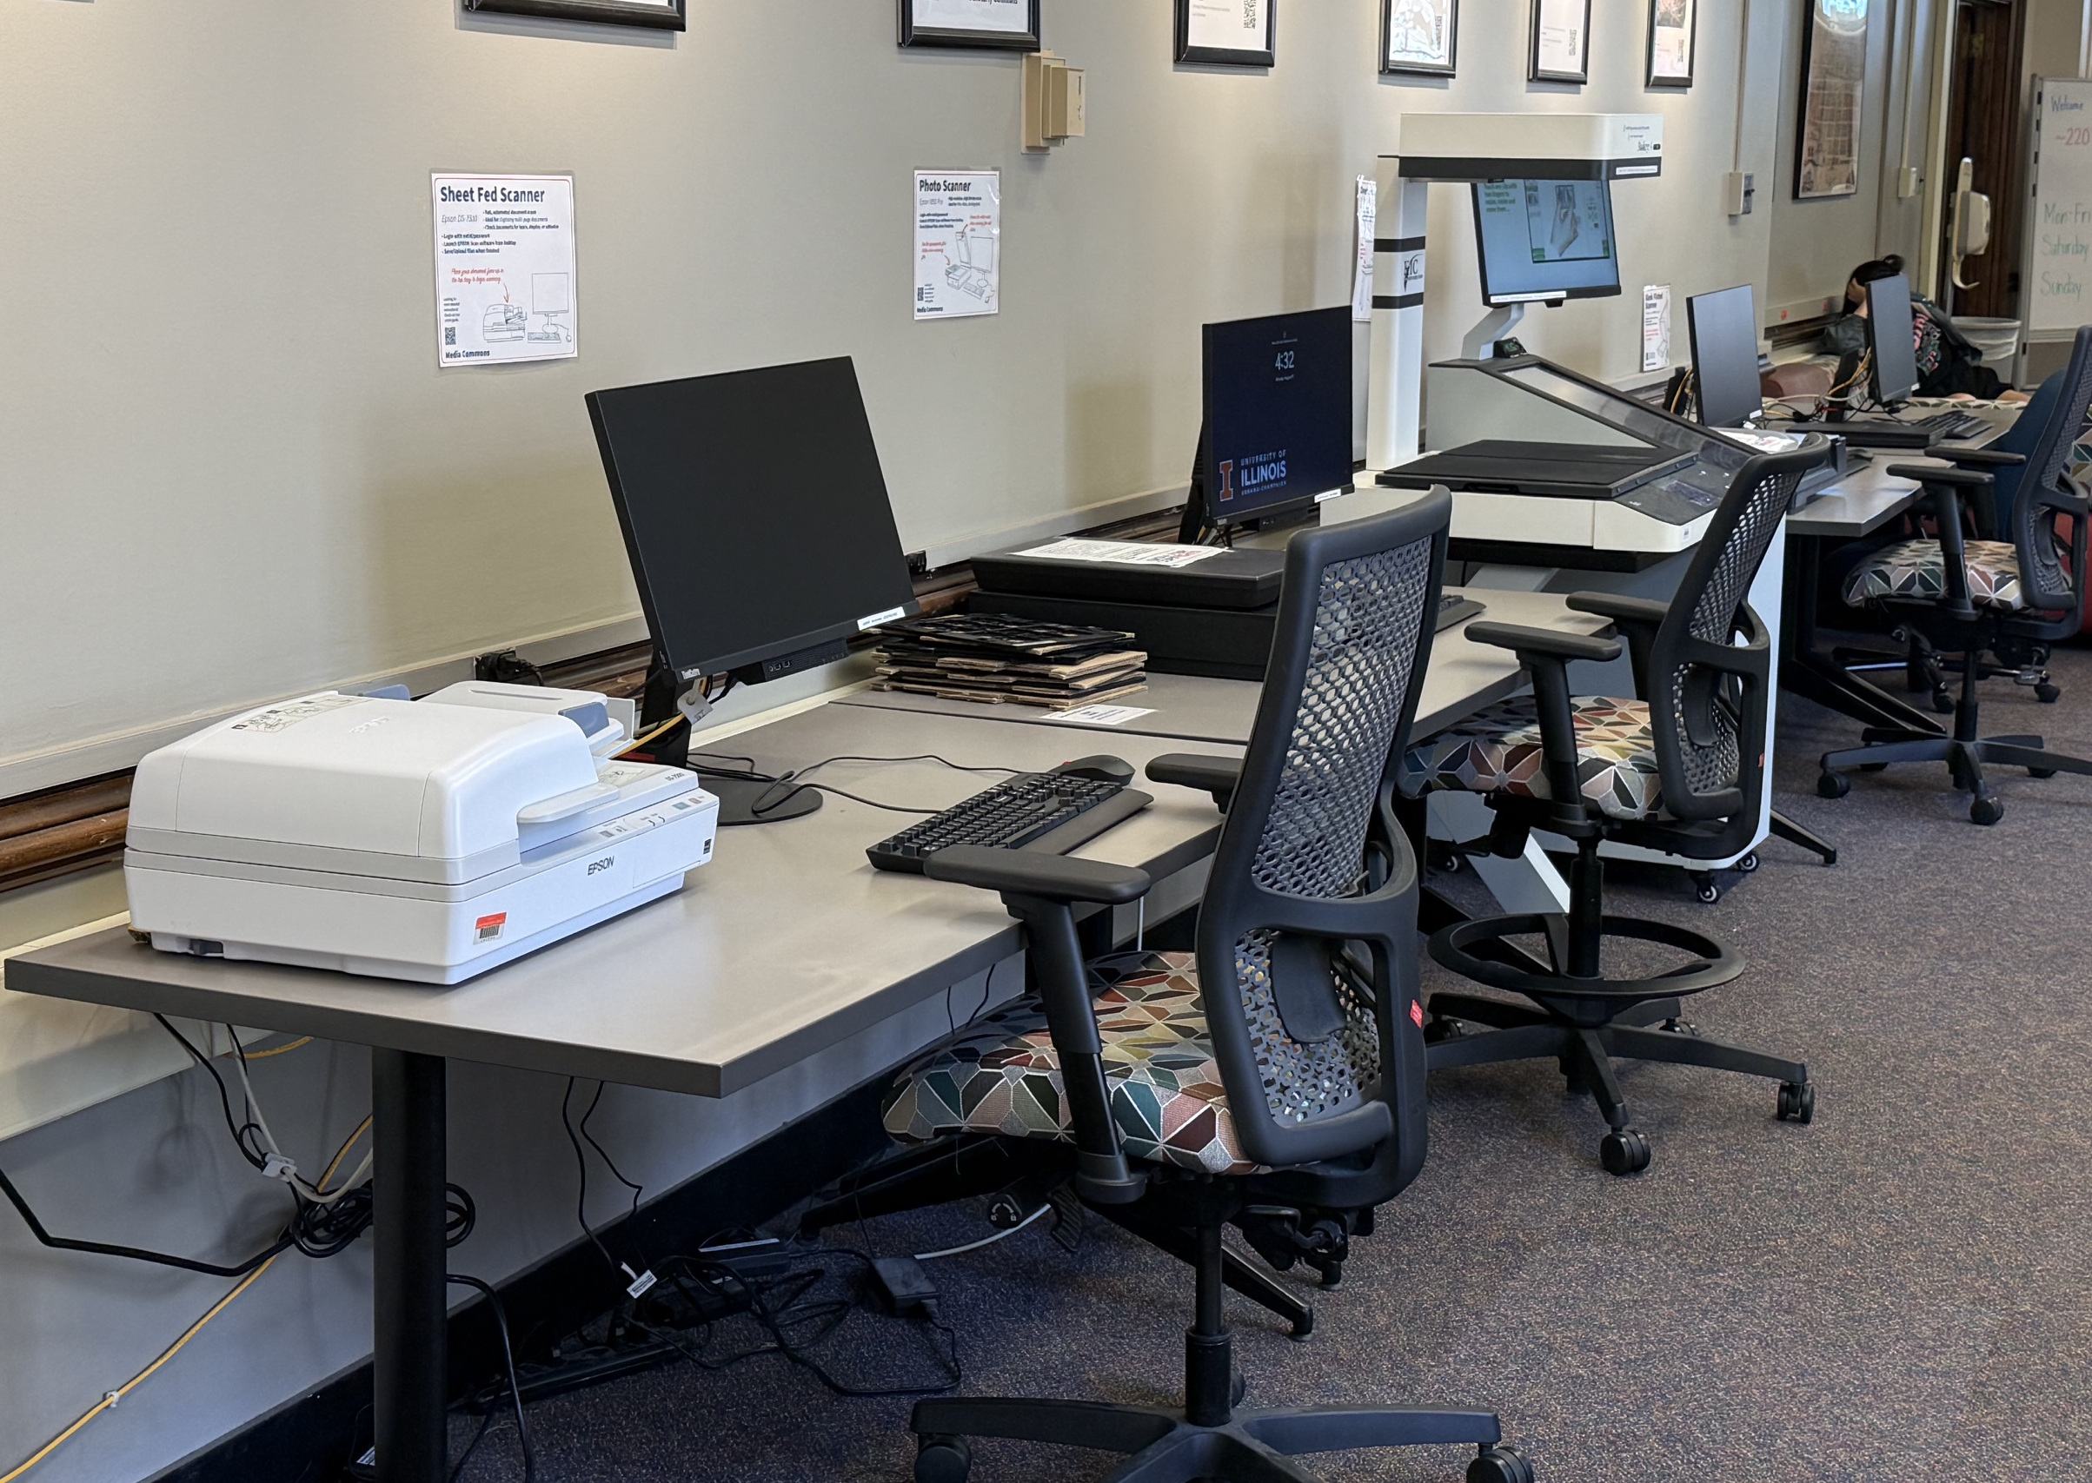
UIUC Libraries
Yes, completely available to the public
16 libraries have
scanners
Media Commons
in Main Library has
best selection

Slide 8
KIC Bookeye 4 v3
Has two, in Media Commons (rm 220) and
International and Area Studies Library (rm 319)
Huge scan size, 15.3” × 18.9”
Optical resolution up to 400dpi (200dpi default)
Fast! (@200dpi in 1.1s / @400dpi in 3.2s)
Curve flattener and angled book holder

Slide 10
Mission Accomplished? Almost...
Finished my dad’s tub
  129 items of ~5300 pages
Still has some printouts left to do in my box
OCR
  Tesseract
  Claude

