Slide 1
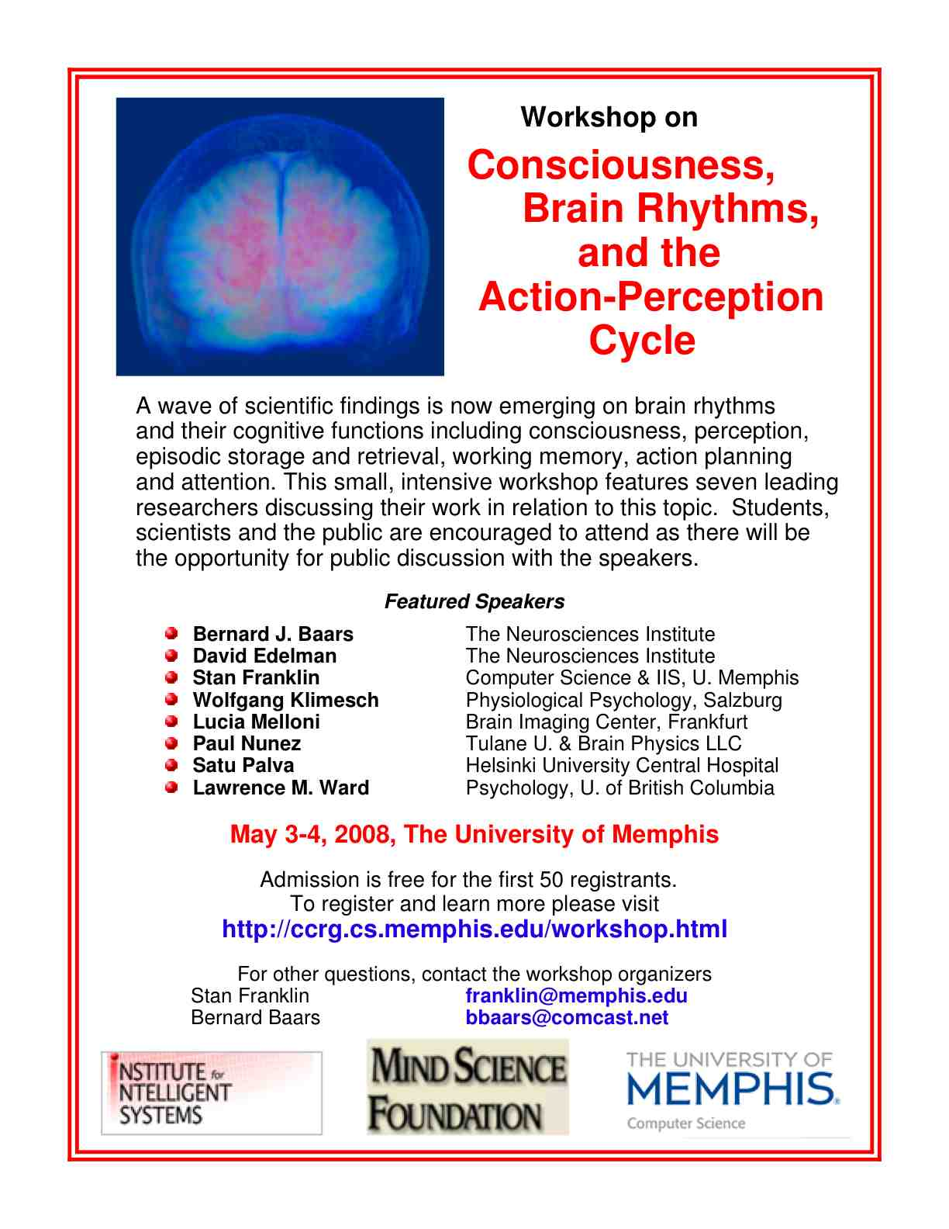
From Carl Carpenter, A New Model of Consciousnes, Sci & Con Rev.2006.

Slide 2
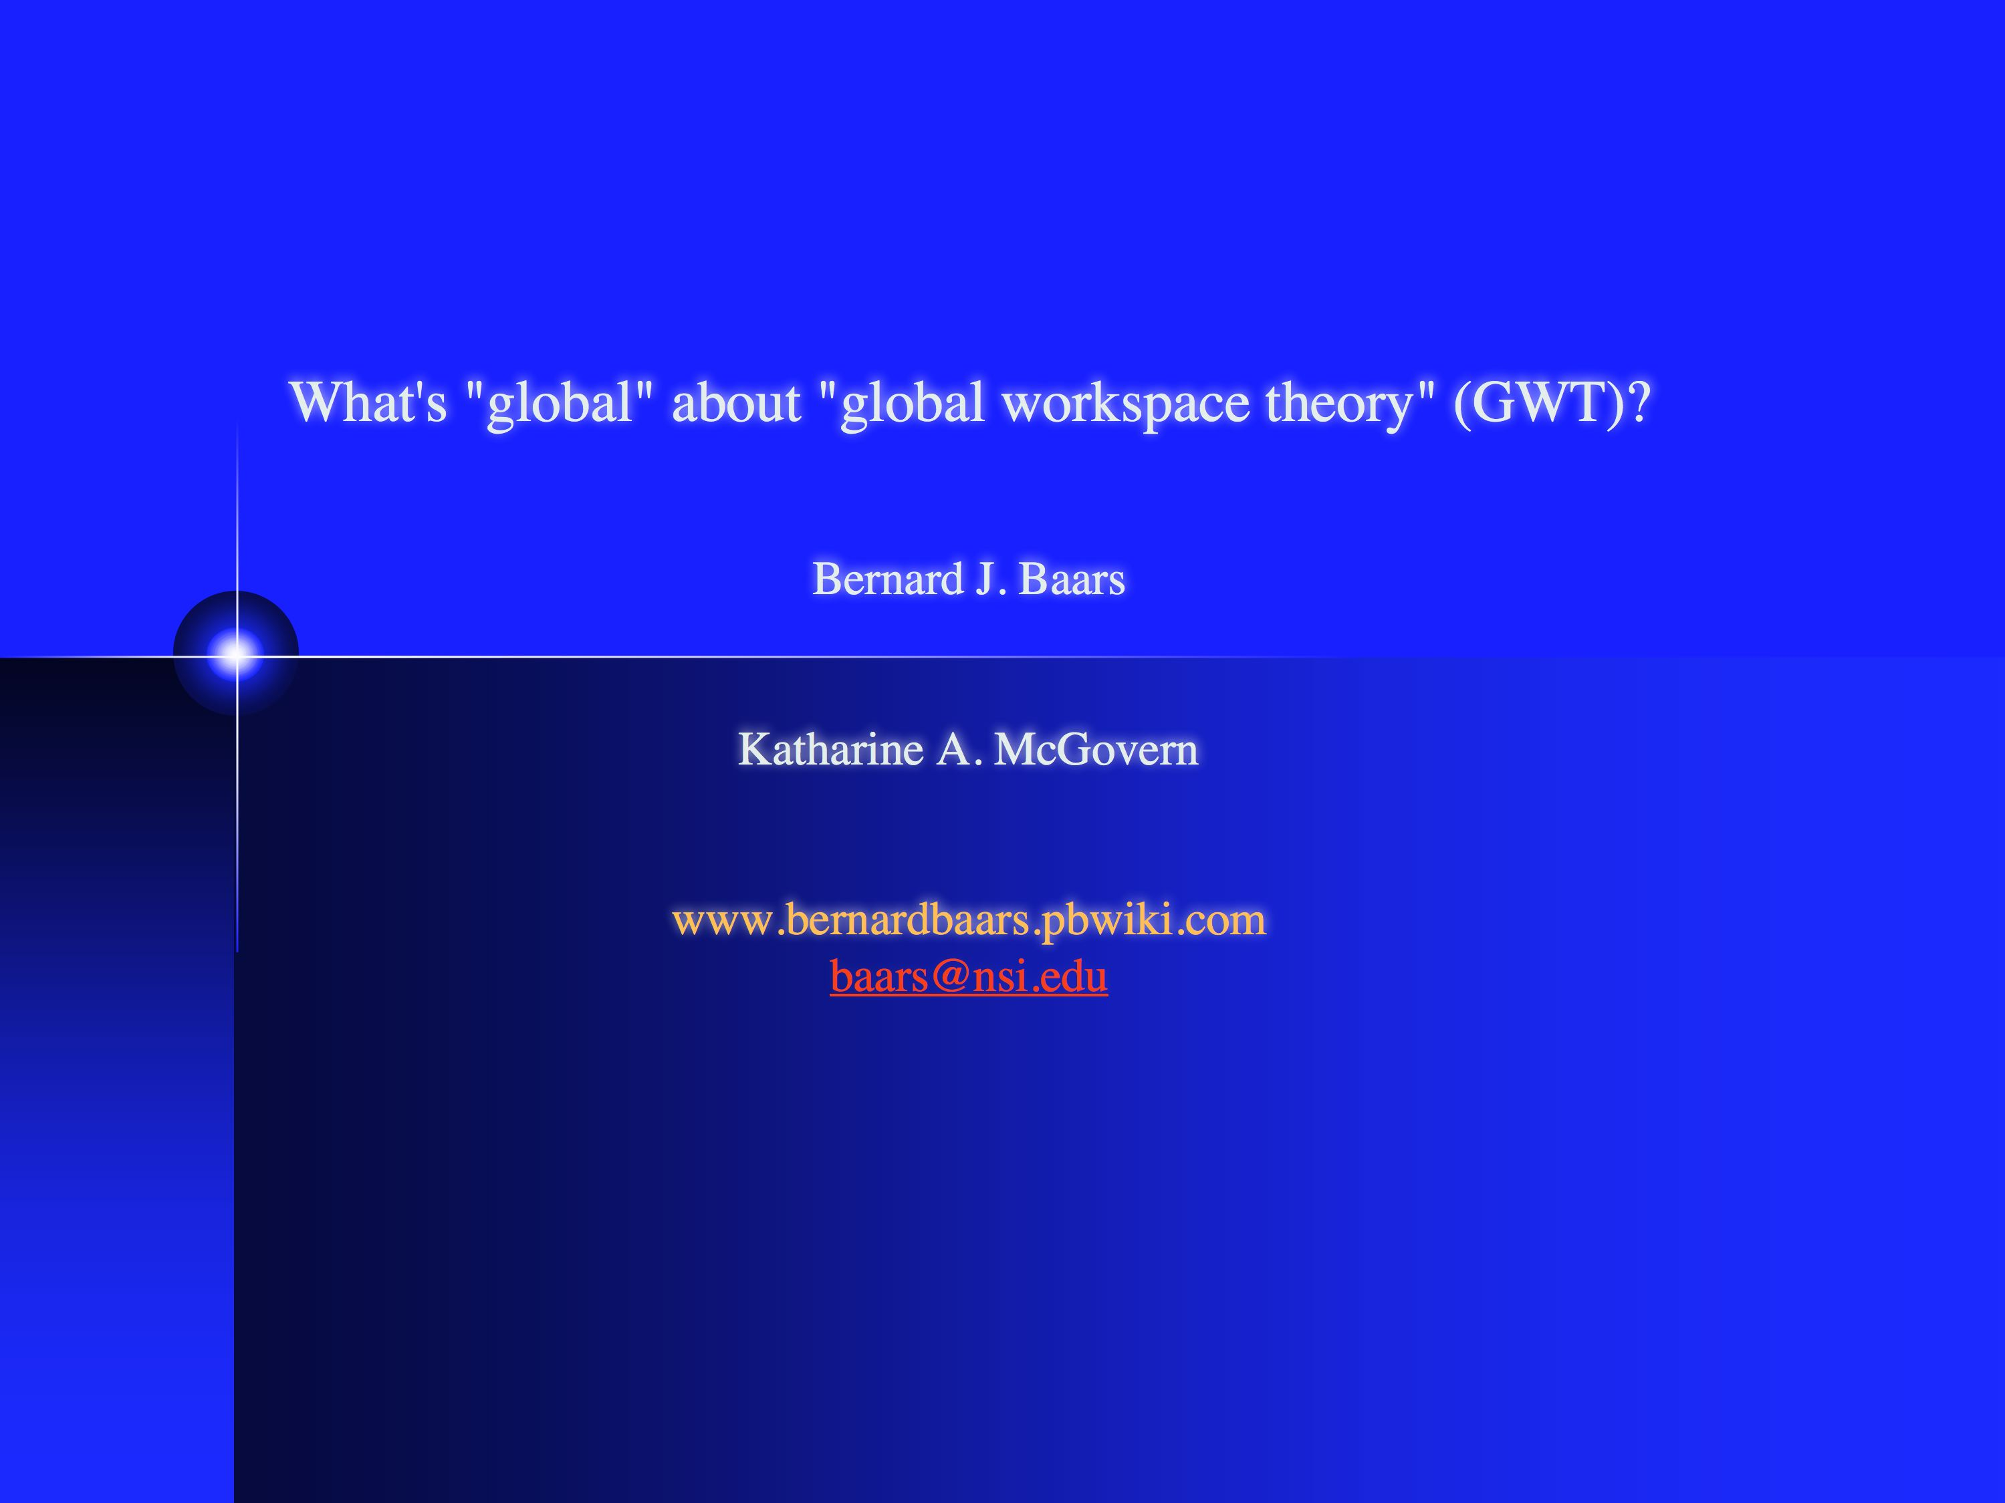
The role of conscious events in the brain.
Bernard J. Baars
This powerpoint is available for educational use, from:
www. bernardbaars.pbwiki.com
Additional pdf articles:
Baars & Franklin (2007) Architectural models of conscious/unconscious brain functions: GWT and IDA. Neural Networks.
Baars & Frankin, (2003) How conscious experience and working memory interact. Trends in Cognitive Sciences.
Baars (2002) The conscious access hypothesis: History and recent evidence. Trends in Cognitive Sciences.

Slide 3
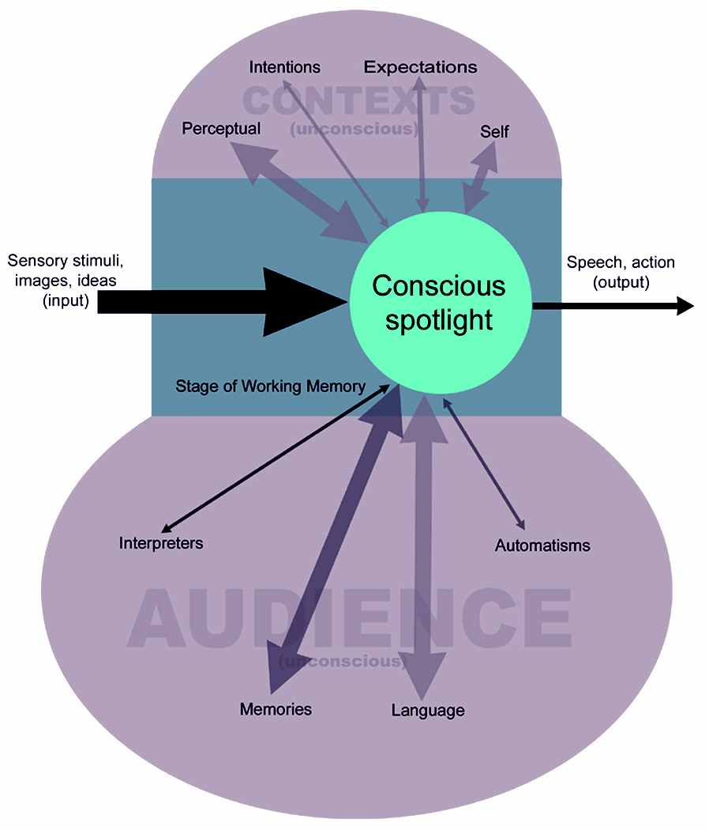
A theater of consciousness - simple metaphor
--- only the bright spot on stage is conscious (because ---consciousness is very limited in capacity)
--- sensory inputs compete for access to the conscious bright spot
--- the "stage" corresponds to Working Memory
--- all other features as unconscious, including long-term memory, the automatic processes of language, and the events going on backstage
-- the theater metaphor has been turned into several testable models.
Unconscious
Conscious
bright spot
on stage
stage of
working memory
Unconscious
From Carl Carpenter, A New Model of Consciousness, Sci & Con Rev.2006.

Slide 4
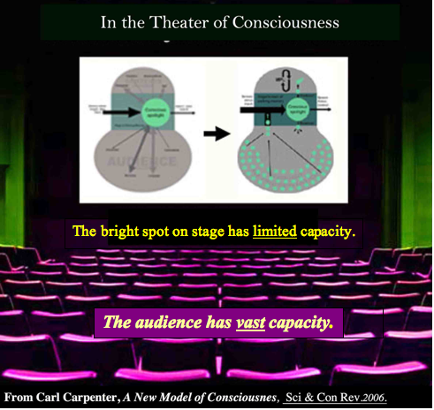

Selective attention
controls the
spotlight that selects what will be in the bright spot on stage
Backstage
is unconscious
The audience is unconscious

Slide 5
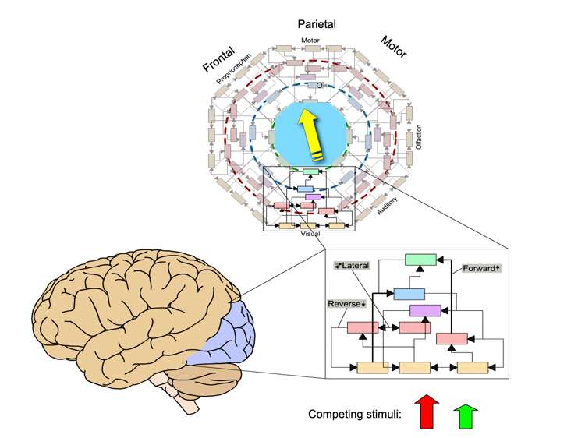
Here is a brain version of global workspace theory:
Prediction: Conscious input activates more widely than similar unconscious input.
Notice that there are two sensory inputs (the red and green arrows), and that the winning input evokes widespread "forward" activity in the brain.
From Baars & Gage (eds) Cognition, Brain & Consciousness.

Slide 6
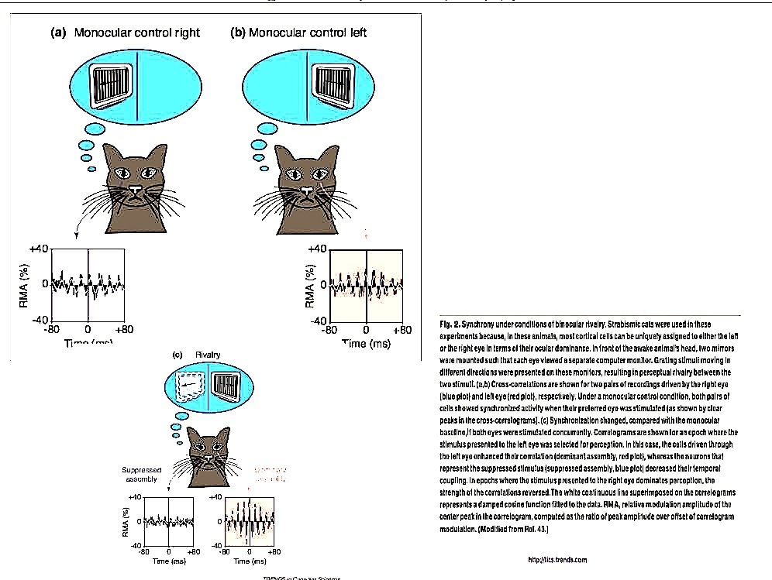
Competition for consciousness:
--- conscious input shows increased gamma synchrony.
(Engel & Singer, 1995)

Slide 7
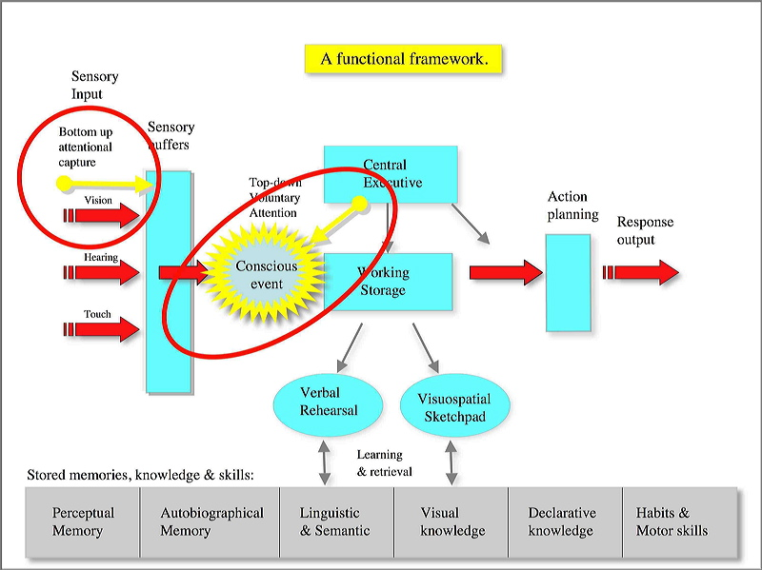
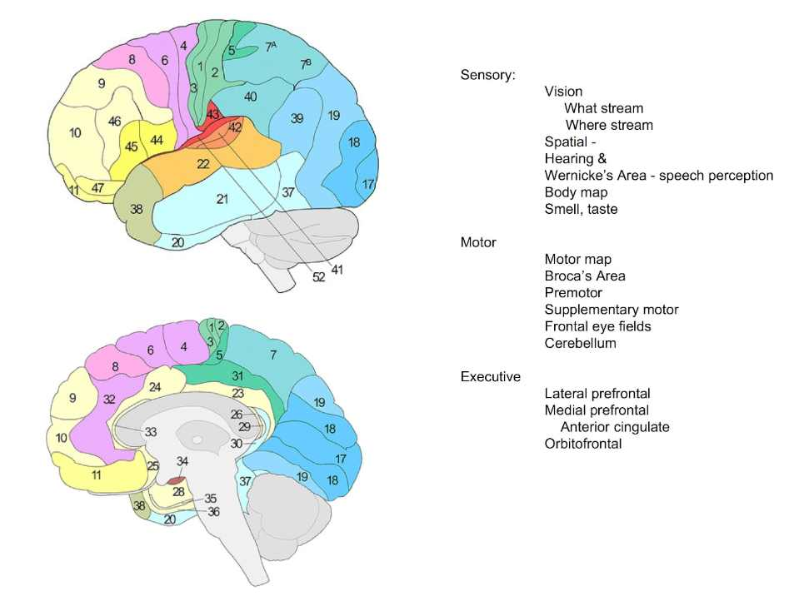
What about "broadcasting" of conscious events?
Applying GWT to cognitive functions.
Baars & Gage, 2007 - Cognition, Brain & Consciousness: An Introduction to Cognitive Neuroscience.
Brain correlates:

Slide 8
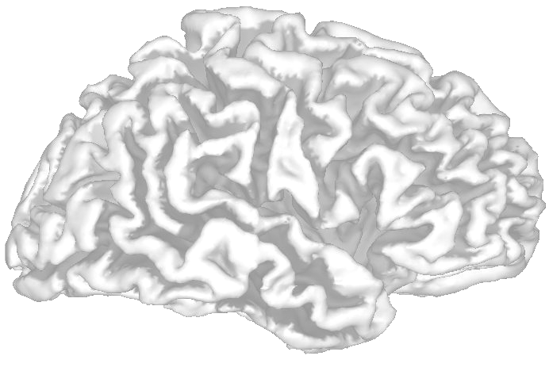
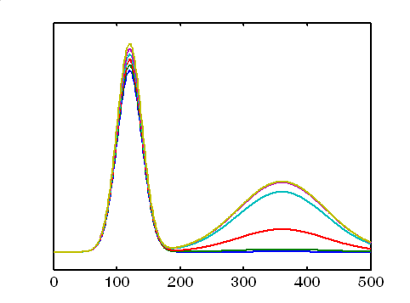
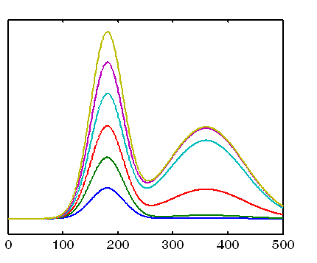
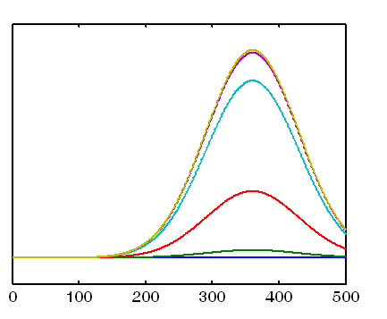
Broadcasting:
Dehaene's Predictions from the global neuronal workspace model
subliminal processing
conscious processing
Masking strength
Early visual areas
Higher visual areas
Prefrontal areas
weak masking
conscious
at threshold
subliminal
strong masking
time following stimulus onset (ms)

Slide 9
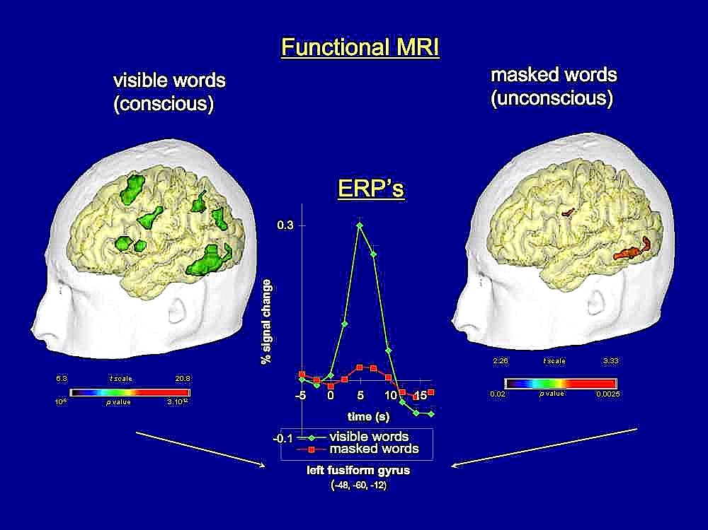
Dehaene's Experimental results:
From Dehaene et al, 2001

Slide 10
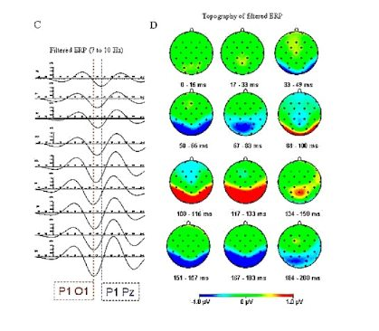
Wolfgang Klimesch et al
Alpha traveling wave in early evoked potential ---- reflects intrinsic default network?
It is suggested that theta, and alpha oscillations in particular, play an important role for the temporal organization of neural activity during top-down control in two large processing systems. One system, associated with theta activity, is related to the processing of new information. Another system, associated with alpha activity, enables controlled access to already stored information, thereby providing us with the very basic ability to be ‘semantically’ oriented in continuously changing environments.

Slide 11
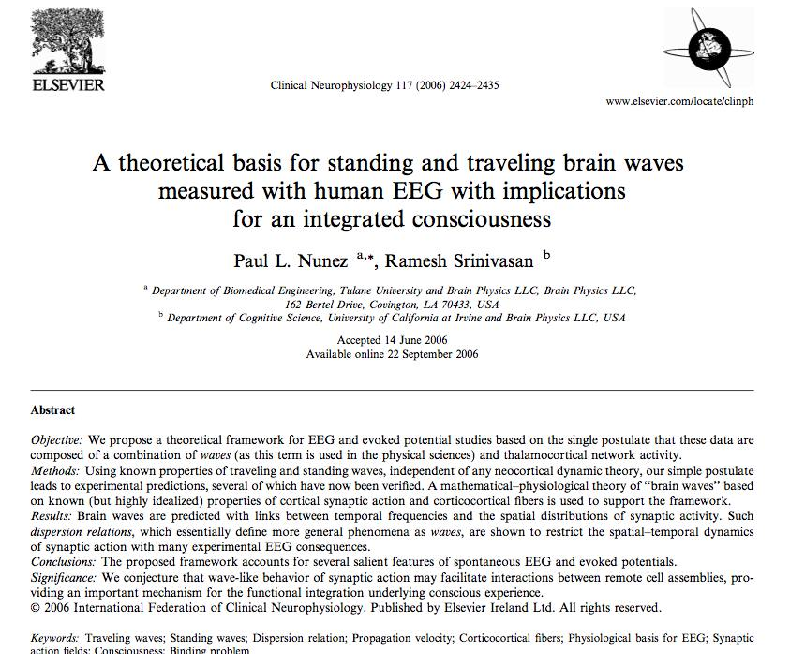
Paul Nunez & Ramesh Srinivasan:

Slide 12
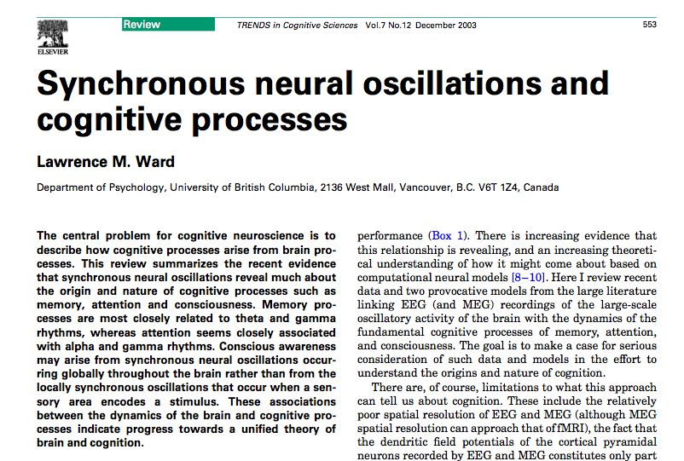
Lawrence Ward:

Slide 13
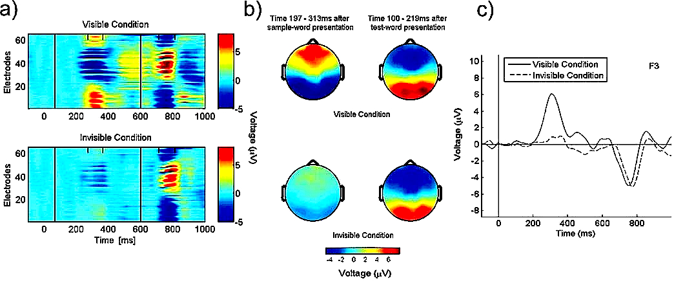
Lucia Melloni et al, Long-distance synchronization of neural activity across cortical areas correlates with conscious perception.
J. Neuroscience, 2007.
L. Melloni: In my talk I will present evidence which suggests that long-distance synchronization in the gamma frequency range plays a crucial role in conscious perception. I will present several studies where long–distance synchronization and local gamma synchronization were measured during the presentation of visible versus invisible stimuli.

Slide 14
Consciousness is not limited to sensory perception:
All "active components" of Working Memory involve consciousness
From Baars & Franklin,"Consciousness and Working Memory Interact" Trends in Cognitive Sciences.2003
after Baddeley & Hitch
Notice the open circles for conscious moments needed to trigger distributed WM functions.

Slide 15
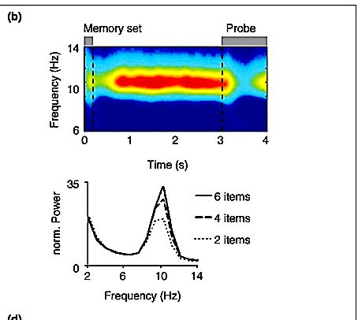
Satu Palva & J. Matias Palva (2007) ---
Working Memory delay - alpha activity

Slide 16
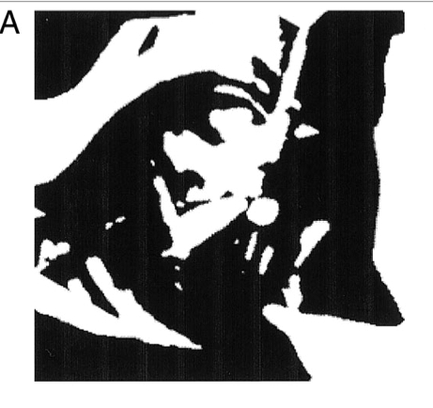
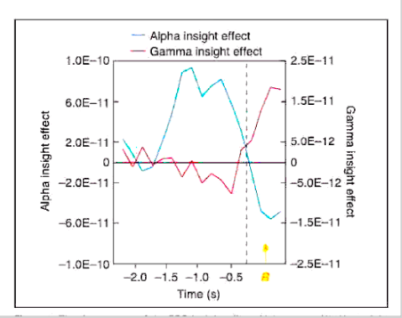
Jung-Beemann et al - "Aha!" experience in unconscious problem-solving

Slide 17
The LIDA Cognitive Cycle - a near-10-Hz cycle?
Possibly reflected in the endogenous alpha rhythm associated with the intrinsic default system?
Environment
Action Execution
Sensory Memory
Perception & Perceptual Memory
Action Selection
Workspace
Procedural Memory
Transient
Episodic Memory
Consciousness
Declarative Memory
Structure-building codelets

Slide 18
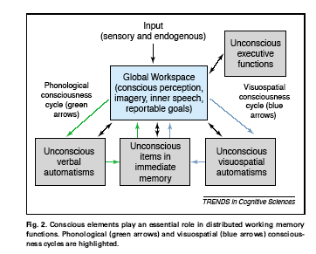
A GW/IDA account of Working Memory
and Spontaneous ("Aha!) Problem Solving
(Baars & Franklin, 2003, TICS)

Slide 19
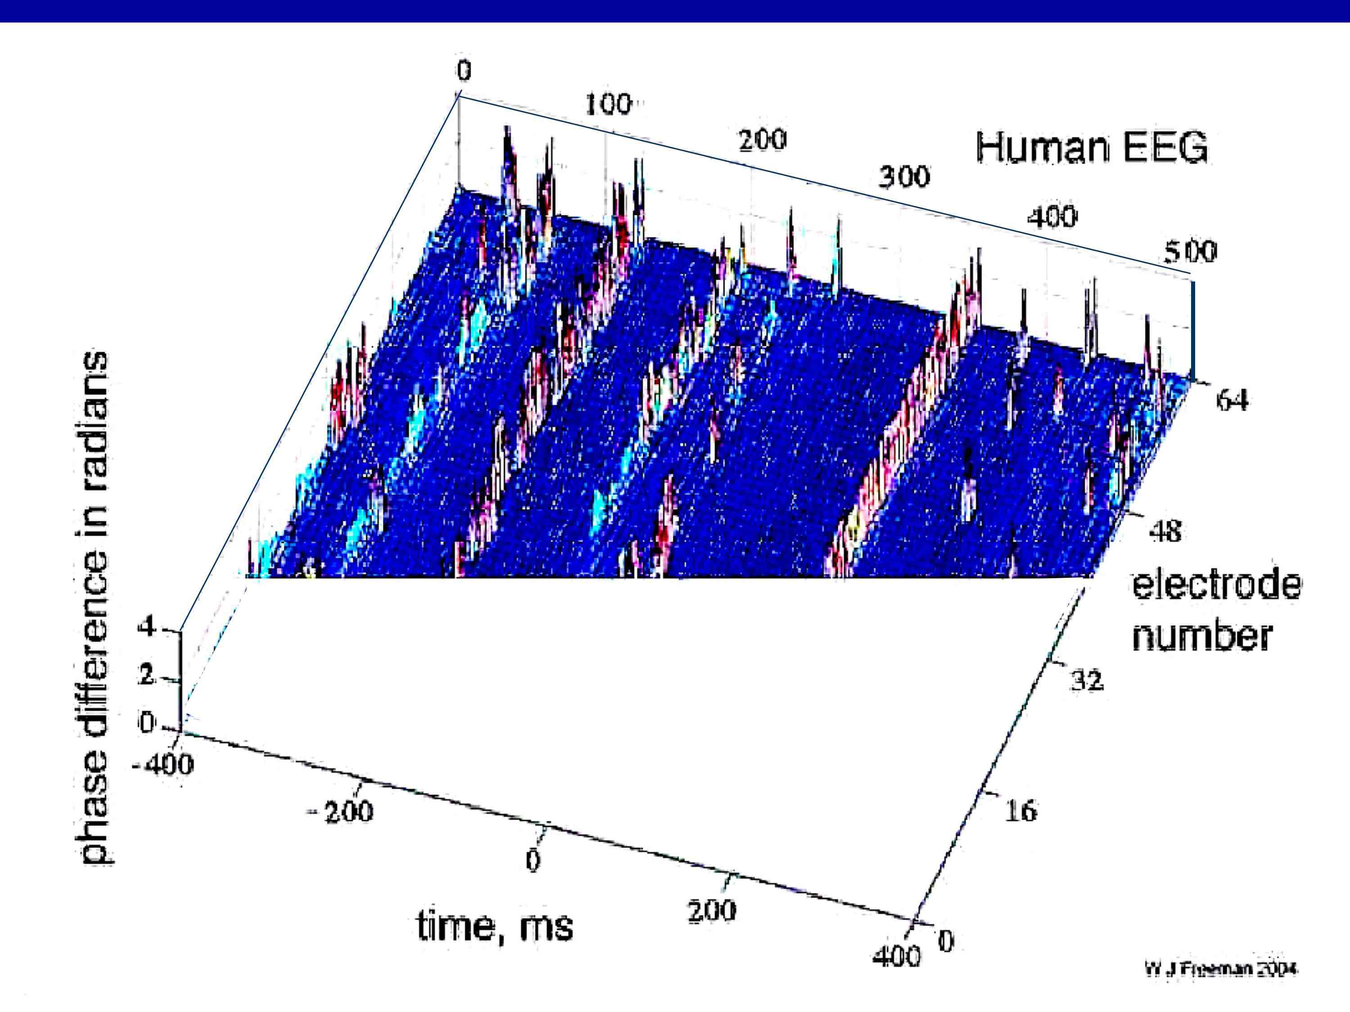
A possible near-10-Hz cognitive cycle (Freeman, 2004)
~50 ms coherent
periods, interrupted by moments of decoherence:
Phase differences

Slide 20
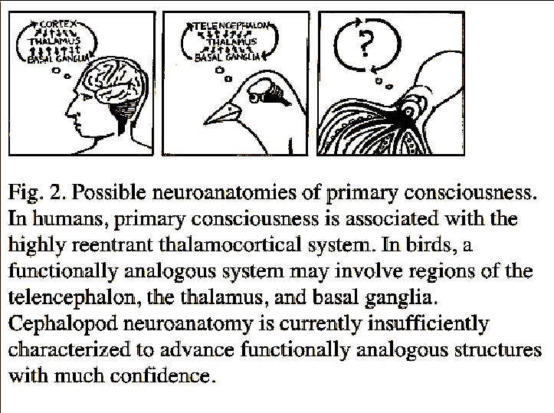
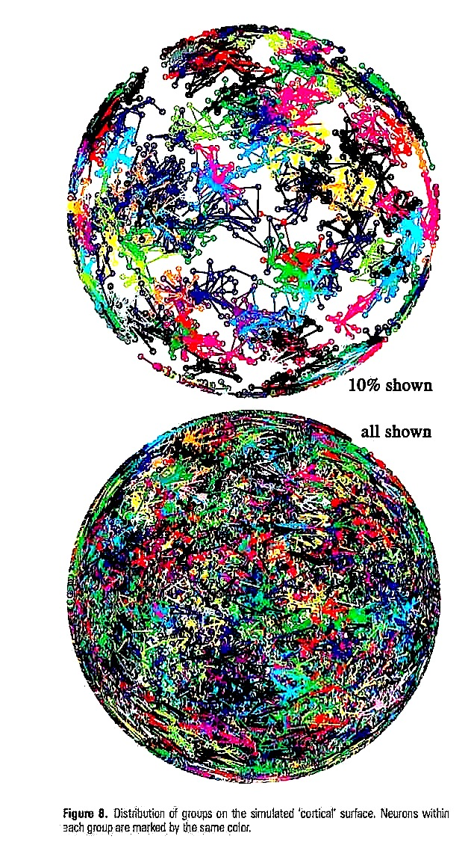
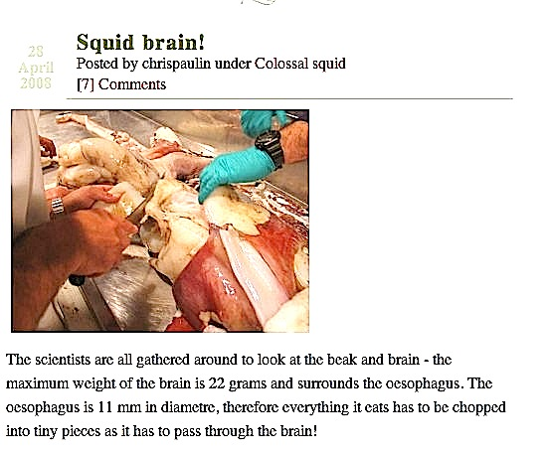
Dave Edelman
What kind of brain reveals these functions and mechanisms?
Simulation of the thalamocortical core in mammals - shows regular rhythms.
Izhikevich, Edelman & Gally, 2008

Slide 21
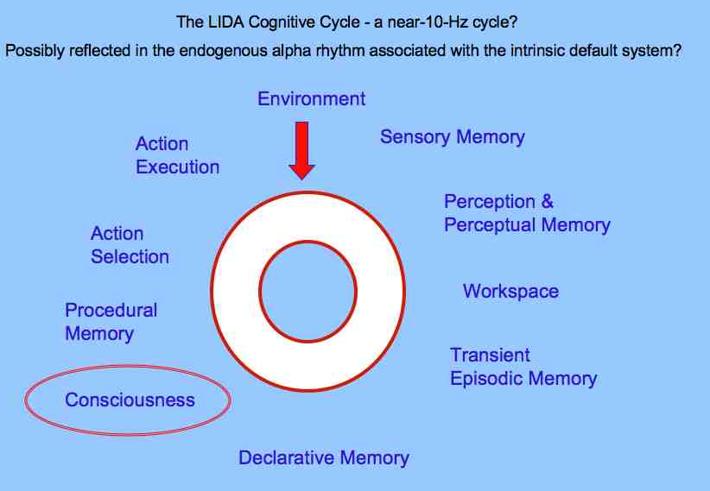
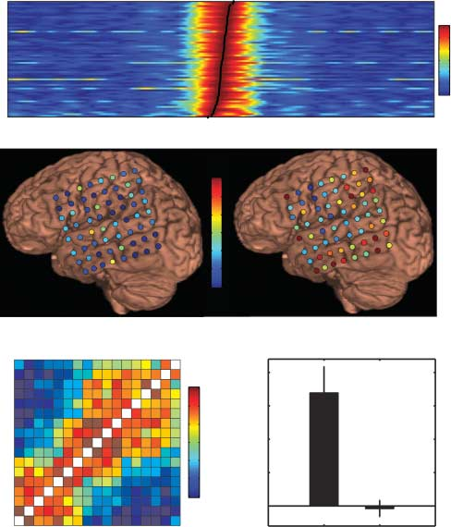
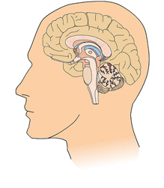
For the workshop: A possible integration?
Unconscious
Conscious
bright spot
on stage
stage of
working memory
Unconscious
From Carl Carpenter, A New Model of Consciousness, Sci & Con Rev.2006.

