Slide 1
A review of select models by Dehaene & Changeux and the implications for future work
By Robert Schuler
June 5, 2007

Slide 2
Overview
Dehaene & Changeux models:
  Stroop
  Wisconsin Card Sorting Test (WCST)
  Tower of London (TOL)
Repeated Themes
  “Effortful” tasks vs. “effortless” tasks
  “Synaptic triad”
  Global workspace (“Generator of Diversity”)
  Hierarchical network, with
    Descending “planning” pathway
    Ascending “evaluative” pathway
  Auto-evaluative loop

Slide 3
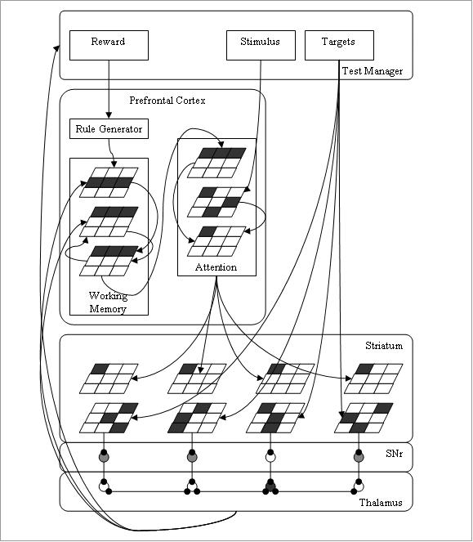
Review of Schuler’s Model
Based on prior WCST model, Amos (2000)
PFC generates rules (non-bio), memory of current rule, and focuses attention on currently selected feature
BG finds matching feature among Target cards
Thalamocortical loop provides dynamic gating for working memory units in PFC
Visual Cortex

Slide 4
A neuronal model of a global workspace in effortful cognitive tasks
S. Dehaene, M. Kerszberg, and J.-P. Changeux (PNAS, Nov. 1998)

Slide 5
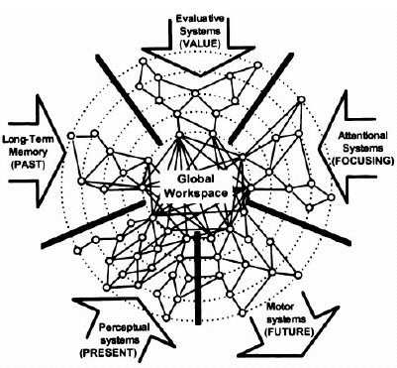
Global Workspace
“Effortless” tasks mobilize well-defined cerebral systems specialized for sensory-motor processing (Felleman & Van Essen 1991, Cheng & Gallistel 1986)
“Effortful” tasks recombine these specialized systems in novel ways (Hermer & Spelke 1994, Fodor 1983) yet there is no cardinal area where all areas project (Baars 1989, Shallice 1988, Posner & Dehaene 1994)
A distributed network of neurons with long range projections to specialized processors serves as a global workspace for “effortful” tasks
A neuronal model of a global workspace in effortful cognitive tasks,
S. Dehaene, M. Kerszberg, and J.-P. Changeux (PNAS, Nov. 1998)

Slide 6
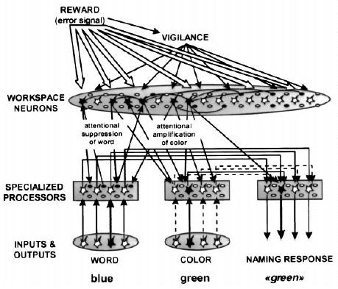
Network architecture
External inputs:
  Reward and Vigilance
  Vigilance sharply increases following errors and slowly decreases after success
Network Assemblies
  3-unit assemblies (EXC, Gating INH, Processing INH)
  Connect w/in Workspace and between Workspace and Processors
  Connect w/ Gaussian Prob. w/ random weights
Processors
  Weights coded for Stroop task
A neuronal model of a global workspace in effortful cognitive tasks,
S. Dehaene, M. Kerszberg, and J.-P. Changeux (PNAS, Nov. 1998)
Notes:
Reward: +1 or -1
Vigilance: if R > 0, gradual reduce, if R < 0, sharply increase

Slide 7
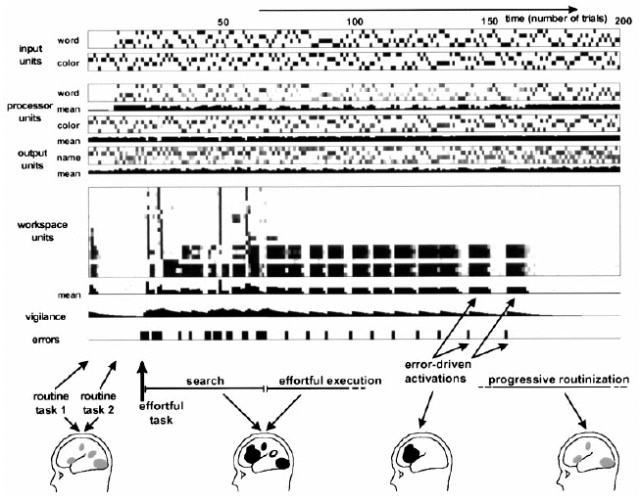
Simulation output
Routine tasks 1 & 2, no workspace activity
Non-routine task, followed by spikes in vigilance (focus) and workspace activity
After several trials, the non-routine task is “routinized” (or “automatized”) and no longer requires workspace activity
A neuronal model of a global workspace in effortful cognitive tasks,
S. Dehaene, M. Kerszberg, and J.-P. Changeux (PNAS, Nov. 1998)

Slide 8
Implications
Use distributed “workspace” neurons to replace rule generator
“Routinize” task as repeated trials succeed
Reactivate the “Generator of Diversity” in the workspace when rules change
Top-down control of specialized processors
Notes:
“Implications” to my model

Slide 9
The Wisconsin Card Sorting Test: Theoretical Analysis and Modeling in a Neuronal Network
S. Dehaene and J.-P. Changeux
(Cerebral Cortex, Jan./Feb. 1991)

Slide 10
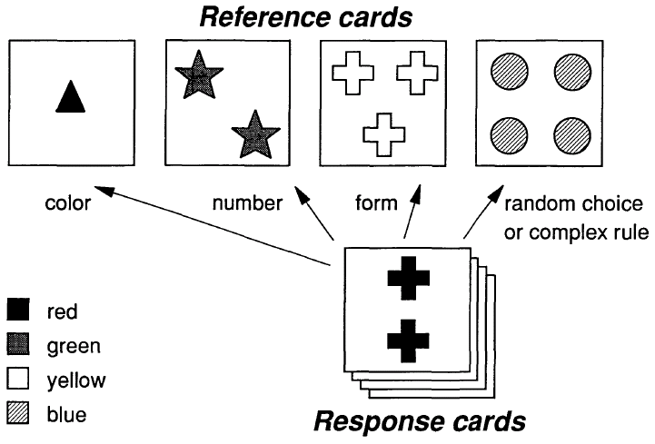
Wisconsin Card Sorting Test
Cognitive demands of the WCST:
  Ability to change rule rapidly when negative reward received
  Ability to memorize previously tested rules and avoid testing twice
  Ability to reject rules a priori by reasoning
The Wisconsin Card Sorting Test: Theoretical Analysis and Modeling in a Neuronal Network,
S. Dehaene and J.-P. Changeux (Cerebral Cortex, Jan./Feb. 1991)

Slide 11
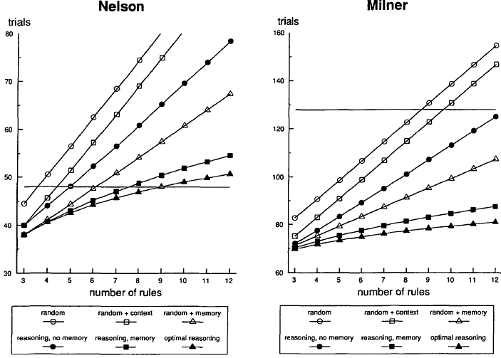
Functional analysis:
Number of Rules
Source of Failure #1: Number of rules that must be considered
The Wisconsin Card Sorting Test: Theoretical Analysis and Modeling in a Neuronal Network,
S. Dehaene and J.-P. Changeux (Cerebral Cortex, Jan./Feb. 1991)

Slide 12
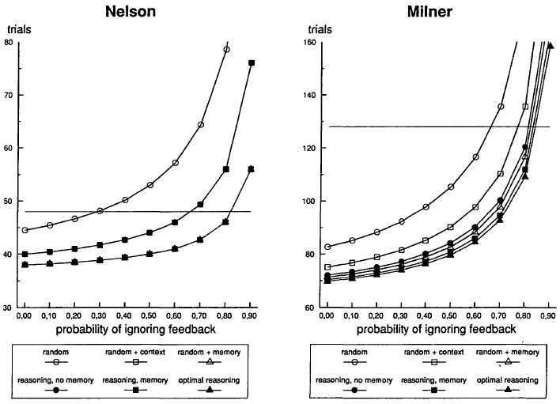
Functional analysis:
Sensitivity to Reward
Source of Failure #2: Sensitivity to the reward signal
The Wisconsin Card Sorting Test: Theoretical Analysis and Modeling in a Neuronal Network,
S. Dehaene and J.-P. Changeux (Cerebral Cortex, Jan./Feb. 1991)

Slide 13
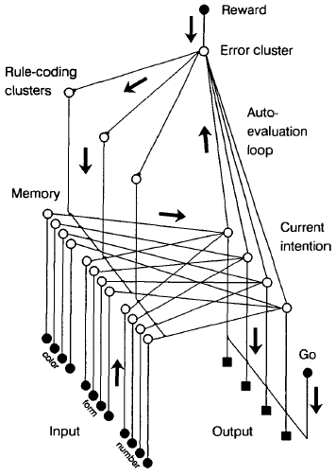
Network architecture
Neural units
  Clusters of self-excitatory neurons with lateral inhibitory connections
Generator of Diversity:
  Noise activates rules units and lateral inhibition extinguishes all but winning rule (“generator of diversity”)
Reward (negative):
  Temporarily weakens active rule (Hebbian learning) allowing other rule to activate
Working memory:
  Function of the “recovery” rate of self-excitation connection weights
Auto-evaluation loop:
  Allows a priori reasoning by dampening bad rules
The Wisconsin Card Sorting Test: Theoretical Analysis and Modeling in a Neuronal Network,
S. Dehaene and J.-P. Changeux (Cerebral Cortex, Jan./Feb. 1991)

Slide 14
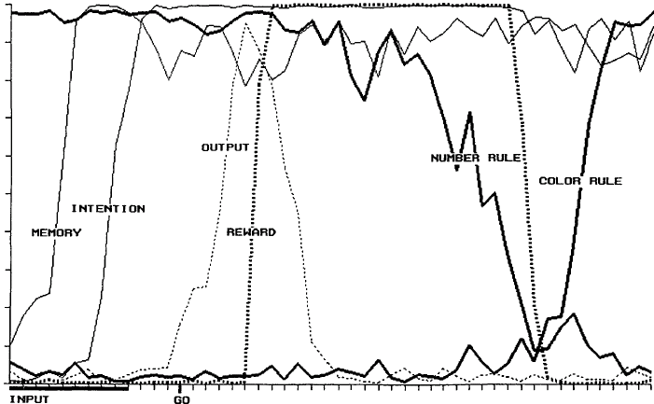
Simulation output
“Number” Rule initially active
(-) Reward weakens active “Number” rule
“Color” Rule activated next
External “Go” signal triggers action, otherwise output is inhibited
The Wisconsin Card Sorting Test: Theoretical Analysis and Modeling in a Neuronal Network,
S. Dehaene and J.-P. Changeux (Cerebral Cortex, Jan./Feb. 1991)

Slide 15
Implications
Working Memory sustained by self-excitatory units, and memory retention (duration) is function of recovery rate
Intended actions may be evaluated by the auto-evaluation loop
Reasoning (a priori rule elimination) may be modeled in part by the auto-evaluation loop

Slide 16
A hierarchical neuronal network for planning behavior
S. Dehaene and J.-P. Changeux
(PNAS, Jan./Feb. 1997)

Slide 17
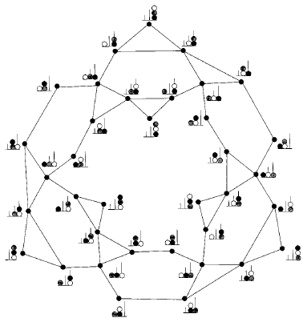
Tower of London
Tower of London test
  3 colored beads on rods of unequal length
  May move unblocked beads
  Given an initial state
  Shown a specified goal state
Difficulty increases with number of “indirect” moves (Ward & Allport 1997)
Frontal patients perform “direct” moves yet fail for indirect moves (Shallice 1982, Goel & Grafman 1995, Owen et al. 1990)
3 Levels of motor control: Gesture, Operation, and Plan
TOL State Space
A hierarchical neuronal network for planning behavior,
S. Dehaene and J.-P. Changeux (PNAS, Jan./Feb. 1997)

Slide 18
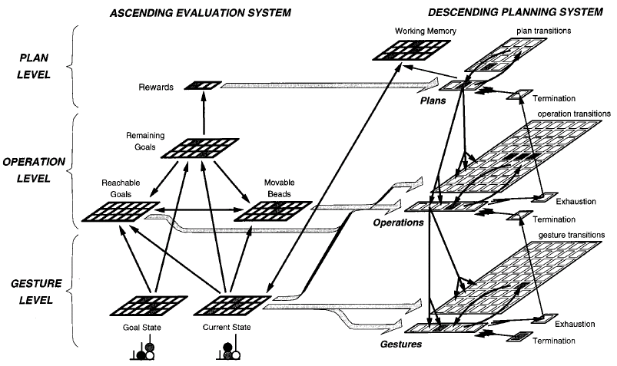
Network architecture
A hierarchical neuronal network for planning behavior,
S. Dehaene and J.-P. Changeux (PNAS, Jan./Feb. 1997)
Notes:
3 Layers: Gesture, Operation, Plan
2 Pathways: Descending Planning, Ascending Evaluative
Remaining goals dSum/dt > 0 or < 0 used as the Reward signal
Units and static connections coded specifically for TOL

Slide 19
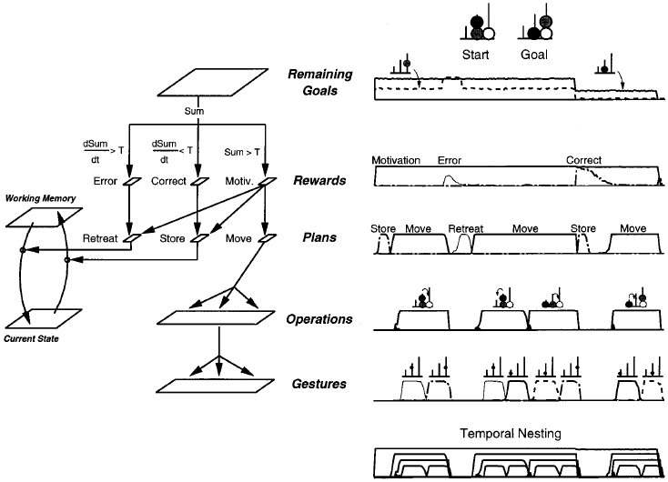
Simulation output
1st Move leads to increased Remaining Goals and Error resulting in Retreat
2nd Move involves 2 Operations (including an indirect move) and leads to reduced Remaining Goals and Store of Current State in memory
Final move leads to 0 Remaining Goals end of Motivation (2nd from top)
A hierarchical neuronal network for planning behavior,
S. Dehaene and J.-P. Changeux (PNAS, Jan./Feb. 1997)

Slide 20
Implications
Decompose network into hierarchy of levels: Gesture, Operation, Plan
Support descending (“planning”) and ascending (“evaluative”) pathways

Slide 21
Final thoughts…
Can a workspace be constructed more flexibly to allow generation of rules applicable to a wider range of tasks?
The 3-layer working memory units (Schuler) may translate well to the neuronal clusters (3-unit assemblies) of Dehaene & Changeux’s models but need to be integrated into workspace clusters
Challenge is to develop a model that can accomplish a range of tasks, e.g., Delayed MTS, Stroop, WCST, TOL,…, without being coded strictly for one task

Slide 22
Summer (extremely high-level) plans
Extract relevant summary data from Dehaene & Changeux’s papers
Some experimentation with “synaptic triad” units for memory, with workspace for “diversity generator” and auto-evaluative loop and hierarchical structures… then
Attempt to design a more general network capable of performing multiple tasks (e.g., delayed MTS, WCST, TOL, TOH) based on implications related to Dehaene & Changeux review and also with consideration given to Newman et al. 2003 and Goel et al. 2001

