Slide 1
Cerebral bases of masked priming
and the neuronal workspace hypothesis
Stanislas Dehaene
INSERM U 334
Service Hospitalier Frédéric Joliot, CEA, Orsay, France
Dehaene, S., & Naccache, L. (2001). Towards a cognitive neuroscience of consciousness: Basic evidence and a workspace framework. Cognition special issue ‘The Cognitive Neuroscience of Consciousness’, 79, 1-37.
Dehaene, S., Naccache, L., Cohen, L., Le Bihan, D., Mangin, J. F., Poline, J. B., & Rivière, D. (2001). Cerebral mechanisms of word masking and unconscious repetition priming. Nature Neuroscience, in press.

Slide 2
A schematic representation of the workspace model
hierarchy of modular
processors
high-level processors
with strong
long-distance
interconnectivity
Perceptual categorization
Long-term memory
Evalution (affect)
Intentional action
automatically
activated
processors
processors
mobilized
into the
conscious
workspace
Dehaene, Kerszberg & Changeux, PNAS, 1998
inspired by Mesulam, Brain, 1998

Slide 3
The conscious neuronal workspace hypothesis
1. The modularity of mind
  A task, involving several mental operations, can proceed unconsciously whenever a set of adequately interconnected specialized processors is available to perform each of the required operations.
2. The apparent non-modularity of the conscious mind
  A distributed neural system with long-distance connectivity (the “conscious workspace”) can potentially interconnect multiple specialized processors in a coordinated, though variable manner.
3. Attentional amplification and dynamic mobilization
  An information becomes conscious if the corresponding neural population is mobilized by top-down attentional amplification into a brain-scale state of coherent activity.
Dehaene & Naccache, Cognition, 2000

Slide 4
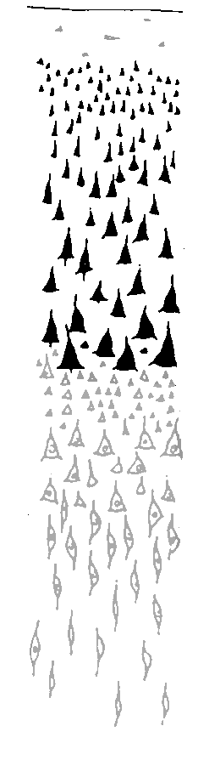

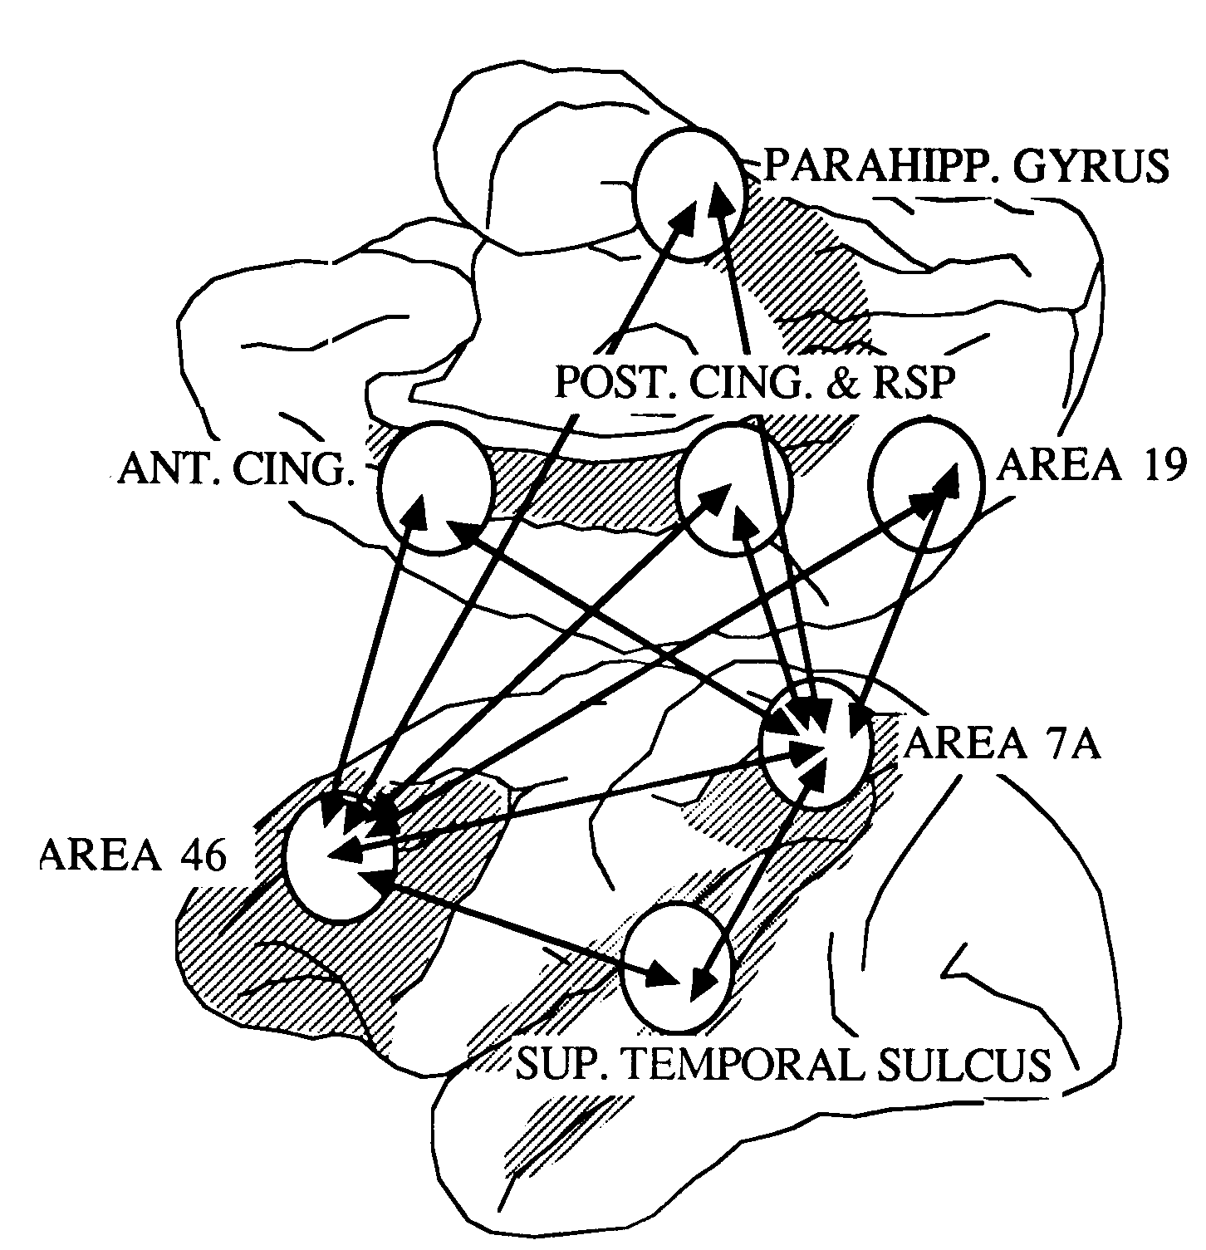
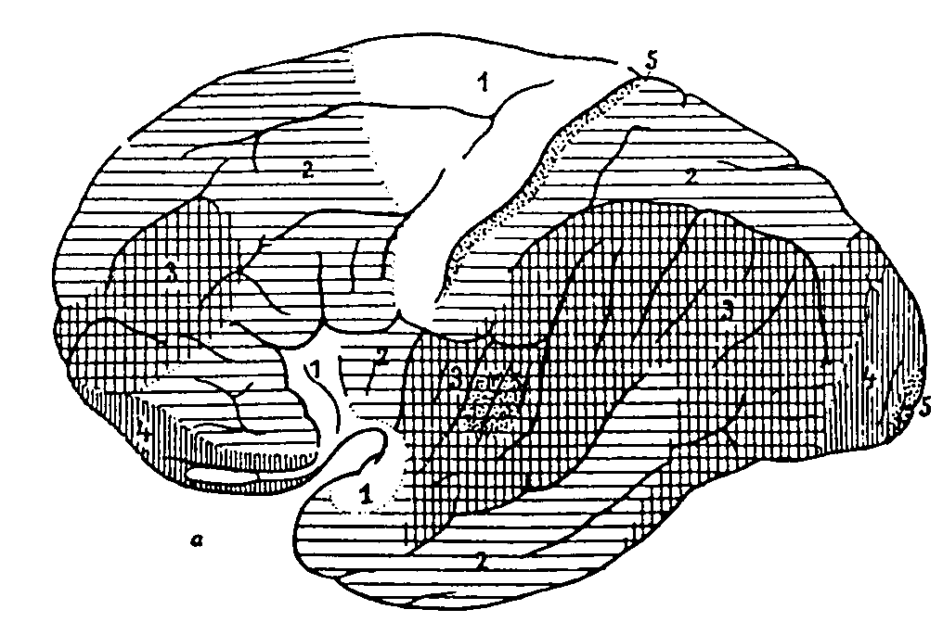
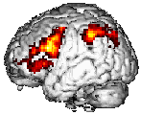
Long-distance connectivity of Workspace Neurons: Putative role of layers II/III
Frontal / parietal
II
sensory
III
II
III
Dehaene, Kerszberg & Changeux, PNAS, 1998

Slide 5
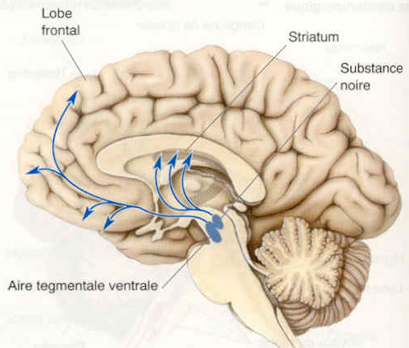
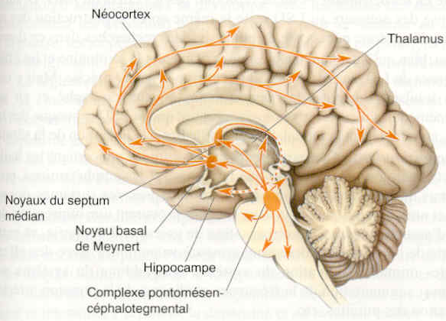
AUTONOMY OF WORKSPACE ACTIVITY
Spontaneous generation of variable activation patterns
Selection by ascending evaluation signals
vigilance signals
intransitive meaning of consciousness
conscious states (sleep, drowsiness, etc)
Thalamus; Acetylcholine
evaluation signals
stimulus relevance
Dopamine

Slide 6
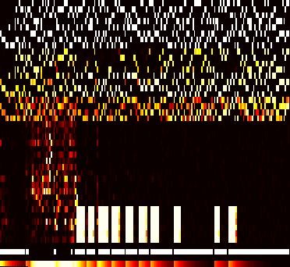
TEMPORAL DYNAMICS OF WORKSPACE ACTIVITY
time
specialized
processors
50
100
150
200
workspace
units
search
effortful execution
progressive routinization
routine
task 1
routine
task 2
effortful
task
errors
Dehaene, Kerszberg & Changeux, PNAS, 1998

Slide 7
The transition from an unconscious to a conscious representation
  Attentional amplification and long-distance correlation are the fundamental properties of consciousness
  Workspace neurons are particularly dense in the prefrontal cortex, inferior parietal cortex, and anterior cingulate.
Dehaene, Kerszberg & Changeux, PNAS, 1998
Dehaene & Naccache, Cognition, 2000

Slide 8
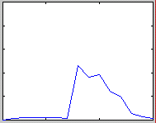
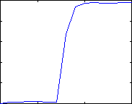
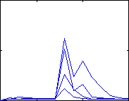
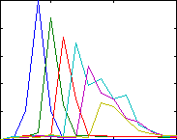
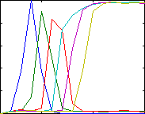
A minimal neuronal network simulation of a
a subliminal processing stream
workspace (W)
long-distance
loop
cascade of processors (P)
...
...
sub-threshold stimulus
supra-threshold stimulus
various levels of
transient workspace
activity
W
W
W
P
P
time
time
time
Dehaene & Naccache, Cognition, 2000
Notes:
1
1
1
1
1

Slide 9
Conscious intentions can influence unconscious processing
A. Unconscious processing stream executing without conscious control
B. Influence of a conscious context or instruction on unconscious processing
S
R
R1
S1
R3
S2
R2
C. IMPOSSIBLE SITUATION: Top-down control by an unconscious stimulus
R1
S1
R3
S2
R2
Dehaene & Naccache, Cognition, 2000

Slide 10
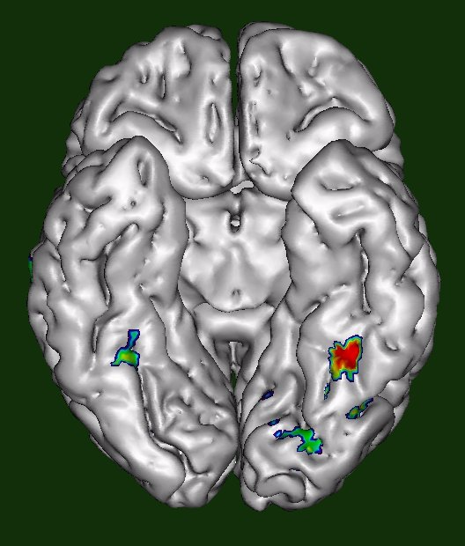
The Visual Word Form Area :
A left fusiform area responsive to words regardless of location
conjunction of words in the left and right hemifields
+
TABLE
TABLE
+

Slide 11
Word repetition priming paradigm
500 ms
radio
29 ms
time
29 ms
RADIO
29 ms
271 ms

Slide 12
Unconscious repetition priming paradigm
Same case
Different case
RADIO-RADIO
radio-radio
RADIO-radio
radio-RADIO
Same word
RADIO-FRUIT
radio-fruit
RADIO-fruit
radio-FRUIT
Different word
Task = Bimanual classification into man-made versus natural

Slide 13
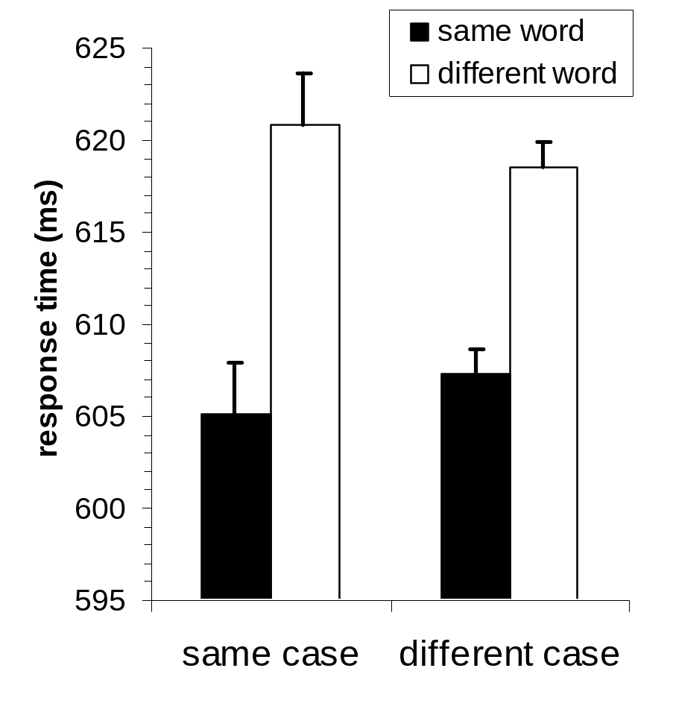
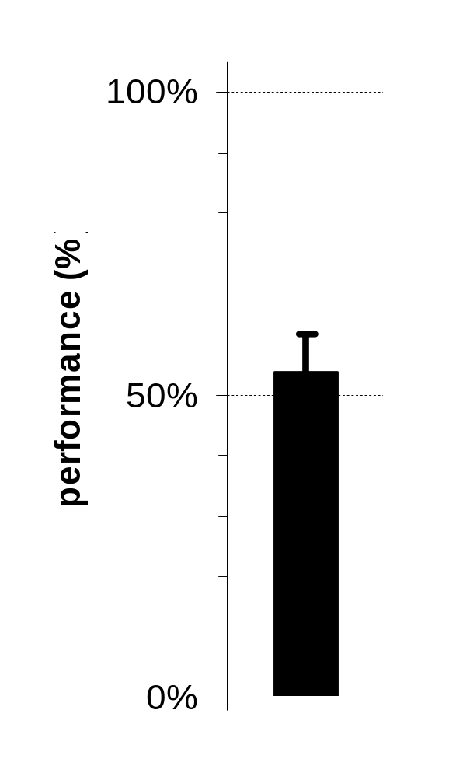
Behavioral effect: case-independent repetition priming
Chance level performance in prime identification

Slide 14
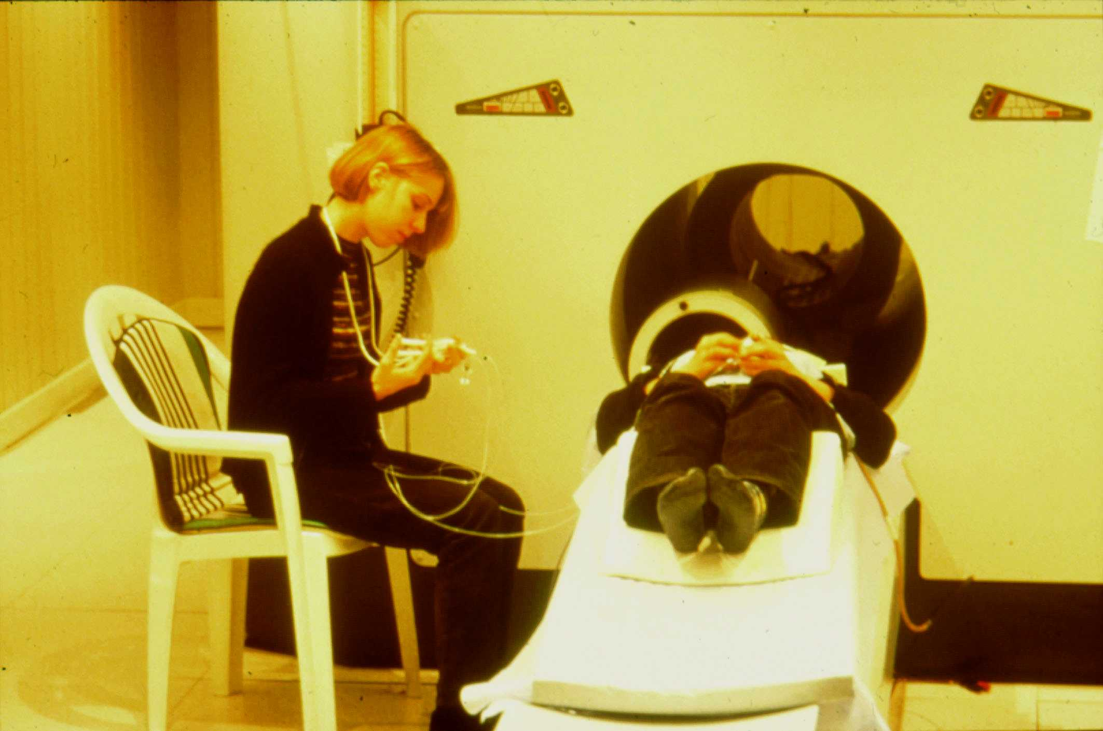
Imaging parameters
10 subjects
3 Tesla magnet (Bruker)
26 slices, 4.5 mm thickness,
TR=2400 ms
Fast event-related design
  5 event types (4 prime-target combinations, plus a null event where the target was omitted)
  4 sessions of 150 trials each (30 minutes total)
Analysis with SPM99
  modeling with hemodynamic response function and time derivative
  improved statistics by masking with the conscious circuit of reading

Slide 15
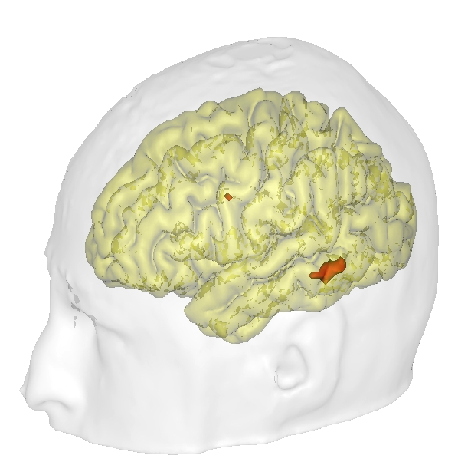
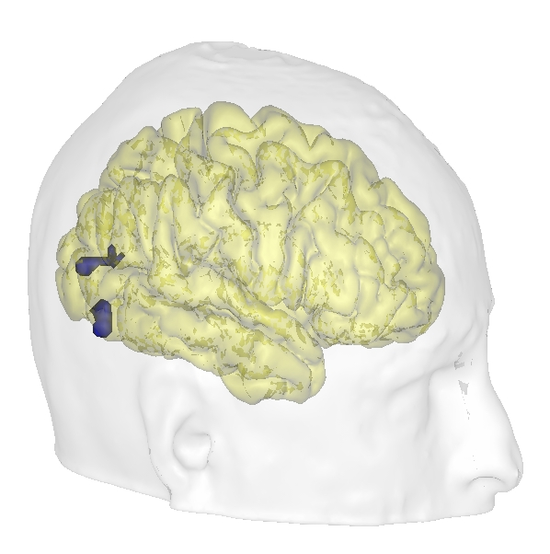
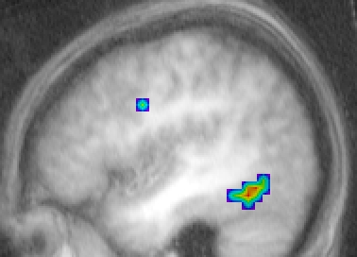
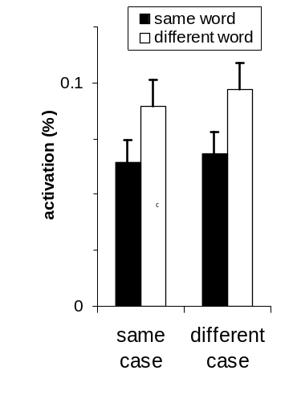
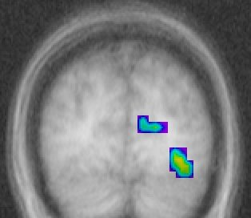
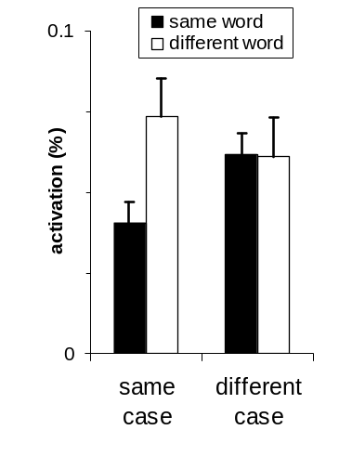

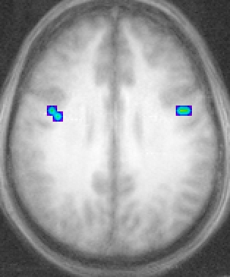
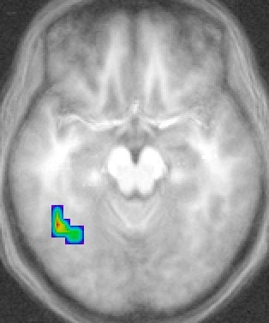
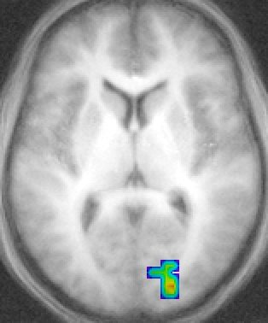
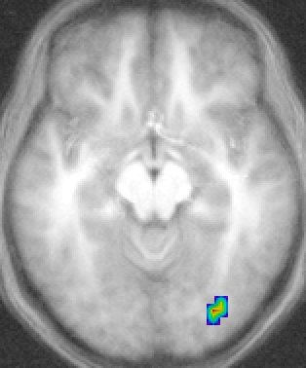
case-independent priming
case-specific priming
x = -44
y = -85
2.40
t scale (9 d.f.)
4.87
4.30
t scale (9 d.f.)
7.61
0.02
p value
0.0004
0.001
p value
2.10⁻⁵
left fusiform
(-44, -52, -20)
right extrastriate
(32, -80, -16)
z = 28
z = -17
z = -12
z = 10

Slide 16
Brain Mechanisms of Conscious and Unconscious Reading
...
...
time
71 ms
71 ms
71 ms
71 ms
29 ms
LION
or
29 ms
NOTE
or
71 ms
71 ms
71 ms
71 ms
...
...
visible word or blank
masked word or blank

Slide 17
Behavioral Measures of Word Visibility
stimulus detection
(% detected)
word naming
(% correct)
recognition memory
(% ‘seen’ responses)
forced
choice
(% correct)
100%
performance (%)
50%
0%
visible
masked
blanks
visible
masked
visible
masked
foils
masked

Slide 18
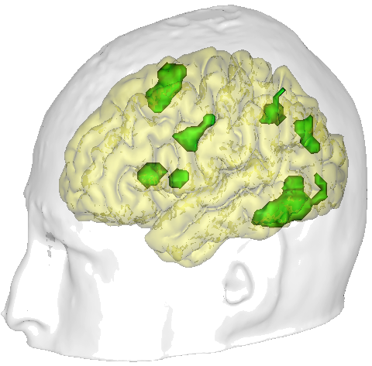
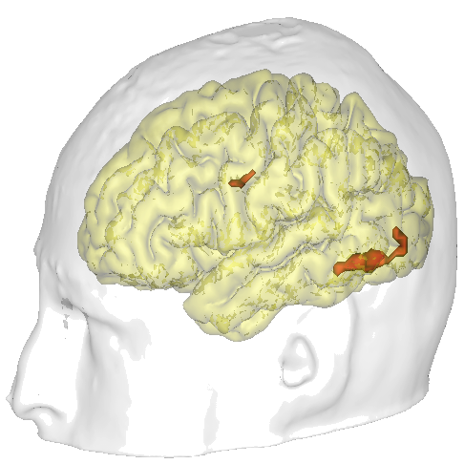
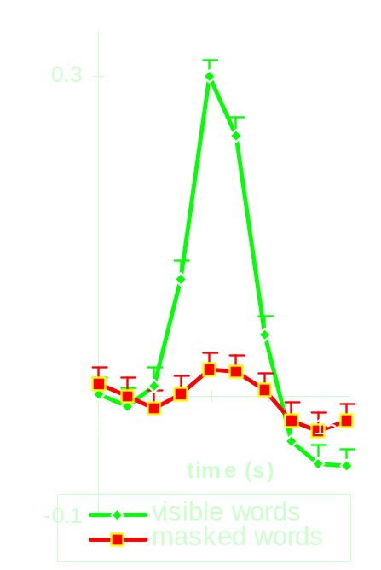
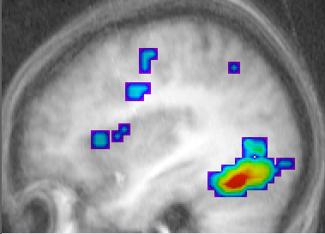
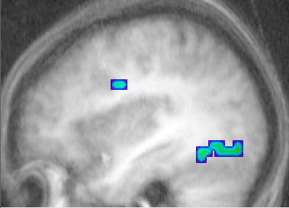
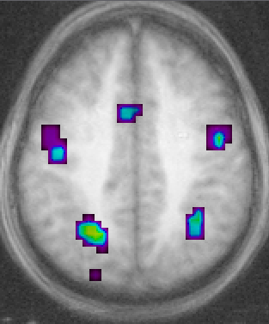
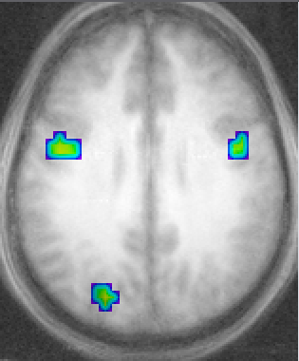
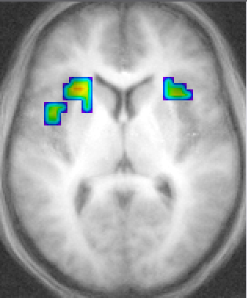
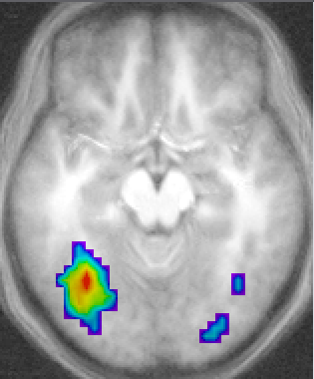
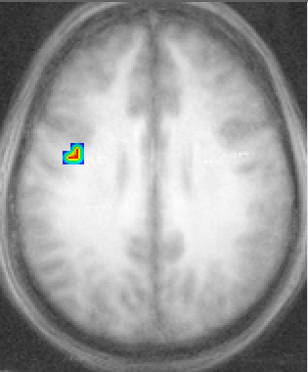
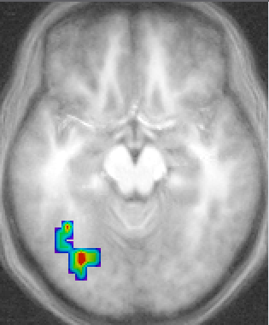
Functional MRI
visible words
masked words
x = -38
x = -38
6.3
t scale
20.8
left fusiform gyrus
(-48, -60, -12)
2.26
t scale
3.33
10⁻⁵
p value
3.10⁻¹²
0.02
p value
0.0025
z = 45
z = 29
z = 5
z = -17
z = 29
z = -17

Slide 19
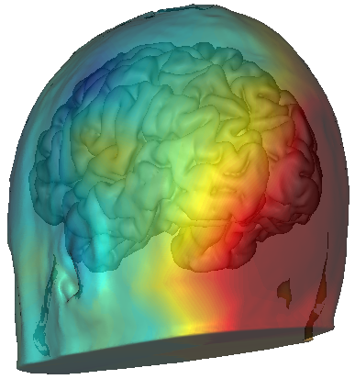
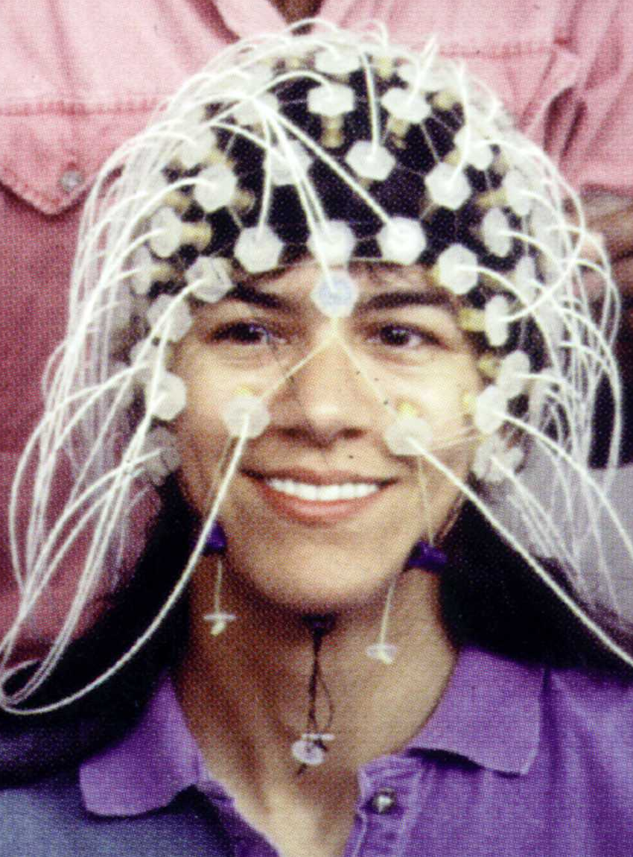
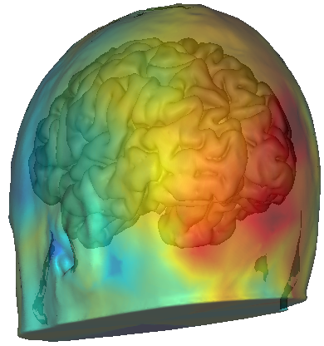
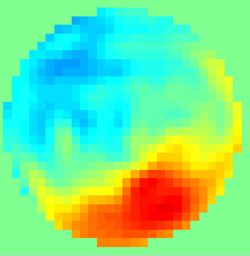
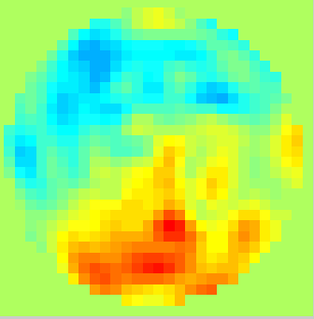
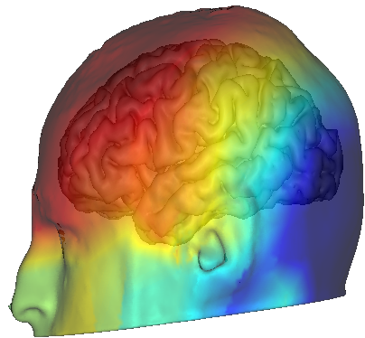
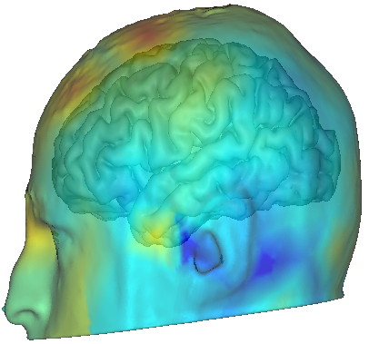
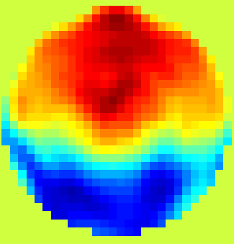
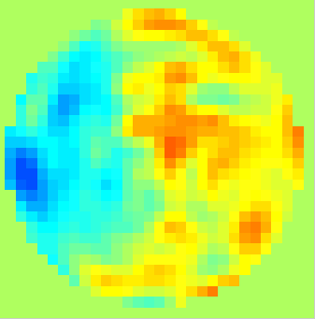
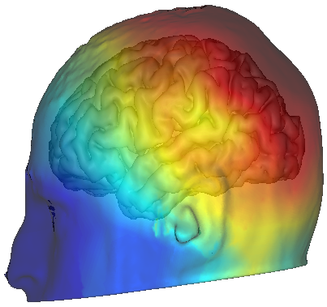
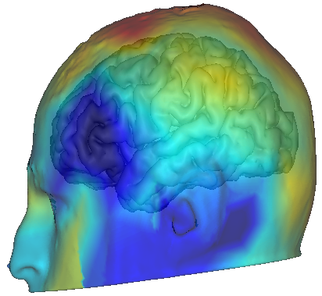
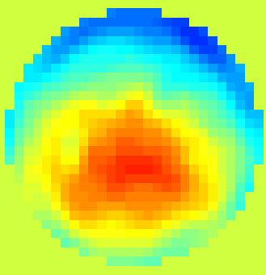
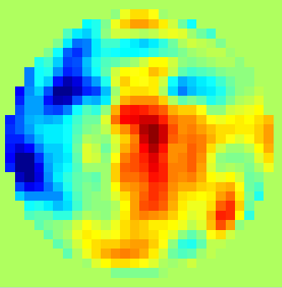
visible words
ERPs
masked words
t=156 ms
t=172 ms
−2 μV
+2 μV
−0.7 μV
+0.6 μV
t=244 ms
t=244 ms
−5 μV
+3.5 μV
−0.7 μV
+0.6 μV
t=476 ms
t=476 ms
−5 μV
+3.5 μV
−0.7 μV
+0.6 μV

Slide 20
Conclusions (1)
Evidence for unconscious processing of masked words
  Within the areas associated with conscious reading, masked words activated left extrastriate, fusiform, and precentral areas.
  Furthermore, masked words reduced the amount of activation evoked by a subsequent conscious presentation of the same word (unconscious repetition suppression).
  In the left fusiform gyrus, this repetition suppression phenomenon was independent of whether the prime and target shared the same case.
  This indicates that case-independent information about letter strings was extracted unconsciously.

Slide 21
Conclusions (2)
Differences between conscious and unconscious word processing
  In comparison to an unmasked situation, the activation evoked by masked words was drastically reduced (in fMRI and ERPs).
  There was no detectable activity in inferior prefrontal/insular, parietal, and anterior cingulate areas.
  The long-distance correlation between the fusiform gyrus and the precentral and anterior cingulate cortices increased during conscious processing.
  A P300 was generated only when the words were conscious
  Although those are plausible correlates of consciousness, they may also be related to the process of naming the words.

