Slide 1

openness is in the air
jonas kubilius | nma | august 19, 2012 | klab.lt
imkiet mani i dalikities

Slide 2
why you should care
you find a nice picture online and want to you it on your blog... or you want to use a song in your short movie...
you want to watch the Olympic Games on your TV...
you want to buy a movie...
you want to create some software/hardware

Slide 3
why you should care
you find a nice picture online and want to you it on your blog... or you want to use a song in your short movie...
you want to watch the Olympic Games on your TV...
you want to buy a movie...
you want to create some software/hardware
This content is not available in your country

Slide 4
why you should care
you find a nice picture online... it’s piracy!
you want to watch the Olympic Games... delayed broadcasting in the US!
you want to buy a movie... not available in your region!
you want to create some software/hardware... patent infringement!

Slide 5
something’s wrong here
instead of promoting sharing of ideas, we do everything to stop that in the name of “copyright protection”
who are we really protecting and why?

Slide 6
misconceptions about piracy
it’s stealing
no: when I steal, I have one and you have none
when I copy, I have one and you have one too

Slide 7
misconceptions about piracy
it’s plagiatarism
no: plagiatarism is about not attributing copyright to somebody

Slide 8
new rules
virtual world is not the same as physical
idea versus object, utility vs art (Johanna Blakley @ TED)

Slide 9
copyright
creator’s exclusive right to his/her creation
do you really need it?
I’m happy people use my stuff!
new business models (Google, Khan Academy, Kickstarter)
donations, grants
1000 true fans
...

Slide 10
copyright
who else can hold this right?
publisher, corporations? why? even after creator’s death? 70 years later???

Slide 11
open science
licenses: Creative Commons, GNU GPL
software: Debian
publishing: arxiv.org, PLoS One

Slide 12
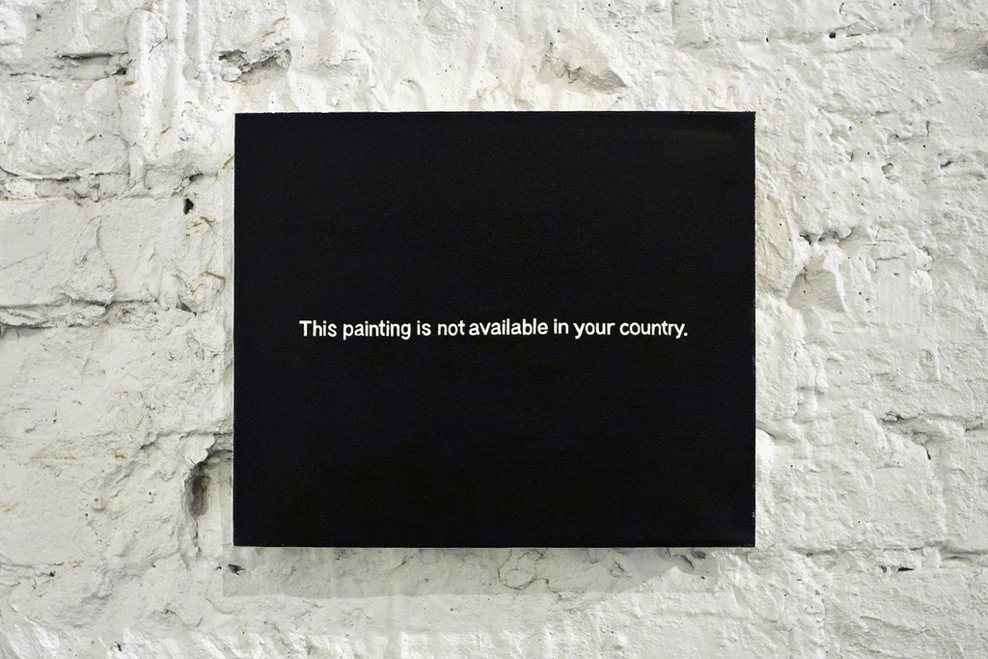
Thanks
Paul Mutant (2010)

