Slide 1
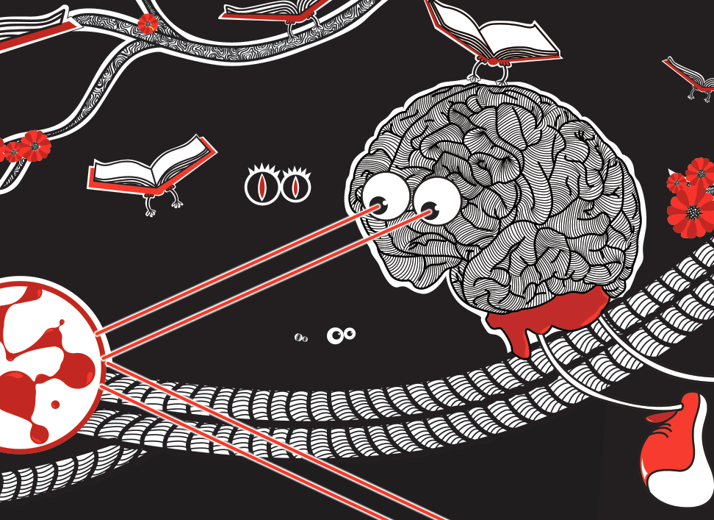
Just Why Are Machines So Stupid?

Slide 2


Jonas
Kubilius

Slide 3
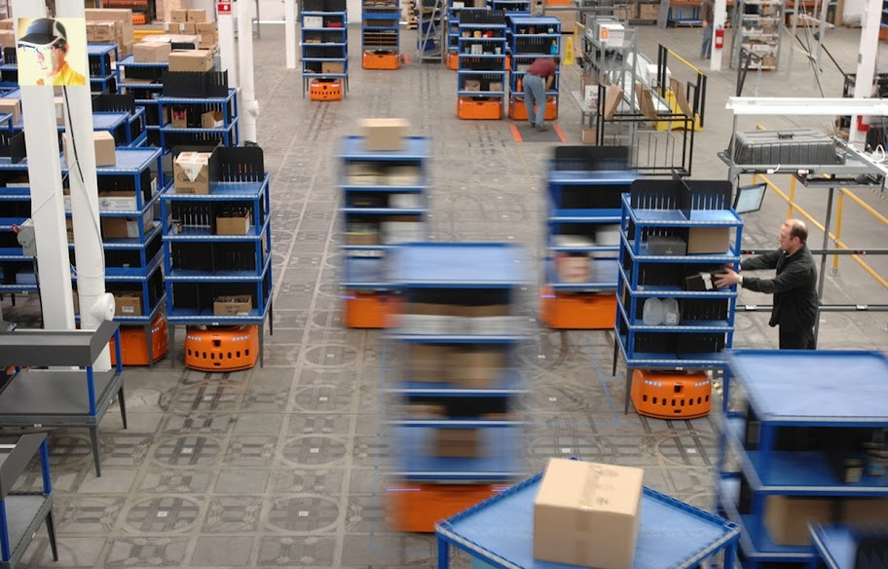
Vir Vikham Singh

Slide 4
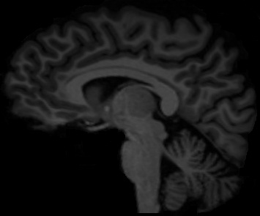
jonas’ brain

Slide 5

jonas’ brain
lithuania
Wikimedia Commons

Slide 6

Vision
How do you see?
source: Celeste | flickr

Slide 7


Slide 8


Slide 9
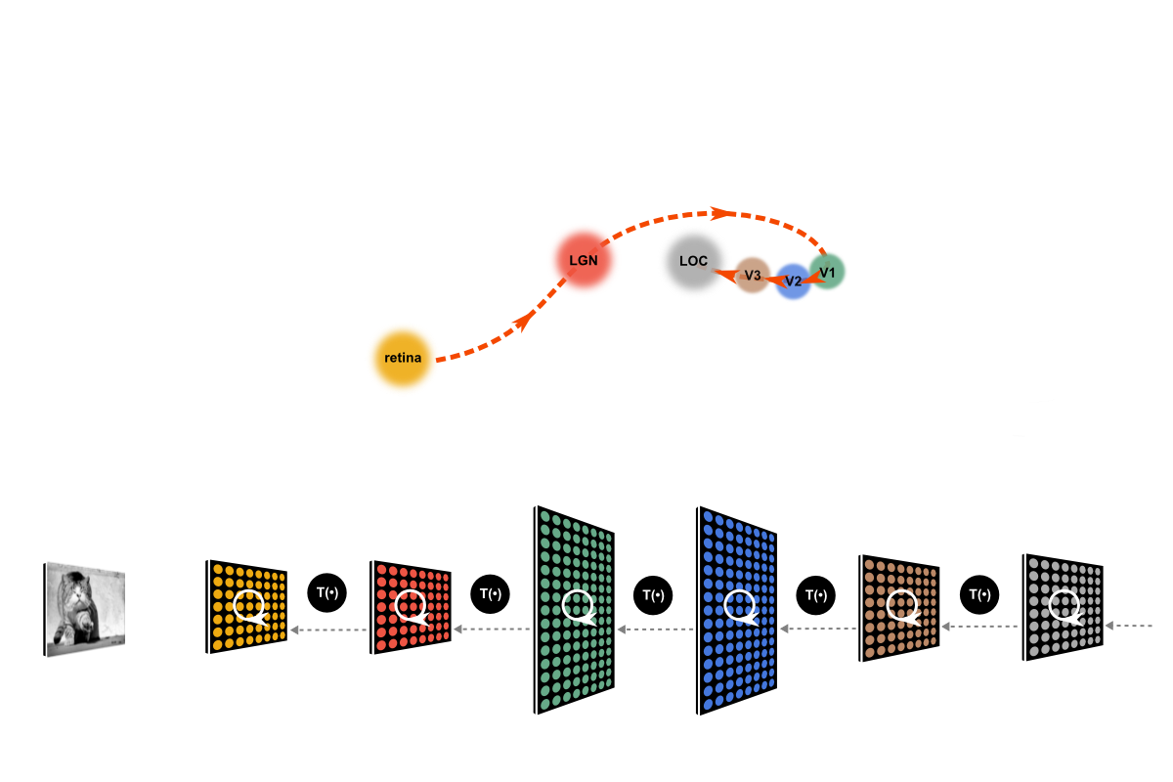
after DiCarlo & Cox, TiCS (2007)

Slide 10
Edge Detection
source: Celeste | flickr

Slide 11
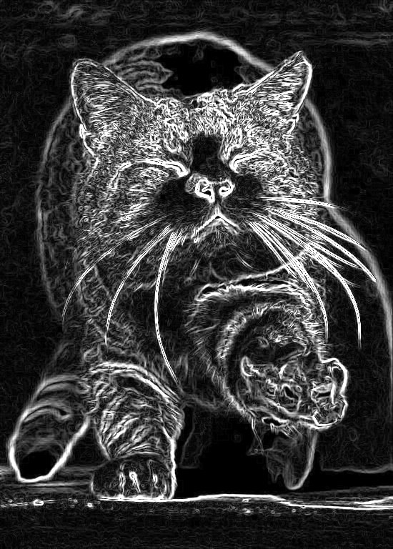
Edge Detection
one edge detected

Slide 12
Edge Detection
all edges

Slide 13
Grouping
how do you put the cat together?
source: Celeste | flickr

Slide 14
Grouping
how do you put the cat together?
source: Celeste | flickr

Slide 15
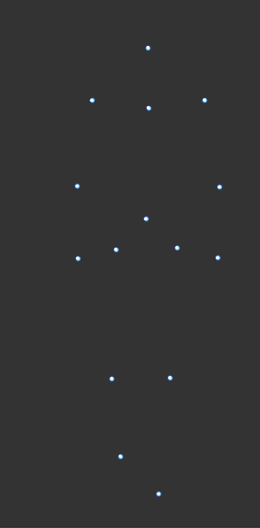
Grouping
parts are put together according to certain rules –
Gestalt laws of grouping
source: Bio Motion Lab
see also: Johansson, 1973

Slide 16
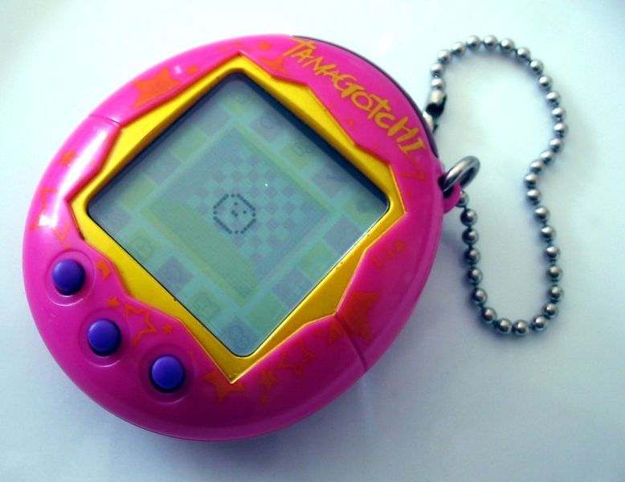
Automatic World
machines that do boring tasks – instead of us
source: Wikimedia Commons

Slide 17
Thank You

