Slide 1
doing science in the open
jonas kubilius | lab meeting | september 30, 2011 | jonaskubilius.mp
imkiet mani i dalikities

Slide 2
motivation
part one

Slide 3
responsibility
being a scientist brings not only
fun to investigate things you care about
freedom
a good salary
two monitors (for some)
there are also some responsibilities

Slide 4
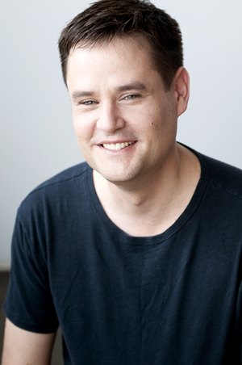
open science
what we do, we do for everybody
research is funded by people
so we should make sure they get something in return
this viewpoint is heavily inspired by Michael Nielsen

Slide 5
our research habits
part two

Slide 6
typical scientific routine
come up with an experiment
write code to run it (Matlab, E-Prime)
collect data
analyze data (Matlab, Excel, SPSS)
present data at a conference (Powerpoint, Illustrator)
write a paper (MS Word)
submit it to a journal
get reviews*
revise and get paper published
get media coverage

Slide 7
typical scientific routine
come up with an experiment
write code to run it (Matlab, E-Prime)
collect data
analyze data (Matlab, Excel, SPSS)
present data at a conference (Powerpoint, Illustrator)
write a paper (MS Word)
submit it to a journal
get reviews*
revise and get paper published
get media coverage
*negative

Slide 8
come up with an experiment
You need to read journals to get inspired / replicate findings.
What if you can't access Current Biology?
What if your institution is poor?
What if you’re just a curious high school student?

Slide 9
write code to run it
What if you want to reuse somebody's code? How do you obtain it? Will it work on your machine?
What if you don’t have the software?
Matlab: € 360 / year (?)
E-Prime: $ 795 / $ 995
and, oh,
Windows: € 200 / € 309 / € 319

Slide 10
collect data
Where do you get enough participants?
Oh, and that's expensive too!

Slide 11
analyze data
How much time do you spend analyzing it manually?
Programming trivial things?
How much do you pay for your analysis software?
MS Office: € 139 (student) / € 379.01 / € 699 (pro)
SPSS: € 25 (student/year) / € 360

Slide 12
present data at a conference
Will you ever see anybody’s slides/poster again?

Slide 13
write a paper
Ever got lost among all different versions of your paper?
Hate formatting?

Slide 14
submit it to a journal
How much time do you spend preparing your manuscript for submission? Figuring out journal’s particular requirements? Redoing all of that for another journal?
How much do you pay for submission?
Journal of Vision: $ 85 per page ($ 510 for 6 pages)
The Journal of Neuroscience: $ 950 / $ 475 (brief)
PLoS One: $ 1350
Psychological Science: $ 0

Slide 15
get (negative) reviews
Stupid reviewers and unreasonable requests? 3 major revisions?
How many years does it take from obtaining results to publishing them?

Slide 16
revise and get published
Who can read your paper?
Did you know that you did not hold the copyright to your own creative work?
And what did you publish? Just some text? Where is raw data, code, analyses? Maybe you made a mistake? Maybe you cheated?

Slide 17
get media coverage
Will they see your paper?
Will anybody see your paper?
And if they do, what will they find on your website? A conveniently double-spaced paper in the Times New Roman typeface?

Slide 18
How to fix That
part three

Slide 19
come up with an experiment
You need to read journals to get inspired / replicate findings.
What if you can't access Current Biology?
What if your institution is poor?
What if you’re just a curious high school student?
The next slides will provide solutions for these fundamental flaws.

Slide 20
write code to run it
What if you want to reuse somebody's code? How do you obtain it? Will it work on your machine?
What if you don’t have the software?
use free and open source software

Slide 21
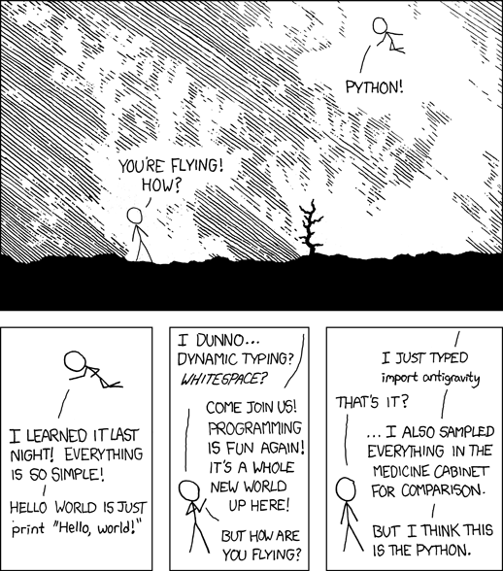
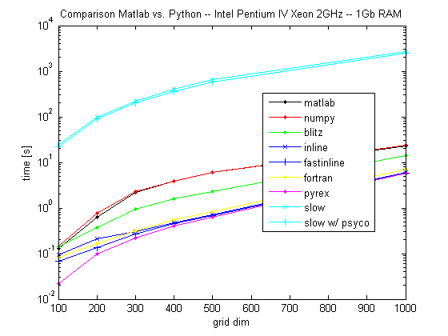
write code to run it: python
user-friendly
fast
Lorenzo Bolla's blog
xkcd

Slide 22
write code to run it: python
has psychophysics packages (PsychoPy, Vision Egg)
and even point-and-click interfaces (PsychoPy, OpenSesame)
versatile
got some C/C++ code? use Cython
want to go online? use Pyjamas, Sculpt
need parallel computing? use IPython
need more? somebody has probably done that already
and to help you migrate to Python, there is an Open-Source MATLAB-to-Python Compiler

Slide 23
write code: neurodebian
get all necessary tools easily: NeuroDebian (maintained actively by Hanke/Halchenko in Haxby’s group)

Slide 24
collect data
Where do you get enough participants?
Oh, and that's expensive too!
do experiments online
python can do it!
make your experiments run on a browser
make them fun!
foldit: resolved a crystal structure of an AIDS-related protein

Slide 25
analyze data
How much time do you spend analyzing it manually?
Programming trivial things?
publish your computer code: it is good enough
use distributed version control systems like git or mercurial: track changes, instant sharing

Slide 26
analyze data
How much do you pay for your analysis software?
do you really need anything for your t-test, linear regression, and a correlation?
use R for more complidated statistical tests
use NiPy for fMRI analyses
use PyMVPA, LIBSVM for SVMs

Slide 27
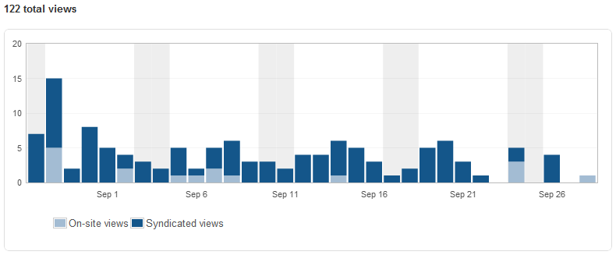
present data at a conference
Will you ever see anybody’s slides/poster again?
use QR codes for immediate dissemination
put them on Gestalt Revision
how about your own website? it’s free and easy to set up. it’s know as a blog
bonus: now you know who cares about your stuff
also: why use Powerpoint
to make your slides/poster?
try Scribus/Inkscape

Slide 28
write a paper
Ever got lost among all different versions of your paper?
use Google Docs:
revision history
commenting
available everywhere
Hate formatting?
use LaTeX, ScribTeX

Slide 29
submit it to a journal
How much time do you spend preparing your manuscript for submission? Figuring out journal’s particular requirements? Redoing all of that for another journal?
How much do you pay for submission?
why do we need journals at all?
use arXiv

Slide 30
get (negative) reviews
Stupid reviewers and unreasonable requests? 3 major revisions?
How many years does it take from obtaining results to publishing them?
Publish peer reviews
Nikolaus Kriegeskorte:
Open access + Open post-publication peer review

Slide 31
revise and get published
Who can read your paper?
Did you know that you did not hold the copyright to your own creative work?
And what did you publish? Just some text? Where is raw data, code, analyses? Maybe you made a mistake? Maybe you cheated?
publish everything: data, analysis workflow, code that generated your figures, full text (put a disclaimer like this one)...

Slide 32
get media coverage
Will they see your paper?
Will anybody see your paper?
And if they do, what will they find on your website? A conveniently double-spaced paper in the Times New Roman typeface?
no problem if you used Google Docs or LaTeX and created your website...
Gallant Lab’s example of making it easy for everybody

Slide 33
Concluding remarks
part four

Slide 34
moving to the cloud
no dependency on a particular platform
free backup
access to everything for everyone anywhere
(use Dropbox, Wuala)
instant collaboration tools

Slide 35
open issues
where do you share your data?
maybe Dryad, Dataverse Network
no facebook for scientists
maybe Academia.edu, Research Gate
there aren’t mature open alternatives for everything yet, e.g., Powerpoint, SPM
privacy issues when moving to the cloud
requires efforts: more coding, more command line interfaces, more things to do

Slide 36
what to do
start by publishing full data, your code, and full text

