Slide 1

some examples from vision research
contents
images
jonas kubilius | nma | august 18, 2012 | klab.lt
fair use
imkiet mani i dalikities
for educational purposes

Slide 2
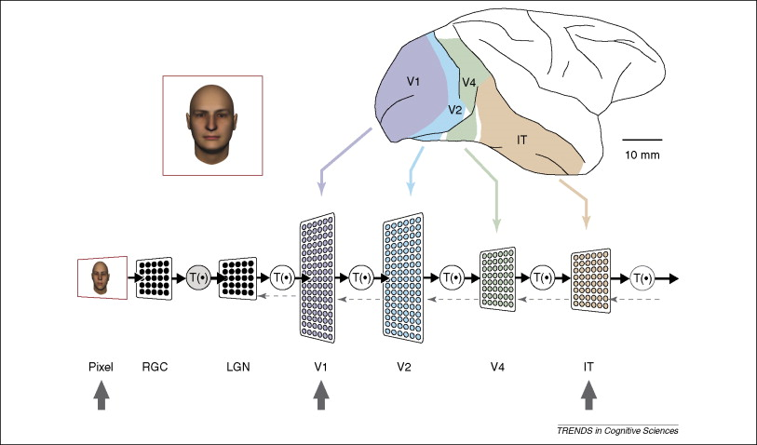
our visual system
DiCarlo & Cox, TiCS (2007)

Slide 3
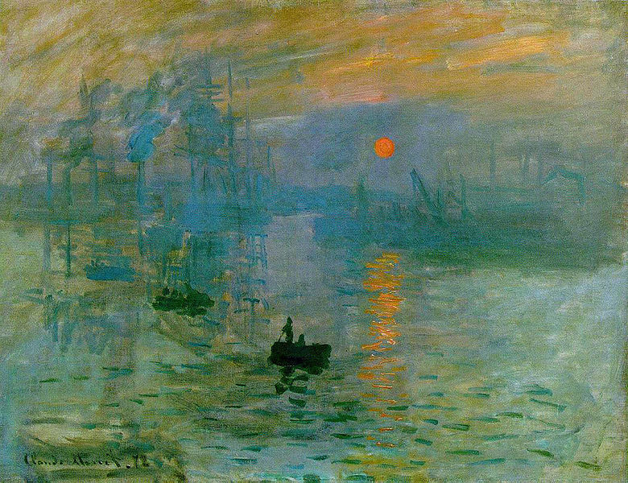
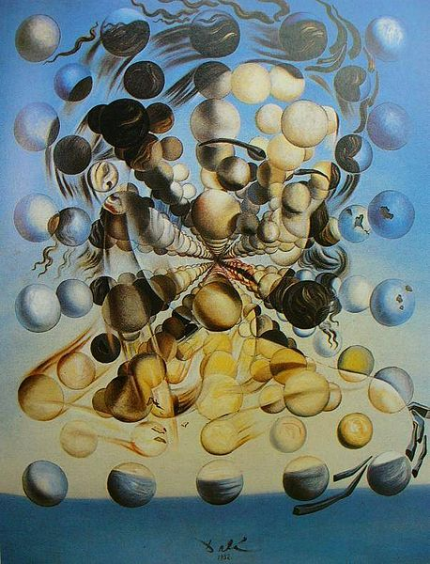
impressionism and the gist
Claude Monet. Impression, Sunrise (1872)
Salvador Dalí, Galatea of the Spheres (1952)

Slide 4
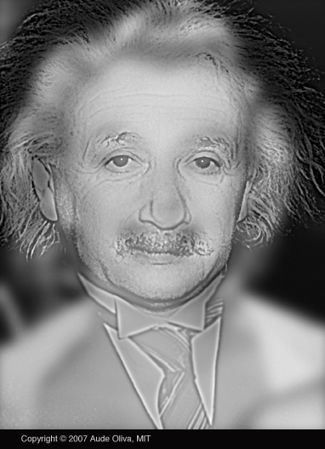
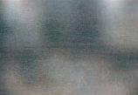
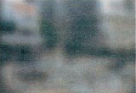
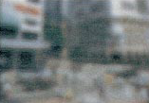
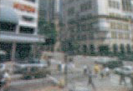
impressionism and the gist
.5 c/d.
1 c/d.
2 c/d.
4 c/d.
Aude Oliva (2007)
Oliva & Schyns, Cognitive Psychology (2000)

Slide 5
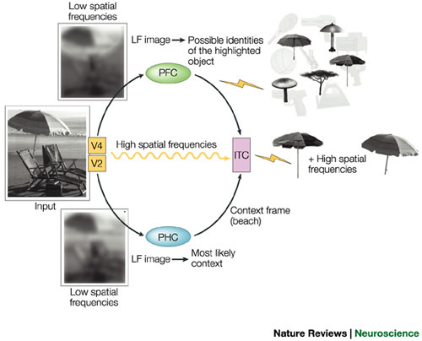
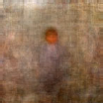
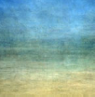
impressionism and the gist
Torralba & Oliva, Network:
Computation in Neural Systems (2003)
Moshe Bar, Nature Reviews Neuroscience (2004)

Slide 6
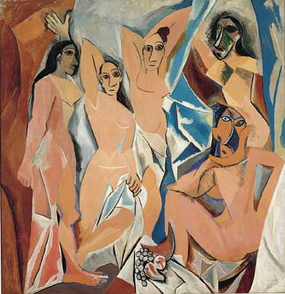
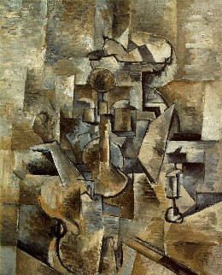
cubism and recognition by components
Pablo Picasso, Les Demoiselles d'Avignon (1907)
Georges Braque, Violin and Candlestick (1910)

Slide 7
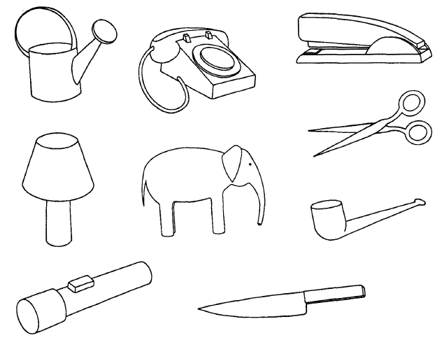
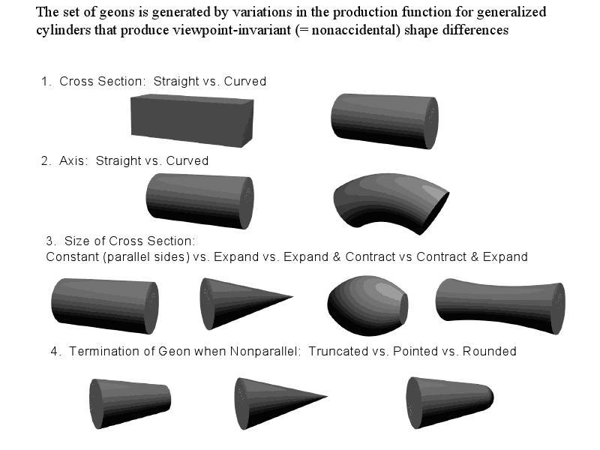
cubism and recognition by components
Biederman, Psychological Review (1987)
Wikimedia Commons

Slide 8
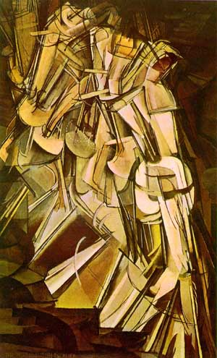
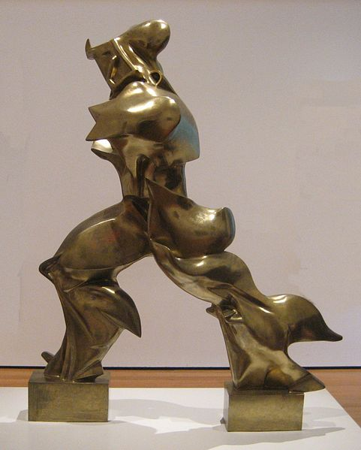
futurism and unsupervised temporal learning
Marcel Duchamp, Nude Descending a Staircase, No. 2 (1912)
Umberto Boccioni, Unique Forms of Continuity in Space (1913)

Slide 9
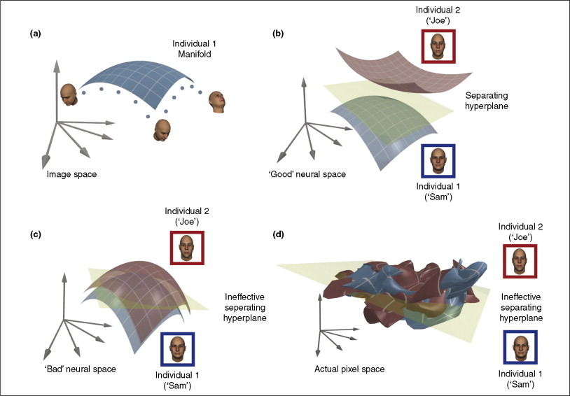
futurism and unsupervised temporal learning
DiCarlo & Cox, TiCS (2007)

Slide 10
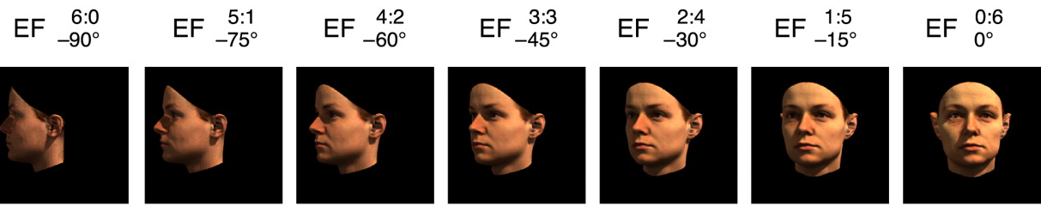
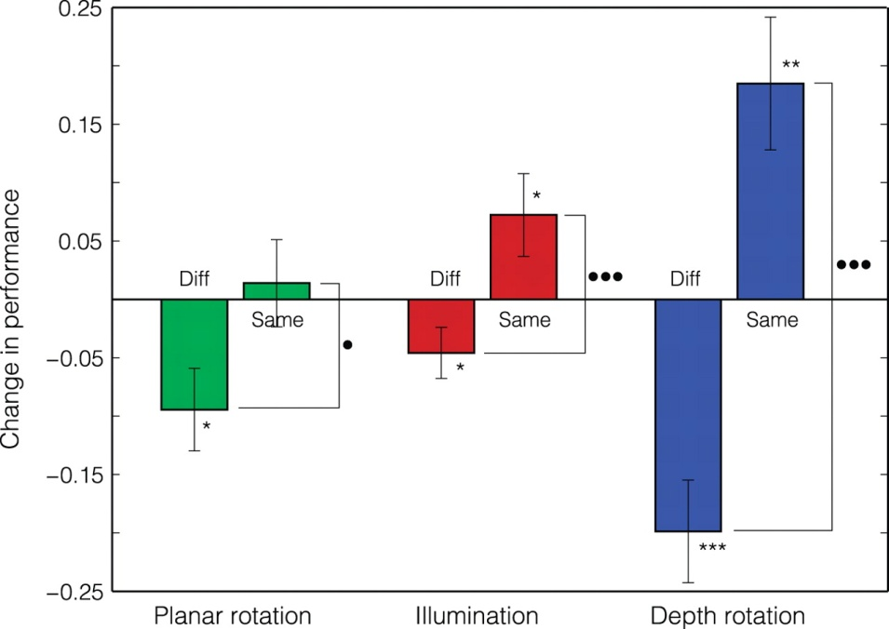
futurism and unsupervised temporal learning
1. rotated faces shown; sometimes the face is the same, but sometimes it changes to another face while rotating
2. people start confusing faces that were changing during rotation (blue Diff), i.e., two different faces start looking alike
Wallis et al., Journal of Vision (2009)

Slide 11
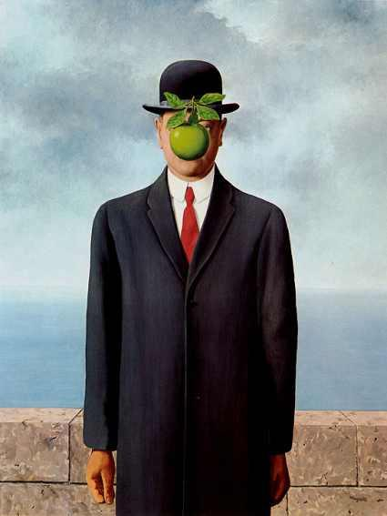
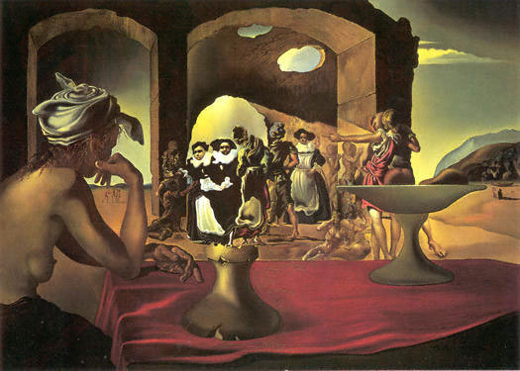
surrealism and faces
Salvador Dalí, Slave Market with the Disappearing Bust of Voltaire (1940)
René Magritte, The Son of Man, 1964

Slide 12
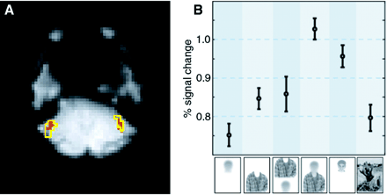
surrealism and faces
contextual information suffices to activate FFA
(works even better than the actual face!)
face selective region FFA
Cox, Meyers & Sinha, Science (2004)

Slide 13
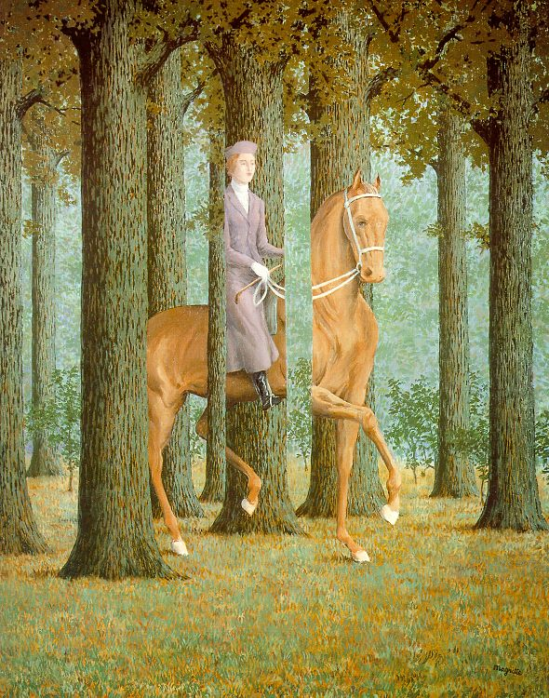
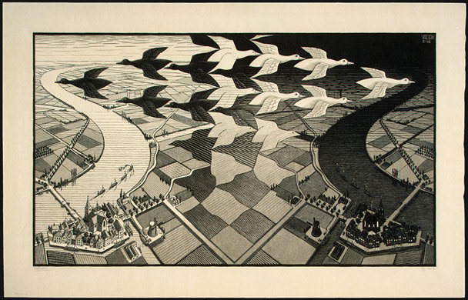
escher, magritte and figure-ground
M.C. Escher, Day and Night, 1938
René Magritte, The Blank Check (1965)

Slide 14
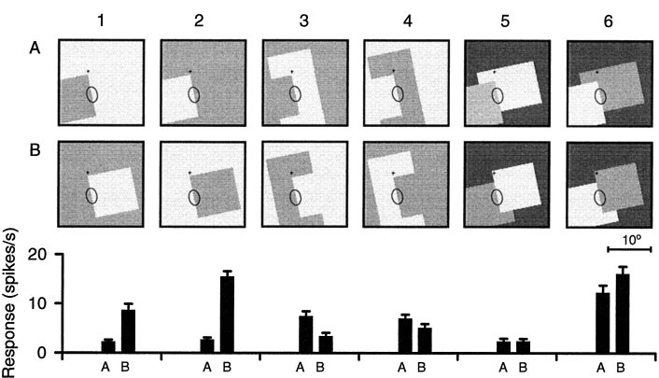
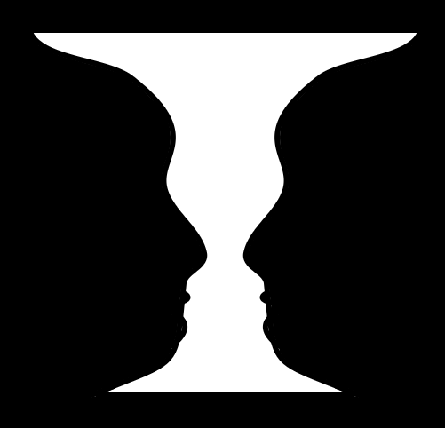
escher, magritte and figure-ground
a single cell response
Wikimedia Commons
Zhou et al., Journal of Neuroscience (2000)

Slide 15
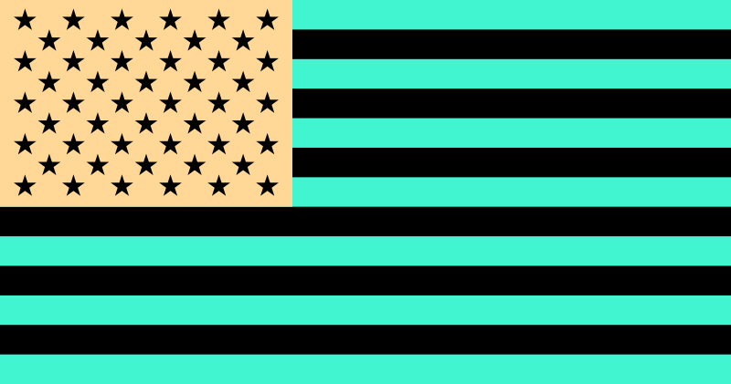
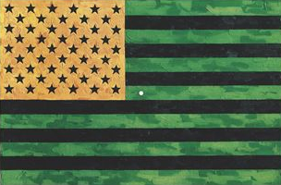
jasper johns and color opponency
Jasper Johns, Flag (Moratorium), 1969
Wikipedia

Slide 16
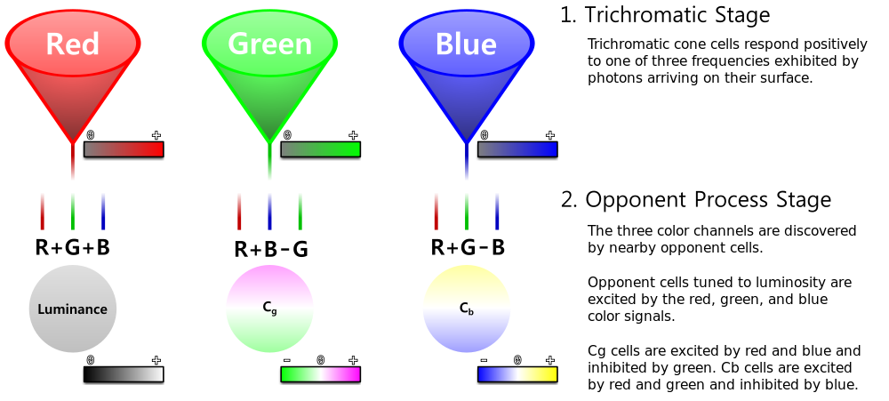
jasper johns and color opponency
Wikimedia Commons

Slide 17
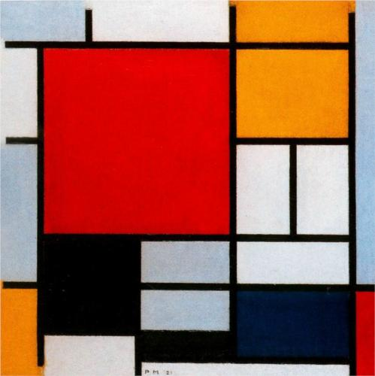
mondrian and non-conscious visual processing
Piet Mondrian, Composition with Large Red Plane, Yellow,
Black, Grey and Blue, 1921

Slide 18
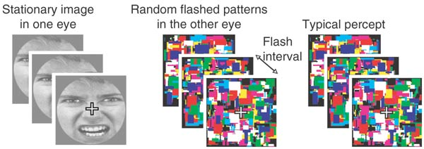
mondrian and non-conscious visual processing
Tsuchiya & Koch, Nature Neuroscience (2005)

Slide 19
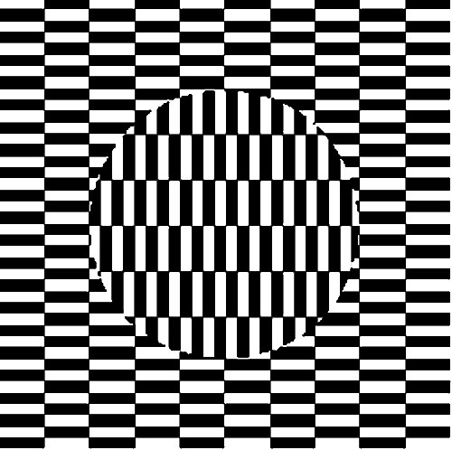
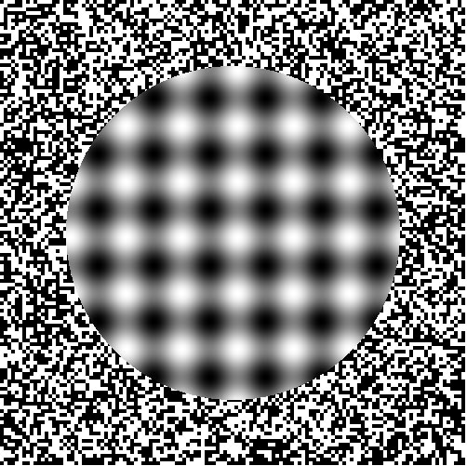
op art and microsaccades
Hajime Ouchi, The Ouchi Illusion (1973) | Scientific American
Akiyoshi Kitaoka, The Ouchi Illusion | Scientific American

Slide 20
Thanks

