Slide 1
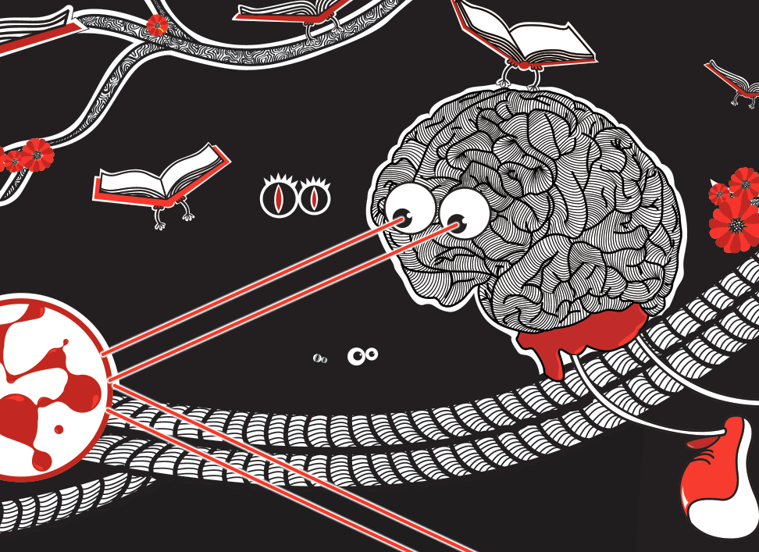
Just Why Are Machines So Stupid?

Slide 2
Just Why Are Machines So Stupid?

Slide 3


Jonas
Kubilius

Slide 4
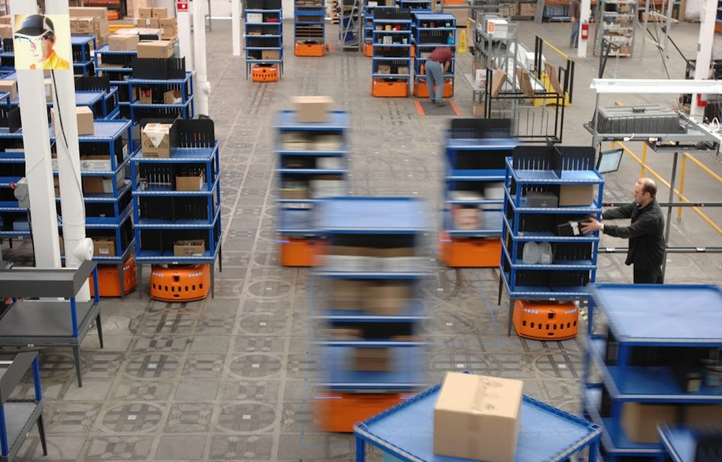
Vir Vikham Singh

Slide 5
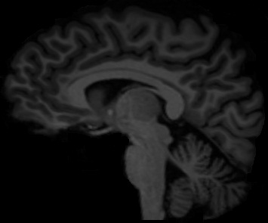
jonas’ brain

Slide 6

jonas’ brain
lithuania
Wikimedia Commons

Slide 7

Vision
How do you see?
source: Celeste | flickr

Slide 8


Slide 9


Slide 10
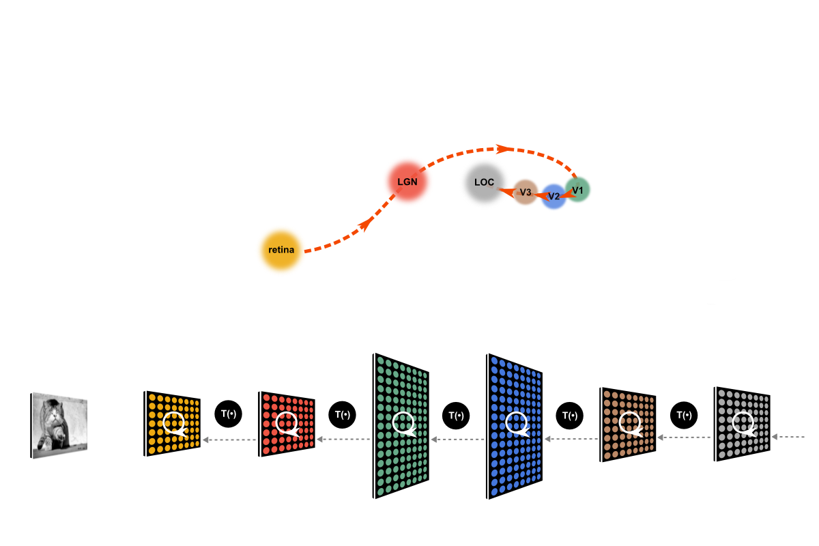
after DiCarlo & Cox, TiCS (2007)

Slide 11
Edge Detection
source: Celeste | flickr

Slide 12
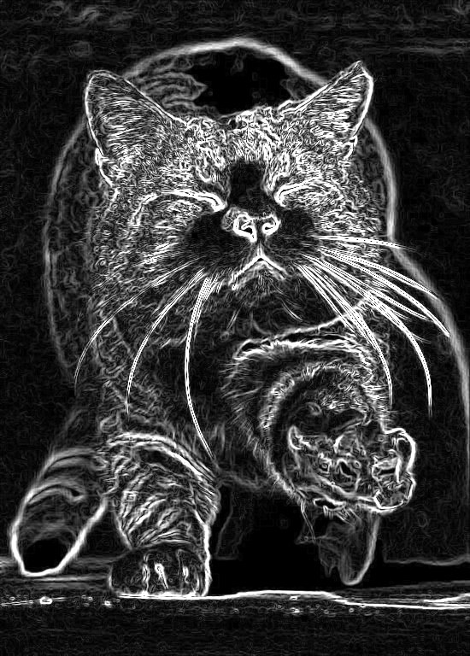
Edge Detection
one edge detected

Slide 13
Edge Detection
all edges

Slide 14
Grouping
how do you put the cat together?
source: Celeste | flickr

Slide 15
Grouping
how do you put the cat together?
source: Celeste | flickr

Slide 16
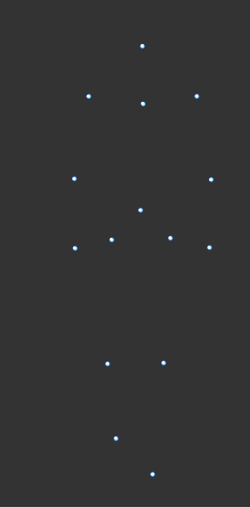
Grouping
parts are put together according to certain rules –
Gestalt laws of grouping
source: Bio Motion Lab
see also: Johansson, 1973

Slide 17
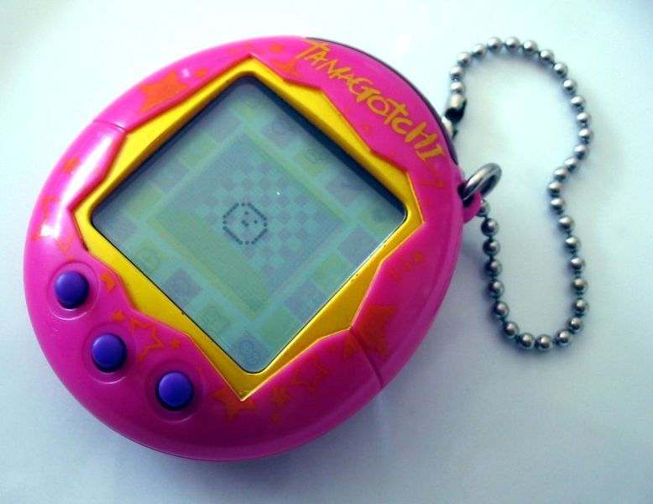
Automatic World
machines that do boring tasks – instead of us
source: Wikimedia Commons

Slide 18
Thank You

