Slide 1
qBio Class #10 Hatice Ulku Osmanbeyoglu
Adapted from https://bioinformatics.ca/files/GeneLists_Lecture1-2.pdf

Slide 2
Analyzing gene lists: over-representation analysis (ORA)
Interpreting Genes from OMICS Studies
(microarray/RNA-seq/ChIP-seq/Dnase-seq/ATAC-seq etc)

Slide 3
Typical omic analysis analysis pipeline
Design and perform experiment
Process and normalise data
Statistical analysis
Differentially expressed genes/binding sites
RNA-seq
ChIP-seq
Biological interpretation

Slide 4
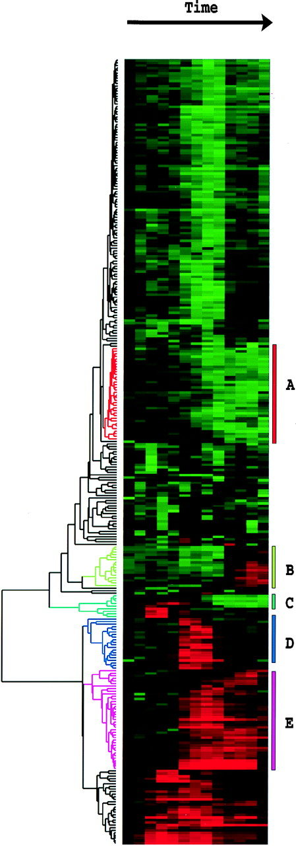
Examples of sources of gene lists
Clustering
Thresholding a gene “score”
Gene list
Gene list
Genes
Genes
Examples of gene scores
Time
Source Eisen et al. (1998) PNAS 95
Source: Gerber et al. (2006) PNAS103

Slide 5
Over-representation analysis (ORA) in a nutshell
Given:
Gene list: e.g. RRP6, MRD1, RRP7, RRP43, RRP42 (yeast), or Gene Scores: RRP6 (4.0), MRD1 (3.0) etc
Gene annotations: e.g. Gene ontology, transcription factor binding sites in promoter
ORA Question: Are any of the gene annotations surprisingly enriched in the gene list?
Details:
How to assess “surprisingly” (statistics)
How to correct for repeating the tests

Slide 6
Overview
The Gene Ontology Consortium
Theory:
Review: What is a P-value? T-test?
Fisher’s Exact Test
Enrichment analysis with gene rankings
Correcting for multiple testing
Practice
Lab #1: DAVID: ORA for Gene Ontology
Lab #2: Using GSEA to evaluate ranked lists

Slide 7
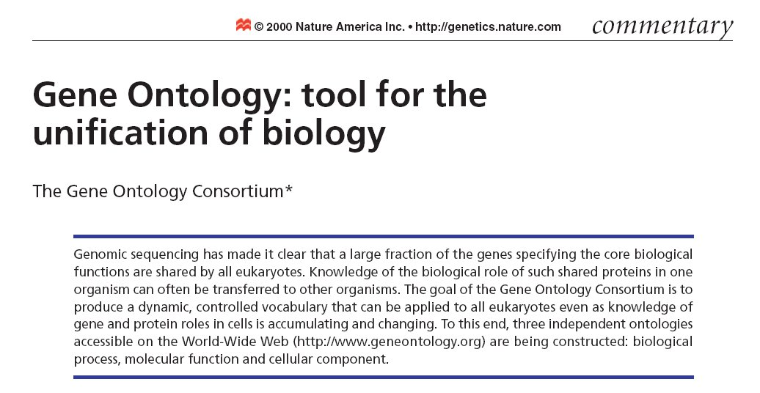
The Gene Ontology Consortium

Slide 8
GO Consortium
Developed three structured and controlled vocabularies (ontologies) that describe gene products in terms of their associated biological processes, cellular components and molecular functions in a species-independent manner
Has become a major resource for omics data interpretation

Slide 9
The Gene Ontology
Molecular Function: basic activity or task
e.g. catalytic activity, calcium ion binding
Biological Process: broad objective or goal
e.g. signal transduction, immune response
Cellular Component: location or complex
e.g. nucleus, mitochondrion

Slide 10
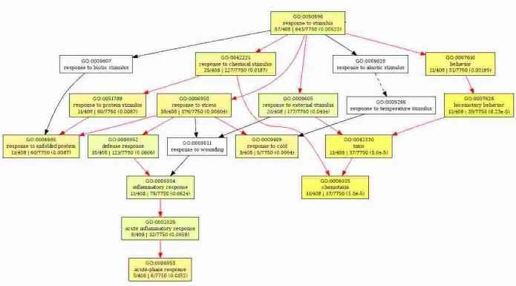
GO Structure
Hierarchical tree
Annotated with most specific annotation, forming path to top of tree
Genes annotated with all relevant terms
Annotations based on published studies and also electronic inferences

Slide 11
Example: GO Terms
GO ID: GO:0007268
GO term: synaptic transmission
Ontology: biological process
Definition: The process of communication from a neuron to a target (neuron, muscle, or secretory cell) across a synapse

Slide 12
Functional profiling tools
Identify GO categories with significantly more DE genes than expected by chance (i.e. over-represented among DE genes relative to representation on array as a whole)
Hypergeometric Distribution or Fisher’s Exact Test
Multiple
hypothesis
correction
Correct for testing multiple GO categories

Slide 13
Overview
The Gene Ontology Consortium
Theory:
Review: What is a P-value?
Fisher’s Exact Test
Enrichment analysis with gene rankings
Correcting for multiple testing (if time allows)
Practice
Lab #1: DAVID: ORA for Gene Ontology
Lab #2: Using GSEA to evaluate ranked lists

Slide 14
What is a P-value?
The P-value is (a bound) on the probability that the “null hypothesis” is true,
Calculated by calculating statistics using the data and testing the probability of observing those statistics, or ones more extreme, given a sample of the same size distributed according to the null hypothesis,
Intuitively: P-value is the probability of a false positive result (aka “Type I error”)

Slide 15
What is a P-value?
The P-value is (a bound) on the probability that the “null hypothesis” is true,
Calculated by calculating statistics using the data and testing the probability of observing those statistics, or ones more extreme, given a sample of the same size distributed according to the null hypothesis,
Intuitively: P-value is the probability of a false positive result (aka “Type I error”)

Slide 16
Table of error types |  | Null hypothesis (H0) is
 |  | True | False
Decision About Null Hypothesis (H0) | Reject | Type 1 error (False positive) | Correct inference (True positive)
 | Fail to reject | Correct inference (True negative) | Tyoe 2 error (False negatice

Slide 17
T-test
A t-test is commonly used to determine whether the mean of a population significantly differs from a specific value (called the hypothesized mean) or from the mean of another population

Slide 18
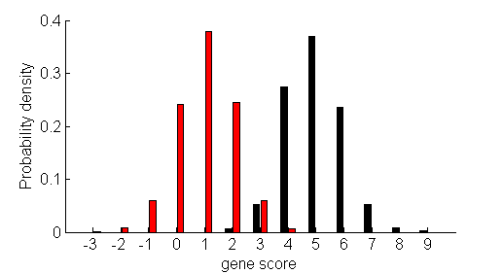
T-test
Gene scores
5
7
Gene score distributions
6
6
7
0
1
1
0
1
1
2
0
0
1
2
0
1
Question: How likely are the observed differences between the two distributions due to chance?

Slide 19
ORA using the T-test
Answer: Two-tailed T-test
Gene score distributions
Black: N₁=500
Mean: m₁ = 1.1
Std: s₁ = 0.9
Red: N₂=4500
Mean: m₁ = 4.9
Std: s₁ = 1.0
Strength of signal
T-statistic =
The surrounding
noise
Formal Question: What is the probability of observing the T-statistic or one more extreme if the means of the two distributions were the same?
= -88.5

Slide 20
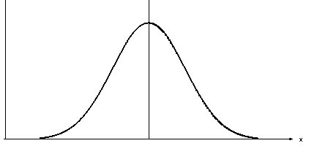
ORA using the T-test
P-value = shaded area * 2
Gene score distributions
T-distribution (d.o.f. N)
Probability density
-88.5
0
T-statistic
T-statistic =
Formal Question: What is the probability of observing the T-statistic or one more extreme if the means of the two distributions were the same?
= -88.5

Slide 21
Statistically Significant?
If your t-test results don't achieve statistical significance, it could be for any of the following reasons:
The difference (signal) isn't large enough. Nothing you can do about that, assuming that your study is properly designed and you've collected a representative sample.
The variation (noise) is too great. This is why it's important to remove or account for extraneous sources of variation when you plan your analysis. For example, you could use a control chart to identify and eliminate sources of special-cause variation from your process before you collect data for a t-test on the process mean.
The sample is too small. Remember the effect of variation is lessened by sample size. That means for a given difference and a given amount of variation, a larger sample is more likely to achieve statistical significance, as shown in this graph:

Slide 22
Overview
Theory:
Review: What is a P-value? The good ole’ T-test.
Fisher’s Exact Test
Enrichment analysis with gene rankings
Correcting for multiple testing
Practice
Lab #1: DAVID – GO enrichment analysis
Lab #3: Using GSEA to evaluate ranked lists

Slide 23
Fisher’s exact test
Fisher's exact test is a statistical significance test used in the analysis of contingency tables
Fisher's exact test calculates deviance from the null hypothesis, which holds that there is no bias in the data, or that the categorical variables have no correlation with each other

Slide 24
Fisher’s exact test: the bread and butter of ORA a.k.a., the hypergeometric test
Gene list
RRP6
MRD1
RRP7
RRP43
RRP42
Formal question: What is the probability of finding 4 or more black genes in a random sample of 5 genes?
 | Black genes | Red genes | Row Total
Selected | 4 | 1 | 5
Non-selected | 496 | 4999 | 5495
Column total | 500 | 5000 | 5500
Background population:
500 black genes,
5000 red genes

Slide 25
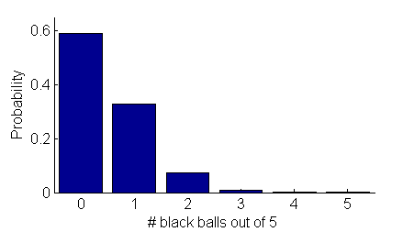
Fisher’s exact test cont.
Gene list
Null distribution
RRP6
MRD1
RRP7
RRP43
RRP42
P-value
Answer = 4.6 x 10⁻⁴
Background population:
500 black genes,
5000 red genes

Slide 26
What have we learned?
Fisher’s exact test is used for ORA of gene lists for a single type of annotation,
P-value for Fisher’s exact test
is “the probability that a random draw of the same size as the gene list from the background population would produce the observed number of annotations in the gene list or more.”,
and depends on size of both gene list and background population as well and # of black genes in gene list and background.

Slide 27
Calculation for Fisher's Exact Test:
An interactive calculation tool for Fisher's exact probability test for 2 x 2 tableshttp://quantpsy.org/fisher/fisher.htm
Using R
## Agresti (1990, p. 61f; 2002, p. 91) Fisher's Tea Drinker
## A British woman claimed to be able to distinguish whether milk or
## tea was added to the cup first. To test, she was given 8 cups of
## tea, in four of which milk was added first. The null hypothesis
## is that there is no association between the true order of pouring
## and the woman's guess, the alternative that there is a positive
## association (that the odds ratio is greater than 1).
TeaTasting <- matrix(c(3, 1, 1, 3), nrow = 2, dimnames = list(Guess = c("Milk", "Tea"),
Truth = c("Milk", "Tea")))
fisher.test(TeaTasting, alternative = "greater")
## => p = 0.2429, association could not be established

Slide 28
Overview
Theory:
Review: What is a P-value? T-test.
Fisher’s Exact Test
Enrichment analysis with gene rankings
Correcting for multiple testing
Practice
Lab #1: David
Lab #2: Using GSEA to evaluate ranked lists

Slide 29
Break for lab #1
Systematic and integrative analysis of large gene lists using DAVID bioinformatics resources
https://david.ncifcrf.gov/home.jsp
http://www.nature.com/nprot/journal/v4/n1/pdf/nprot.2008.211.pdf
http://www.nature.com/nprot/journal/v4/n1/full/nprot.2008.211.html

Slide 30
Gene list A
BAP1
TCF3
ETS1
MECOM
MZF1
MAX
FOXQ1
JUN
NFYA
TBP
LMO2
FOXC1
PAX8
STAT5B
STAT3
NR1H4
MAZ
E4F1
TCF12
TEAD1
GTF2A1
POSTN
HMGA1
NFE2L2
ADD1
BCL2L1
CHEK1
CLDN7
GSK3A
MAPK9
STK11
CDH3
CDKN1B
RAD51
RPTOR
RPS6
STAT5A
VHL
YBX1

Slide 31
Gene List B
PBRM1
TFAP4
MEF2A
SP1
HNF1A
ESR1
SRF
AHR
BPTF
STAT5A
FOXM1
MAF
SPI1
TEF
GTF2I
NFYB
MYC
TUBA1B
AR
BAP1
CAV1
MAPK1
NF2
SQSTM1
PDCD4

Slide 32
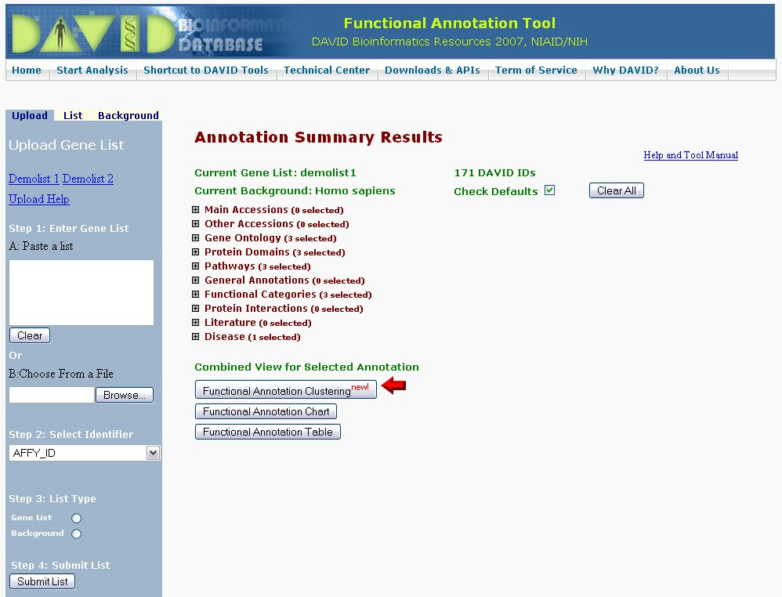

Slide 33
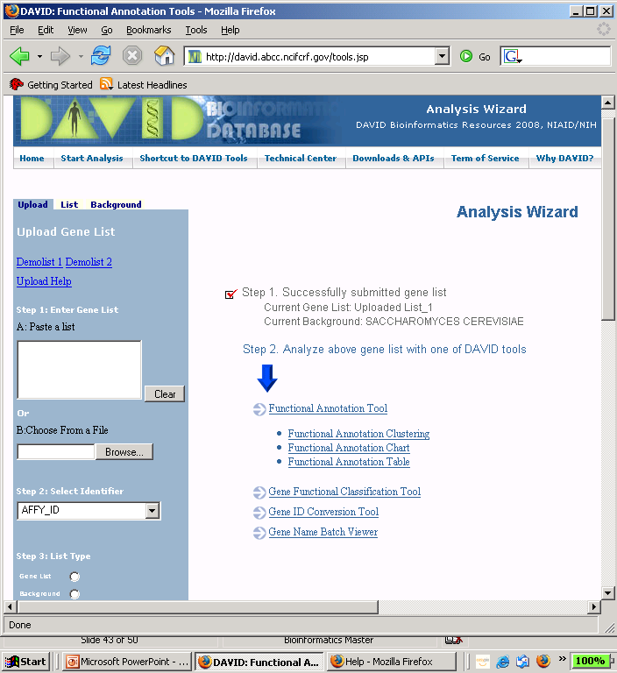
DAVID, part 1 http://david.abcc.ncifcrf.gov/
Paste list here
DAVID automatically detects organism
Choose ID type
List type: list or background?

Slide 34
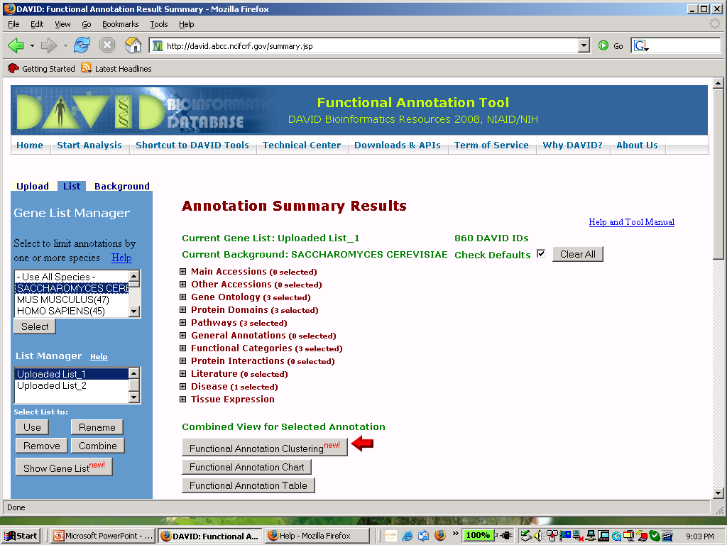
DAVID, part 2 http://david.abcc.ncifcrf.gov/

Slide 35
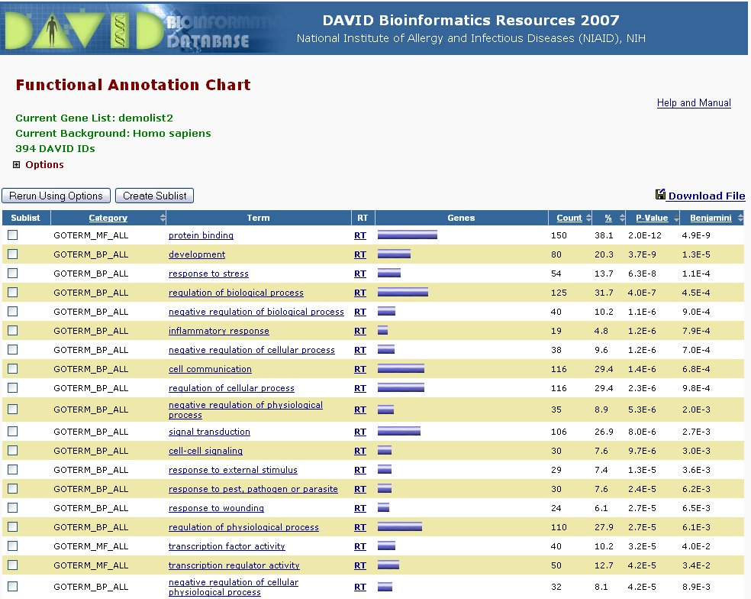
DAVID Results

Slide 36
ORA with gene rankings: overview
Why can’t I use the T-test?
The Wilcoxon-Mann-Whitney (WMW) test:
a T-test on ranks
The Kolmogorov-Smirnov (KS) test:
testing for arbitrary differences between gene score distributions.

Slide 37
Overview
The Gene Ontology Consortium
Theory:
Review: What is a P-value? The good ole’ T-test.
Fisher’s Exact Test, the bread and butter of ORA
Enrichment analysis with gene rankings
Correcting for multiple testing
Practice
Lab #1: DAVID: ORA for Gene Ontology
Lab #2: Using GSEA to evaluate ranked lists

Slide 38
Reminder: ORA using the T-test
P-value = shaded area * 2
Gene score distributions
T-distribution (d.o.f. N)
Probability density
-88.5
0
T-statistic
T-statistic =
Formal Question: What is the probability of observing the T-statistic or one more extreme if the means of the two distributions were the same?
= -88.5

Slide 39
Why can’t we use the T-test?
Assumes black and red gene score distributions are both approximately Gaussian (i.e. normal)
Score distribution assumption is often true for:
Log ratios from microarrays
Score distribution assumption is rarely true for:
Peptide counts, sequence tags (SAGE or NextGen sequencing), transcription factor binding sites hits
Tests for significance of difference in means of two distribution but does not test for other differences between distributions.
Notes:
I’m

Slide 40
Examples of inappropriate score distributions for T-tests
Distributions with gene score outliers, or “heavy-tailed” distributions
Bimodal “two-bumped” distributions.
Gene scores are positive and have increasing density near zero, e.g. sequence counts
Probability density
Probability density
Probability density
Gene score →
Gene score →
0
Gene score →
Solutions:
1) Robust test for difference of medians (WMW)
2) Direct test of difference of distributions (K-S)

Slide 41
Wilcoxon-Mann-Whitney (WMW) test aka Mann-Whitney U-test, Wilcoxon rank-sum test
For each observation in one set,
count the number of times this first
value wins over any observations in the
other set
(the other value loses if this first is larger)
1) Rank gene scores, calculate R_{B}, sum of ranks of black gene scores
2.1
5.6
-1.1
-2.5
-0.5
ranks
6.5
5.6
4.5
3.2
2.1
1.7
0.1
-1.1
-2.5
-0.5
1
2
3
4
5
6
7
8
9
10
R_{B} = 21
Probability density
N₂ red gene
scores
3.2
1.7
6.5
4.5
0.1
Gene score →
Formal Question: Are the medians of the two distributions significantly different?
N₁ black gene
scores
Z

Slide 42
Wilcoxon-Mann-Whitney (WMW) test aka Mann-Whitney U-test, Wilcoxon rank-sum test
2) Calculate Z-score:
mean rank
R_{B} = 21
= -1.4
Probability density
3) Calculate P-value:
P-value = shaded area * 2
Gene score →
Normal distribution
Formal Question: Are the medians of the two distributions significantly different?
Probability density
-1.4
0
Z
Z

Slide 43
WMW test details
Described method is only applicable for large N₁ and N₂ and when there are no tied scores, WMW software uses a tied rank correction
In most cases the WMW test is simply a T-test applied to the ranks of the gene scores
WMW test is robust to (a few) outliers

Slide 44
Kolmogorov-Smirnov (K-S) test
Cumulative distribution
1.0
Cumulative probability
Probability density
0.5
0
0
Gene score →
Gene score →
Question: Are the red and black distributions significantly different?
1) Calculate cumulative distributions of red and black

Slide 45
Kolmogorov-Smirnov (K-S) test
Cumulative distribution
1.0
Cumulative probability
Probability density
0.5
0
0
Gene score →
Gene score →
Question: Are the red and black distributions significantly different?
1) Calculate cumulative distributions of red and black

Slide 46
Kolmogorov-Smirnov (K-S) test
Cumulative distribution
1.0
Cumulative probability
Probability density
0.5
Length = 0.4
0
0
Gene score →
Gene score →
Formal question: Is the length of largest difference between the “empirical distribution functions” statistically significant?

Slide 47
WMW and K-S test caveats
Neither tests is as sensitive as the T-test, ie they require more data points to detect the same amount of difference, so use the T-test whenever it is valid.
K-S test and WMW can give you different answers: K-S detects difference of distributions, WMW detects difference of medians
Rare problem: Tied scores and small # of observations can be a problem for some implementations of the WMW test

Slide 48
Proper tests for different distributions
Distributions with gene score outliers, or “heavy-tailed” distributions
Bimodal “two-bumped” distributions.
Gene scores are positive and have increasing density near zero, e.g. sequence counts
Probability density
Probability density
Probability density
Gene score →
Gene score →
0
Gene score →
Recommended test:
WMW or K-S
K-S only
WMW or K-S
Notes:
First example goes last

Slide 49
GSEA: Key Features
Ranks all genes on array based on their differential expression
Identifies gene sets whose member genes are clustered either towards top or bottom of the ranked list (i.e. up- or down regulated)
Enrichment score calculated for each category
Permutation test to identify significantly enriched categories
Extensive gene sets provided via MolSig DB – GO, chromosome location, KEGG pathways, transcription factor or microRNA target genes

Slide 50
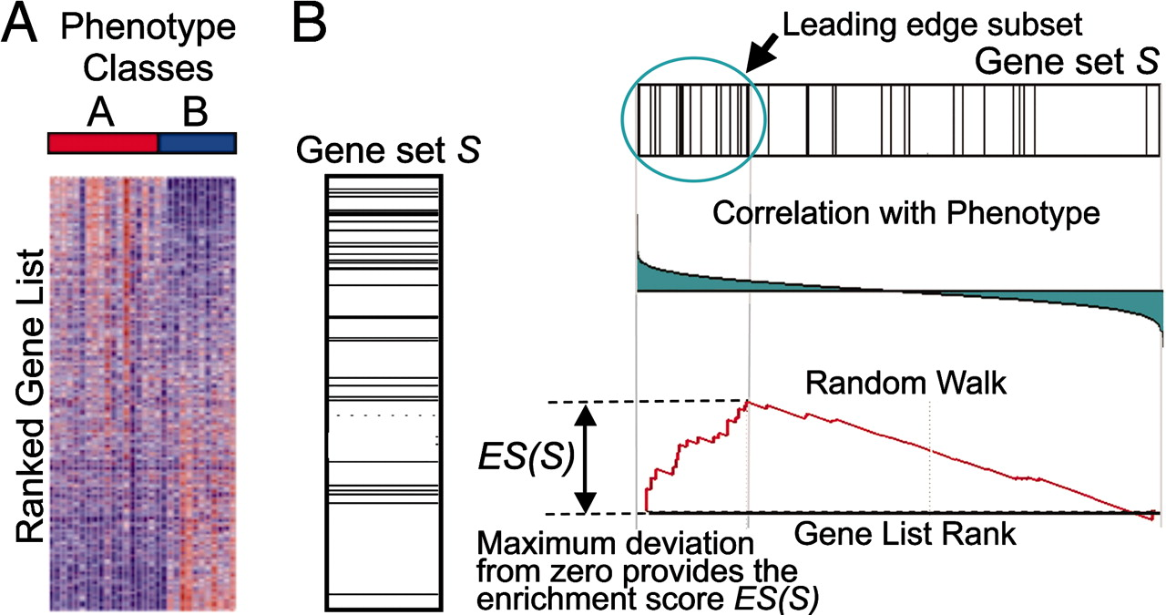
A GSEA overview illustrating the method
Subramanian A. et.al. PNAS;2005;102:15545-15550
An expression data set sorted by correlation with phenotype, the corresponding heat map, and the “gene tags,” i.e., location of genes from a set S within the sorted list.
Plot of the running sum for S in the data set,
including the location of the maximum enrichment
score (ES) and the leading-edge subset.
©2005 by National Academy of Sciences
Notes:
A GSEA overview illustrating the method. (A) An expression data set sorted by correlation with phenotype, the corresponding heat map, and the “gene tags,” i.e., location of genes from a set S within the sorted list. (B) Plot of the running sum for S in the data set, including the location of the maximum enrichment score (ES) and the leading-edge subset.

Slide 51
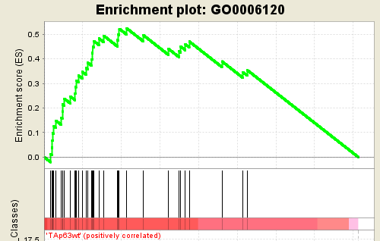
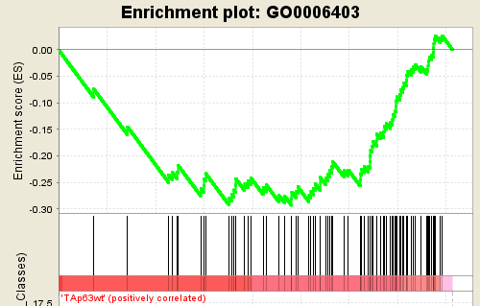
Testing Gene-set Enrichment: GSEA (Gene-Set Enrichment Analysis)
Define a differentiality statistic (e.g. t-test)
Rank the genes (e.g. up and down)
Compute the Enrichment Score (EM)
Navigate the ranked genes
Gene in the gene-set → positive score
Gene not in the gene-set → negative score
Cumulative sum
Enriched in UP
Enriched in DOWN

Slide 52
Testing Gene-set Enrichment: GSEA (Gene-Set Enrichment Analysis)
Pick the EM value with maximum (absolute value)
Weight by position on the ranked list
Estimate significance (p-value, FDR) by permutations
Enriched in UP
Enriched in DOWN

Slide 53
What have we learned?
T-test is not valid when one or both of the score distributions is not normal,
If need a “robust” test, or to test for difference of medians use WMW test or GSEA,
To test for overall difference between two distributions, use K-S test.

Slide 54
Other common tests and distributions
Chi-squared (contingency table) test
Useful if there are >2 values of annotation (e.g. red genes, black genes, and blue genes)
Used as an approximation to Fisher’s Exact Test but is inaccurate for small gene lists
Binomial test
Tests if gene scores for red and black either come from either N flips of the same coin or different coins.
E.g. black genes are “expressed” in, on average, 5 out of 12 conditions and red genes are expressed in, on average, 2 out of 12 conditions, is the probability of being expressed significantly different for the black and red genes?

Slide 55
Overview
Theory:
Review: What is a P-value? The good ole’ T-test.
Fisher’s Exact Test, the bread and butter of ORA
Enrichment analysis with gene rankings
Correcting for multiple testing
Practice
Lab #1: Funspec: ORA using Fisher’s Exact Test
Lab #2: Using GSEA to evaluate ranked lists

Slide 56
Break for lab #2
Try out an over-representation analysis on gene ranks using GSEA
GSEA:
http://www.broad.mit.edu/gsea/

Slide 57
Overview
Theory:
Review: What is a P-value? The good ole’ T-test.
Fisher’s Exact Test, the bread and butter of ORA
Enrichment analysis with gene rankings
Correcting for multiple testing
Practice
Lab #2: Using GSEA to evaluate ranked lists

Slide 58
Correcting for multiple testing: overview
Why do we need to correct? Winning the P-value lottery.
Controlling the Family-wise Error Rate (FWER) with the Bonferroni-correction
Controlling the false-discovery rate (FDR): Benjamini-Hochberg, Storey-Tibshirani, Q-values and all that

Slide 59
How to win the P-value lottery, part 1
Random draws
Expect a random draw with observed enrichment once every 1 / P-value draws
… 7,834 draws later …
Background population:
500 black genes,
5000 red genes
Notes:
Whenever you do multiple tests, need to correct the p-values
Remind audience of p-value definition
Motivating example: Do 20 tests at a p-value of 0.05, expect one false positive

Slide 60
How to win the P-value lottery, part 2 Keep the gene list the same, evaluate different annotations
Observed draw
Different annotations
RRP6
MRD1
RRP7
RRP43
RRP42
RRP6
MRD1
RRP7
RRP43
RRP42
Notes:
Use different annotations. “evaluate different annotations”

Slide 61
ORA tests need correction
From the Gene Ontology website:
Current ontology statistics: 25206 terms
14825 biological process
2101 cellular component
8280 molecular function

Slide 62
Two types of multiple test corrections
Controlling the Family-Wise Error Rate (FWER) controls the probability that any test is a false positive
Controlling the False Discovery Rate (FDR) controls the proportion of positive tests (i.e. rejections of the null hypothesis) that are false positives

Slide 63
Controlling Family-Wise Error Rate using the Bonferroni correction
If M = # of annotations tested:
Corrected P-value = M x original P-value
Corrected P-value is greater than or equal to the probability that any single one of the observed enrichments could be due to random draws. The jargon for this correction is “controlling for the Family-Wise Error Rate (FWER)”

Slide 64
Bonferroni correction caveats
Bonferroni correction is very stringent and can “wash away” real enrichments.
Often users are willing to accept a less stringent condition, the “false discovery rate” (FDR), which leads to a gentler correction when there are real enrichments.

Slide 65
False discovery rate (FDR)
FDR is the expected proportion of the observed enrichments that are due to random chance.
Compare to Bonferroni correction which is the probability that any one of the observed enrichments is due to random chance.

Slide 66
Overview
The Gene Ontology Consortium
Theory:
Review: What is a P-value? The good ole’ T-test.
Fisher’s Exact Test, the bread and butter of ORA
Enrichment analysis with gene rankings
Correcting for multiple testing
Practice
Lab #1: DAVID: ORA for Gene Ontology
Lab #2: Using GSEA to evaluate ranked lists

Slide 67
What have we learned
When testing multiple annotations, need to correct the P-values (or, equivalently, α) to avoid winning the P-value lottery.
There are two types of corrections:
Bonferroni controls the probability any one test is due to random chance (aka FWER) and is very stringent
B-H controls the FDR, i.e., expected proportion of “hits” that are due to random chance
Can control stringency by carefully choosing which annotation categories to test.

Slide 68
Other Tools
Cytoscape
http://www.cytoscape.org/index.html
Does GO/pathway annotations and displays enrichment results graphically and visually organizes related categories
Ingenuity:
http://www.ingenuity.com/products/pathways_analysis.html

Slide 69
Questions?

Slide 70
Benjamini-Hochberg (B-H) FDR
If α is the desired FDR (ie level of significance), then choose the corresponding cutoff for the original P-values as follows:
1) Rank all “M” P-values
2) Test each P-value against q = α x (M-Rank+1) / M
e.g. Let M = 100, α = 0.05
P-value
Rank
q
Is P-value < q?
3) New P-value cutoff, i.e. “α”, is lowest ranked P-value to pass the test.
0.9
0.7
0.5
0.04
…
0.005
1
2
3
4
…
M
0.05 X 1.00
0.05 x 0.99
0.05 X 0.98
0.05 x 0.97
...
0.05 x 0.01
No
No
No
Yes
…
No
P-value cutoff of 0.04 ensures FDR < 0.05
Notes:
Have numerical example.

Slide 71
Reducing multiple test correction stringency
The correction to the P-value threshold α depends on the # of tests that you do, so, no matter what, the more tests you do, the more sensitive the test needs to be
Can control the stringency by reducing the number of tests: e.g. use GO slim or restrict testing to the appropriate GO annotations.

