Slide 1
Exploratory data analysis
Hatice Ulku Osmanbeyoglu

Slide 2
Roadmap
Math Reminder
Dimensionality reduction
Clustering

Slide 3
Standard Deviation
Statistics – analyzing data sets in terms of the relationships between the individual points
Standard Deviation is a measure of the spread of the data
Calculation: average distance from the mean of the data

Slide 4
Variance
Another measure of the spread of the data in a data set
Calculation:
  Var( X ) = E(( x – μ )^2)
Why have both variance and SD to calculate the spread of data?
Variance is claimed to be the original statistical measure of spread of data. However it’s unit would be expressed as a square e.g. cm^2, which is unrealistic to express heights or other measures. Hence SD as the square root of variance was born.

Slide 5
Roadmap
Dimensionality Reduction
  Principle Components Analysis
  t-SNE
Clustering

Slide 6
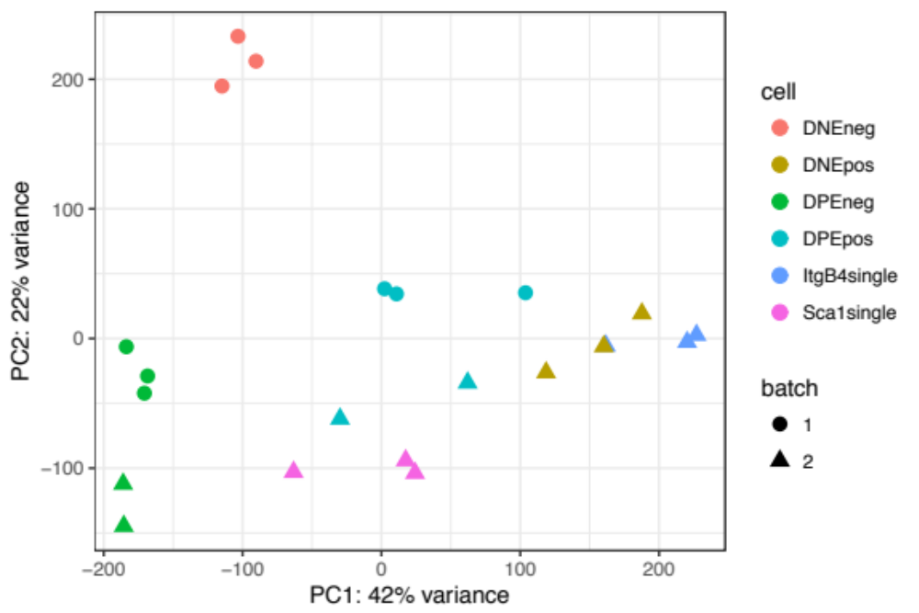
PCA
principal components analysis (PCA) is a technique that can be used to simplify a dataset

Slide 7
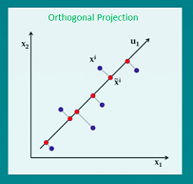
PCA
It is a linear transformation that chooses a new coordinate system for the data set such that
  greatest variance by any projection of the data set comes to lie on the first axis (then called the first principal component),
  the second greatest variance on the second axis, and so on.
PCA can be used for reducing dimensionality by eliminating the later principal components.
https://www.r-bloggers.com/principal-component-analysis-using-r/

Slide 8
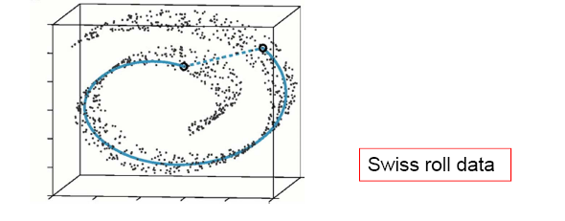
Nonlinear dimensionality reduction
Data often lies on or near a nonlinear low-dimensional surface
Such low-dimensional surfaces are called manifolds.

Slide 9
t-Stochastic neighbor embedding (t-SNE)
Visualizes high-dimensional data in a 2- or 3-dimensional map.
Better than existing techniques at creating a single map that reveals structure at many different scales.
Particularly good for high-dimensional data that lie on several different, but related, low-dimensional manifolds.
  Example: images of objects from multiple classes seen from multiple viewpoints.

Slide 10
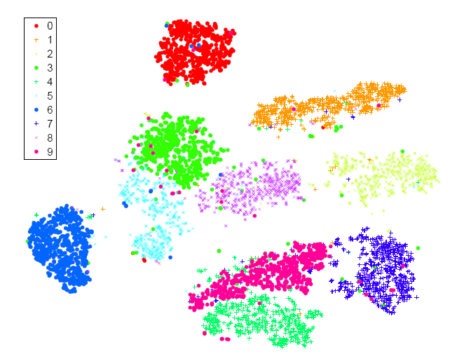
Visualization of classes in MNIST data
t-SNE

Slide 11
Roadmap
Dimensionality reduction
Clustering

Slide 12
What is Cluster Analysis?
Cluster: a collection of data objects
  Similar to the objects in the same cluster (Intraclass similarity)
  Dissimilar to the objects in other clusters (Interclass dissimilarity)
Cluster analysis
  Statistical method for grouping a set of data objects into clusters
  A good clustering method produces high quality clusters with high intraclass similarity and low interclass similarity
Clustering is unsupervised classification

Slide 13
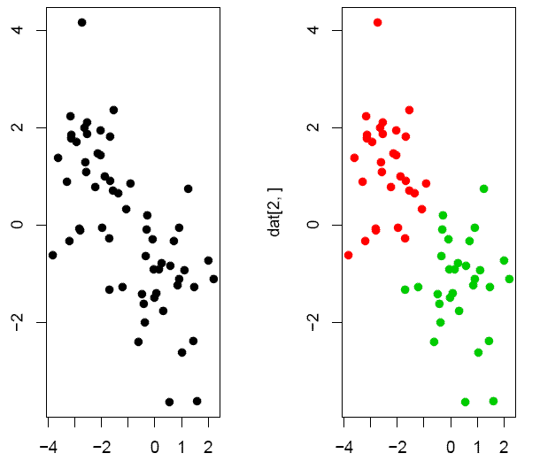
Group objects according to their similarity
Cluster:
a set of objects
that are similar
to each other
and separated
from the other
objects.
Example: green/
red data points
were generated
from two different
normal distributions

Slide 14
Clustering data
object expression data matrix
Experiments/samples are given as the row and column vectors of an expression data matrix
Clustering may be applied either to objects experiments (regarded as vectors in Ro or Rn).
n experiments
o objects

Slide 15
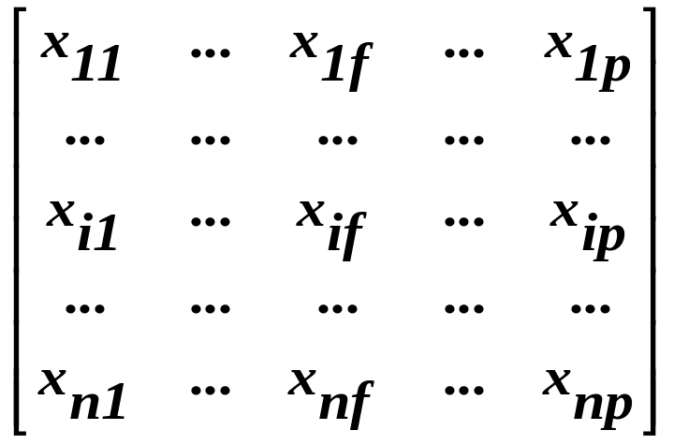

Pattern matrix → Proximity matrix
Pattern matrix (nxp)
  p=attributes
  n=# of objects
Proximity matrix (nxn)
  d(i,j)=difference/
  dissimilarity between i and j

Slide 16
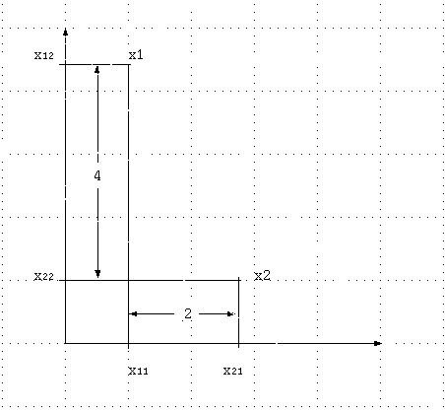
Different proximity measures
r = 2(Euclidean distance)
[42 + 22]1/2 = 4.472
r = 1(Manhattan distance)
4 + 2 = 6
r → ∞ (“sup” distance)
max{4,2} = 4

Slide 17
K-Means Clustering
The meaning of ‘K-means’
  Why it is called ‘K-means’ clustering: K points are used to represent the clustering result; each point corresponds to the centre (mean) of a cluster
Each point is assigned to the cluster with the closest center point
The number K, must be specified
Basic algorithm

Slide 18

The K-Means Clustering Method (cntd)

Slide 19



The K-Means Clustering Results
Example
10
10
9
9
8
8
7
7
6
6
5
5
4
Assign each objects to most similar center
Update the cluster means
4
3
3
2
2
1
1
0
0
0
1
2
3
4
5
6
7
8
9
10
0
1
2
3
4
5
6
7
8
9
10
reassign
reassign
K=2
Arbitrarily choose K object as initial cluster center
Update the cluster means

Slide 20
Weaknesses of the K-Means Method
Unable to handle noisy data and outliers
Very large or very small values could skew the mean
Not suitable to discover clusters with non-convex shapes

Slide 21
Hierarchical Clustering
Start with every data point in a separate cluster
Keep merging the most similar pairs of data points/clusters until we have one big cluster left
This is called a bottom-up or agglomerative method

Slide 22
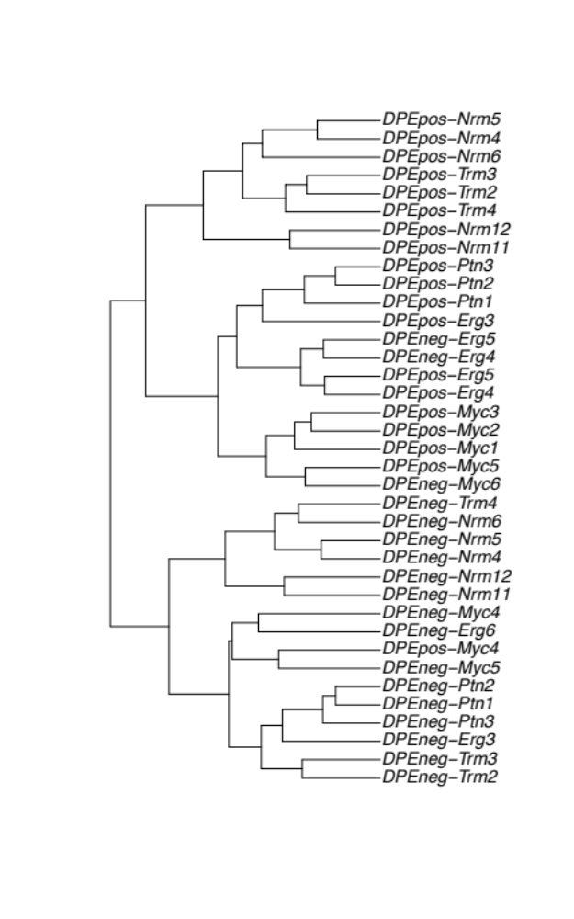
Hierarchical Clustering (cont.)
This produces a binary tree or dendrogram
The final cluster is the root and each data item is a leaf
The height of the bars indicate how close the items are

Slide 23
Linkage in Hierarchical Clustering
We already know about distance measures between data items, but what about between a data item and a cluster or between two clusters?
We just treat a data point as a cluster with a single item, so our only problem is to define a linkage method between clusters
As usual, there are lots of choices…

Slide 24
Distances between clusters (summary)
Calculation of the distance between two clusters is based on the pairwise distances between members of the clusters.
  Complete linkage: largest distance between points
  Average linkage: average distance between points
  Single linkage: smallest distance between points
  Centroid: distance between centroids
Complete linkage gives preference to compact/spherical
clusters. Single linkage can produce long stretched clusters.

Slide 25
More on Hierarchical Clustering Methods
Major advantage
  Conceptually very simple
  Easy to implement → most commonly used technique
Major weakness of agglomerative clustering methods
  do not scale well: time complexity of at least O(n2), where n is the number of total objects
  can never undo what was done previously → high likelihood of getting stuck in local minima

