Slide 1
Beer Searching App

Slide 2
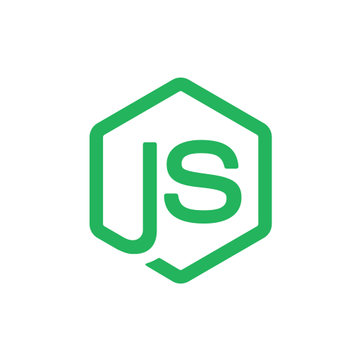

Tech Stack
Front End - VueJS
Uses VueMaterial
Uses KeenUI Component library for stylish buttons and modal
Easy to quickly setup basic CRUD applications
Makes GET & POST requests to the NodeJS API
Hosted separately from the Node back end
Back End - NodeJS
Uses the Express Framework
Hosted to Heroku
Very easy to setup and deploy
Node comes with many packages that make development of the API easier
Comes with GridFS package to allow easy creation of a read stream for images

Slide 3
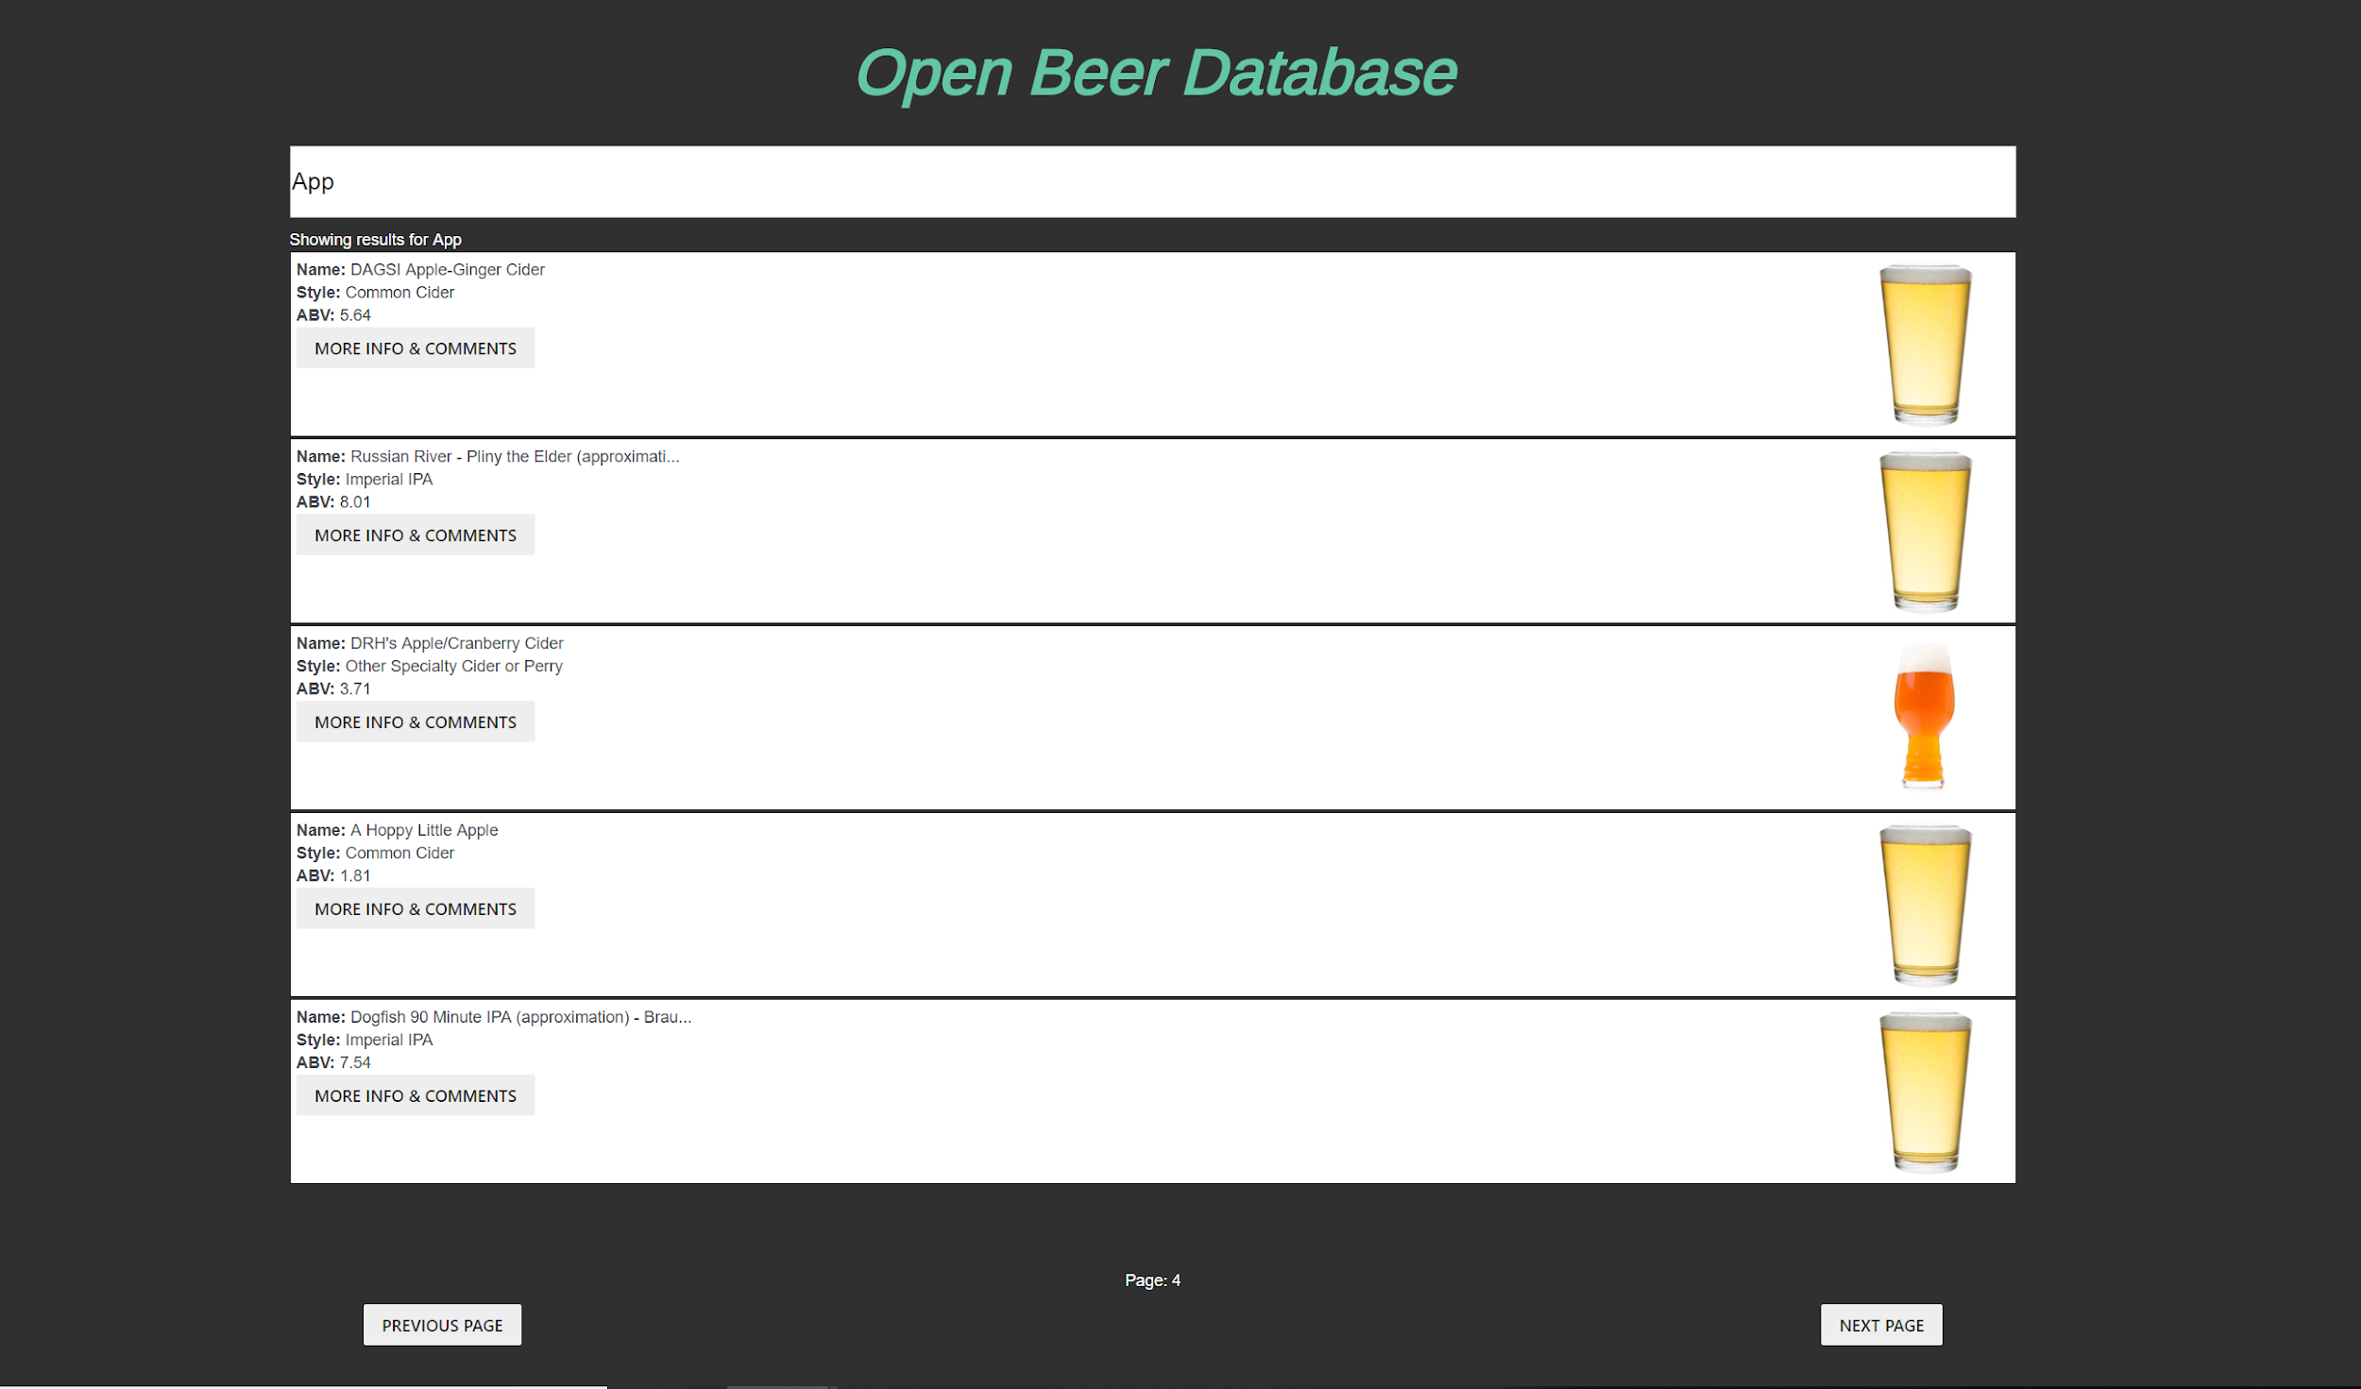
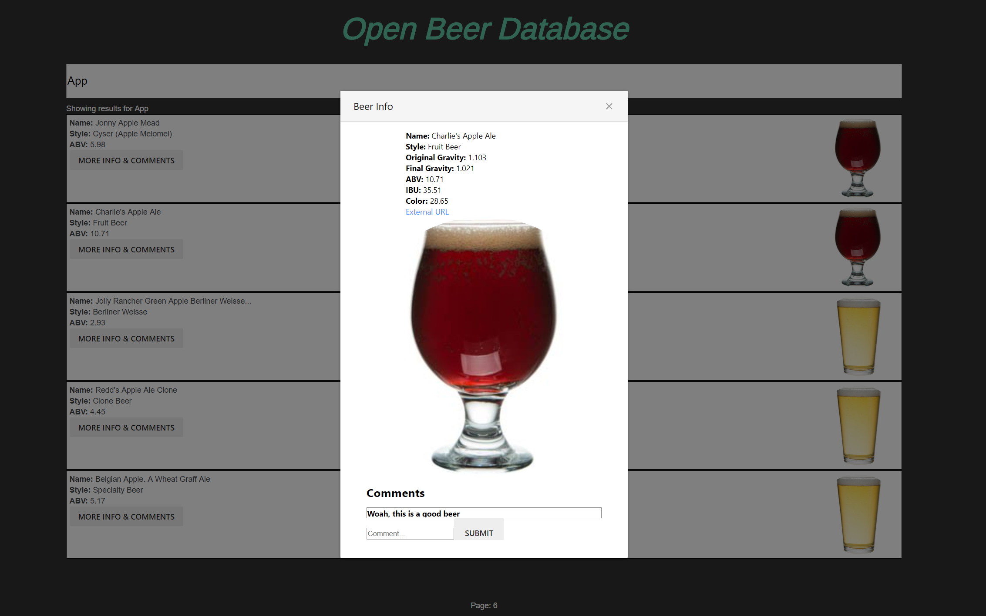
App Screenshot

Slide 4
Loading the database
Retrieved csv file of 70k+ beer recipes from kaggle.com
Downloaded five different pictures of beer to represent lighter/darker colors
Imported csv files with mongoimport
a
a
Imported images with mongofiles

Slide 5
Hosting the database
Create a binary export of the local BeerDB database
Import the mongodump into our remote database

Slide 6
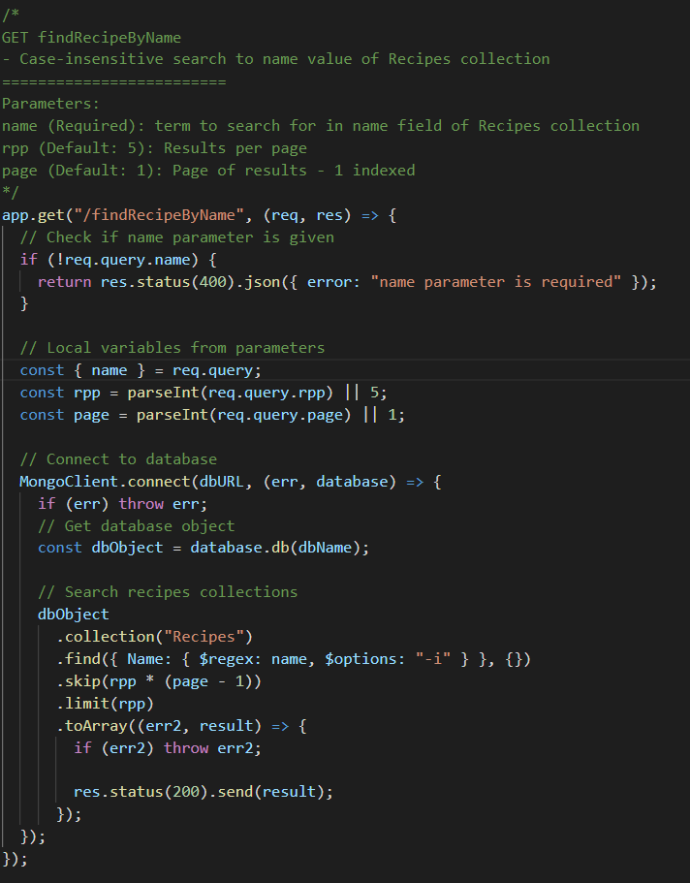
Example API Route
Checks for matching route
Checks for parameters passed in
Set default parameters if missing any
Connects to the database
Searches the Recipes collection
Sends the results to an array
Sends the array back to the user

Slide 7
Demo
http://beer-db-app.surge.sh/

