Slide 1
“An Athlete’s Dream”
A data analysis of ‘120 years of Olympic history: athletes and results’
By Quentin Bone.

Slide 2
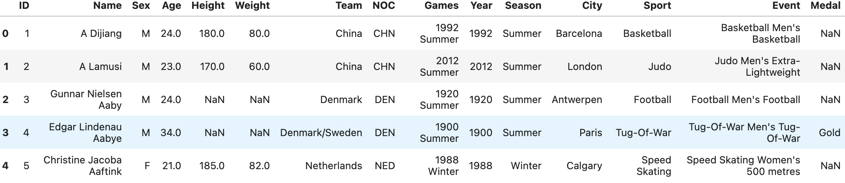
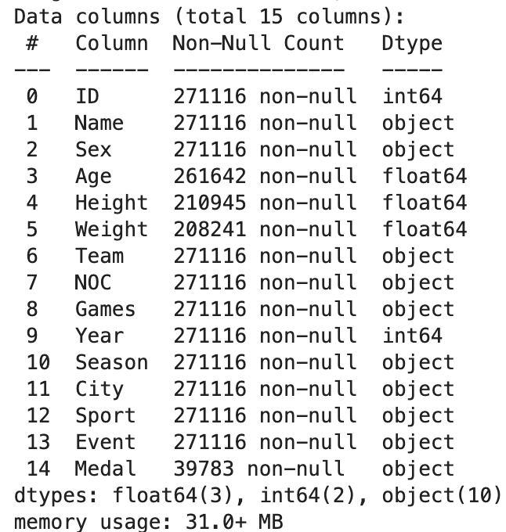
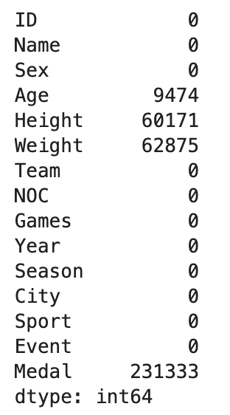
Data Understanding
- This initial analysis helped to understand of the shape, basic trends and cleanliness of the dataset.
- There are many 1385 duplicate values and many null values as well.
- The null values in the medal column can be ignored, as the null values mean that they didn't win a medal seeing as there are only three medals to give for each event.

Slide 3
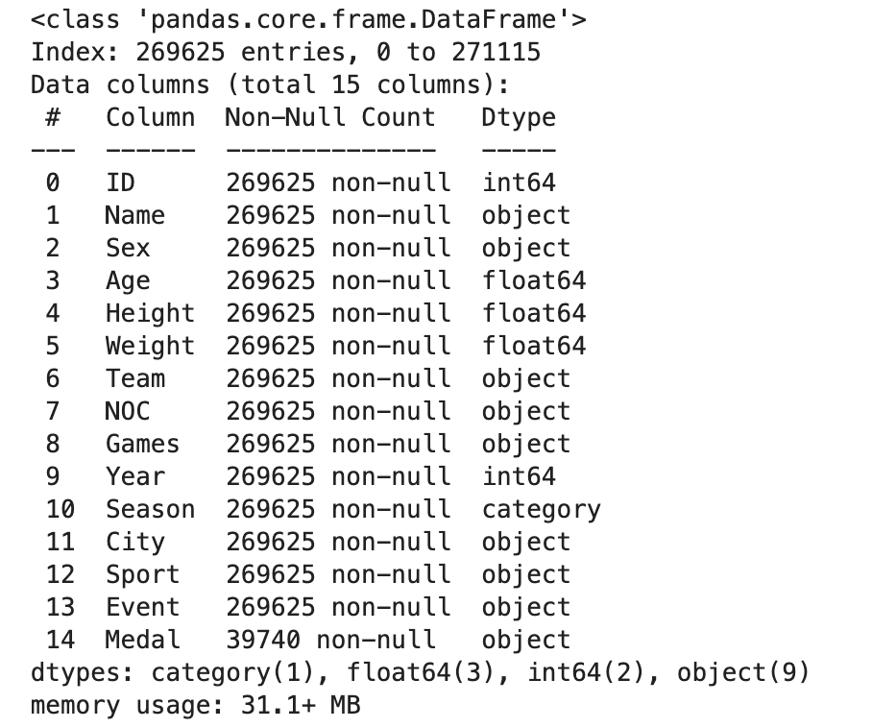
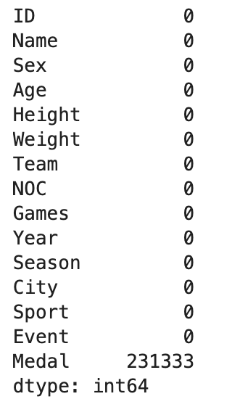

Data Cleaning
Created copy of dataset for manipulation
Filled in missing values by taking median height, weight and age for males and females and .fillna() and lambda.
Started with 60,000 null values and now down to zero

Slide 4
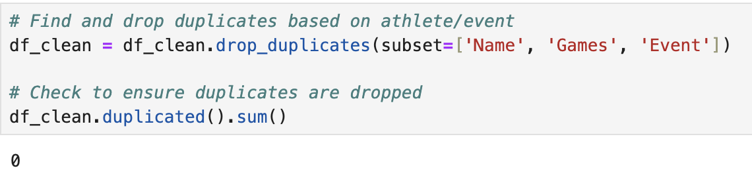
Data Cleaning
Removed all duplicates
Turned ‘Season’ column into category datatype

Slide 5
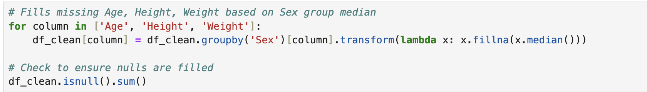
Filling null values
Creates a loop for columns designated: ’Age’, ‘Height’, ‘Weight’
This way, the code doesn’t have to be written separately for each
Next, the columns are grouped by ‘Sex’ separating male and female
.transform(lambda x: x.fillna(x.median()) tells Python to find missing values and convert them to the median for that specific sex
Lambda x allows for an anonymous function so that it doesn’t need to be named

Slide 6
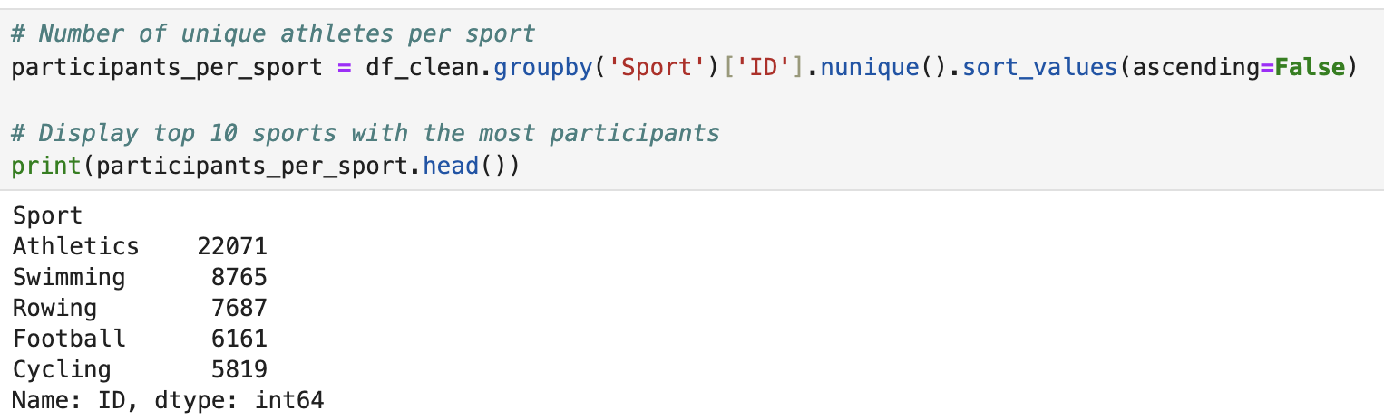
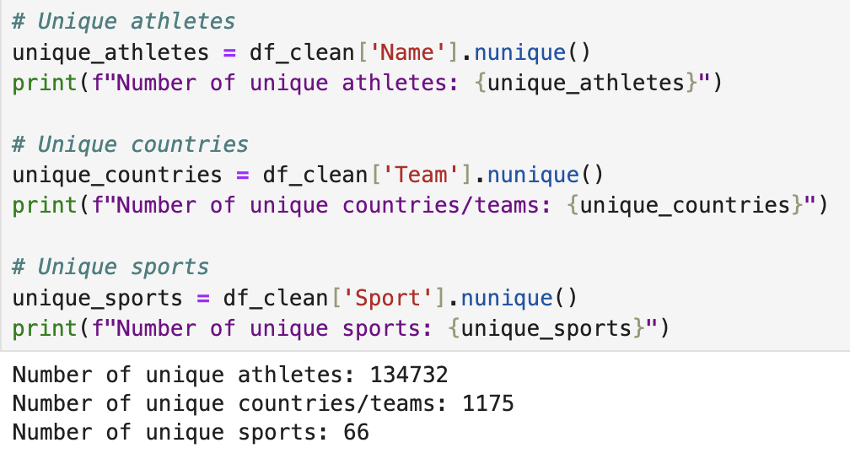
Exploratory Data Analysis
Athletics, is commonly referred to as track and field.
It contains the most events and the most unique participants
Using .nunique() unique rows from the dataset are found and counted

Slide 7
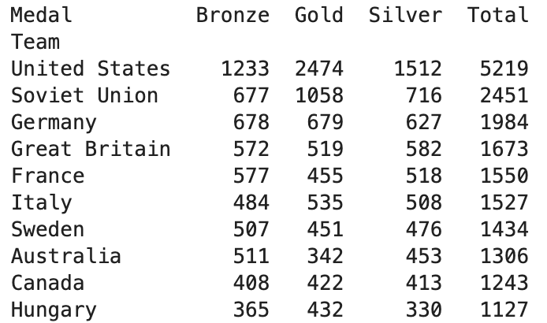
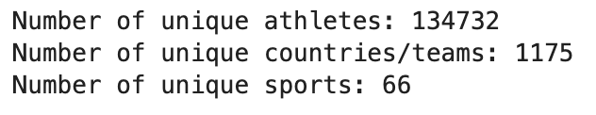
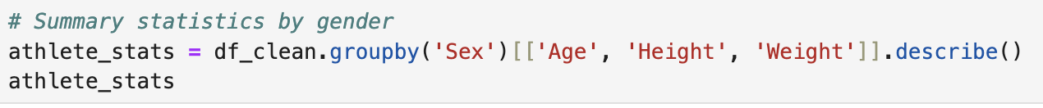
Exploratory Data Analysis
Female participation has been steadily on the increase, especially over the last several decades.
Certain countries dominant in terms of winning medals, showing how political, historical, and economic factors might have influenced sporting success.
Added new columns like BMI and Age Group.

Slide 8
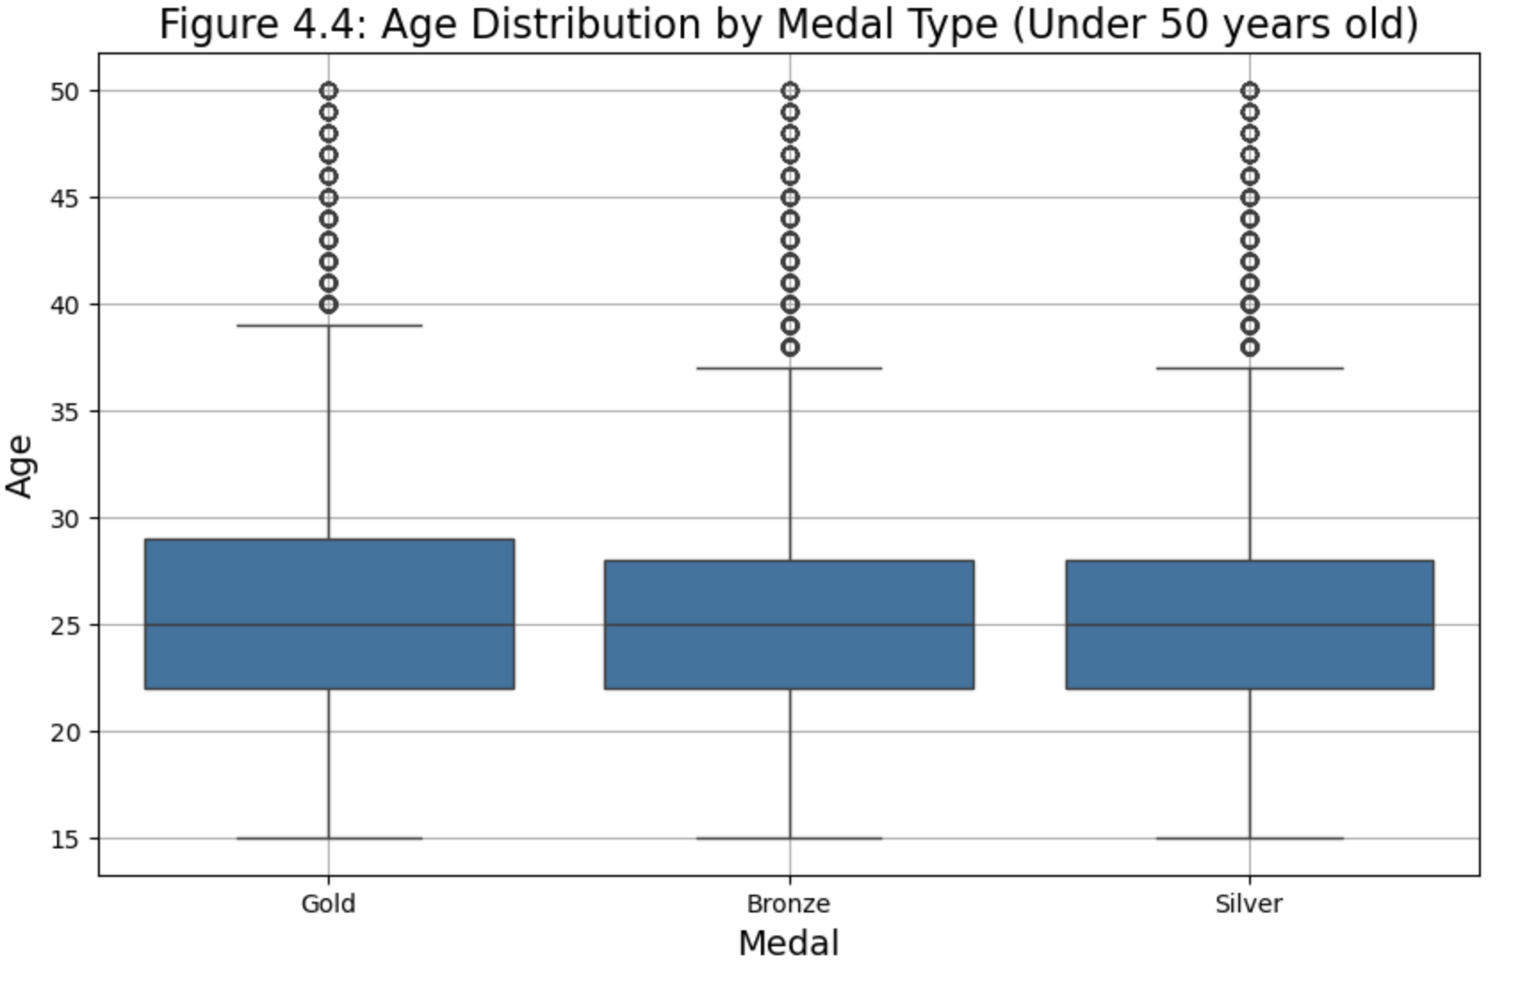
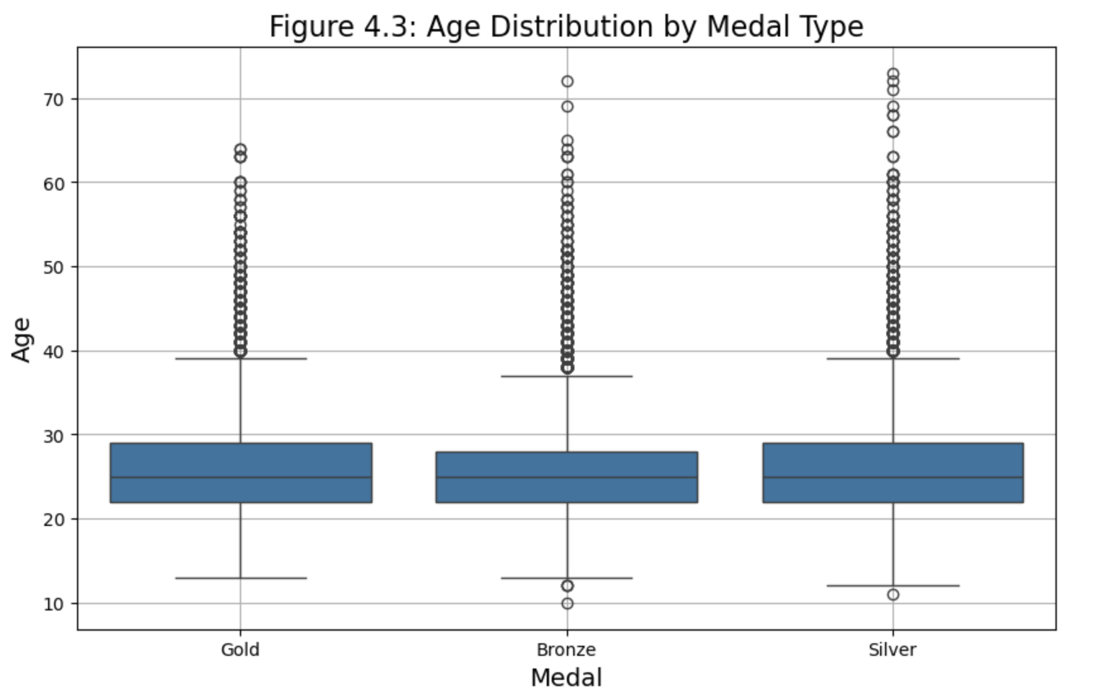
Data Visualizations

Slide 9
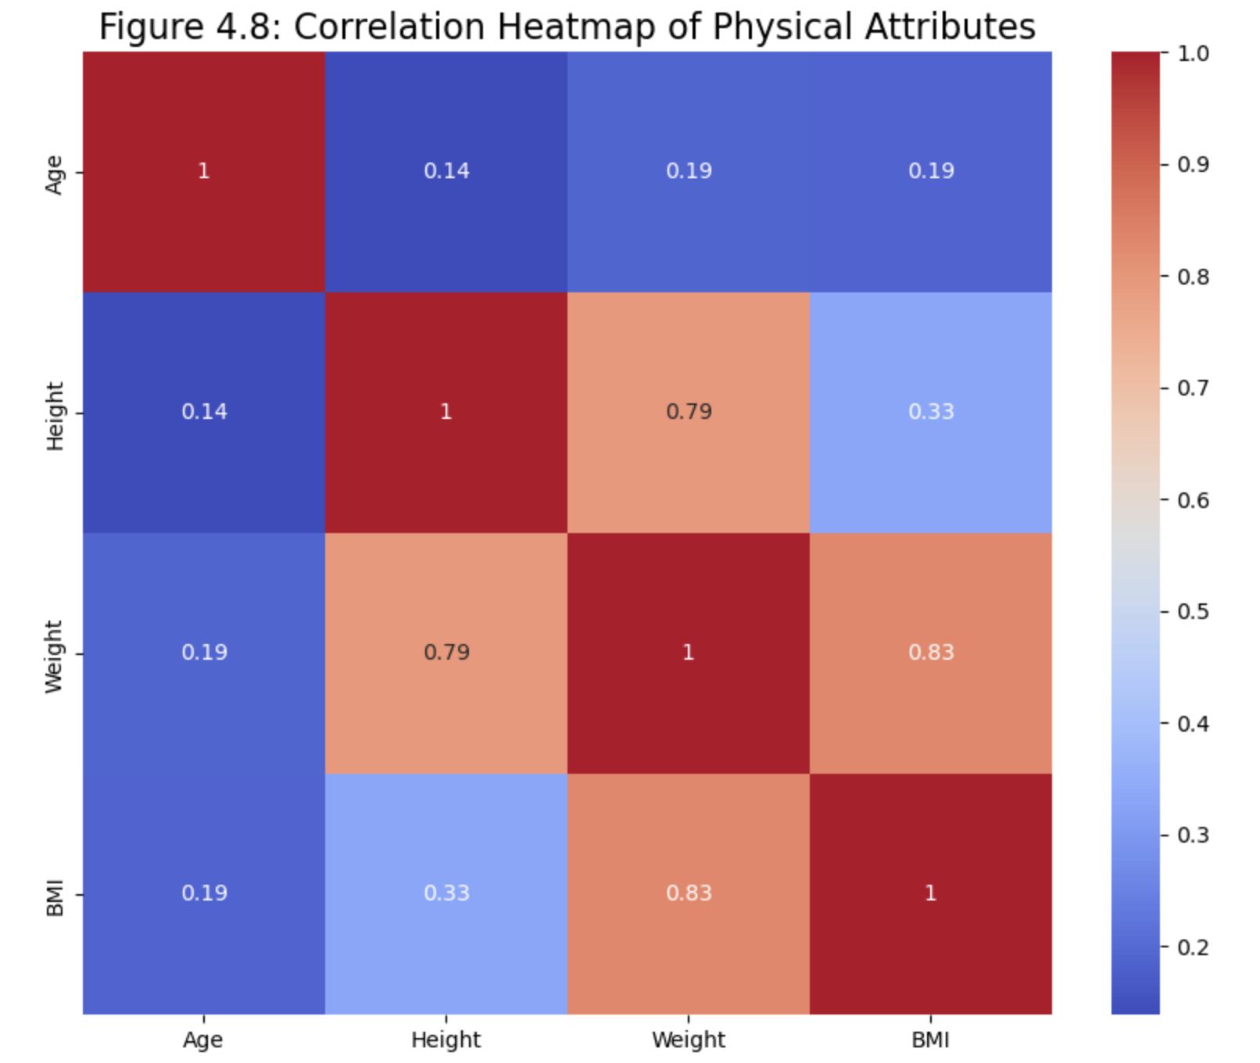
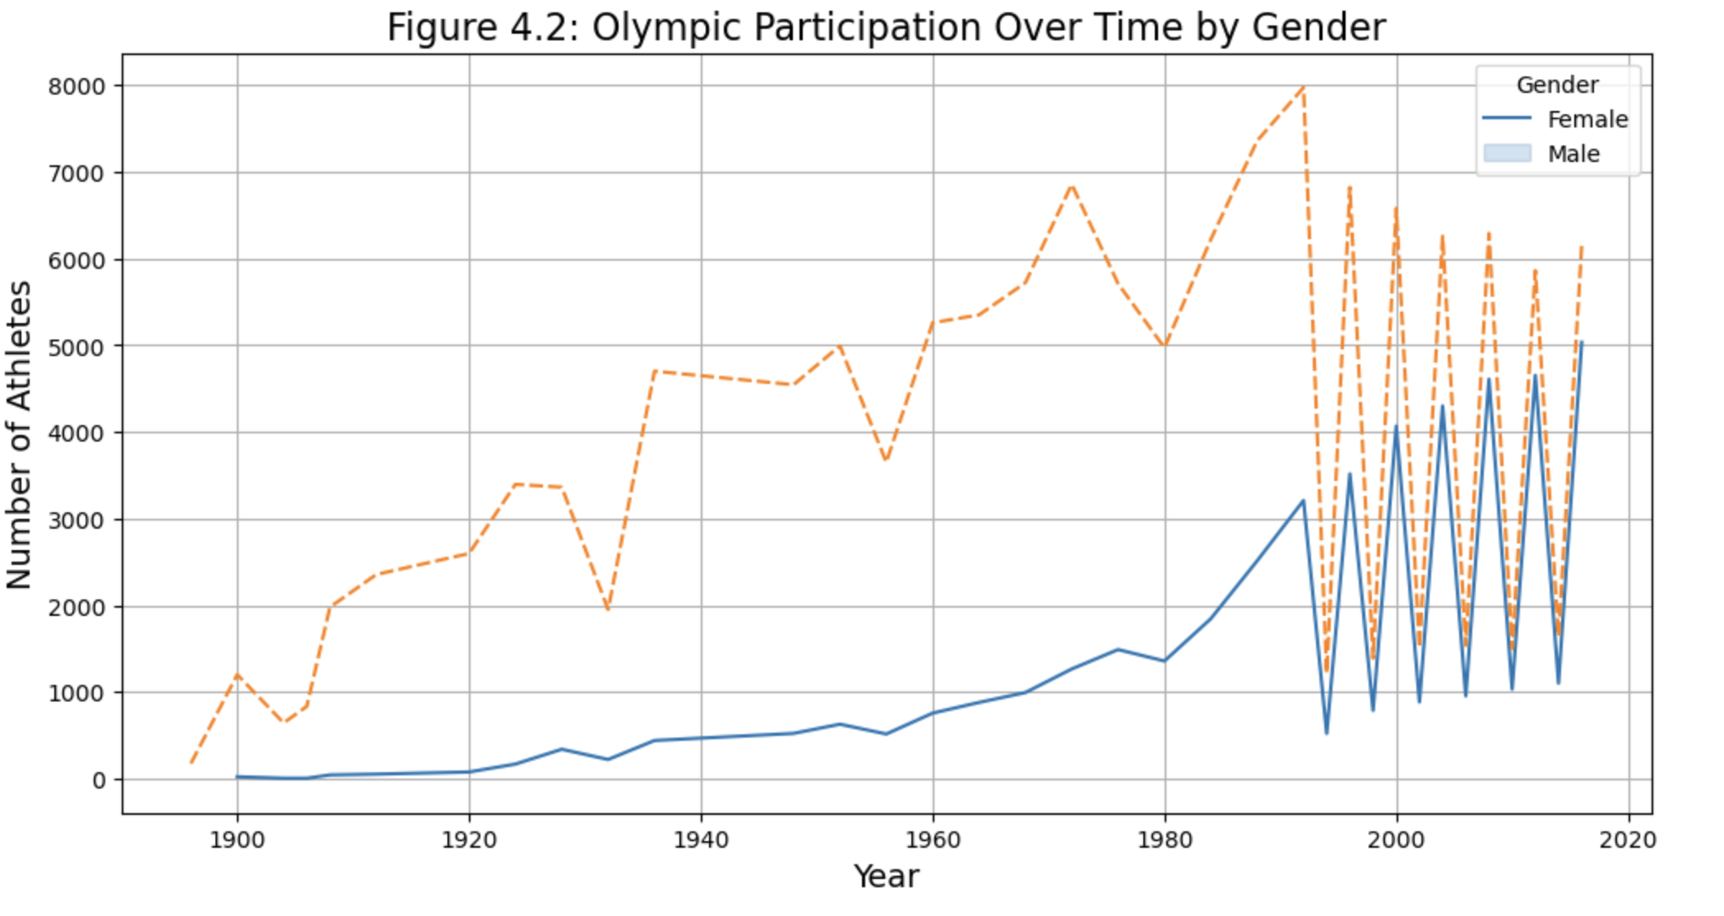
Data Visualizations

Slide 10
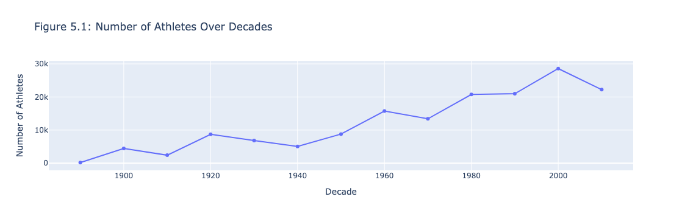
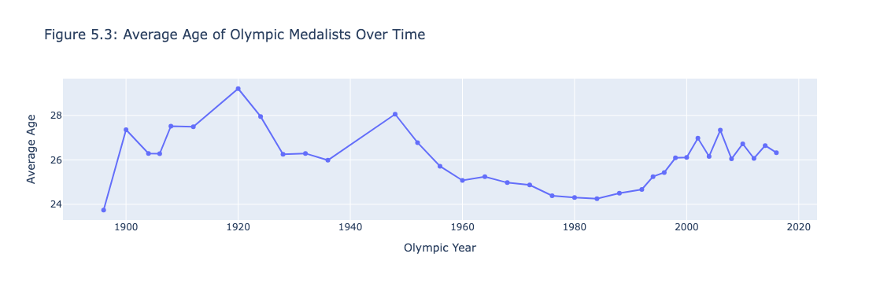
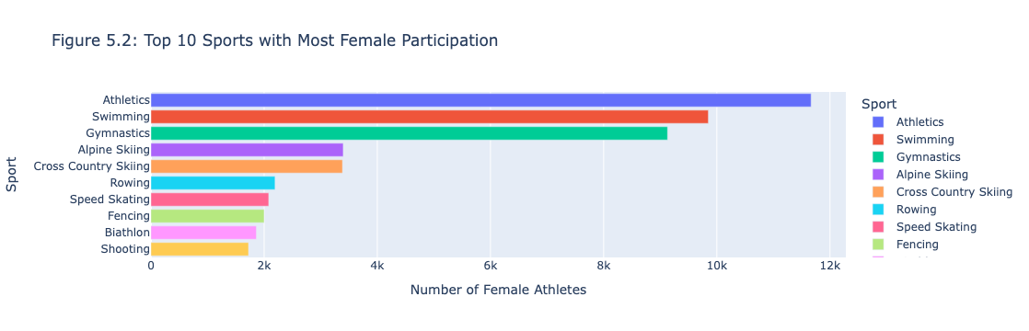
Additional Insights and Questions
Question 1: How has the number of athletes per decade changed over time?
Question 2: Which sports have had the most female participation over time?
Question 3: How has the average age of medalists changed over time?
px.bar and px.line for the animated graphs.

Slide 11
Insights and Generalizations
Growth in participation
Dominance of particular countries
Trends in athlete age
Relationships between physical traits
Rise in female athletes
Data limitations

Slide 12
Thank you!

