Slide 1
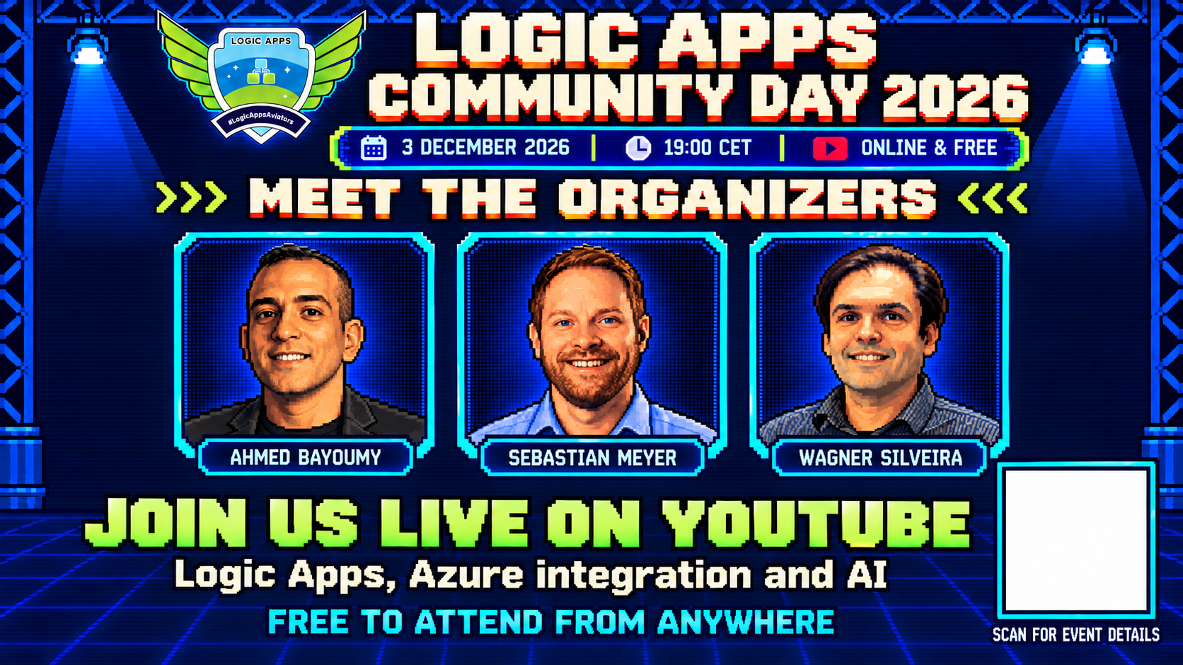
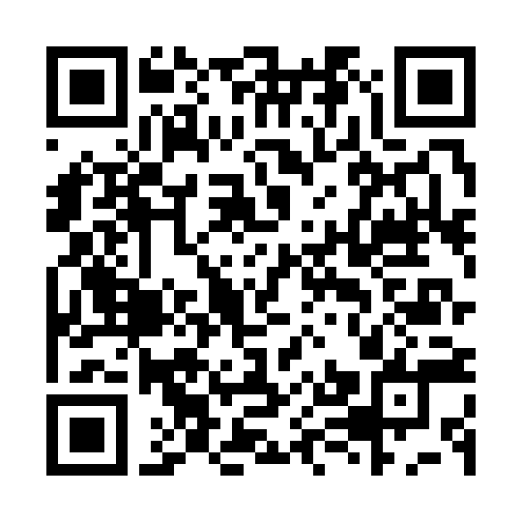
Notes:
Logic Apps Community Day takes place online on 3 December 2026 at 19:00 CET, live on YouTube and free to attend. The QR code links to https://qbq-hh-sebastian-meyer.github.io/logic-apps-community-day-2026/ for event details. Share the event with colleagues and the community.
Organizers: Ahmed Bayoumy, Sebastian Meyer and Wagner Silveira. Source: supplied campaign poster la_call-retrogame.png and organizer portraits in the repository. Artwork adapted with OpenAI image generation.

