Slide 1
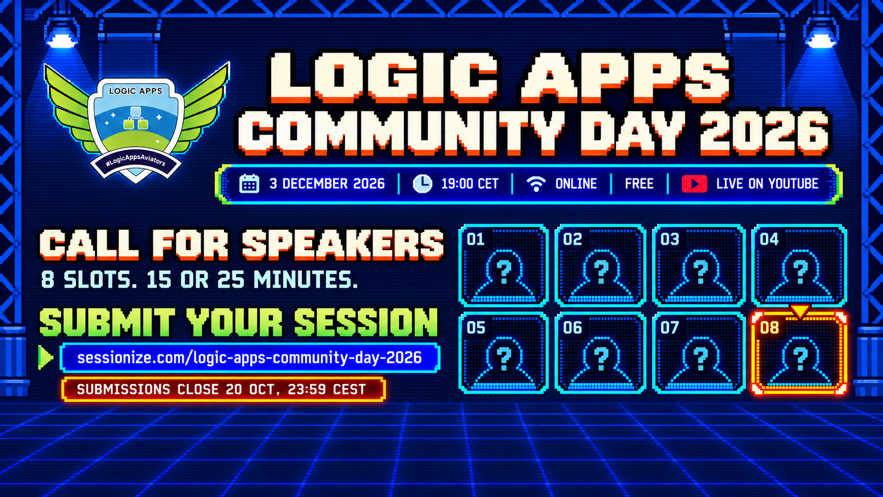
Notes:
Logic Apps Community Day takes place online on 3 December 2026 at 19:00 CET, live on YouTube and free to attend. We are looking for eight community talks, lasting 15 or 25 minutes. Submit at https://sessionize.com/logic-apps-community-day-2026 before 20 October 2026 at 23:59 CEST. First-time speakers are welcome.
Source: supplied campaign poster la_call-retrogame.png. Artwork adapted with OpenAI image generation.

