Slide 1
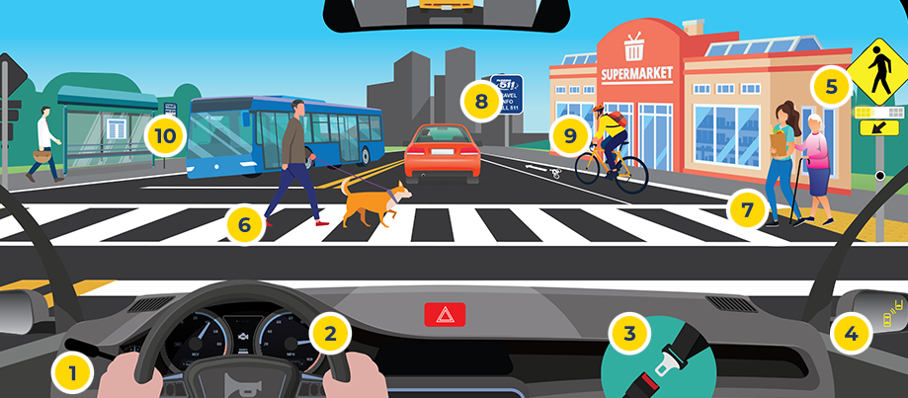
Older Driver Safety Awareness Week 2024
Notes:
This week is Older Driver Safety Awareness Week! Here are a few tips for safe mobility:
Proper mirror use and adjustments can reduce blind spots and increase safety on the roadway.
The tilt of the steering wheel determines the angle at which the airbag deploys. It should be tilted towards the driver's chest, not face, and a minimum of 10 inches away from the driver.
Wearing a seatbelt correctly reduces the chance of injury in a crash. The seat belt should sit low on the hips and across the shoulder.
New in-vehicle safety technology is designed to make driving safer, but it does not replace the important role each of us plays as drivers.
When approaching a flashing Rectangular Flashing Beacon (RRFB) stop at the stop bar pavement marking. Remain stopped until the pedestrian has finished crossing.
High-emphasis crosswalks are designed to increase driver awareness of pedestrians crossing the road.
Learning how to safely use other transportation options, like walking, biking, or riding transit, helps you remain independent beyond driving.
Florida 511 has everything you need to safely plan your route, receive the latest traffic information and urgent alerts.
Bike lane features are designed to increase visibility and enhance the safety of cyclists when sharing the road with drivers and pedestrians.
Age-friendly communities are considerate of the needs of residents of all ages and abilities and offer a variety of transportation options to safely get from place to place.

