Slide 1

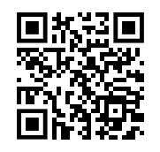







Submit your Abstract
Deep Tech Conference
An academic conference for the undergrad science & tech community.
Overview
A one-day inter-organizational conference hosted by undergraduate organizations in deep tech and science, including QCB, XR@B, SPS, GWC, ML@B, ULAB, etc. The goal of the event is to provide undergraduate students with opportunities to present their ongoing group/individual projects in the format of an academic conference. Professionals from industry and academia will be invited for the panel(s) and a networking session. Lunch, snacks, and dinner will be provided.
Register for a Talk!!
Submit an abstract if you would like to give a 12-15min group or individual presentation during the conference in front of your peers and experts from industry and academia. The deadline is 4/2 11:59pm (end of spring break). The topic is flexible as long as it is related to an emerging tech field, such as deep learning, blockchain, extended reality, quantum information science, etc.
Time & Location
🕘 April 29th, 2023
(Saturday)
🏢 Tamalpais Room,
David Brower Center

