Slide 1
Deep Tech Conference Follow-up
2/27/2023

Slide 2
Agenda
Introduction
Logistics (Time & Location)
Collaboration Format
Intersections and Project Areas

Slide 3
Introduction
QC@B
ML@B
SPS
XR@B

Slide 4
Logistics
Time: 4/29/2023 Saturday, 9:30AM - 8:00PM
Two meals provided
Schedule in short
Technological research presentations
Panel/talk by academic professors
Application presentations
Panel/talk by industrial speakers
Alternative time: 4/23 Saturday
Location: Sibley Auditorium

Slide 5
Collaboration Format
Co-host
Project presentation & participation
Abstract submission: https://forms.gle/XBWj2zGNNqcLE8Rw5
Deadline: End of Spring Break
Hosts
Sponsorship & Speakers
Logistics Planning
Potential Sponsors in touch
AWS, Deloitte, Accenture, Startups in Quantum Computing

Slide 6
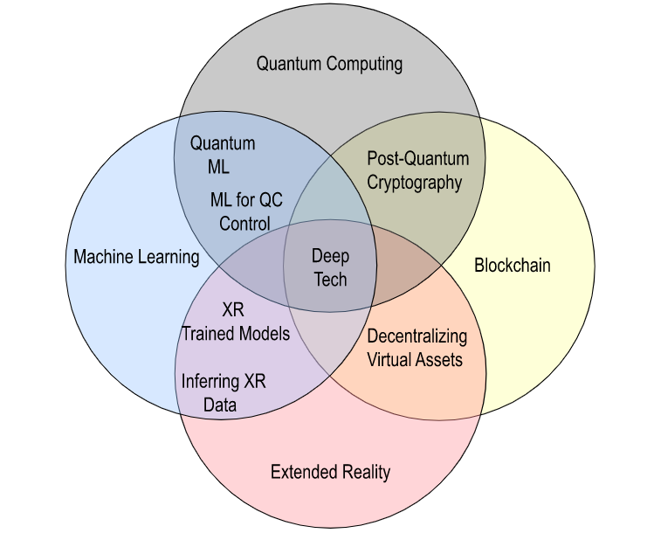
Intersections and Project Areas

Slide 7
Q&A

