Slide 1

CS 198 · FALL 2026 · LECTURE 1
Quantum Algorithms DeCal
Lecture 1: Introduction and Syllabus

Slide 2
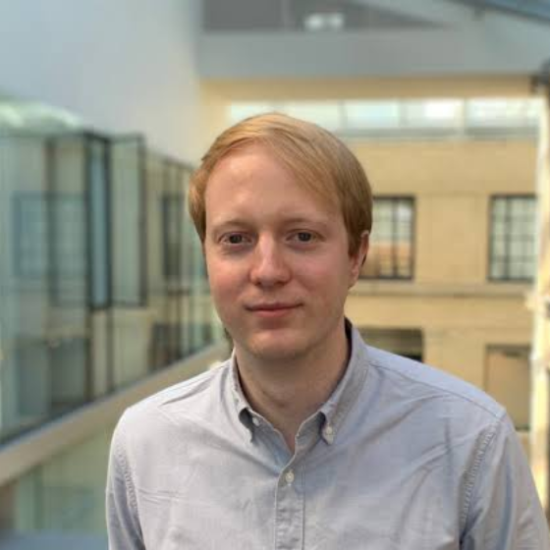
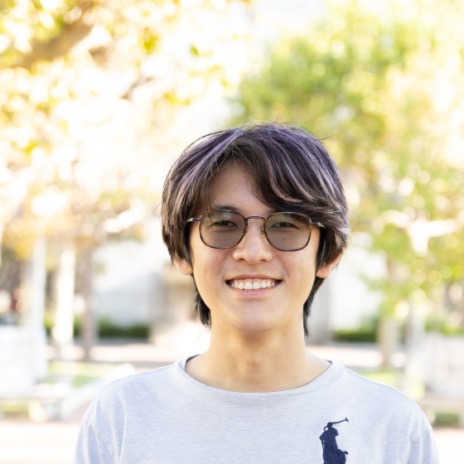
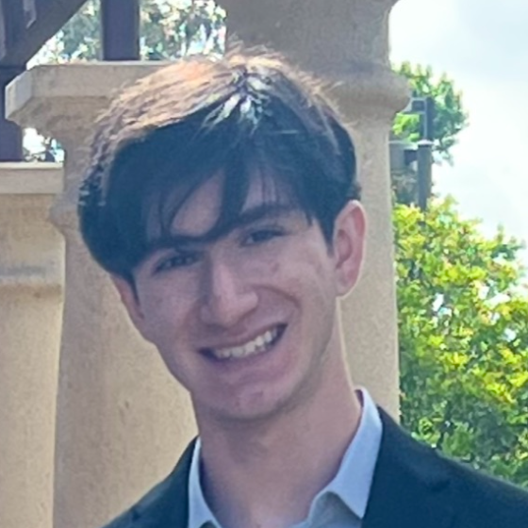
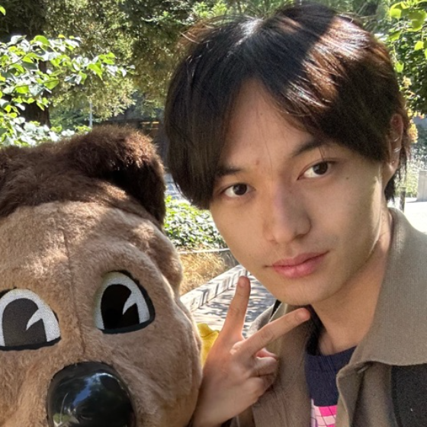
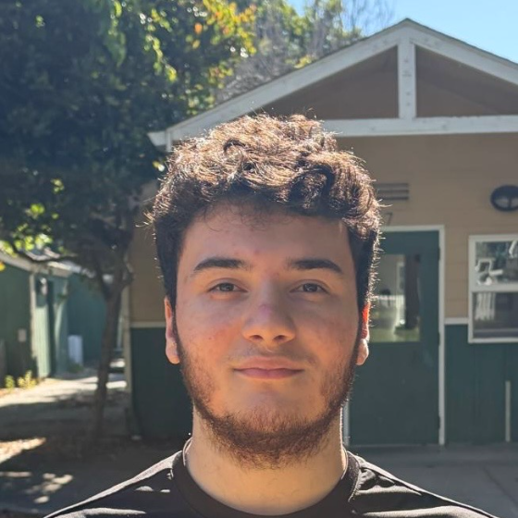
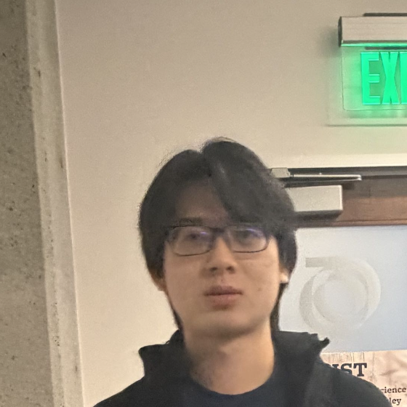

Instructors
John Wright
Kepha Sher
Ian Loam
Jason Dong
Bruno Leopoldo
Morris Hsu
Faculty advisor
kephasher@ berkeley.edu
ianloam
@berkeley.edu
jasondong1
@berkeley.edu
brunoleopoldo
@berkeley.edu
morris.c.hsu
@berkeley.edu
Office hours are held every week @ Campbell 101.

Slide 3
Overview
The purpose of this course is to survey the development of quantum algorithms, from Shor's original breakthrough to more recent approaches.
Students will learn about extensions on classic results, gaining a modern perspective on original algorithms. Special topics lectures inspire students to explore their own interests.

Slide 5
Prerequisites
Linear Algebra (Math 54, Physics 89 or equivalent) and python programming experience (e.g. CS 61A or equivalent). Knowledge of Physics 191A, or concurrent enrollment, is strongly preferred. No instructor permission required.
Learning objectives
01
Be very comfortable with well-known algorithms such as Grover, Shor, Quantum Phase Estimation.
02
Understand the basics of algorithmic analysis applied to quantum algorithms, including results on quantum advantage.
03
Hands-on experience with implementing quantum algorithms using Qiskit.
04
Learn about algorithms developed since, developing a well thought out final project that involves one of these approaches.

Slide 6
Requirements and grading
Lectures
Attending the two lectures per week.
Homeworks
Optional (but highly recommended)
Final project
A capstone project on a topic of your choice. Explore an algorithm not discussed in class, or an extension of what we talked about, and present it to the class.
•
Graded P/NP — attendance 20%, final project 80%
•
2 unexcused absences. Excused absences by email in advance.
•
Lectures are not recorded. Slides are posted after each lecture.

Slide 7
Schedule
W1–3
Introductory Material
UNIT 1
W4–6
Algorithms
UNIT 2
W7–11
Hamiltonian Simulations and Beyond
UNIT 3
W12
Special Topics
UNIT 4
W13
Final Project — workshops and presentations
UNIT 5
This is a tentative schedule and would be updated based on student interests/feedback

Slide 8
Materials
Required
Supplemental
Students are required to read the sections corresponding to lecture for the texts below.
Students are encouraged to learn more by going over the following materials.
Lecture Notes on Quantum Algorithms
Quantum Computation and Quantum Information
Childs
Nielsen & Chuang
Classical and Quantum Computation
Lecture Notes on Quantum Algorithms for Scientific Computation
Kitaev, Shen & Vyalyi
Quantum Algorithm Zoo
Lin
Qiskit Textbook
Quantum Computing: Lecture Notes
de Wolf
Our website contains additional resources and examples of past projects. Links to all readings are on the syllabus.

Slide 9
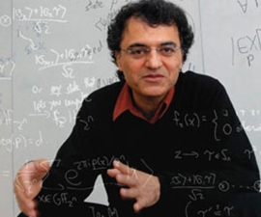
Wisdom from Vazirani
Newtonian Physics tells us that the laws of nature are described by local differential equations

Slide 10
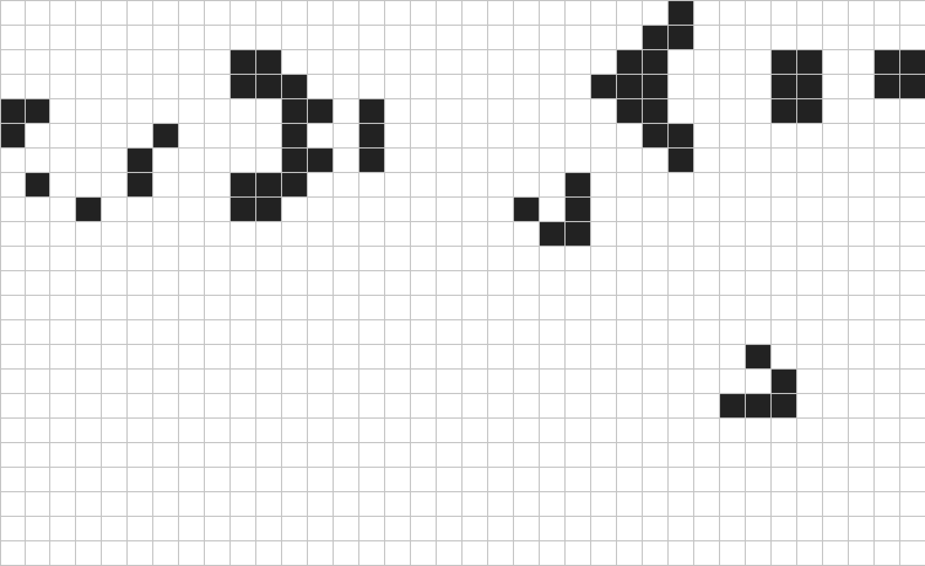
Wisdom from Vazirani
Newtonian Physics tells us that the laws of nature are described by local differential equations
Assume space and time are discrete:

Slide 11
Wisdom from Vazirani
Newtonian Physics tells us that the laws of nature are described by local differential equations
Assume space and time are discrete:
Then the laws of nature are cellular automata!

Slide 12
Quantum Physics
However, this is not what happens!
Quantum Mechanics is described by an exponentially large wavefunction
The state of n classical bits is just nn bits, whereas describing an arbitrary state of n qubits classically requires 2^n amplitudes.

Slide 13

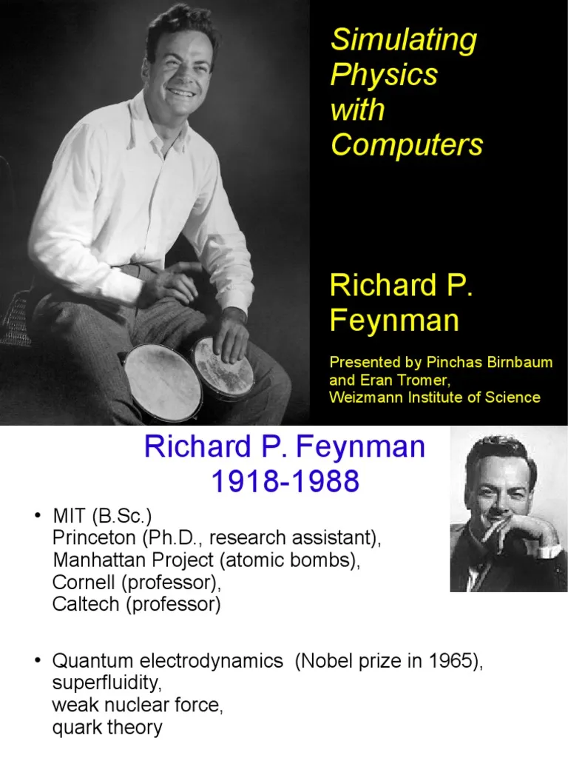
Feynman’s Idea
Use the quantum physics to simulate the quantum physics

Slide 14
Why Study Quantum Computing
Exploiting the laws of nature for computation
A view of Natural Law as a computational subject
(See Aaronson - P NP and Physical Reality)

Slide 15
qcb.studentorg.berkeley.edu
Office hours after class — Campbell 101
Feedback. Each week we will have an attendance form, in which students can voice anything that they like and anything that they wish were different.
Accommodations. The DSP office must determine or verify accommodations before they can be offered. Please contact the instructor when a request has been filed.
The syllabus is subject to change.

Slide 16

Quantum Algorithms Decal
The Undergraduate Quantum Community at UC Berkeley

Slide 17
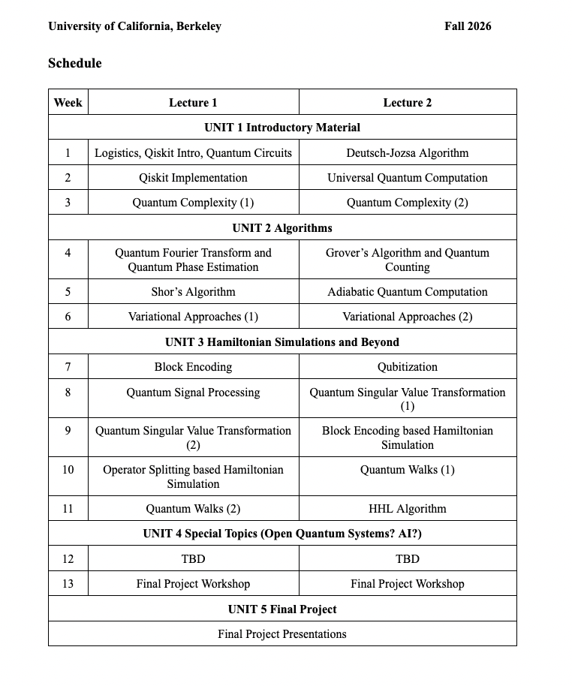
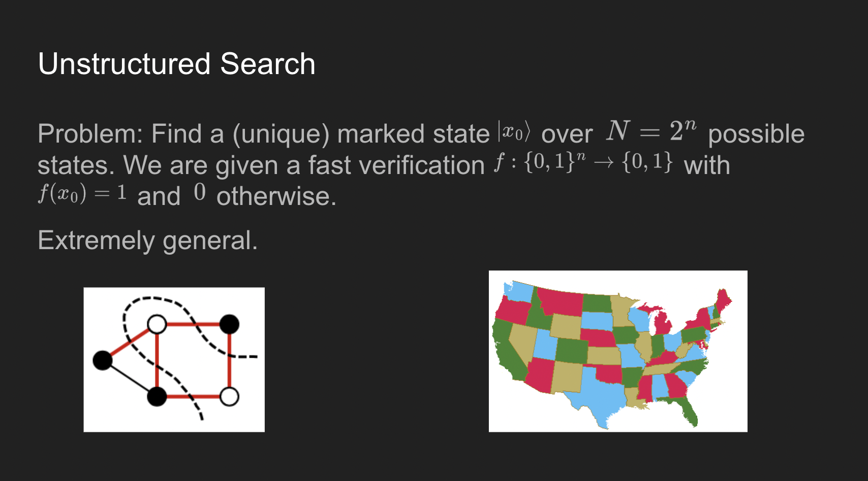
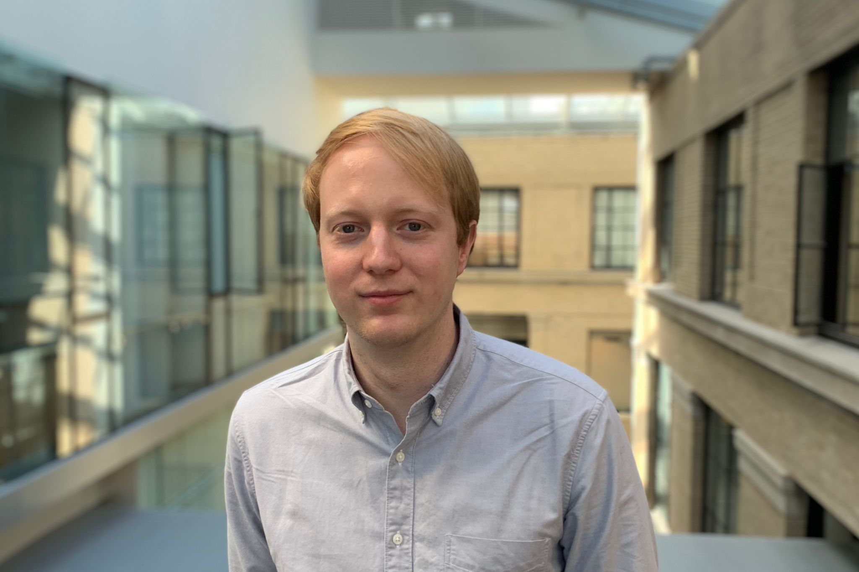
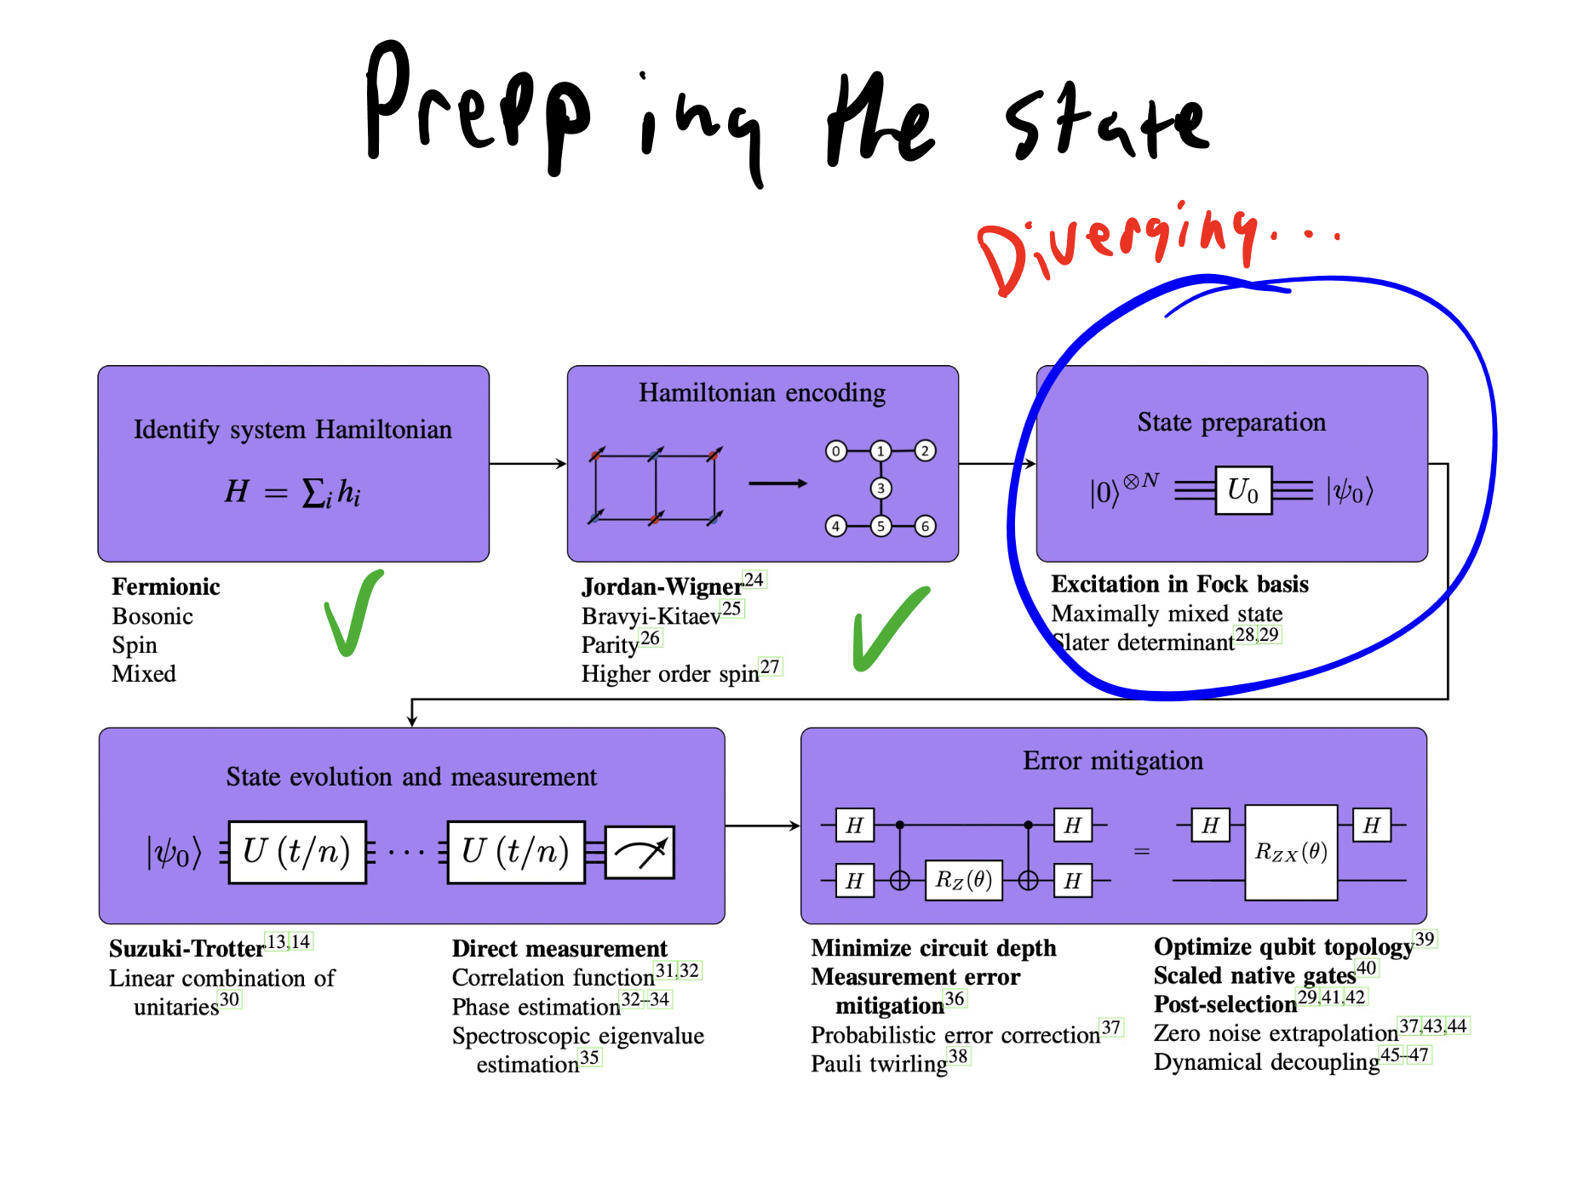
https://qcb.berkeley.edu/education
Course in Quantum Algorithms
A two-unit DeCal course run by QC@B. CS194
Advised by Prof. John Wright
John Wright.
Quantum Complexity
Fall 2026 Syllabus

Slide 18
Make a few slides motivating quantum computing, no math yet, just introducing the topic

Slide 19
Explain projects briefly (maybe doesnt require whole slide?)

