Slide 1
Tools for coding in C++

Slide 2
1: https://www.onlinegdb.com/

Slide 3
1: https://www.onlinegdb.com/
Convenient and don’t need to install anything
But very easy to lose your work and you need to sign in to save

Slide 4
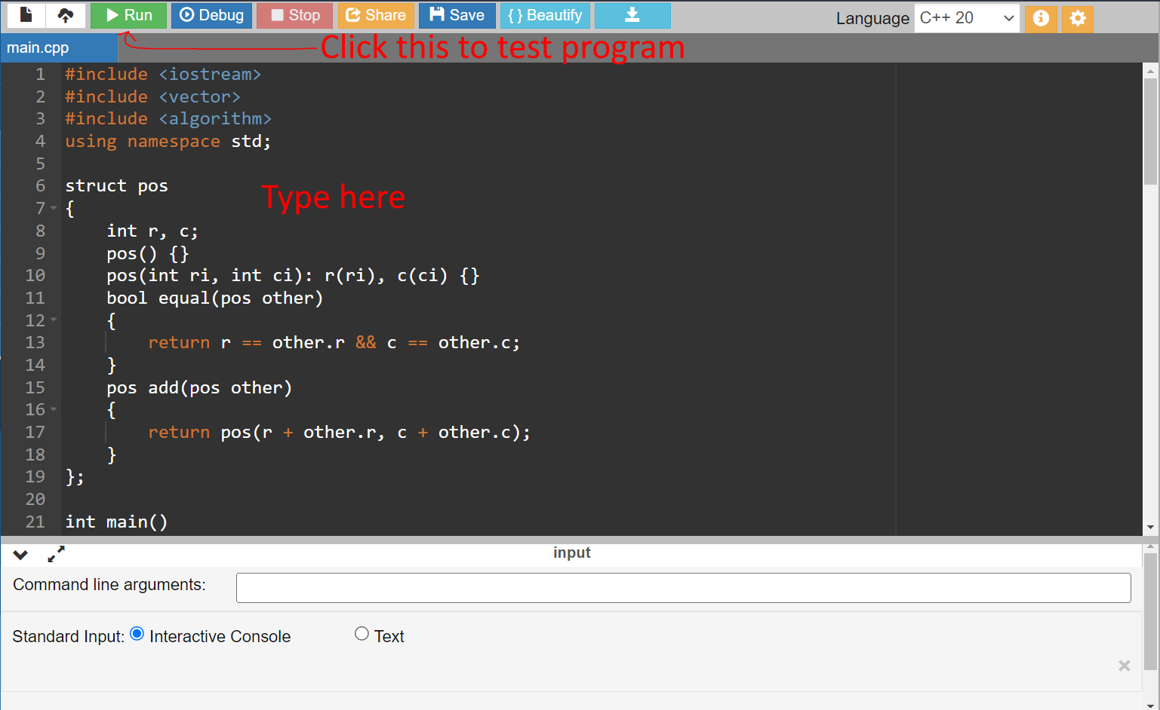
1: https://www.onlinegdb.com/

Slide 5
2: Visual Studio Code

Slide 6
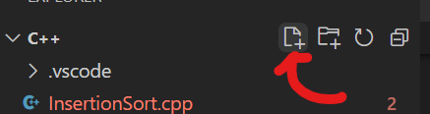
2: Visual Studio Code
Install visual studio code (Just search online)
Create a new folder and open it in VSCode
Click this button to add files (Name the file somethingsomething.cpp)

Slide 7
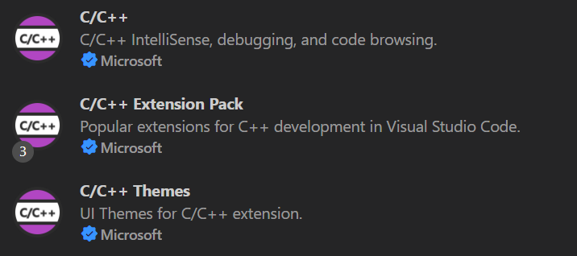
2: Visual Studio Code
Install these extensions (In the blocks tab)

Slide 8
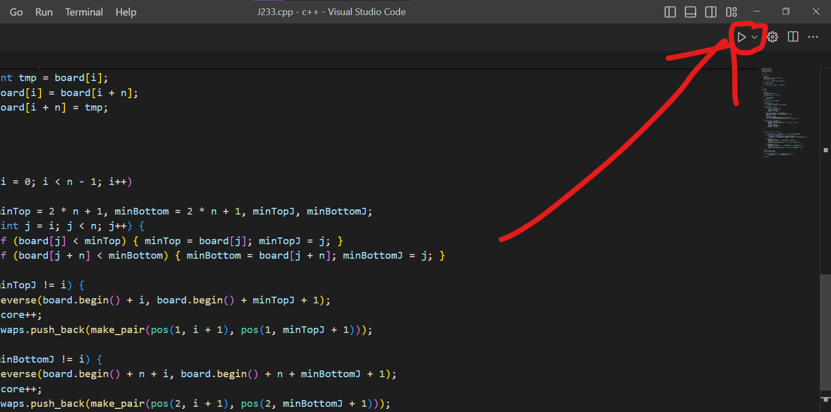
2: Visual Studio Code
Click this button to compile and run your code
(If it asks you about options, choose the one with “g++”)

