Slide 1
Programming in C++

Slide 2
Introduction to the programming course
Hi we are a bunch of fai cais who think we very good at programming
In this course, you will first learn C++, and then another language by popular request (Either making web or desktop applications)

Slide 3
What is C++?
C++ is a very fast language which is often used to write backend frameworks especially for performance reasons
Nobody cares let’s just learn the most basic features of this language

Slide 4
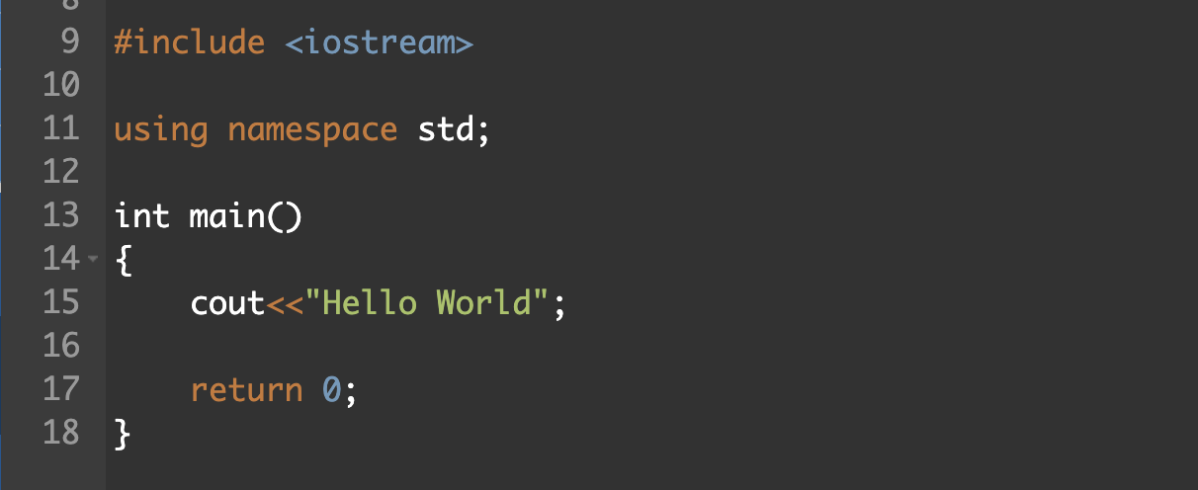
Hello world
For now you only need to know the code inside main() would be executed in order Other keywords will be explained later on

Slide 5
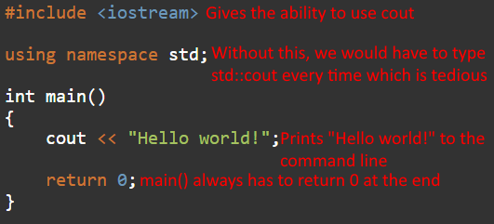
Hello world

Slide 6
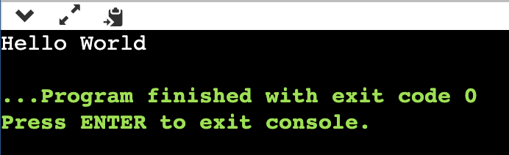
Hello world (cont’d)
⭐IMPORTANT cout << means to print the output
Make sure the words you want to print are in double quotation marks (“”)
Output (press run)

Slide 7
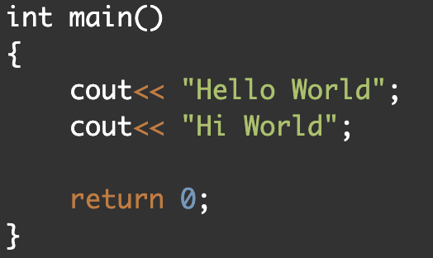
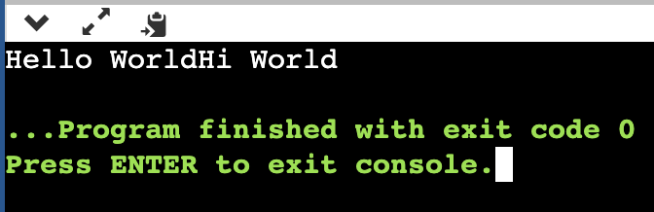
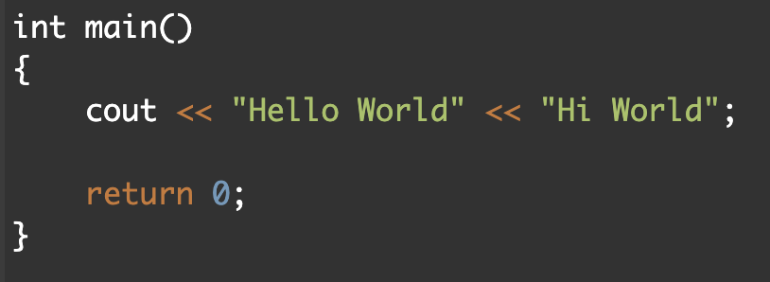
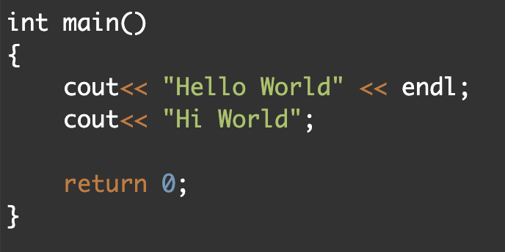
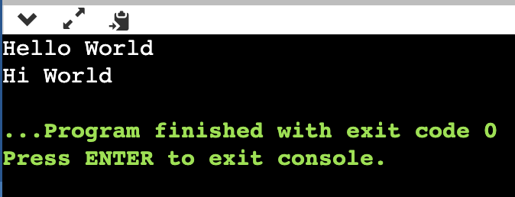
You can print as many times as you want (Use the << operator or cout again)
Use endl to end a line (open new line)

Slide 8
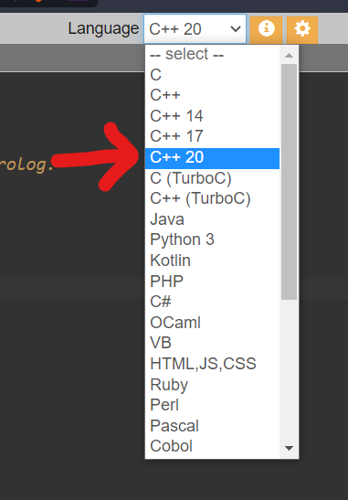
It’s your time to code
https://onlinegdb.com

Slide 9
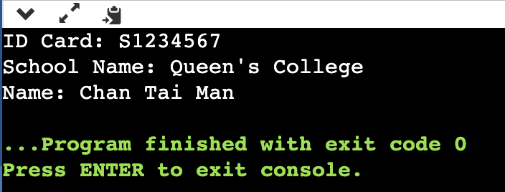
Task 1: ID Card Write some code with the following output

Slide 10
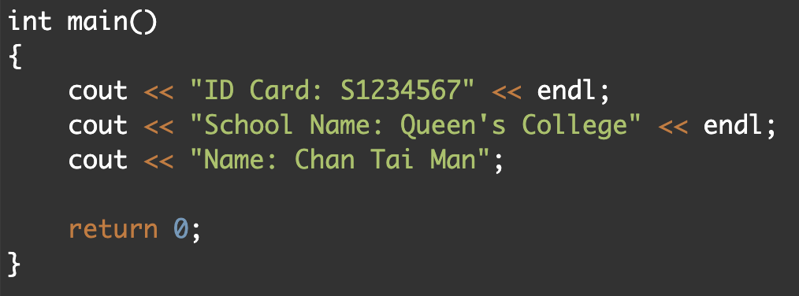
❗Don’t forget semicolon after each line :)))))

Slide 11
Variables
There are many types of variables in C++
Basic types include
Integer (int) [Maximum: 2147483647, Minimum: -2147483647]
Float and double (float) (double) (Represent fractions)
String (string) (To use strings, type #include <string> at the start of the file) (Surrounded by double quotes, i.e. “string”)
Character (char) (Surrounded by single quotes, i.e. ‘c’)
Boolean (bool)

Slide 12
Variables
IMPORTANT NOTE
Using double quotes to surround text does not create a string, it actually creates something called a char[] which is another way of representing strings
You don’t need to know what it is yet, but it has different properties from the string type which will be important later.

Slide 13
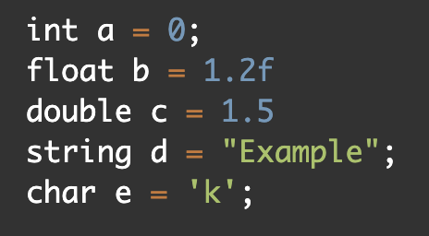
Variables (cont’d)
How to declare a variable:
<Type> <Variable name> = <Value>;
Naming rules:
Names can only contain letters, digits and underscores and it must not begin with a digit
Names are case sensitive
C++ keywords cannot be used as names
Note:
Add f after float values to indicate the decimal is a float, not a double
A string needs double quotation marks, while a character needs single quotation marks

Slide 14
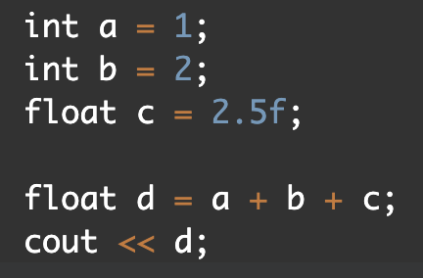
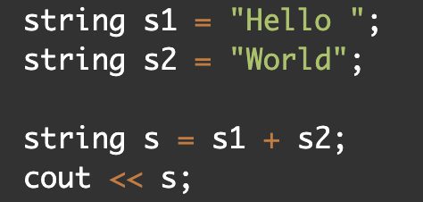
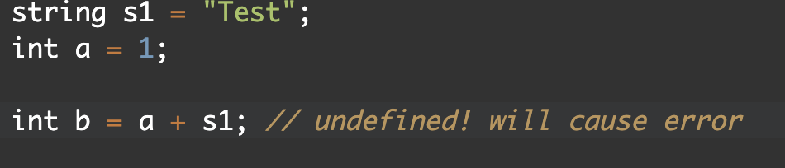
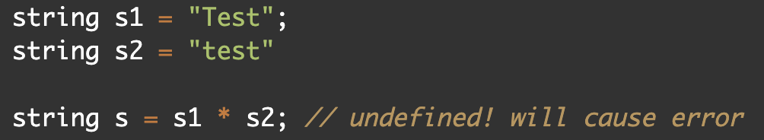
Operations of variables
Obviously, you could perform operations to variables, e.g.
However, some operations are invalid, e.g.

Slide 15
List of operations
a = b: Changes the value of variable a to b
a + b, a - b, a * b, a / b: These should be self-explanatory
a % b: Get the remainder when a is divided by b
a += b, a -= b, a *= b, a /= b: Shorthand for a = a + b, a = a - b, blah blah blah
a++, ++a: Increase the value of a by one
a--, --a: Decrease the value of a by one

Slide 16
Extra notes on division
If both a and b are integers in a / b, the return result is also an integer and the fractional part is thrown away.
Otherwise, if one of a or b is a floating point number, the result will be a floating point number.
i.e. 5 / 2 = 2 5.0 / 2 = 2.5 5 / 2.0 = 2.5

Slide 17

Casting variables (1st method)
You may cast some variables to another by “brute-forcing” them
Syntax: newVar = (type name)oldVar
This method doesn’t work for casting involving strings
Examples include:
float to int (note: int to float doesn’t need any casting)
Special:
char to int (‘a’, ‘b’, ‘c’ corresponds to 97, 98, 99…) (note: the reverse doesn’t do anything)
bool to int doesn’t need any casting (false is 0, true is 1)

Slide 18
Casting variables (2nd method)
Some casts involving strings can’t be ‘brute-forced’, e.g.
Integer to string
string myStr = to_string(myInt);
String to integer
int myInt = stoi(myStr);
Casting a non-integer (e.g. “abc”) will result in an error
Note: You need to use #include <string> both of those functions!!!

Slide 19
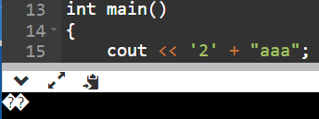
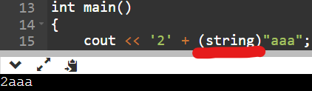
List of valid addition operations
Any number type + Any number type
(Note: char is also a number type, since each character is assigned a numerical value, more precisely its ASCII Code!)
string + string (char[] + char[] does not work!!!)
string + char (char[] + char does not work!!!)

Slide 20
Taking user input
Programs are not very useful if the user can’t change what it does. So let’s see the most basic way we can ask input from the user: CIN

Slide 21
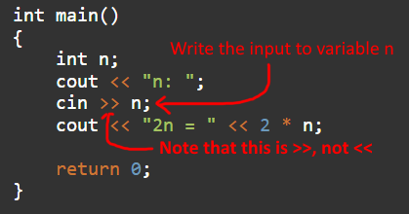
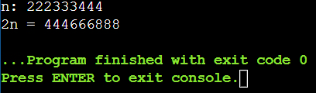
Using cin

Slide 22
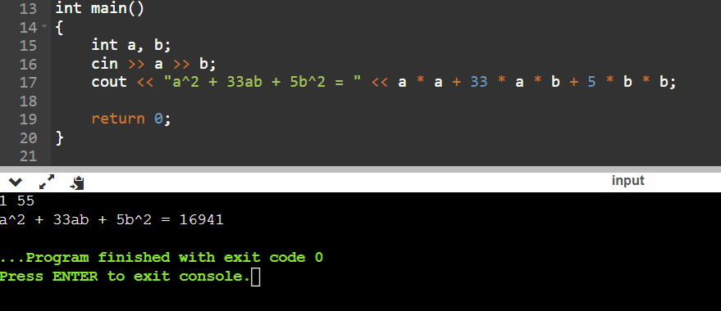
Cin on multiple variables

Slide 23
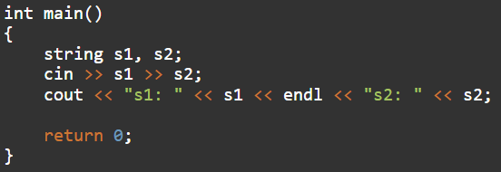

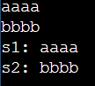
Cin is separated by spaces or new lines

Slide 24

Tasks (Asking the user for input nicely not needed)
You are given the following input in the command line:
A B C
A, B, and C are numbers (not necessarily of integer value).
Output the value of A + B + C, A + B * C, A * B + C, and A * B * C in that order.
Given a single character c as an input, output the numerical value which is assigned to it by the system. (Ascii code) Sample tests:

Slide 25
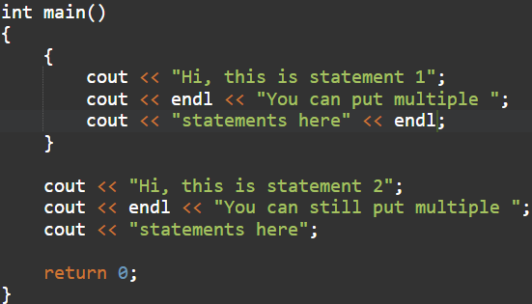
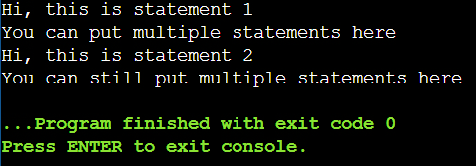
Blocks
You can group a bunch of statements together using {}. The following statements execute properly

Slide 26
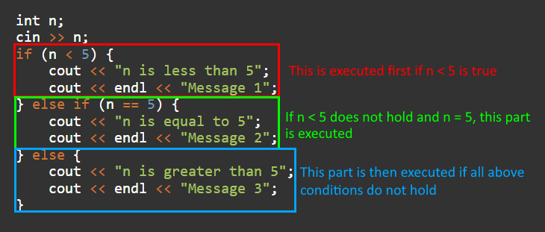
Logical flow
Use blocks after the “if” to tell the program that these statements should run if the condition is true
Both the “else if” block and “else” block may be omitted if not used

Slide 27
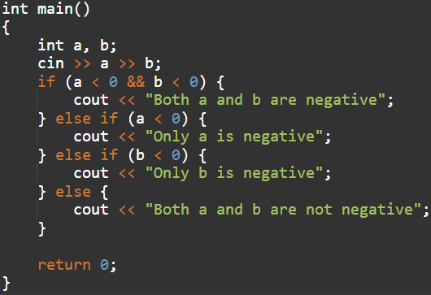
Chaining “else if”

Slide 28
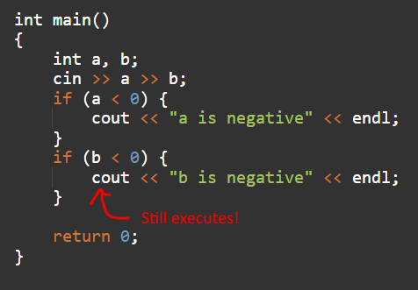

Each if ignores the “if” before it

Slide 29
Boolean operations
a > b, a < b, a >= b, a <= b: >= means greater than or equal to, <= means less than or equal to
a == b, a != b: a and b are equal, a and b are unequal respectively Don’t use a = b!!!!!!!!!!!!!!!!!!!!!!!!!!!!!!!!!!
a && b, a || b: && checks whether a and b are both true, || checks whether either one of a and b is true
!a: Not a, returns true if a is false and false if a is true

Slide 30



Ternary operators
a ? b : c: Returns b if a is true, otherwise returns c

Slide 31
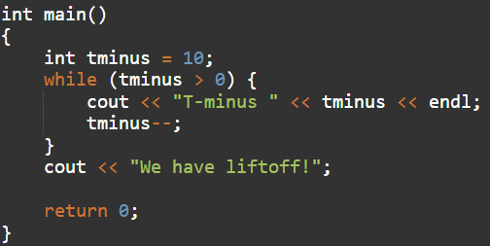
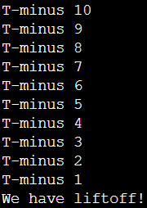
While loop
Like “If”, except the statement keeps on running as long as the statement is true
(Will not run the first time if the condition is already false)

Slide 32
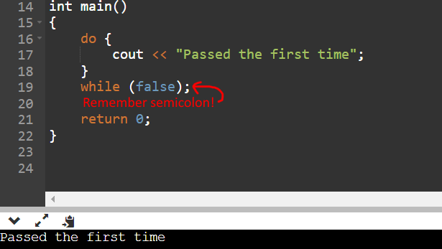
Do while loop
Almost the same as while loop, but the statement is executed the first time even if the check is false

Slide 33

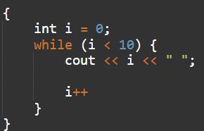
For loop
It is a more complicated version of the while loop. The code above is equivalent to the code below:

Slide 34
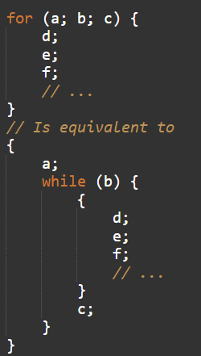
For loop
In general, these two are equivalent:
However, we usually declare a variable in a and increment/decrement it in c, while checking if its maximum value is met in b.

Slide 35
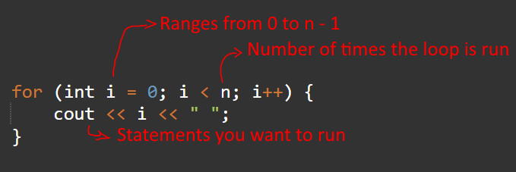
For loop
The general plan is:

Slide 36




Tasks (Asking the user for input nicely not needed)
1. Given an expression a op b in the console, where a and b are floating point numbers and the operation may be +, -, *, or /, output the corresponding value. Sample tests:

Slide 37



Tasks (Asking the user for input nicely not needed)
2. Given an integer input n, calculate n factorial.

Slide 38
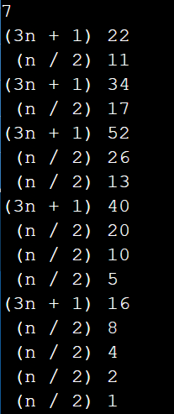
Tasks (Asking the user for input nicely not needed)
3. According to the collatz conjecture, the following operations should be repeated on a given input n: - If n is even, assign n / 2 to n - If n is odd, assign 3n + 1 to n This process is repeated until n reaches 1. According to the conjecture, n will eventually reach 1 for all n > 0. Simulate this and output each integer in the process. EXTRA: Indicate if the operation was 3n + 1 or n / 2 at each step

