Slide 1
Programming in C++ (cont)

Slide 2
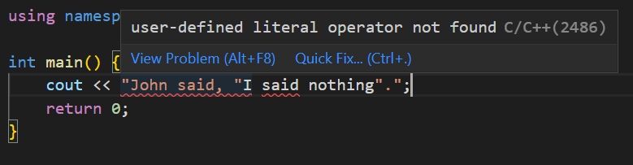
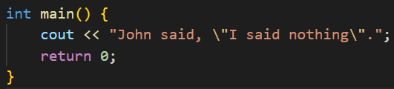

Strings - Escape sequences
In the previous chapter, we have learnt that strings are surrounded by double quotes ("").
But how do we express double quotes in text form if it marks the closing of a string?
We use \".

Slide 3




Strings - Escape sequences
Escape sequence- "\\" to write “\”
"\n" can be used to create a new line (but has slightly different properties from endl which are not important here)

Slide 4


Chars - Escape sequences
The same applies to chars (“\n” is a single character)

Slide 5
Functions
A function contains a set of instructions which you can execute. We have already seen an example of this previously- It’s the function int main(), which is called when the program starts!
A function may have a return value, which basically means that you use the function to calculate a value. Think of sin(x): It takes in an angle as an input, and returns a ratio as the output!

Slide 6
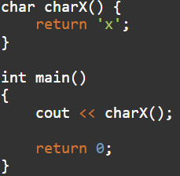
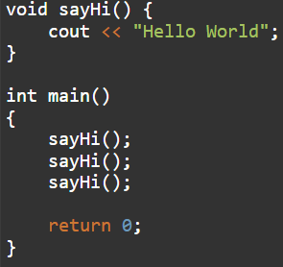
Declaring and running functions
We declare a function using type function_name() { instructions }
Later in the code, we may run the instructions inside the function (“Call the function”) again using function_name();
Type is the return type, such as int or char or bool (If the function does not return anything, put void as the type) Functions cannot be declared inside other functions, they must be defined outside of any blocks ({}).

Slide 7
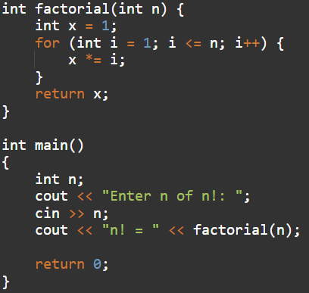
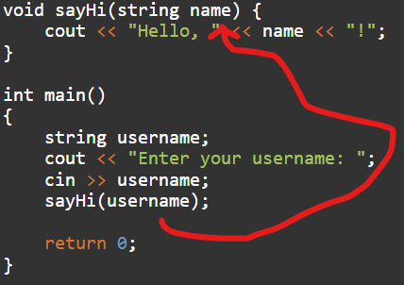


Function parameters
To make functions more useful, we can add parameters to it, which are defined inside the round brackets ( parameter 1, parameter 2, parameter 3, … ).
Each parameter consists of the type of the parameter (int, char, bool etc) and the name of the parameter. It is much easier to demonstrate this:

Slide 8
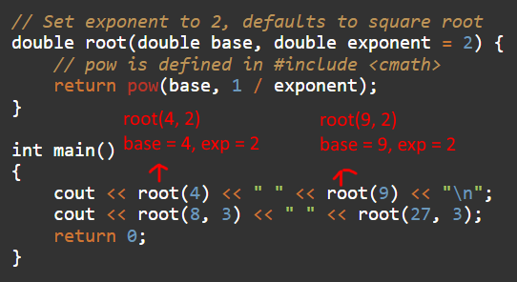

Function parameters
Sometimes we don’t want to provide all parameters every time we call a function, especially if one of the parameters is often the same. We can provide a default parameter using type parameter_name = default value:

Slide 9
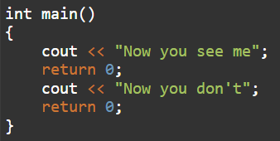
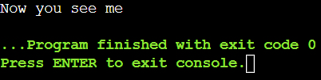
Early return on functions
Calling return always stops a function from executing any further. This is true even if return is called inside an if, while, or for block.

Slide 10
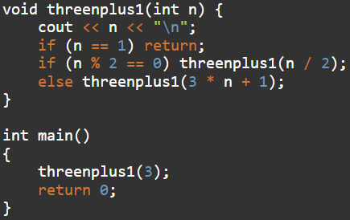

Recursion
Functions can call themselves, e.g.:

Slide 11
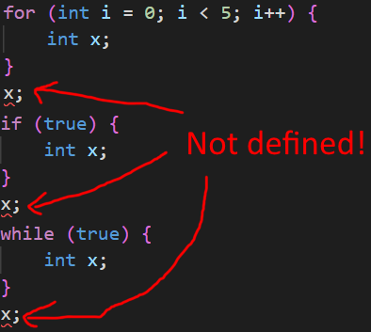
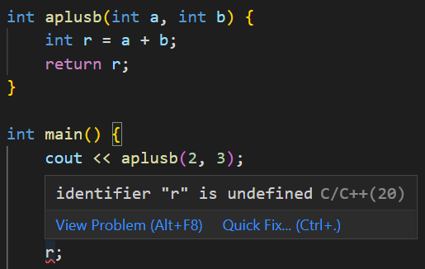
Variable scoping
Variables defined inside one function cannot be used in another, i.e. this doesn’t work:
The same is true for anything wrapped inside {}.

Slide 12
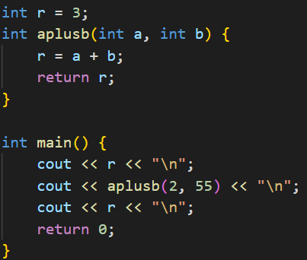

Global variables
To declare variables that can be used across all functions, simply put them outside of any blocks ({}):

Slide 13
Task
Write a function that takes in an integer n and writes “n is even” if it is even, and “n is odd” if it is not even.

Slide 14



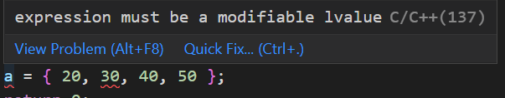
Arrays
An array is a list of variables of any one data type.
For example, the following code declares a list of 5 integers:
For other data types, replace int with the desired type.
Arrays may have an initial value: (Only works on initialization)
Writing the length is not needed if the initial value is given. Note that you cannot change existing arrays using the method above:

Slide 15
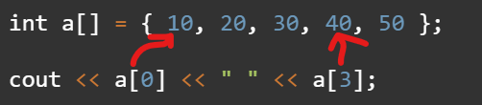
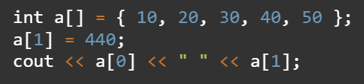
Arrays
To get the nth element of an array, use array[n].
The first element is a[0], not a[1]. Likewise, the 2nd element is a[1], then a[2], a[3], a[4], so on.

Slide 16
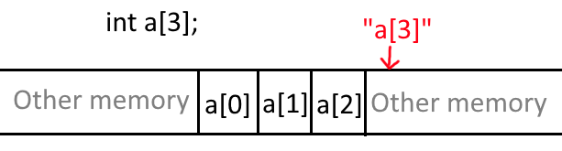

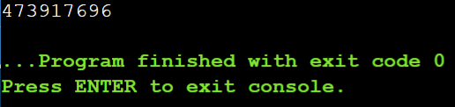
Arrays
Array size is fixed - You can’t change the size once it is declared
In C++, accessing a[3] won’t give a runtime error, but it will likely return BS

Slide 17
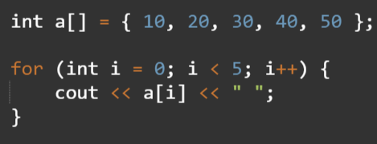
Iterating through elements in an array
Use a for loop, with the i < n term set to the length of the array.

Slide 18
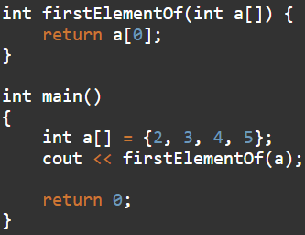
Arrays as function parameters
Instead of type paramName, use type paramName[]
However, it is not possible to get its size without using something else later.

Slide 19
Arrays as function parameters
To get the size of an array as a parameter, we may use the sizeof function, which outputs the size of the parameter in bytes.
To get the length of an array, we need to divide the size of the array in bytes by the size of the data type that the array carries in bytes:

Slide 20
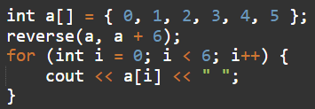
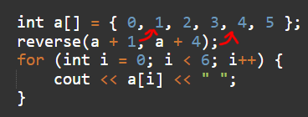
#include <algorithm>
The <algorithm> library has useful function for manipulating arrays. (Some compilers may allow you to use these functions without #include <algorithm>)
reverse- reverse(array, array + array_size);

Slide 21
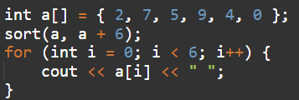
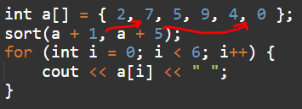
<algorithm>
Sort

Slide 22

Vectors
Arrays are inconvenient because they have a fixed length. You can use #include <vector>, which implements an array with variable size.
Initialising a vector:
Of course, you may replace int with the data type you want (Even another vector!)

Slide 23
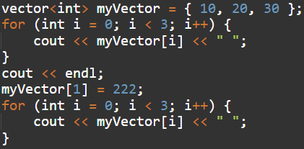

Vectors
The syntax for accessing the element at index i is the same:

Slide 24

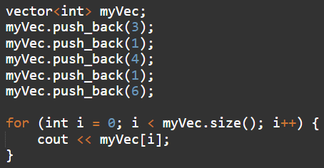
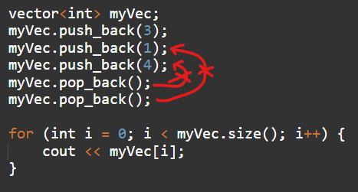
Vectors
Size of a vector:
Adding elements at the end: Deleting elements at the end:

Slide 25
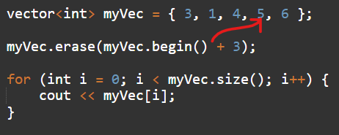
Vectors
Erasing an element at position i: (Again remember i starts from 0)
Do myVector.erase(myVector.begin() + i);

Slide 26
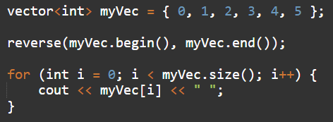
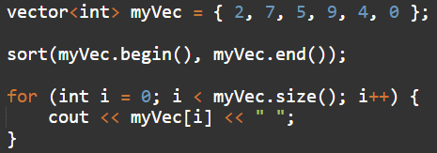
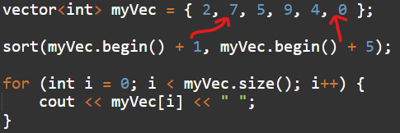
<algorithm> with vectors
Use vector.begin and vector.end

Slide 27
Tasks
1. To allow the user to input a vector, they can do the following:
Write a sequence of integers separated by spaces. Each integer is inserted into the vector in the order they are written.
The user may input “}”, which stops the input and “finishes” the vector.
e.g.: 2 3 6 4 88 } → { 2, 3, 6, 4, 88 }
Write a program to implement this, so that the user’s input is converted to a vector.

Slide 28
Tasks
2. Write a set of simple math functions for vector<int>:
int sum(vector<int> myVec): Return the sum of all elements in the vector
double mean(vector<int> myVec): Return the average of all elements in the vector (Hint: You may reuse sum()! Do (double)number to cast an integer to a floating point number)
int largest(vector<int> myVec): Output the largest number in the vector. (Hint: A variable that keeps track of the highest number) Avoid using sort(), as it is very inefficient.

