Slide 1

Queen’s College
Society of Computer Studies
How machines learn: NEURAL NETWORKS

Slide 2

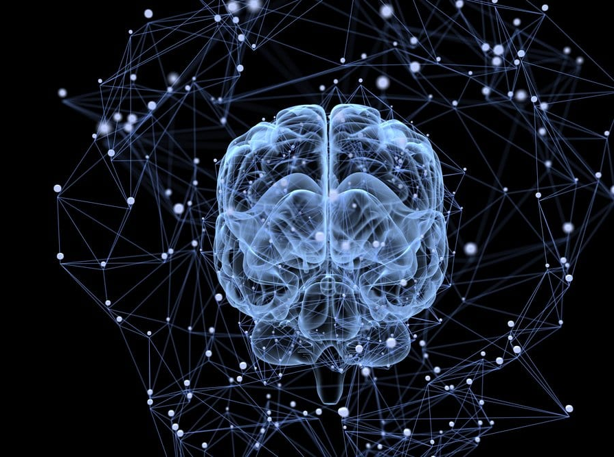
Neural (adj.) Network (n.)
Nerve system of computers
Can receive information and make own deductions and actions
Like a self-functional brain in computers

Slide 3
Why do we need neural networks?
It helps us in making accurate predictions
E.g. We can train the computer to predict the test score
 | Hours of studying | Hours of sleeping | Test score (/100)
Data 1 | 0 | 1 | 9
Data 2 | 6 | 8 | 70
Data 3 | 100 | 10 | 99
Prediction | 55 | 9 | ?

Slide 4

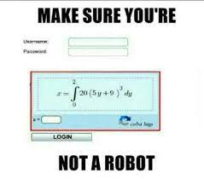
It is also widely used in modern technologies, e.g. face recognition
In 2014, a study even found out that compared to humans, which only attains 33% accuracy in solving captchas, robots are able to solve the same anti-robot tests with 99.9% accuracy

Slide 5
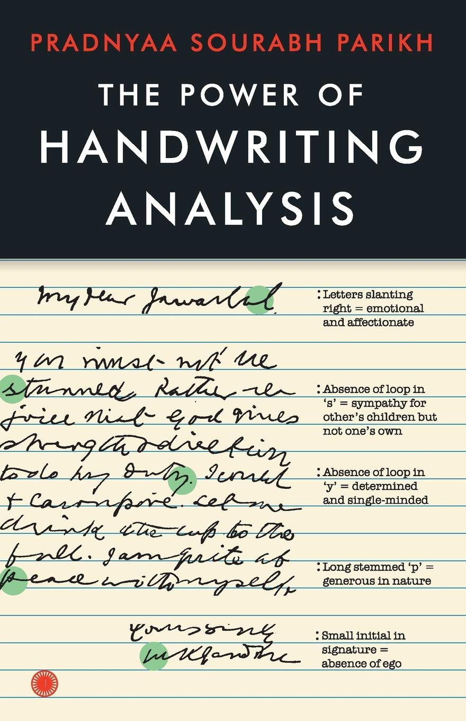
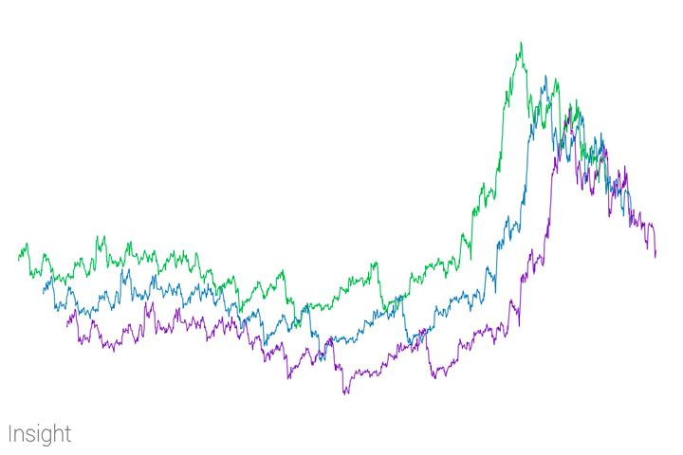
MORE applications
Social media bots (both legit and non-legit ones)
Facial Recognition
Prediction of weather, stock market, etc.
Handwriting analysis

Slide 6

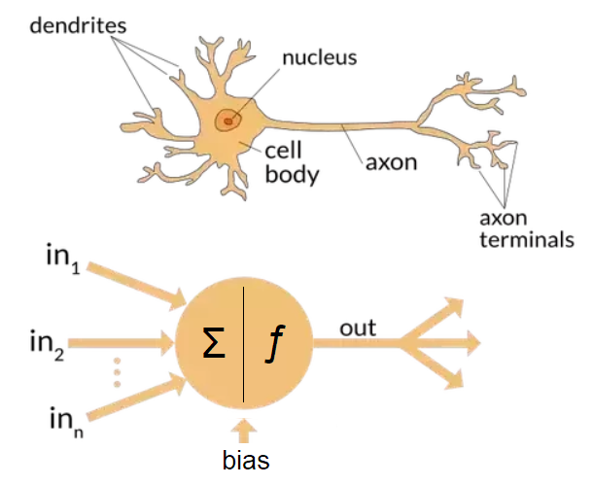
What exactly are neural networks?
Computing systems inspired by the biological neural networks in animal’s brains
Learn by processing examples, or data sets
Adjust predictions based on previous errors

Slide 7
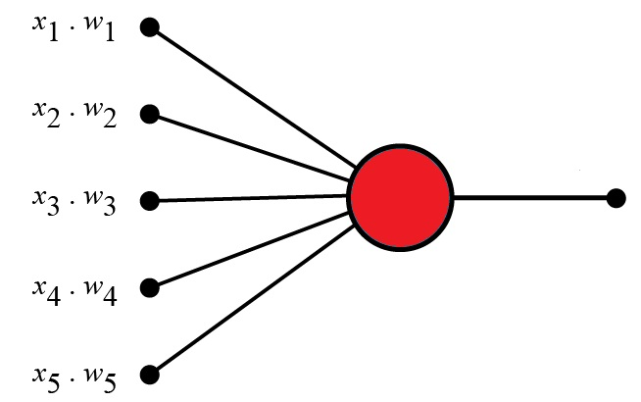
Structure of a neural network
Simplest: Perceptron (Multiple input -> one output, single-layered)

Slide 8
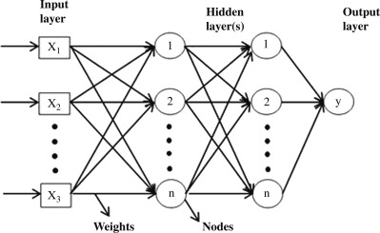
Others: Deep learning neural network
Consists of multiple layers and perceptrons

Slide 9

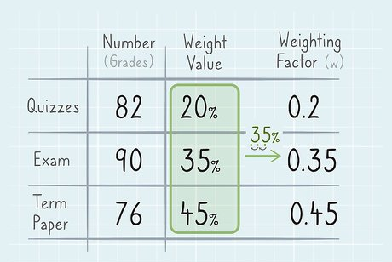
How neural networks work
(Note: We will use a perceptron as an example as it is the simplest)
Each input has a ‘weight’
The larger the weight, the more the output will depend on that particular input
E.g. In exams, different papers have different weights and contribute to different portions of your average score

Slide 10
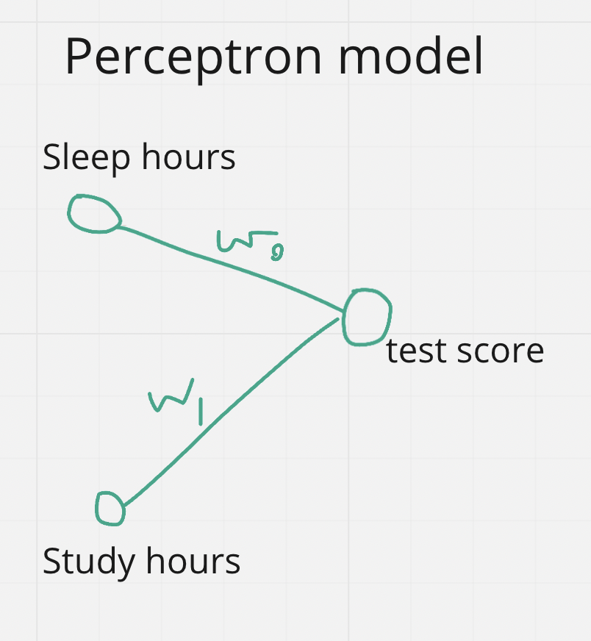
 | Hours of studying | Hours of sleeping | Test score (/100)
Data 1 | 260 | 1 | 80
Data 2 | 100 | 8 | 90
Data 3 | 0 | 10 | 99
Prediction | 240 | 5 | ?
E.g. Consider the following data set
It can be seen that this (hokba)’s
score is more related to how much
he sleeps, rather than how much
he studies
Therefore, the weight of sleep hours will be much larger than that of study hours (w₀ >>>> w₁)

Slide 11
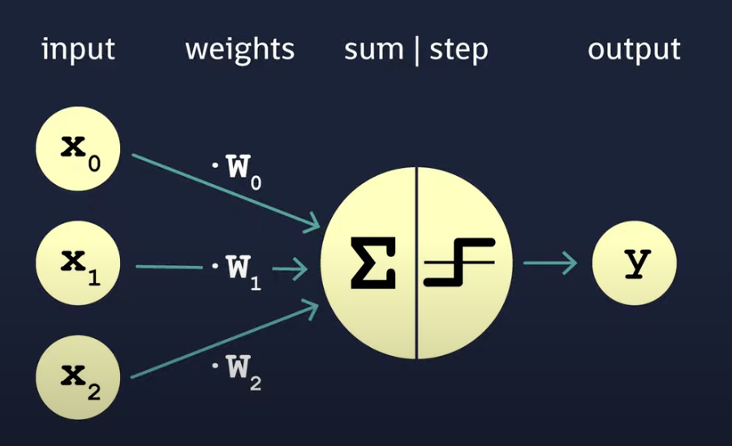
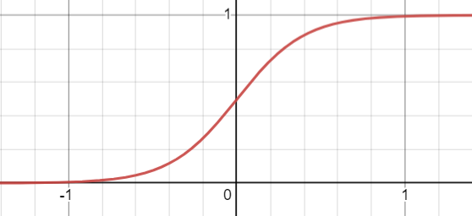
 | Music score (/50) | VA score (/50) | Like VA teacher
Data 1 | 15 | 27 | No
Data 2 | 30 | 45 | Yes
Data 3 | 2 | 45 | No
Data 4 | 49 | 26 | No
Data 5 | 42 | 42 | Yes
Predict | 11 | 43 | ?
Actual computation:
Take the weighted sum of the inputs
Put the answer into an activation function and get a ‘predicted’ answer
Compare with the actual answer and compute the error -> Adjust the weights accordingly
Note: In this example, We use “Step function” as the activation function (i.e. If input > some threshold, Output = true, otherwise false)
Other activation functions example: Sigmoid function
(Notice the S shape)

Slide 12
Adjusting the weights
3a. Find error function: (Actual value - Predicted value) ^ 2
3b. Use gradient descent algorithm to minimize the error function
(more on that later)
3c. Adjust the weights accordingly

Slide 13
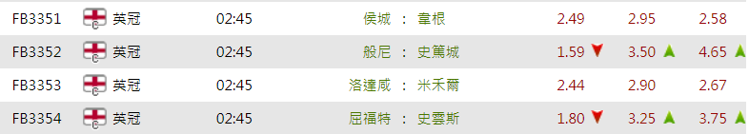
Simpler concept
Trend observation
- e.g. odds in football matches Based on players, previous scores, and recent form, all with different weights

Slide 14

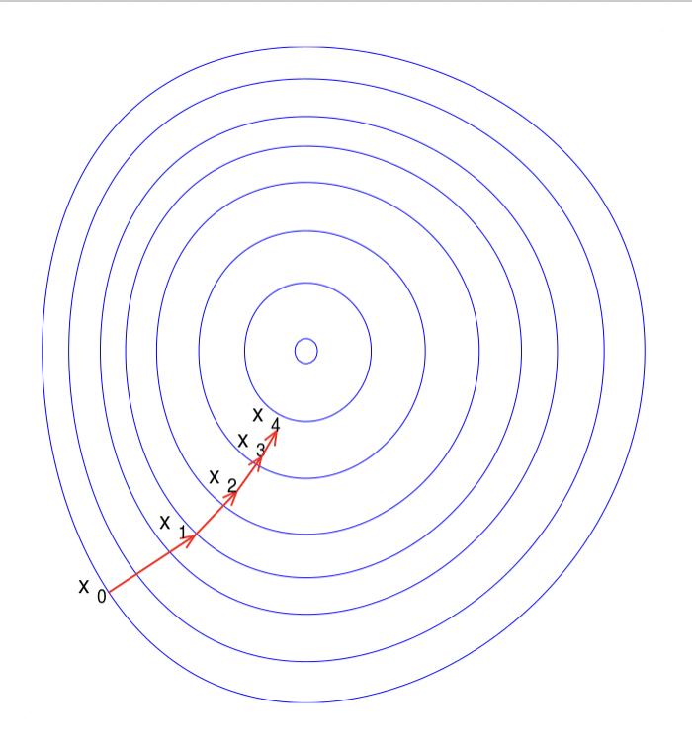
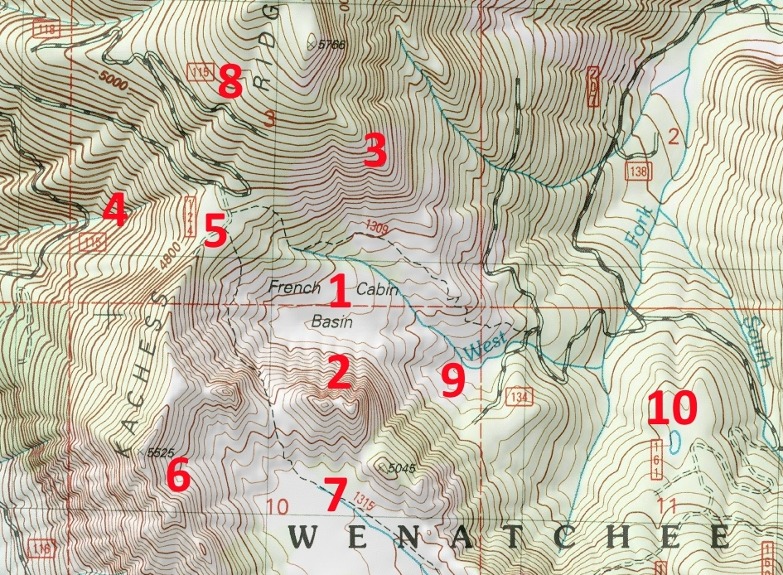
Gradient descent
An optimization algorithm for finding a local minimum
Analogy: A person stuck in a mountain proceeds in the direction with the steepest descent. He/she will find a basin eventually

Slide 15
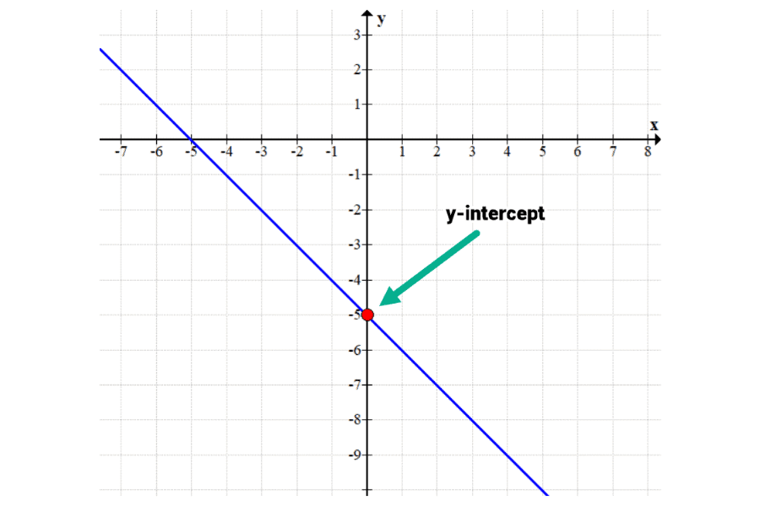
Background knowledge: Coordinate planes
X-axis and y-axis
Slope: Gradient in geography

Slide 16

NOTE
The following section may be difficult to understand, do not freak out

Slide 17
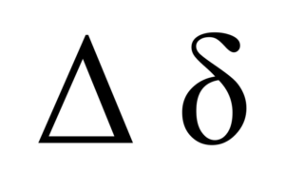
Basic knowledge on some notations
d = delta = “change in”
For example:
Velocity = change in distance/change in time
= d(distance)/d(time)

Slide 18
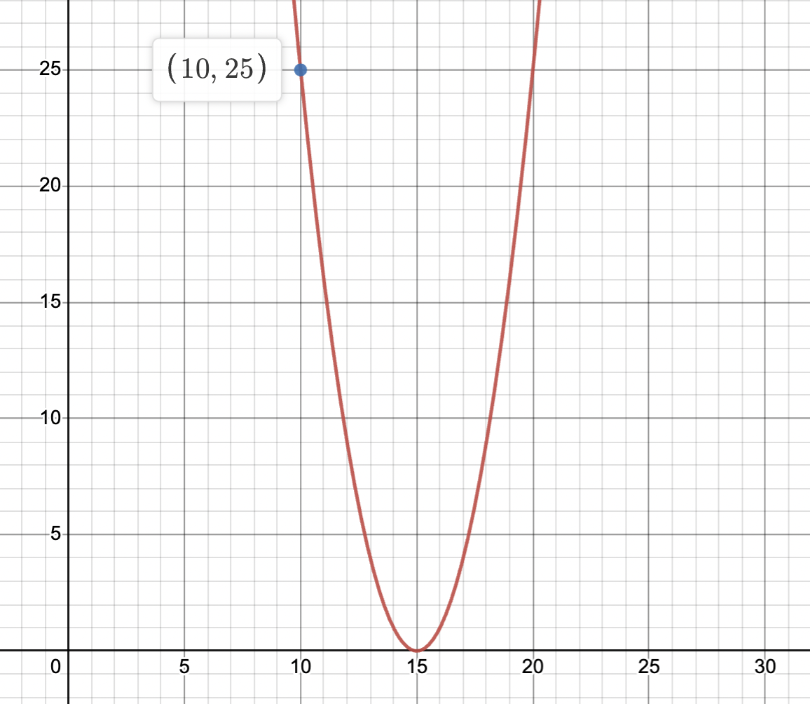
Derivative function: gives the slope of a specific point
Analogy: The original function gives you the shape of the hill
The derivative function lets you know how steep the hill at different points are
Notation: df(x)/dx or f’(x)
E.g. df(x)/dx at x = 10 is -10 (For every infinitesimal step you go in +x direction at x = 10, you descent by 10 steps)

Slide 19
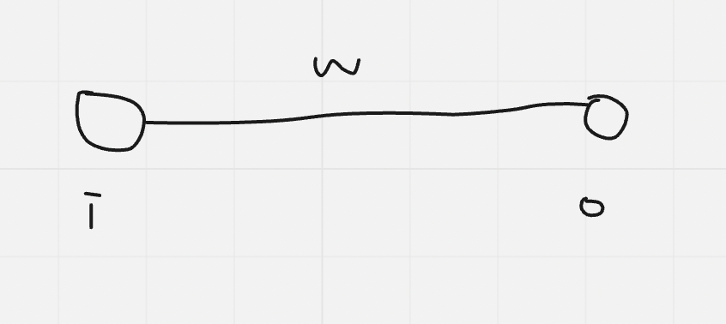
Now let’s consider the simplest perceptron
Error = (a - 15) ^ 2, where a = input * weight
Computation:
Firstly, we choose a random weight (e.g. 10)
Then we multiply the slope of the function at that point with the learning rate (r), and subtract it from the original weight
w_{new} = w_{original} - (slope of Error function at w) * r
Learning rate (a constant): The actual “step” to go downhill
Input | Random Weight | Actual output | Desired output
1 | 10 | 10 | 15

Slide 20
Iteration example: (Let’s choose r to be 0.05)
Note: Since E = (a - 15)^2, dE/dw = 2(a - 15) <- a = iw
w_{new} = w_{original} - (dE/dw_{original} at w )* r
w_{new1} = 10 - (2(1*10 - 15)) * 0.05 = 10.5
w_{new2} = 10.5 - (2(1*10.5 - 15)) * 0.05 = 10.95
w_{new3} = 10.95 - (2(1*10.95 - 15)) * 0.05 = 11.36
…
After doing it for infinitely many times, w will approach 15, that is, the error approaches 0 and the model is practically accurate
Input | Random Weight | Actual output | Desired output
1 | 10 | 10 | 15

Slide 21
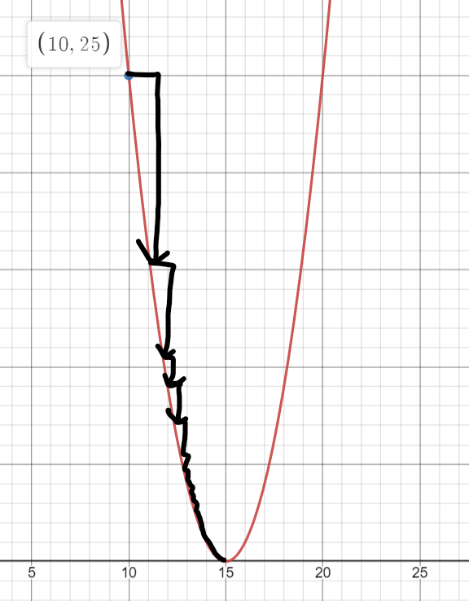
Graphical interpretation if you understood nothing:
Input | Random Weight | Actual output | Desired output
1 | 10 | 10 | 15

Slide 22
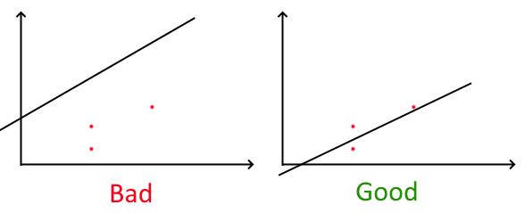
LINEAR REGRESSION
Suppose you have lots and lots of training data.
Obviously, you cannot have a straight line that passes through all the data points to minimise the error down to 0.
Instead, we seek to minimise the sum of the “error function squared” of all the data points that a particular line produces.
Calculating the derivative of the sum of the squared error can be done by calculating the derivative for each individual data point and adding them together, which is very convenient.
With reference to the form y = mx + c, two “weights” can be adjusted

Slide 23
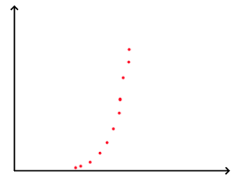
POLYNOMIAL REGRESSION
Unfortunately, not everything is a straight-line relationship. For example, the relationship of how highest point an object reaches and the speed at which you throw the object at is not a straight line relationship.
To combat this, something called polynomial regression was invented, which uses many weights (We’ll talk about that later):
y = w_{o} + w₁x + w₂x² + w₃x³ + … + w_{n}x^{n}

Slide 24

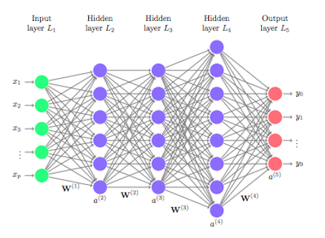
Deep learning
Multiple layers of perceptrons
Output is used as input for next layer, so each layer affects another

Slide 25
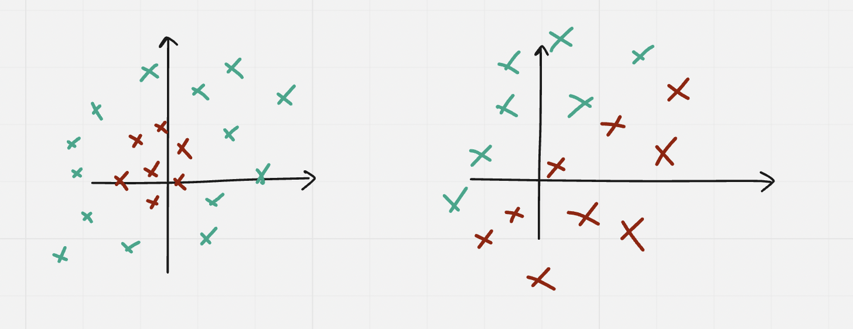
Why do we need multiple layers
Deal with non-linear relationships
Linear: A straight line
Non linear vs linear relationships:

Slide 26
Weight adjustion
Backpropagation
The (n + 1)_{th} layer depends on the n_{th} layer
The weights of previous layers will therefore affect the final output

Slide 27

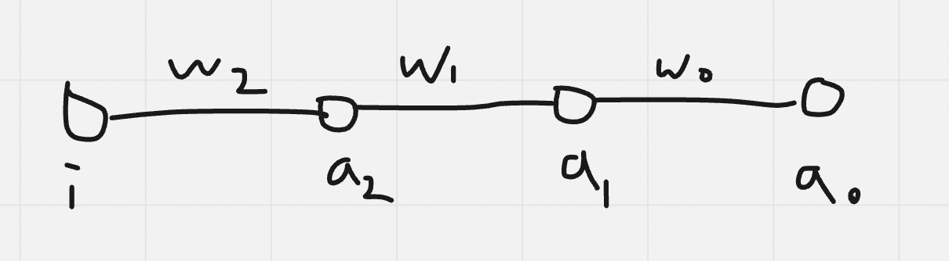
Backpropagation
Since the weights of hidden layers affect the final output, we can adjust the weights of the hidden layers to fit the model
Therefore, we need multiple derivative functions, to see how much a change to the weights affect the error function
Computation example (w₂):
From the above, w_{2 (new)} = w_{2 (original)} - (dE/dw₂ at w₂) * learning rate
Similarly, w_{n (new)} = w_{n (original)} - (dE/dw_{n} at w_{n}) * learning rate

Slide 28
Chain rule
So, how can we find out dE/dw_{n} (Let’s use w₂ as an example)?
By the chain rule, dE/dw₂ = dE/da₀ * da₀/da₁ * da₁/da₂* da₂/dw₂
E = (a - y <- (desired output))^2, therefore dE/da₀ = 2 (a - y)
a₀ = a₁w₀, therefore da₀/da₁ = w₀
a₁ = a₂w₁, therefore da₁/dw₂ = w₁
a₂ = iw₂, therefore da₂/dw₂ = i
Therefore w_{2(new)} = w_{2(original)} - 2 (a - y) * w₀ * w₁ * i * r

Slide 29
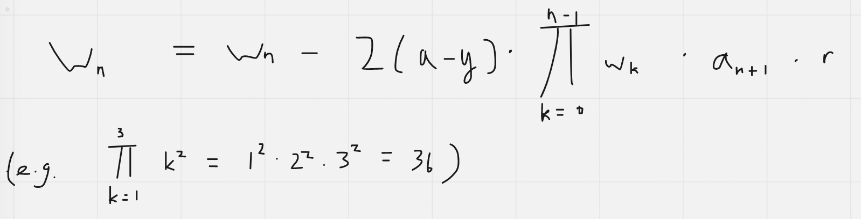
Chain rule generalisation
Notice, dE/dw_{n} = dE/da₀ * da₀/da₁ * … da_{n-1}/da_{n}* da_{n}/dw_{n}
For the same reason, dE/da₀ = 2 (a - y)
a_{n-1} = a_{n}w_{n-1}, therefore da_{n-1}/da_{n} = w_{n-1}
a_{n} = a_{n+1}w_{n}, therefore da_{n}/dw_{n} = a_{n+1}
Therefore we should adjust w_{n} by (2 (a - y) * w₀ * w₁ *... * w_{n-1}* a_{n+1} * r)
I.e.

Slide 30
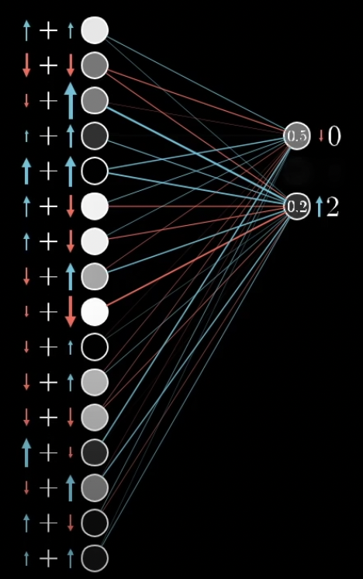
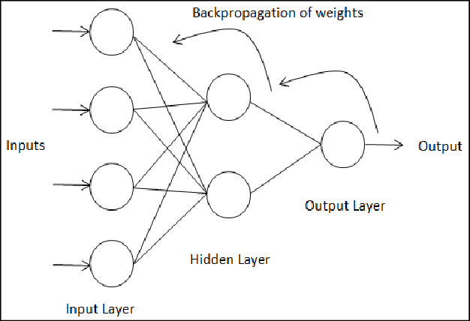
Multiple inputs or outputs
Multiple inputs: Take the partial derivative of the error function with respect to one of the weights
Multiple outputs: Add up all of the changes ‘wanted’ by each output

Slide 31
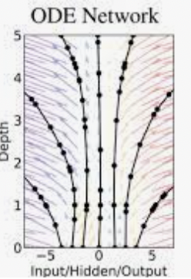
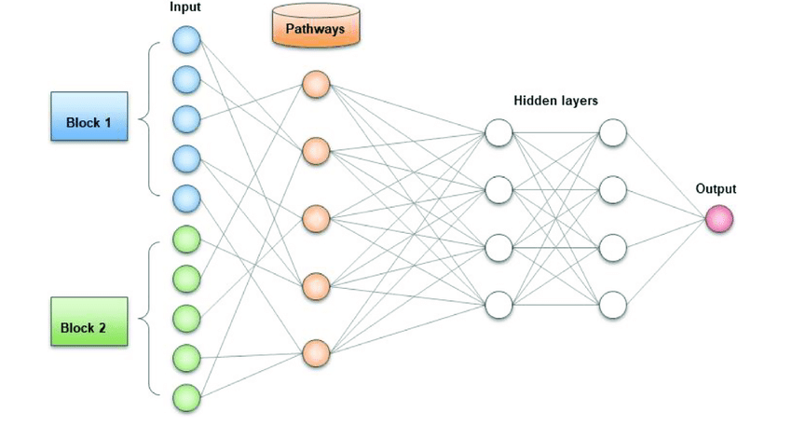
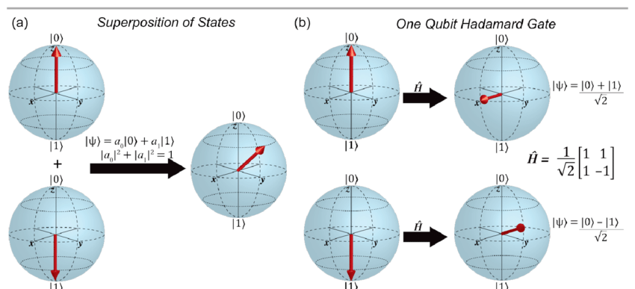
What comes next
Optimized gradient descent (Stochastic gradient descent)
Unsupervised learning
Solving equations (especially partial differential equations)
Other models (Ordinary Differential Equation Net (ODE net), Pathways Language Model (PaLM), Quantum neural network)

Slide 32
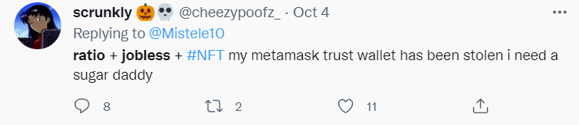
Flaws of current neural networks
No.1 May not be able to identify fake information, for example internet “trolls” (Applies to unsupervised learning models only)

Slide 33
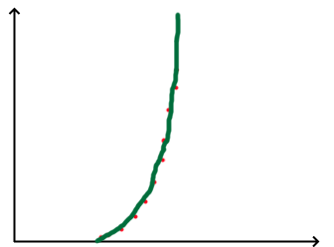
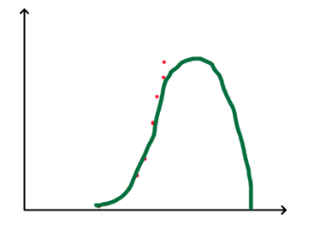
Flaws of current neural networks
No.2 Overfitting: Trying too hard to satisfy the training data, accounting for random errors in the data
Example: Human fitting vs Possible AI fitting

Slide 34
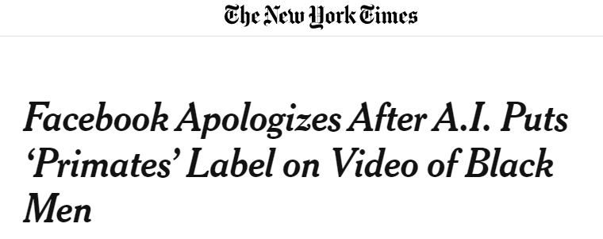
Flaws of current neural networks
No.3 Must be exposed to large amount of data to be accurate (Most important)
Without large amounts of data, overfitting (In last slide) may occur easily, and biases in the training data (for example, biases on race, like in the example) will have a great effect on the result

Slide 35
Queen’s College
Society of Computer Studies
End of presentation

