Slide 1
Data Storage

Slide 2
Contents
Shared Preferences
Internal/External Files
Sqlite
Room database

Slide 3
Shared Preferences
Shared Preferences allows activities and applications to keep preferences, in the form of key-value pairs
Android stores Shared Preferences settings as XML file in shared_prefs folder under DATA/data/{application package} directory
To get access to the preferences, we have APIs:
getPreferences() : used from within your Activity, to access activity-specific preferences
getSharedPreferences() : used from within your Activity (or other application Context), to access application-level preferences

Slide 4
Shared Preferences
Implement:
getSharedPreferences (String PREFS_NAME, int mode) PREFS_NAME is the name of the file. mode is the operating mode.

Slide 5
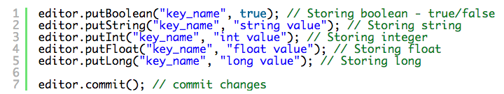
Shared Preferences
Initialization
SharedPreferences pref = getApplicationContext().getSharedPreferences("MyPref", Context.MODE_PRIVATE);
Editor editor = pref.edit();
Storing Data

Slide 6
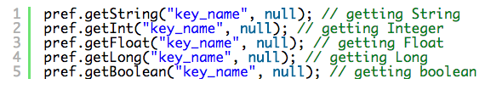
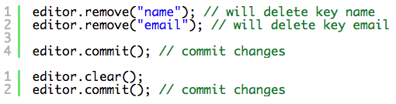
Shared Preferences
Retrieving Data
Clearing or Deleting Data:
remove(“key_name”) is used to delete that particular value.
clear() is used to remove all data

Slide 7
File Storage
External storage -- Public directories
Internal storage -- Private directories for just your app
Apps can browse the directory structure
Structure and operations similar to Linux and java.io

Slide 8
File Storage
Internal storage is best when
you want to be sure that neither the user nor other apps can access your files
External storage is best for files that
don't require access restrictions
you want to share with other apps
you allow the user to access with a computer

Slide 9
File Storage
Internal Storage
Always available
Uses device's filesystem
Only your app can access files, unless explicitly set to be readable or writable
On app uninstall, system removes all app's files from internal storage

Slide 10
File Storage
External storage
Not always available, can be removed
Uses device's file system or physically external storage like SD card
World-readable, so any app can read
On uninstall, system does not remove files private to app

Slide 11
Using Internal Storage
An activity has methods you can call to read/write files:
getFilesDir() - returns internal directory for your app
getCacheDir() - returns a "temp" directory for scrap files
getResources().openRawResource(R.raw.id) - read an input file from res/raw/
openFileInput("name", mode) - opens a file for reading
openFileOutput("name", mode) - opens a file for writing

Slide 12
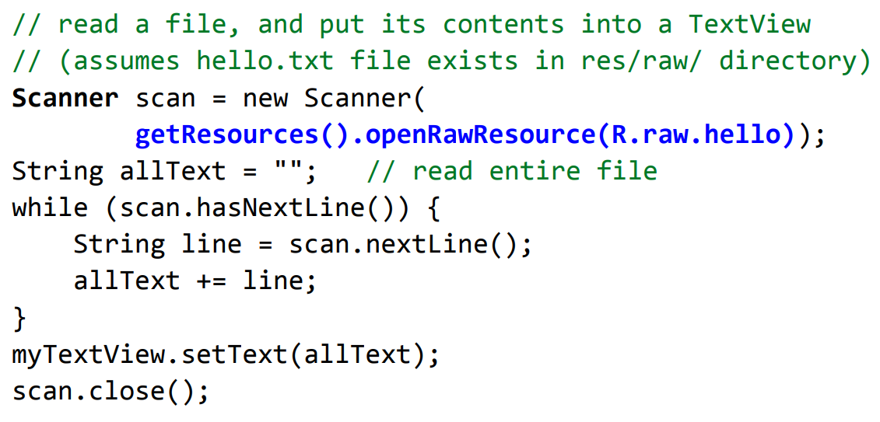
Using Internal Storage – Example 1

Slide 13
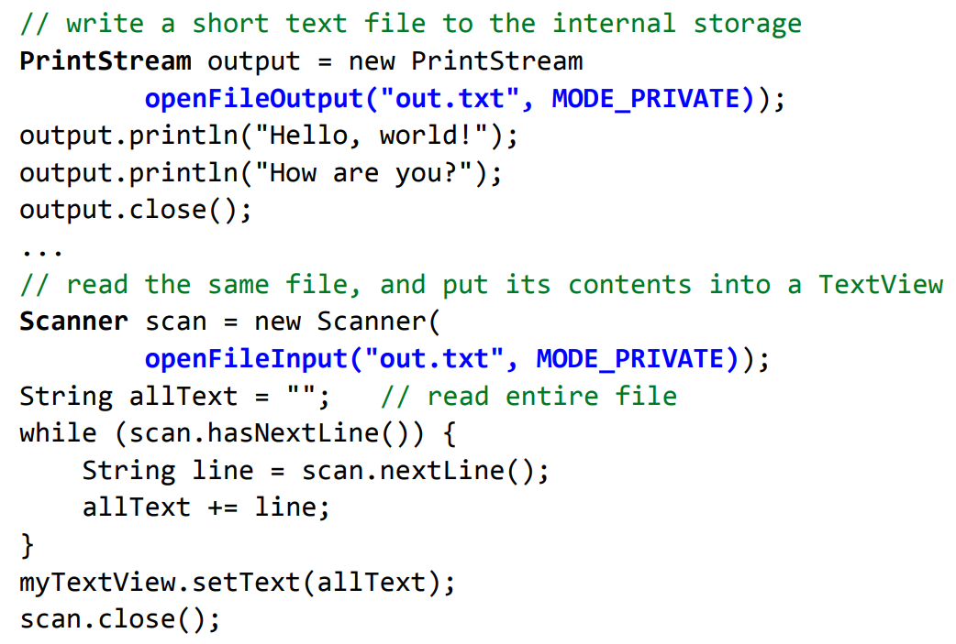
Using Internal Storage – Example 2

Slide 14
Using External Storage
Must explicitly request permission
Methods to read/write external storage:
getExternalFilesDir("name") - returns "private" external directory for your app with the given name
Environment.getExternalStoragePublicDirectory(name) - returns public directory for common files like photos, music, etc.
<uses-permission
android:name="android.permission.WRITE_EXTERNAL_STORAGE" />
<uses-permission
android:name="android.permission.READ_EXTERNAL_STORAGE" />

Slide 15
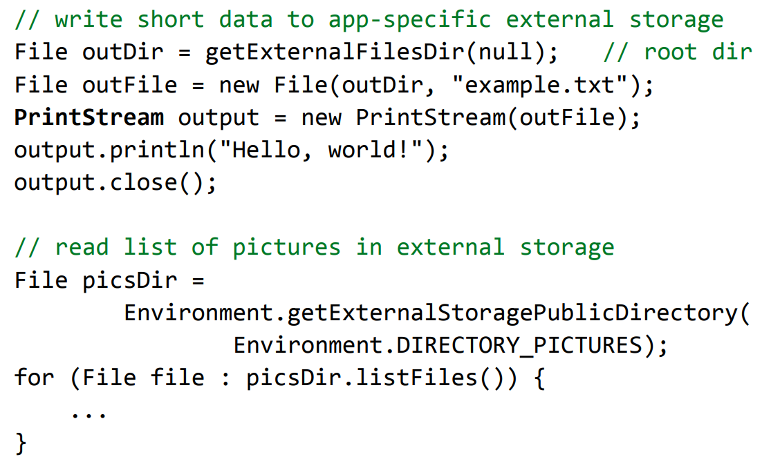
External Storage – Example

Slide 16
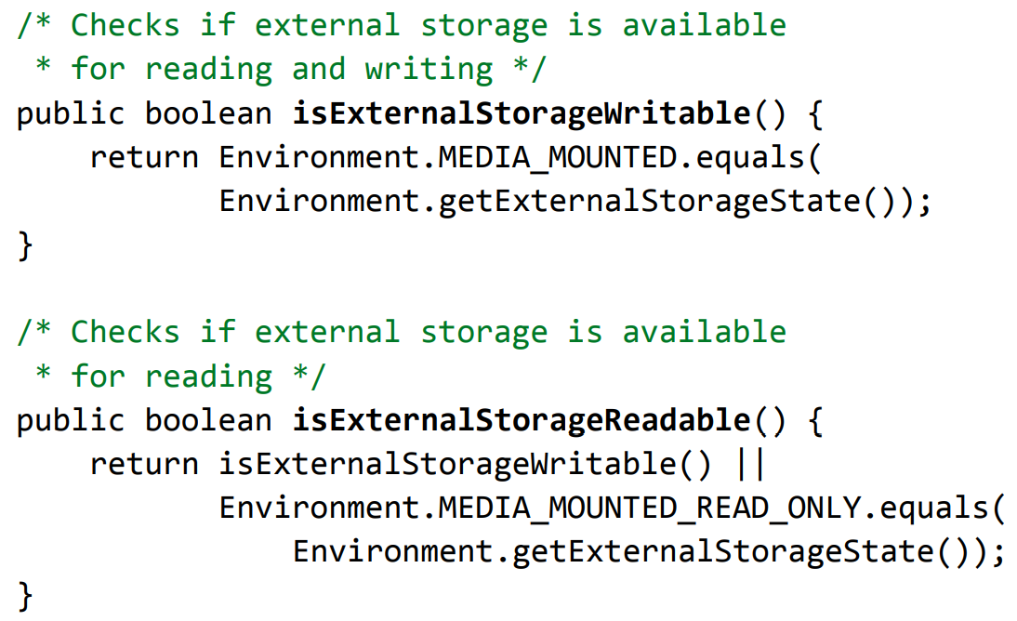
External Storage - Checking if storage is available

Slide 17
Assignment
In LoginActivity, using SharedPreference to handle:
If user has not login app, show LoginActivity
If user logined app, show HomeActivity

Slide 18
Sqlite database
Store data in tables of rows and columns (spreadsheet…)
Field = intersection of a row and column
Fields contain data, references to other fields, or references to other tables
Rows are identified by unique IDs
Column names are unique per table

Slide 19
Sqlite database
Table
WORD_LIST_TABLE
_id | word | definition
1 | "alpha" | "first letter"
2 | "beta" | "second letter"
3 | "alpha" | "particle"

Slide 20
SQL basic operations
Insert rows
Delete rows
Update values in rows
Retrieve rows that meet given criteria

Slide 21
SQL Query
SELECT word, description FROM WORD_LIST_TABLE WHERE word="alpha"
Generic
SELECT columns FROM table WHERE column="value"

Slide 22
SELECT columns FROM table
SELECT columns
Select the columns to return
Use * to return all columns
FROM table—specify the table from which to get results

Slide 23
WHERE column="value"
WHERE—keyword for conditions that have to be met
column="value"—the condition that has to be met
common operators: =, LIKE, <, >

Slide 24
AND, ORDER BY, LIMIT
SELECT _id FROM WORD_LIST_TABLE WHERE word="alpha" AND definition LIKE "%art%" ORDER BY word DESC LIMIT 1
AND, OR—connect multiple conditions with logic operators
ORDER BY—omit for default order, or ASC for ascending, DESC for descending
LIMIT—get a limited number of results

Slide 25
Sample queries
1 | SELECT * FROM WORD_LIST_TABLE | Get the whole table
2 | SELECT word, definition FROM WORD_LIST_TABLE WHERE _id > 2 | Returns [["alpha", "particle"]]

Slide 26
More sample queries
3 | SELECT _id FROM WORD_LIST_TABLE WHERE word="alpha" AND definition LIKE "%art%" | Return id of word alpha with substring "art" in definition [["3"]]
4 | SELECT * FROM WORD_LIST_TABLE ORDER BY word DESC LIMIT 1 | Sort in reverse and get first item. Sorting is by the first column (_id) [["3","alpha","particle"]]

Slide 27
Last sample query
5 | SELECT * FROM WORD_LIST_TABLE LIMIT 2,1 | Returns 1 item starting at position 2. Position counting starts at 1 (not zero!). Returns [["2","beta","second letter"]]

Slide 28
rawQuery()
String query = "SELECT * FROM WORD_LIST_TABLE";
rawQuery(query, null);
query = "SELECT word, definition FROM WORD_LIST_TABLE WHERE _id> ? ";
String[] selectionArgs = new String[]{"2"}
rawQuery(query, selectionArgs);

Slide 29
query()
SELECT * FROM WORD_LIST_TABLE WHERE word="alpha" ORDER BY word ASC LIMIT 2,1; Returns: [["alpha", "particle"]] | String table = "WORD_LIST_TABLE" String[] columns = new String[]{"*"}; String selection = "word = ?" String[] selectionArgs = new String[]{"alpha"}; String groupBy = null; String having = null; String orderBy = "word ASC" String limit = "2,1" query(table, columns, selection, selectionArgs, groupBy, having, orderBy, limit);

Slide 30
Cursors
Queries always return a Cursor object
Cursor is an object interface that provides random read-write access to the result set returned by a database query
⇒ Think of it as a pointer to table rows

Slide 31
Using sqlite
SQLiteDatabase db = openOrCreateDatabase( "name", MODE_PRIVATE, null); db.execSQL("SQL query");
Methods:
– db.beginTransaction(), db.endTransaction()
– db.delete("table", "whereClause" , args)
– db.deleteDatabase(file)
– db.insert("table", null, values)
– db.query(...)
– db.rawQuery("SQL query", args)
– db.replace("table", null, values)
– db.update("table", values, "whereClause", args)

Slide 32
Using sqlite
ContentValues can be optionally used as a level of abstraction for statements like INSERT, UPDATE, REPLACE
ContentValues cvalues = new ContentValues();
cvalues.put("columnName1", value1);
cvalues.put("columnName2", value2);
...
db.insert("tableName", null, cvalues);
db.execSQL("INSERT INTO tableName (" + columnName1 + ", " + columnName2 + ") VALUES (" + value1 + ", " + value2 + ")");

Slide 33
Using sqlite
SQLiteOpenHelper class provides the functionality to use the SQLite database
Constructor | Description
SQLiteOpenHelper(Context context, String name, SQLiteDatabase.CursorFactory factory, int version) | creates an object for creating, opening and managing the database.
SQLiteOpenHelper(Context context, String name, SQLiteDatabase.CursorFactory factory, int version, DatabaseErrorHandler errorHandler) | creates an object for creating, opening and managing the database. It specifies the error handler.

Slide 34
Using sqlite
Method | Description
public abstract void onCreate(SQLiteDatabase db) | called only once when database is created for the first time.
public abstract void onUpgrade(SQLiteDatabase db, int oldVersion, int newVersion) | called when database needs to be upgraded.
public synchronized void close () | closes the database object.
public void onDowngrade(SQLiteDatabase db, int oldVersion, int newVersion) | called when database needs to be downgraded.

Slide 35
Using sqlite
Method | Description
void execSQL(String sql) | executes the sql query not select query.
long insert(String table, String nullColumnHack, ContentValues values) | inserts a record on the database. The table specifies the table name, nullColumnHack doesn't allow completely null values. If second argument is null, android will store null values if values are empty. The third argument specifies the values to be stored.
int update(String table, ContentValues values, String whereClause, String[] whereArgs) | updates a row.
Cursor query(String table, String[] columns, String selection, String[] selectionArgs, String groupBy, String having, String orderBy) | returns a cursor over the resultset.

Slide 36
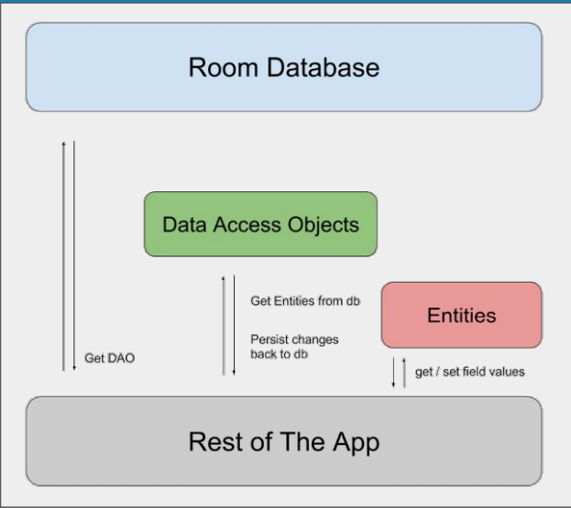
Room database
Room is a robust SQL object mapping library
Generates SQLite Android code

Slide 37
Room database
Room works with DAO and Entities
Entities define the database schema
DAO provides methods to access database
RoomDatabase
LiveData
LiveData
Entity
SQLite
DAO

Slide 38
Using Room database
Add library
Create Entity
Create DAO
Create Database

Slide 39
Using Room database
Add library
// Room components implementation "androidx.room:room-runtime:$rootProject.roomVersion" annotationProcessor "androidx.room:room-compiler:$rootProject.roomVersion" androidTestImplementation "androidx.room:room-testing:$rootProject.roomVersion"

Slide 40
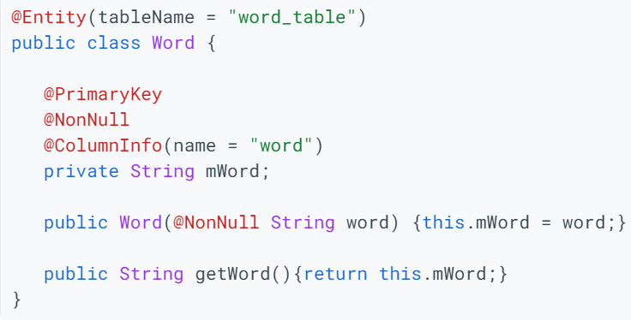
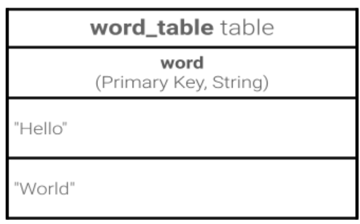
Using Room database
Create Entity

Slide 41
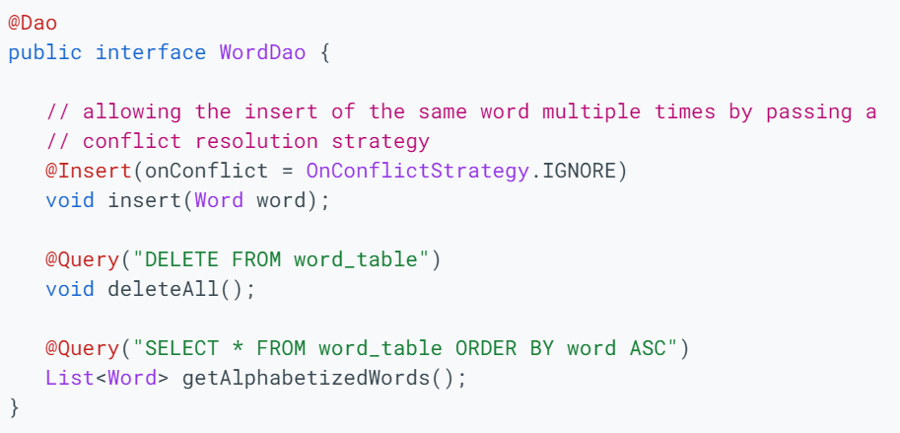
Using Room database
Create DAO

Slide 42
Using Room database
Create database
Create public abstract class extending RoomDatabase
Annotate as @Database
Declare entities for database schema and set version number
@Database(entities = {Word.class}, version = 1)
public abstract class WordRoomDatabase extends RoomDatabase

Slide 43

Using Room database
Entity defines
DB schema
@Database(entities = {Word.class}, version = 1)
public abstract class WordRoomDatabase
extends RoomDatabase {
public abstract WordDao wordDao();
private static WordRoomDatabase INSTANCE;
// ... create instance here
}
DAO for database
Create database as singleton instance

Slide 44
Using Room database
Use Database builder
Use Room's database builder to create the database
Create DB as singleton instance
private static WordRoomDatabase INSTANCE;
INSTANCE = Room.databaseBuilder(...)
.build();

Slide 45
Room database creation example
static WordRoomDatabase getDatabase(final Context context) {
if (INSTANCE == null) {
synchronized (WordRoomDatabase.class) {
if (INSTANCE == null) {
INSTANCE = Room.databaseBuilder(
context.getApplicationContext(),
WordRoomDatabase.class, "word_database")
.build();
}}}
return INSTANCE;

Slide 46
Classwork
Create a database in sqlite, named “goods.db”
Create a table, named “product”
Load data into the recyclerview (slot 10)
Create Insert/Update/Delete function for Product screen
Id | ProductName | Product Description | ProductPrice
1 | Laptop | Abc… | 20.000.000
2 | Smartphone | Xyz… | 15.000.00
3 | Headphone | Kzz… | 1000.000

Slide 47
References
https://developer.android.com/codelabs/android-room-with-a-view#0
https://google-developer-training.github.io/android-developer-fundamentals-course-concepts-v2/

