Slide 1
Multithread

Slide 2
Contents
Main thread
Worker thread
Asynctask

Slide 3
Main thread
Independent path of execution in a running program
Code is executed line by line
App runs on Java thread called "main" or "UI thread"
Draws UI on the screen
Responds to user actions by handling UI events

Slide 4
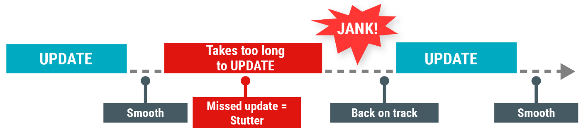
Main thread
Hardware updates screen every 16 milliseconds
UI thread has 16 ms to do all its work
If it takes too long, app stutters or hangs
WAIT

Slide 5
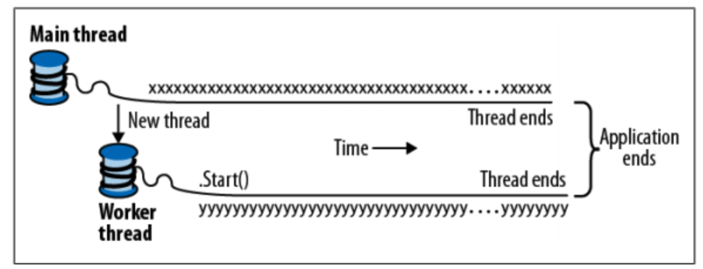
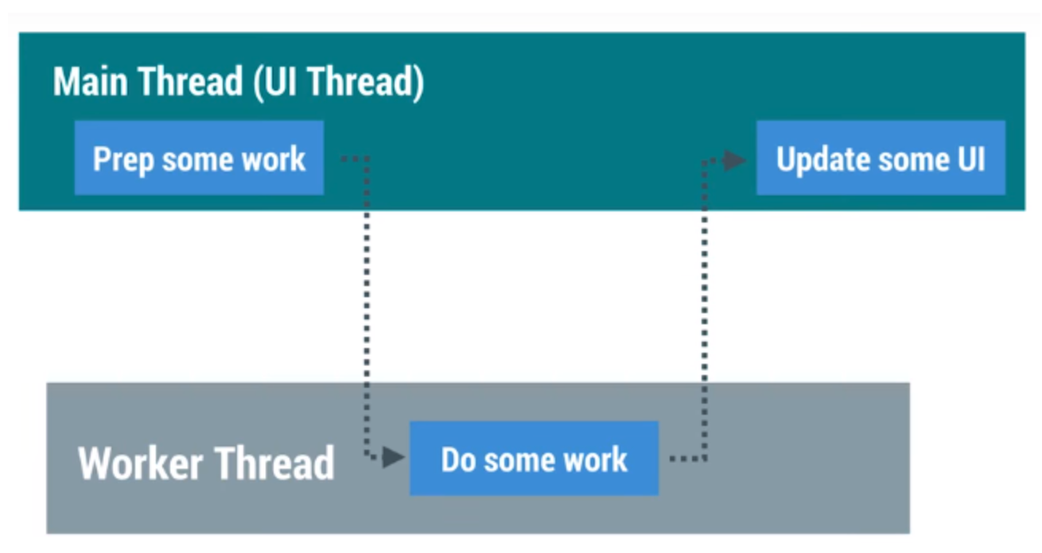
Worker thread

Slide 6
Worker threads do:
Network operations
Long calculations
Downloading/uploading files
Processing images
Loading data

Slide 7
Two rules for Android threads
Do not block the UI thread
Complete all work in less than 16 ms for each screen
Run slow non-UI work on a non-UI thread
Do not access the Android UI toolkit from outside the UI thread
Do UI work only on the UI thread

Slide 8
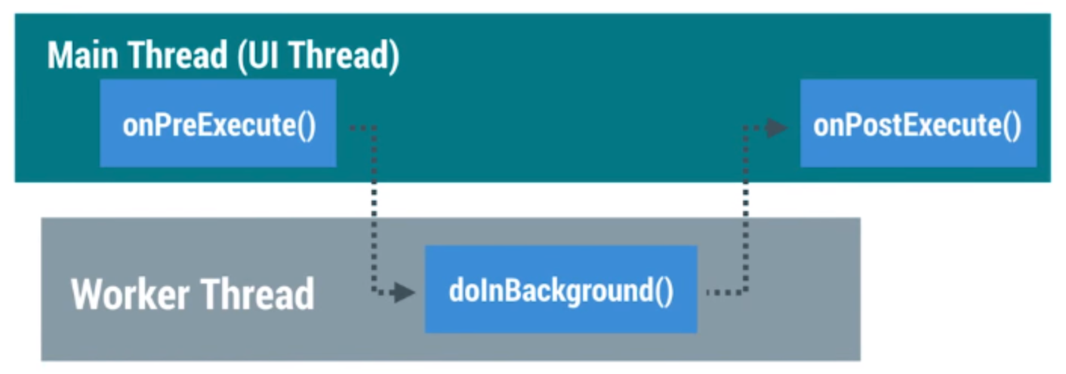
Asynctask
To implement basic background tasks

Slide 9
Asyntask
doInBackground()—runs on a background thread
All the work to happen in the background
onPostExecute()—runs on main thread when work done
Process results
Publish results to the UI

Slide 10
Asyntask
onPreExecute()
Runs on the main thread
Sets up the task
onProgressUpdate()
Runs on the main thread
receives calls from publishProgress() from background thread

Slide 11
AsyncTask helper methods
Main Thread (UI Thread)
onPreExecute()
onProgressUpdate()
onPostExecute()
Worker Thread
publishProgress()
doInBackground()

Slide 12
Creating an AsyncTask
Subclass AsyncTask
Provide data type sent to doInBackground()
Provide data type of progress units for onProgressUpdate()
Provide data type of result for onPostExecute()
private class MyAsyncTask
extends AsyncTask<URL, Integer, Bitmap> {...}

Slide 13
MyAsyncTask class definition
private class MyAsyncTask
extends AsyncTask<String, Integer, Bitmap> {...}
doInBackground()
doInBackground(
String—could be query, URI for filename
Integer—percentage completed, steps done
Bitmap—an image to be displayed
Use Void if no data passed
doInBackground()
onProgressUpdate()
onPostExecute()

Slide 14
onPreExecute()
protected void onPreExecute() {
// display a progress bar
// show a toast
}

Slide 15
doInBackground()
protected Bitmap doInBackground(String... query) {
// Get the bitmap
return bitmap;
}

Slide 16
onProgressUpdate()
protected void onProgressUpdate(Integer... progress) {
setProgressPercent(progress[0]);
}

Slide 17
onPostExecute()
protected void onPostExecute(Bitmap result) {
// Do something with the bitmap
}

Slide 18
Start background work
public void loadImage (View view) {
String query = mEditText.getText().toString();
new MyAsyncTask(query).execute();
}

Slide 19
Limitations of AsyncTask
When device configuration changes, Activity is destroyed
AsyncTask cannot connect to Activity anymore
New AsyncTask created for every config change
Old AsyncTasks stay around
App may run out of memory or crash

Slide 20
When to use AsyncTask
Short or interruptible tasks
Tasks that do not need to report back to UI or user
Lower priority tasks that can be left unfinished
Use AsyncTaskLoader otherwise

Slide 21
Classwork
Using Asynctask to download 1 image from Url into an ImageView

Slide 22
References
https://google-developer-training.github.io/android-developer-fundamentals-course-concepts-v2/

