Slide 1
Maps, Geocoding, and Location-Based Services

Slide 2
Contents
Add Google Map to Android application
Google Map methods
Access phone’s position

Slide 3
Add Google Map to Android application
Add Google Play Services to project
Get an API key
Add permission to AndroidManifest.xml
Add MapFragment
Wait for map to be ready

Slide 4
Step 1: Add Google Play Services to project
add Google Play to project in app's build.gradle file
dependencies {
implementation fileTree(dir: 'libs', include: ['*.jar’])
implementation 'com.google.android.gms:play-services:18.0.0’
}

Slide 5
Step 2: Get an API key
Google won't allow you to fetch map data without an API key.
To get a key, open a Terminal and find the file debug.keystore:
Windows (new): C:\Users\USERNAME\.android
Windows (old): C:\Documents and Settings\USERNAME\.android
Linux: /home/USERNAME/.android/
Mac: /Users/USERNAME/.android/ (?)
In the terminal, cd to that directory, then type:
keytool -list -v -keystore debug.keystore
(it asks for a password, so just press Enter)
Find the line with your "Certificate fingerprint" for "SHA-1". It should contain a long string in this format. Copy it down.
BD:2B:3F:4B:.........

Slide 6
Step 2: Get an API key
Go to the Google APIs developer console:
https://code.google.com/apis/console/
click APIs and Auth → Credentials → Create new Key
choose Android Key
paste in the SHA-1 key you got from the previous slide

Slide 7
Step 3: Add permission to AndroidManifest.xml
To use maps in your app, must make some manifest changes:
<manifest ...>
<uses-permission android:name="android.permission.ACCESS_NETWORK_STATE" />
<uses-permission android:name="android.permission.INTERNET" />
<uses-permission android:name="android.permission.WRITE_EXTERNAL_STORAGE" />
<uses-feature android:glEsVersion="0x00020000" android:required="true" />
<application ...>
<meta-data android:name="com.google.android.gms.version"
android:value="@integer/google_play_services_version" />
<meta-data android:name="com.google.android.maps.v2.API_KEY"
android:value="your API key" />
<activity ...> ... </activity>
</application>
</manifest>

Slide 8
Step 4: Add MapFragment
Google Maps API provides a fragment class named MapFragment for displaying a map within an activity.
<LinearLayout ...
xmlns:android="http://schemas.android.com/apk/res/android"
xmlns:map="http://schemas.android.com/apk/res-auto"
tools:ignore="MissingPrefix">
<fragment ...
android:name="com.google.android.gms.maps.MapFragment"
android:id="@+id/ID" />
</LinearLayout>

Slide 9
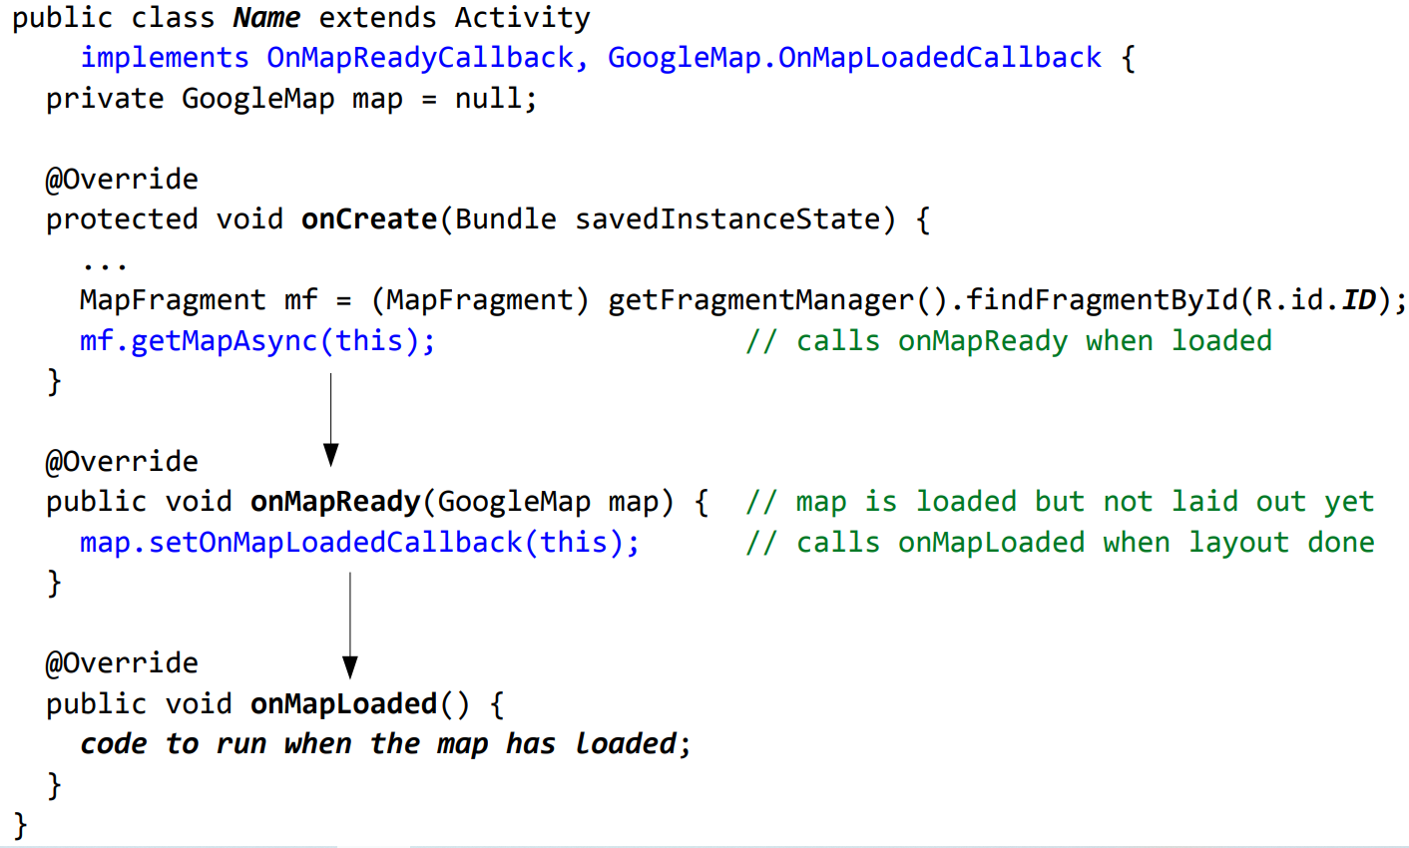
Step 5: Wait for map to be ready

Slide 10
GoogleMap methods
placing items on the map:
addCircle, addGroundOverlay, addMarker, addPolygon, addPolyline, addTileOverlay
clear - Removes all markers, polylines/polygons, overlays
manipulating the camera:
getCameraPosition, moveCamera, animateCamera, stopAnimation
map settings and appearance:
setBuildingsEnabled, setIndoorEnabled, setMapType, setPadding, setTrafficEnabled

Slide 11
GoogleMap methods
snapshot - take a screen shot of the map as a bitmap
event listeners:
setOnCameraChangeListener, setOnMapClickListener, setOnMapLoadedCallback, setOnMapLongClickListener, setOnMarkerClickListener, setOnMarkerDragListener, setOnMyLocationChangeListener

Slide 12
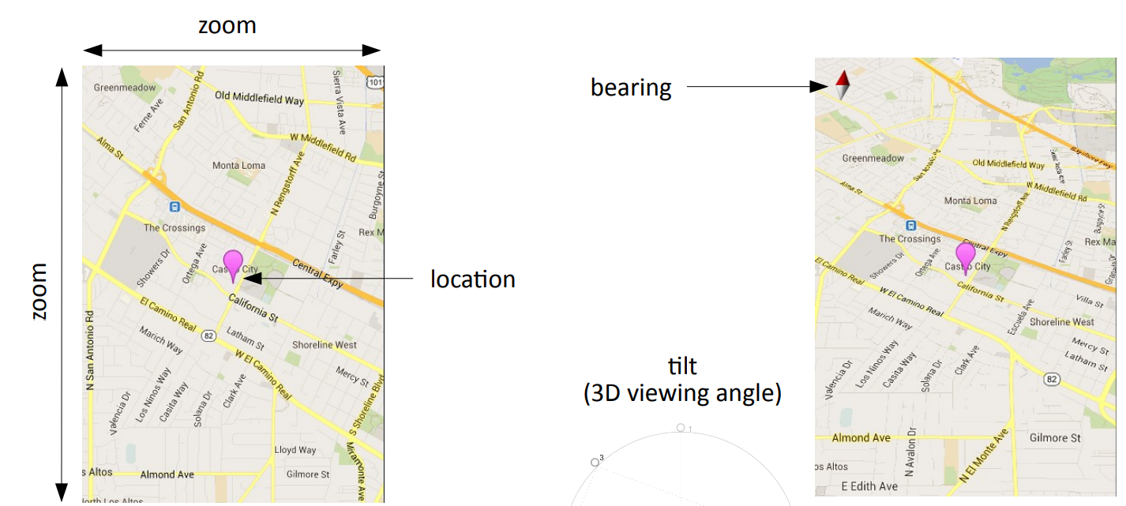
The map's camera
The current viewing window of a map's camera is defined by:
target location (latitude/longitude), zoom (2.0 - 21.0),
bearing (orientation/rotation), and tilt (degrees)

Slide 13
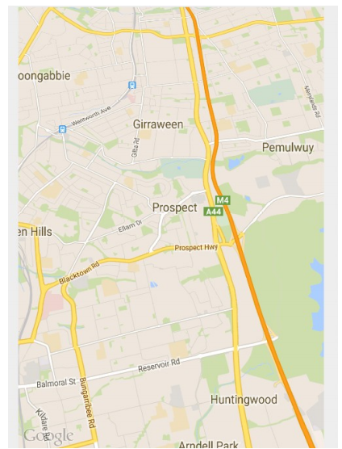
Set camera in XML
Set initial map settings and camera position in the layout XML:
<fragment ...
android:name="com.google.android.gms.maps.MapFragment"
android:id="@+id/ID"
map:cameraBearing="112.5"
map:cameraTargetLat="-33.796923"
map:cameraTargetLng="150.922433"
map:cameraTilt="30"
map:cameraZoom="13"
map:mapType="normal"
map:uiCompass="false"
map:uiRotateGestures="true"
map:uiScrollGestures="false"
map:uiTiltGestures="true"
map:uiZoomControls="false"
map:uiZoomGestures="true" />

Slide 14
Set camera in Java code
CameraUpdateFactory methods:
newLatLng(new LatLng(lat, lng))
newLatLngBounds(new LatLngBounds(SW, NE), padding)
newLatLngZoom(new LatLng(lat, lng), zoom)
newCameraPosition(CameraPosition)
others:
LatLngBounds bounds = new LatLngBounds(
new LatLng(20, -130.0), // SW
new LatLng(55, -70.0)); // NE
map.moveCamera(CameraUpdateFactory.newLatLngBounds(bounds, 50));

Slide 15
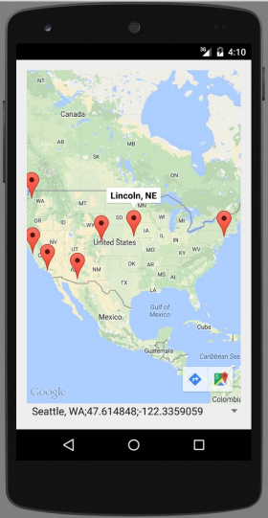
Placing markers
A GoogleMap object has an addMarker method that can let you put "push pin" markers at locations on the map.
The marker's methods return the marker, so you can chain them.
options: alpha, draggable, icon, position, rotation, title, visible, ...
map.addMarker(new MarkerOptions()
.position(new LatLng(40.801, -96.691))
.title("Lincoln, NE") );
Marker mark = map.addMarker(new MarkerOptions() ...);
mark.remove();

Slide 16
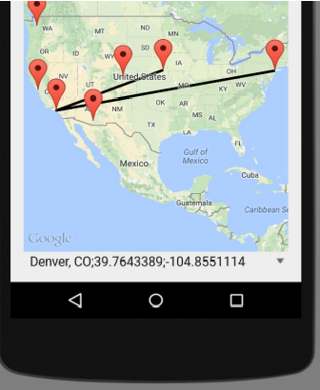
Lines and paths
A GoogleMap object has an addPolyline method that can let you put lines between locations on the map.
options: color, visible, width, zIndex, ...
map.addPolyline(new PolylineOptions()
.add(new LatLng(40.801, -96.691)) // Lincoln, NE
.add(new LatLng(34.020, -118.412)) // Los Angeles, CA
.add(new LatLng(40.703, -73.980)) // New York, NY
);
Polyline polly = map.addPolyline(...); polly.remove();

Slide 17
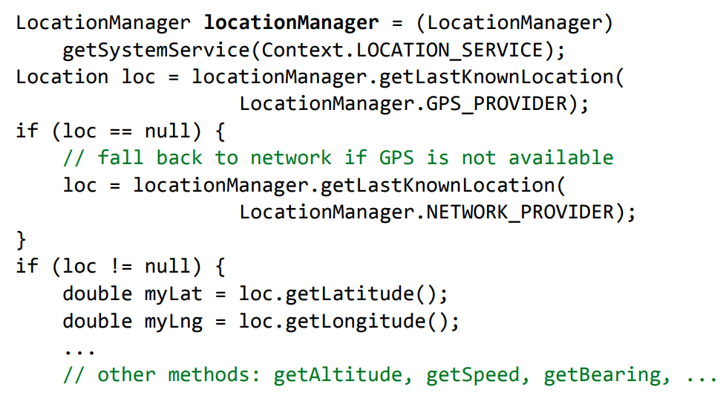
Accessing phone's location
Android LocationManager gives you the phone's position:
GPS provider provides highest accuracy
Network provider is a fallback in case GPS is disabled / not present

Slide 18
AndroidManifest.xml changes
Because of privacy issues, to access phone's current location, must request permission in AndroidManifest.xml:
<manifest ...>
<uses-permission
android:name="android.permission.ACCESS_COARSE_LOCATION" />
<uses-permission
android:name="android.permission.ACCESS_FINE_LOCATION" />
<application ...>
...
</application>
</manifest>

Slide 19
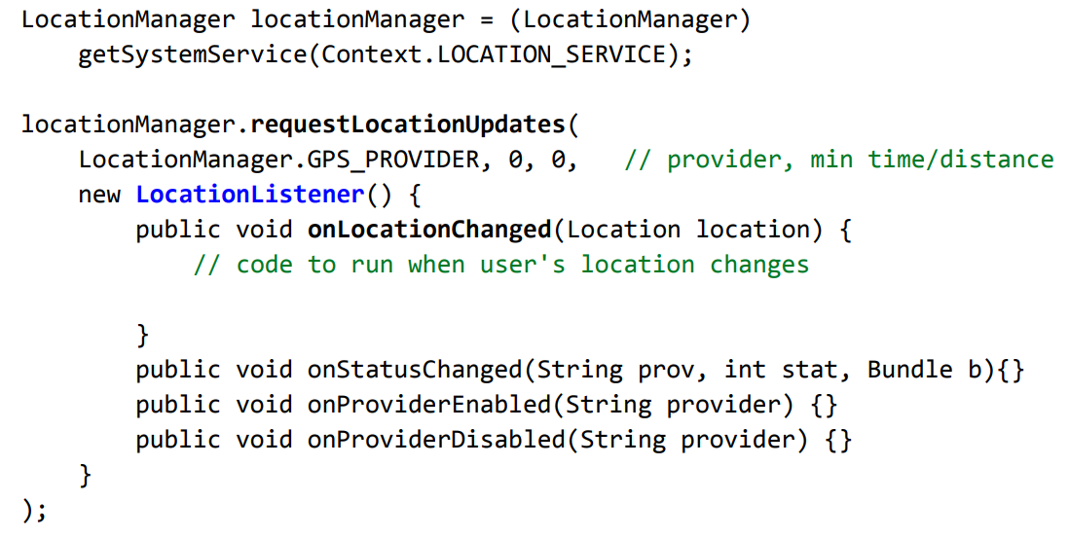
Location update events
Track user's movement by listening for location update events

Slide 20
Classwork
Create a Google Map screen
Create a marker showing your current location on the Map

Slide 21
References
CS 193A Standford course - Marty Stepp and Stanford Computer Science
https://developers.google.com/maps/documentation/android-sdk/map-with-marker

