Slide 1
Android architecture

Slide 2
Contents
Architecture
MVP
MVVM

Slide 3
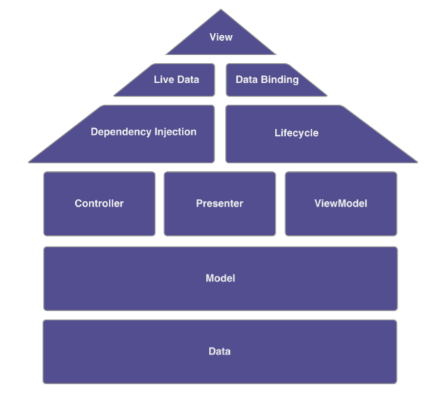
Architecture

Slide 4
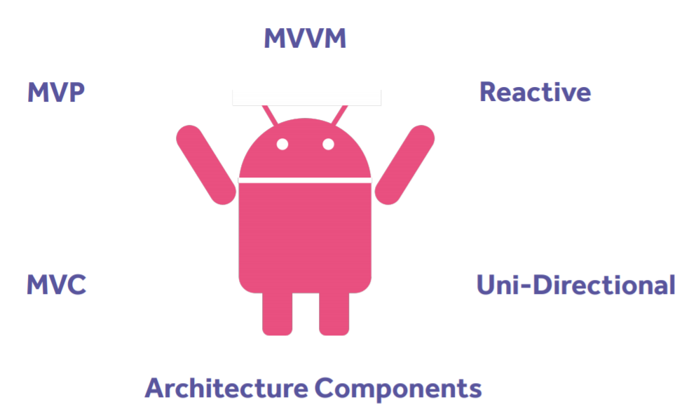
Architecture

Slide 5
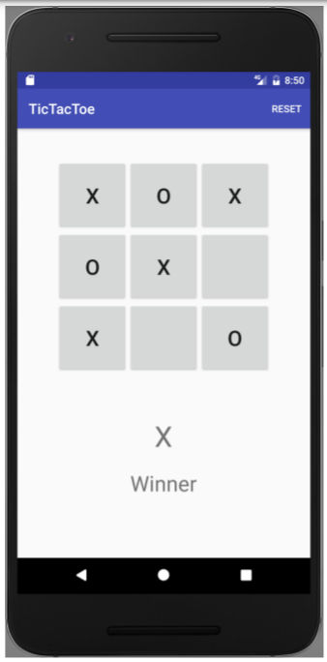
Sample application

Slide 6
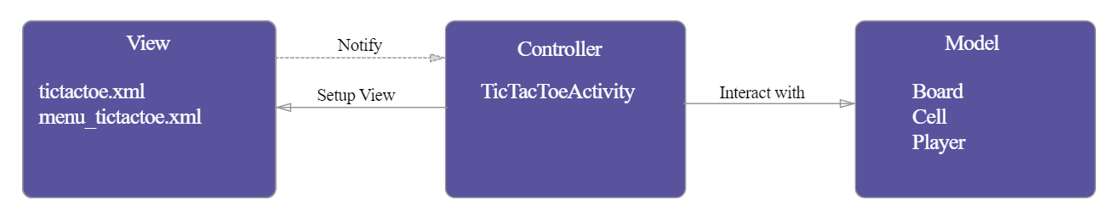
MVC Pattern Architecture
MVC stands for Model-View-Controller.

Slide 7
MVC components
Model: represents a set of classes that describe the business logic
View: represents the UI components
Controller:
is responsible to process incoming requests.
It receives input from users via the View, then process the user's data with the help of Model and passing the results back to the View.
it acts as the coordinator between the View and the Model.
There is One-to-Many relationship between Controller and View, means one controller can handle many views

Slide 8
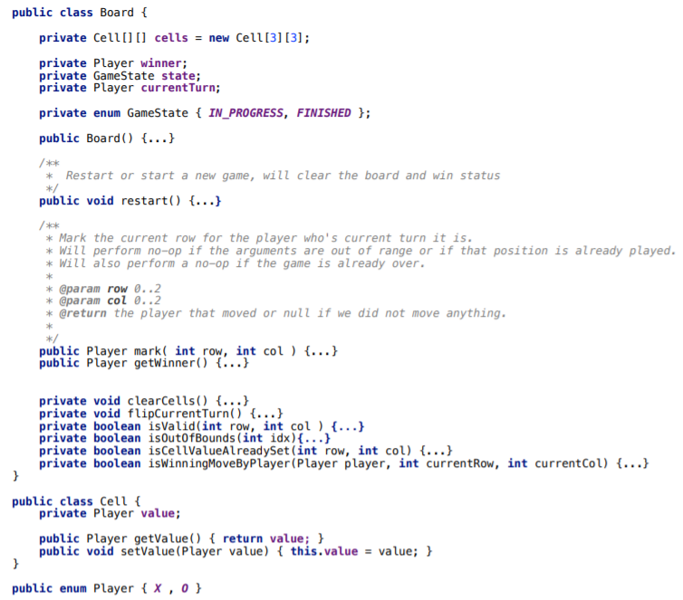
MVC - Model

Slide 9
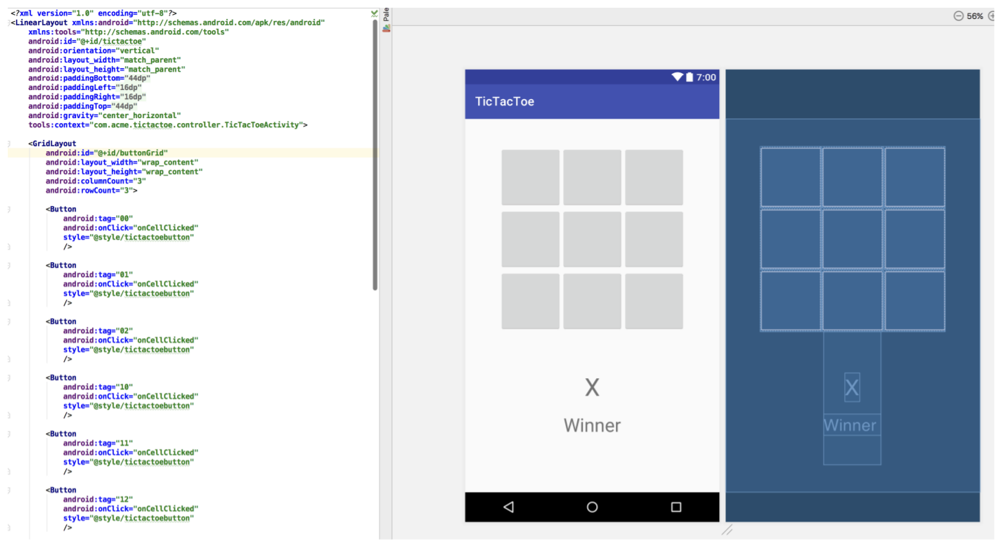
MVC - View

Slide 10
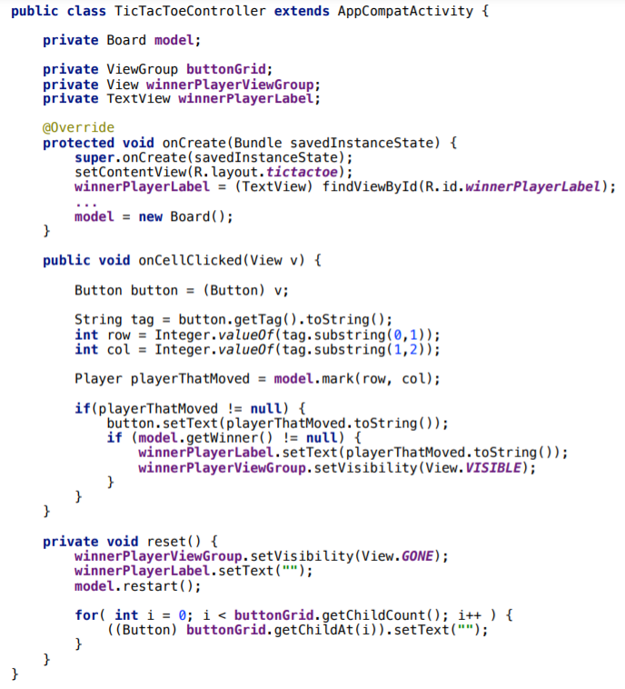
MVC - Controller

Slide 11
MVC - Advantages
Easy to maintain, test and upgrade the multiple system.
Easy to add new clients just by adding their views and controllers.
Be able to have development process in parallel for model, view and controller.
Make the application extensible and scalable.

Slide 12
MVC - Disadvantages
Requires high skilled experienced professionals
Requires the significant amount of time to analyze and design.
This design approach is not suitable for smaller applications.

Slide 13
MVP Pattern
Model-View-Presenter (MVP) is a variation of the Model-View- Controller (MVC) pattern.
The primary differentiator of MVP is that the Presenter implements an Observer design of MVC but the basic ideas of MVC remain the same:
the model stores the data
the view shows a representation of the model
the presenter coordinates communications between the layers.

Slide 14
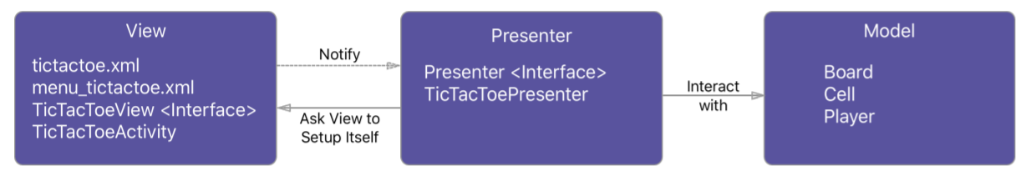
MVP Pattern Architecture

Slide 15
MVP components
Model: The model in MVP is the same as MVC
Presenter:
handle user input and use this to manipulate the model data.
interactions of the User are first received by the view and then passed to the presenter for interpretation
there is One-to-One relationship between View and Presenter
View: When the model is updated, the view also has to be updated to reflect the changes

Slide 16
Passive view and Supervising Controller
The Model-View-Presenter variants: Passive View and Supervising Controller
In Passive View:
the presenter updates the view to reflect changes in the model.
The interaction with the model is handled exclusively by the presenter.
The view is not aware of changes in the model.
In Supervising Controller:
the view interacts directly with the model to perform simple data-binding that can be defined declaratively, without presenter intervention.
The presenter updates the model
it manipulates the state of the view only in cases where complex UI logic that cannot be specified declaratively is required.

Slide 17
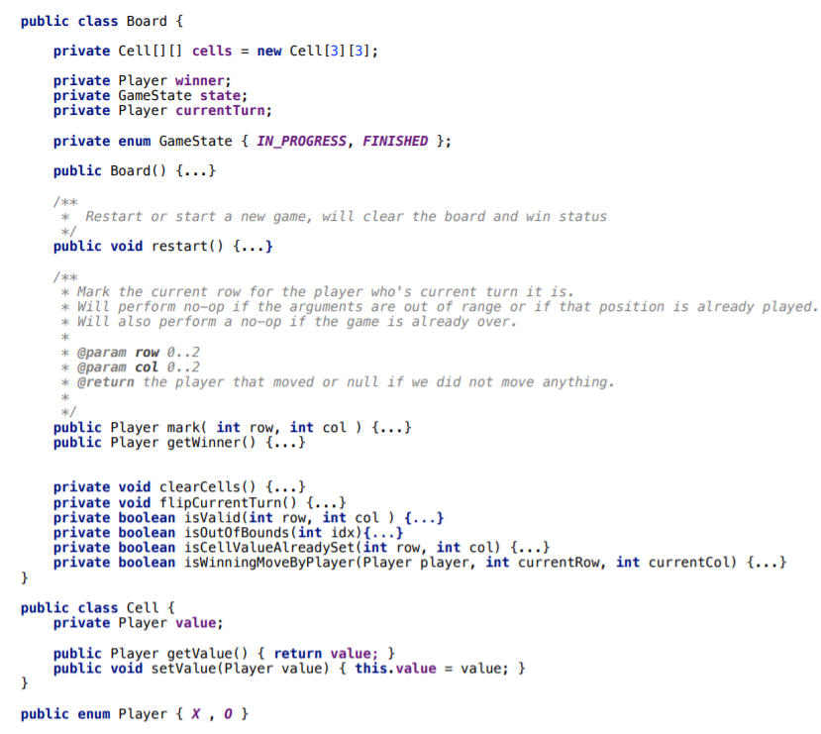
MVP - Model

Slide 18
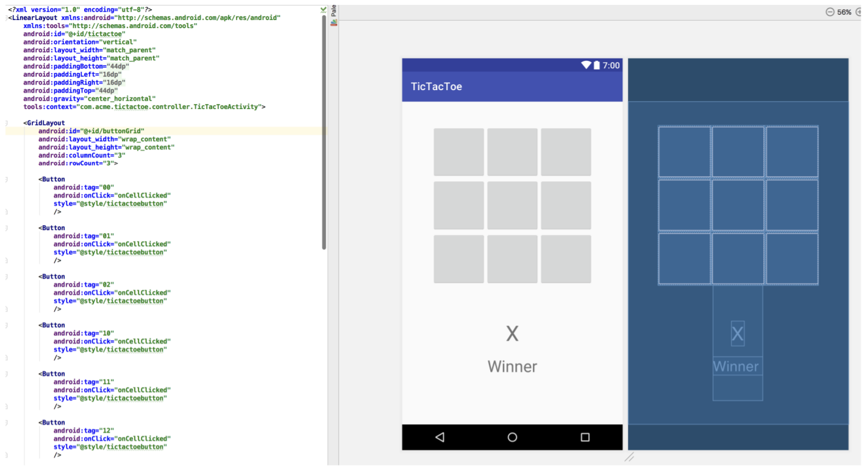
MVP - View

Slide 19
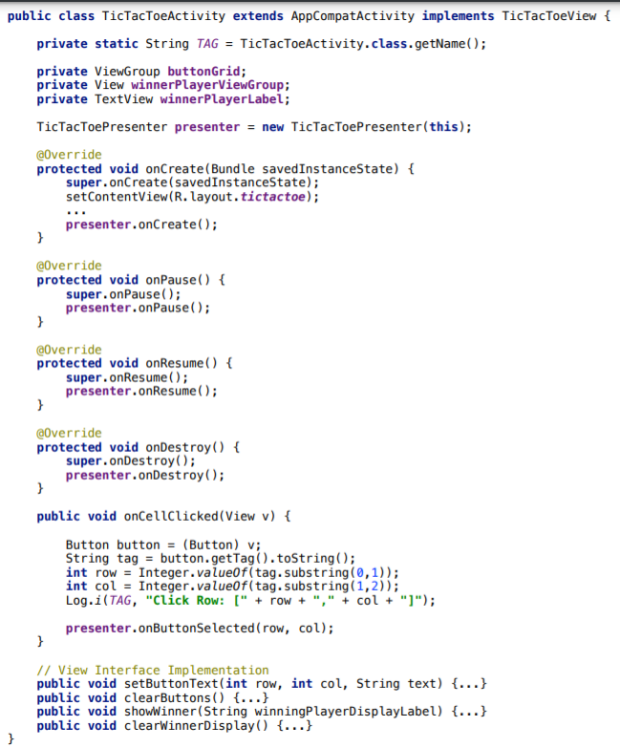
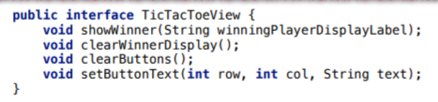
MVP - View

Slide 20
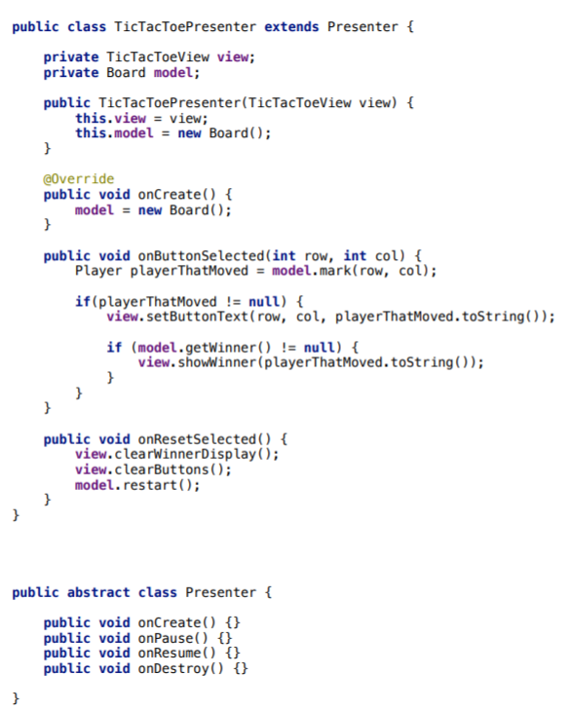
MVP - Presenter

Slide 21
Advantages of MVP
it clarifies the structure of our user interface code and can make it easier to maintain.
almost all complex screen logic will reside in the Presenter.
We have almost no code in our View apart from screen drawing code Model- View-Presenter also makes it theoretically much easier to replace user interface components, whole screens, or even the whole user interface
It is features can be enhanced separately with more involvement from the customer.
In addition, unit testing the user interface becomes much easier as we can test
the logic by just testing the Presenter.

Slide 22
MVVM Pattern
The Model-View-ViewModel (MVVM or ViewModel) is a pattern for separating concerns in technologies that use data-binding.
The MVVM pattern is an adaptation of the MVC and MVP patterns in which the view model provides a data model and behavior to the view but allows the view to declaratively bind to the view model.

Slide 23
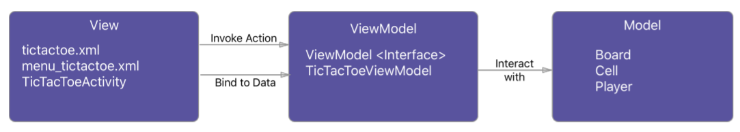
MVVM Architecture

Slide 24
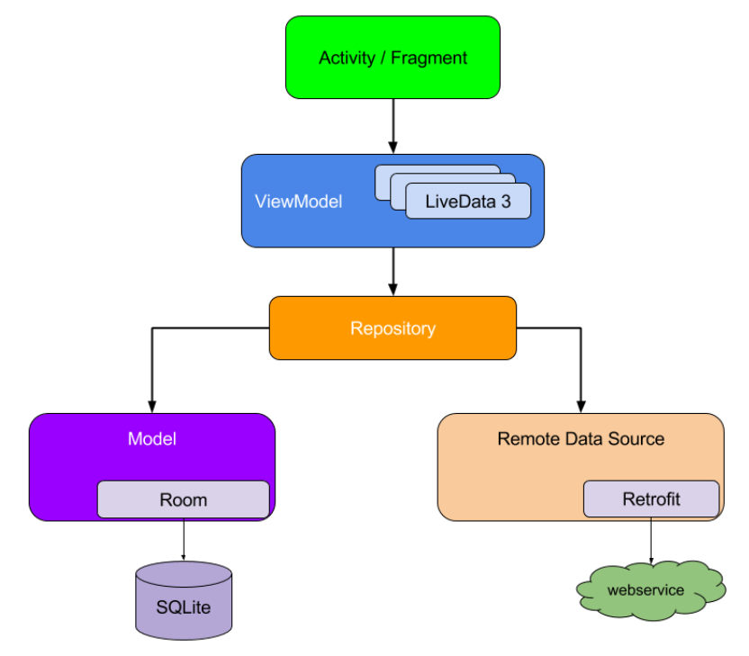
MVVM Architecture

Slide 25
MVVM components
Model:
It represents the data and the business logic of the Android Application
It consists of the business logic - local and remote data source, model classes, repository.
View:
It consists of the UI Code(Activity, Fragment), XML
It sends the user action to the ViewModel but does not get the response back directly
To get the response, it has to subscribe to the observables which ViewModel exposes to it

Slide 26
MVVM components
ViewModel :
is a bridge between the View and Model
It does not have any clue which View has to use it as it does not have a direct reference to the View
It interacts with the Model and exposes the observable that can be observed by the View

Slide 27
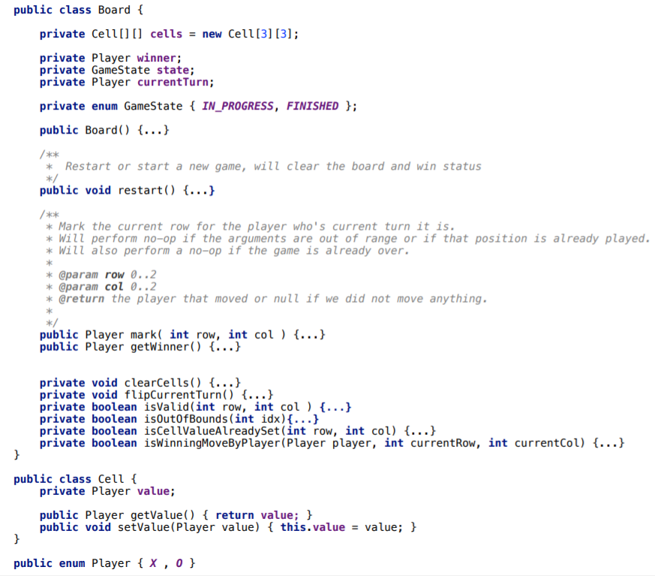
MVVM - Model

Slide 28
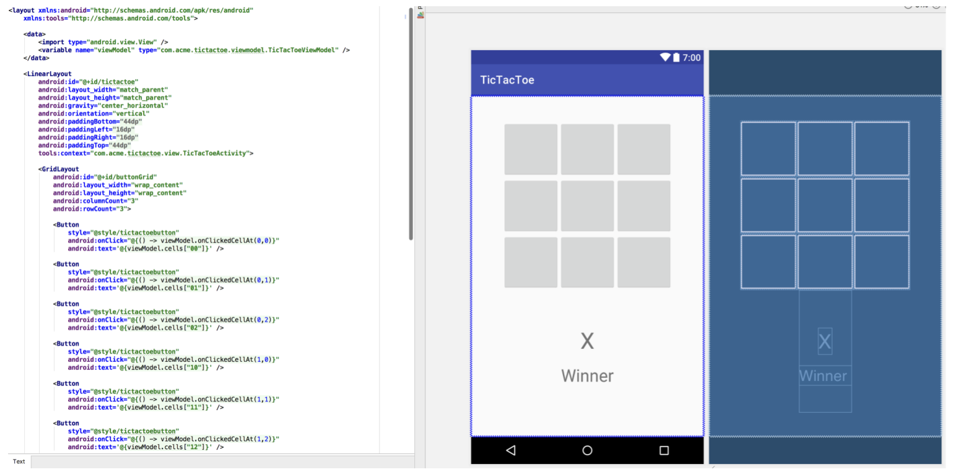
MVVM - View

Slide 29
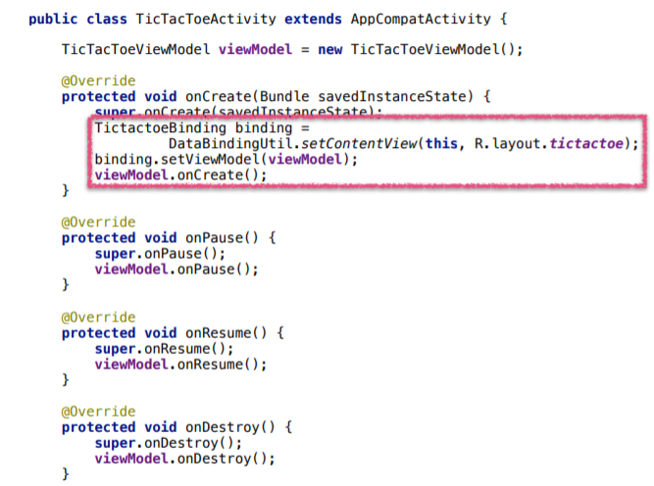
MVVM - View

Slide 30
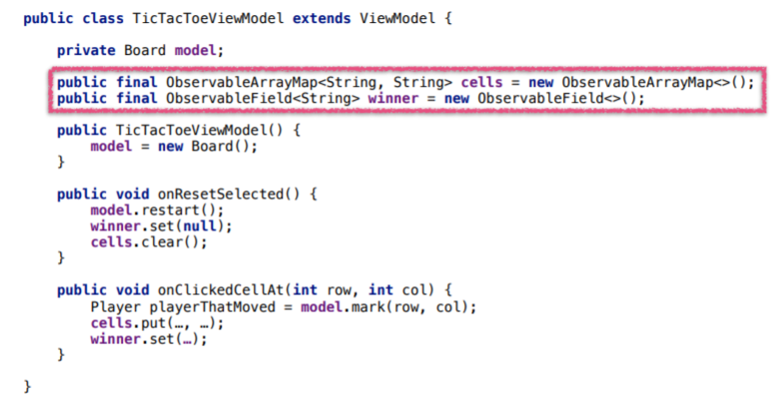
MVVM - ViewModel

Slide 31
Advantages of MVVM
Reduces the amount of code in the View’s code behind file.
UI elements can be written in XAML
Strong Data Binding, which saves a lot of code. No need for manually refresh the view.

Slide 32
Disadvantages of MVVM
In bigger cases, it can be hard to design the ViewModel up front in order to get the right amount of generality.
Data-binding for all its wonders is declarative and harder to debug than nice imperative stuff where you just set breakpoints.

Slide 33
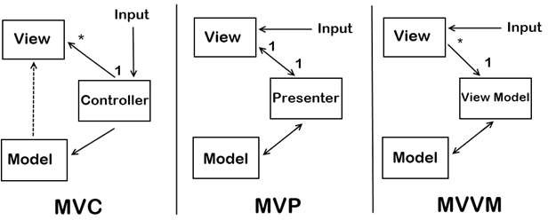
Summary

Slide 34
References
https://www.vogella.com/tutorials/AndroidArchitecture/article.html
https://www.slideshare.net/mudasirqazi00/design-patterns-mvc-mvp-and-mvvm?from_action=save
https://www.vogella.com/tutorials/AndroidArchitecture/article.html
https://academy.realm.io/posts/eric-maxwell-mvc-mvp-and-mvvm-on-android/

